Slide 1

Going across the USA
Tematická oblast | Angličtina: The USA
Datum vytvoření | 27.12.2012
Ročník | 2. - 4., sexta – oktáva, úroveň B1+
Stručný obsah | Přehledné seznámení s prostředky veřejné dopravy v USA+ zajímavosti o možnostech využití a porovnání nákladů.
Způsob využití | Jednotlivé stránky přinášejí informace o způsobu cestování po USAspolu s obrazovými stimuly. V závěru kontrolní otázka a odpovědi.
Autor | Tomáš Kolenovský
Kód | VY_22_INOVACE_02_AKLN01
Gymnázium a Jazyková škola s právem státní jazykové zkoušky Zlín
Poznámka: prezentace je plně funkční při použití programu Microsoft PowerPoint 2010 a vyšší

Slide 2
Going across the USA
How big is the country?
  very big…
  the world’s third largest (after Russia and Canada)
  from New York City to Los Angeles about 2800 miles (approx. 4500 kilometres)
  there are four time zones (six including Alaska and Hawaii)

Slide 3
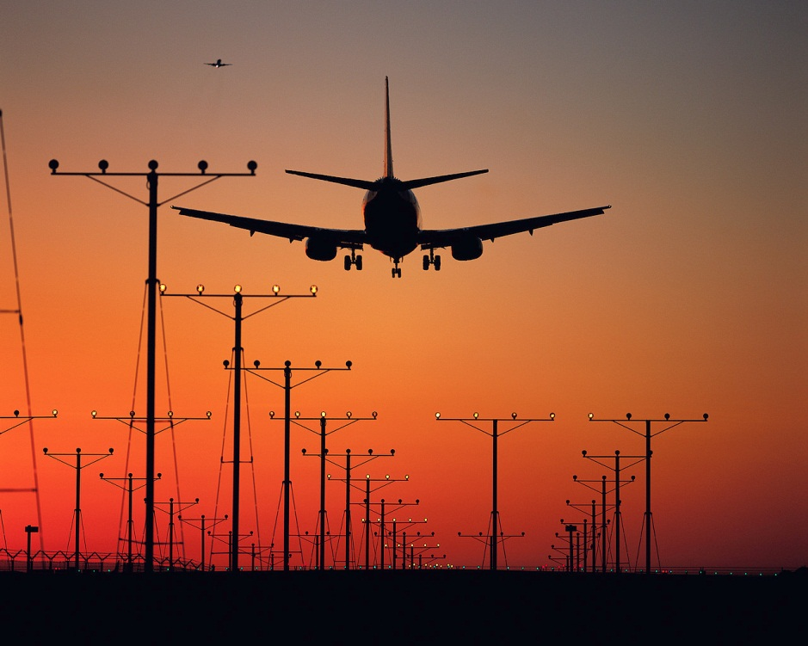
What is the best way to travel across?
Flying!
Why?
the fastest
several airlines to choose from
hundreds of airports all over the country
quite reasonable prices
Why not?
mainly because you cannot see any beauties of the country

Slide 4
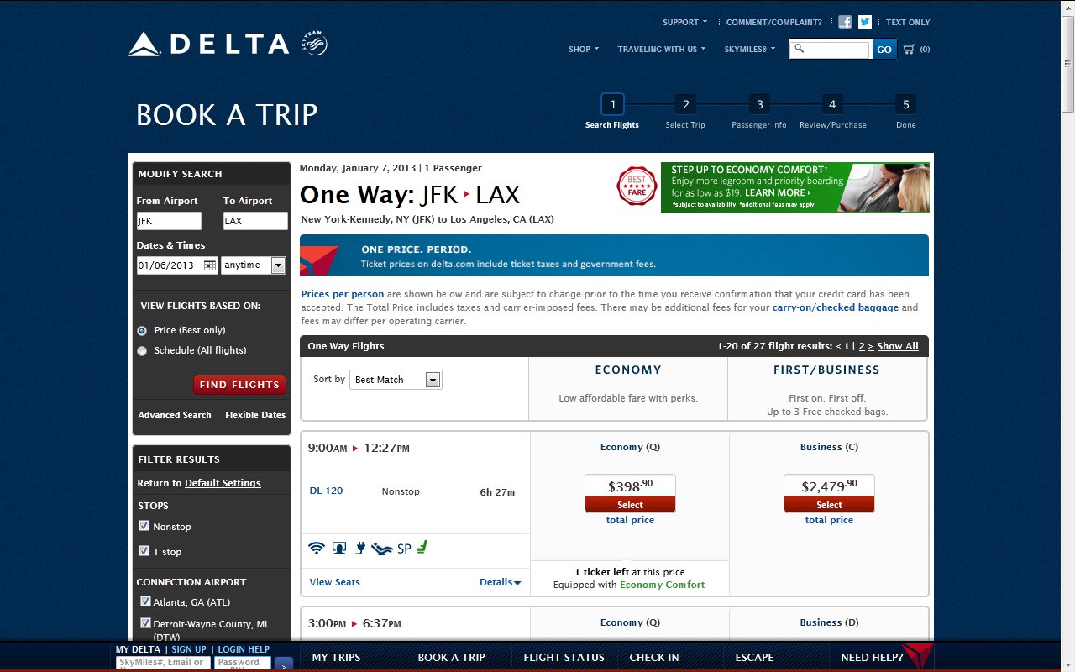
Is it really fast and cheap?

Slide 5
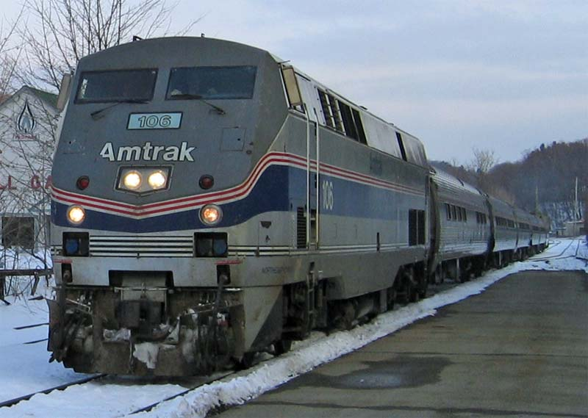
How about going by train?
Amtrak is the national railway company serving more than 500 destinations in 46 states
It operates 15 long distance routes over an 18500 mile network (approx. 30000 km)
rather comfortable, most have sleeping cars and dining cars
not very fast
better comfort always means much higher fares

Slide 6
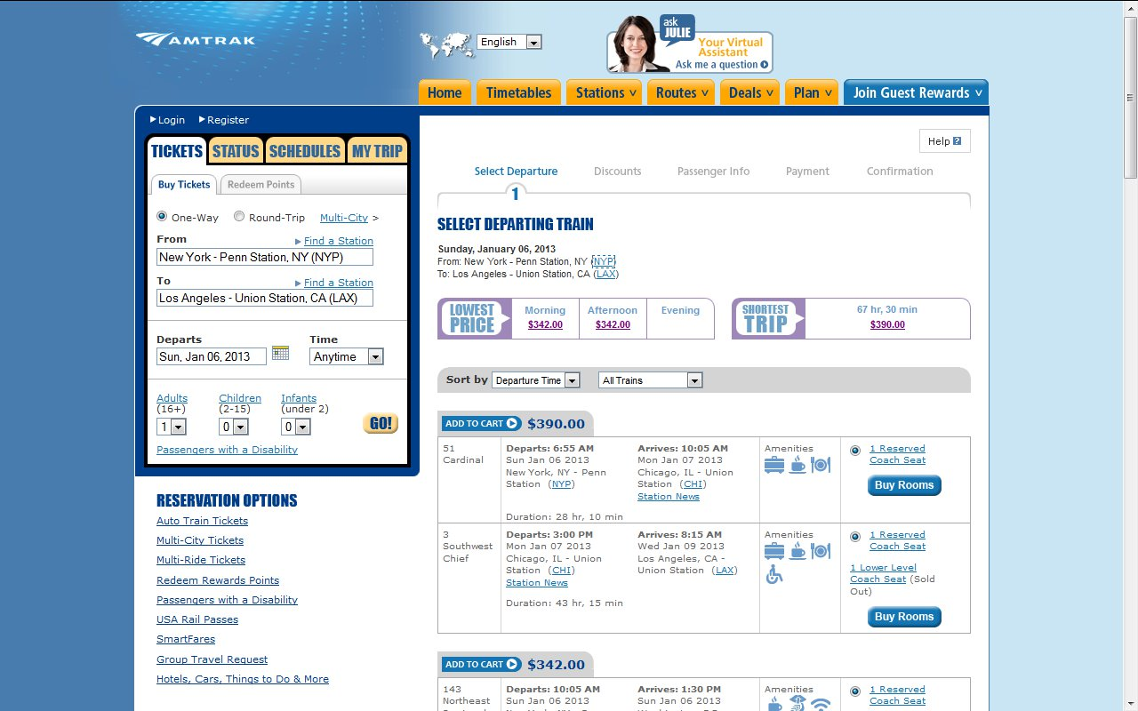
How much for all that?

Slide 7
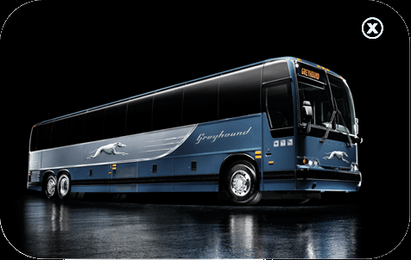

Is there a coach option?
Yes, of course, one!
serves more than 3800 destinations
founded in 1914 and named Greyhound in 1930
according to the U.S. Department of Transportation it is the safest mode of transportation
it is not very comfortable and the stations are often in areas (downtowns) where you do not want to walk alone at night!

Slide 8
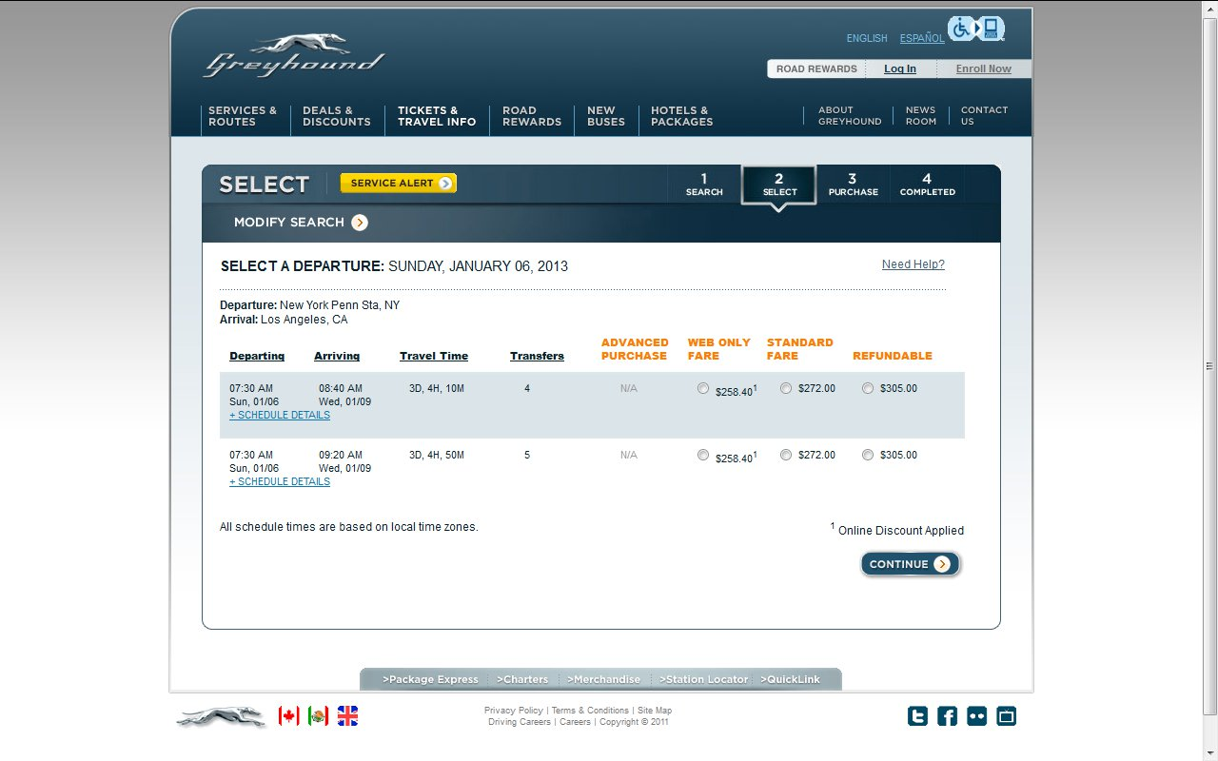
So is it at least cheap?

Slide 9



Can you match the numbers with the pictures?
46 398,9 3800 4
$ 398,90
serving 3800 destinations
going to 46 states
4 time zones
Note: In some cases American English is used to preserve terminology and some other aspects

Slide 10
Links:
http://www.amtrak.com/home
http://www.delta.com/
https://www.greyhound.com/farefinder/
http://en.wikipedia.org/wiki/File:Amtrak_train.jpg
http://www.amtrak.com/ccurl/374/876/Long%20Distance%20Trains.pdf
https://www.greyhound.com/App_Themes/Common/Images/buses/p-image-1.gif
https://www.greyhound.com/app_themes/en/images/hdr-gh-logo.gif
https://www.greyhound.com/en/about/default.aspx
https://www.greyhound.com/en/about/factsandfigures.aspx

