Slide 1

Driving around the USA
Tematická oblast | Angličtina: The USA
Datum vytvoření | 28. 12. 2012
Ročník | 2. - 4., sexta – oktáva, úroveň B1+
Stručný obsah | Přehledné seznámení s možnostmi cestování automobilem po USA + zajímavosti a praktické tipy.
Způsob využití | Jednotlivé stránky přinášejí informace o způsobu cestování automobilem v USA spolu s obrazovými stimuly. V závěru kontrolní úkol a odpovědi.
Autor | Tomáš Kolenovský
Kód | VY_22_INOVACE_02_AKLN02
Gymnázium a Jazyková škola s právem státní jazykové zkoušky Zlín
Poznámka: prezentace je plně funkční při použití programu Microsoft PowerPoint 2010 a vyšší

Slide 2
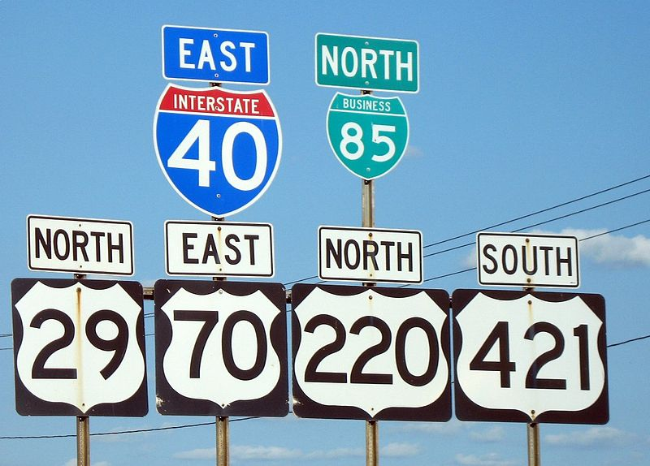
Driving around the USA
The best way to explore the USA is driving a car.
There are about 3 ways to do so:
buy your own car
rent a car
Auto Driveaway

Slide 3
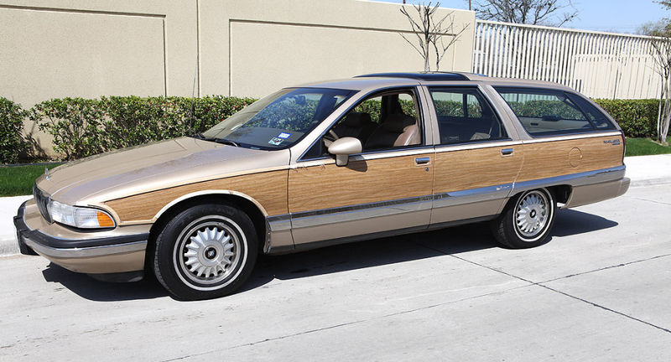
Buying your own car
Why would you do it?
you don’t have a lot of money
it is easy as there are a lot of places where to buy used cars
when you finish travelling you sell the car and get your money back (if you are lucky!)
Are there any negatives?
you usually buy a very old car (but travel in style)
you drive a lot of miles
chances of breaking down are really good

Slide 4
Rent a car
Very comfortable thing to do as
there are plenty deals to choose from, main companies are
big companies offer their services at the airports
the cars are reliable and the company handles all potential problems
you can arrange all before you go

Slide 5

Are there any problems with renting a car?
Well, it depends…
it is quite expensive
it is even more expensive if you are younger than 25
you have to pay extra if you want more people to drive
you have to pay by a credit card in most cases
you have to be careful about insurance policies
But otherwise…
no problem!

Slide 6

And what is Auto Driveaway?
it is an option for those who have almost no money
it is a company which arranges moving cars around the USA
How is it connected with travelling?
you call the office and ask what cars they have
you take a bus to the pick up destination to collect the car
you drive the car to its final destination
if you wish you go back to point 1

Slide 7
Is it really so cheap and simple?
Yes, you only need
to pay for petrol and have about $350 for refundable deposit
to be a driver older than 23
to have a current MVR (motor vehicle driver’s record)
Are there any negatives?
you have limited choice of places where to go (all depends on available cars)
you have limited amount of miles and number of days to finish your trip

Slide 8
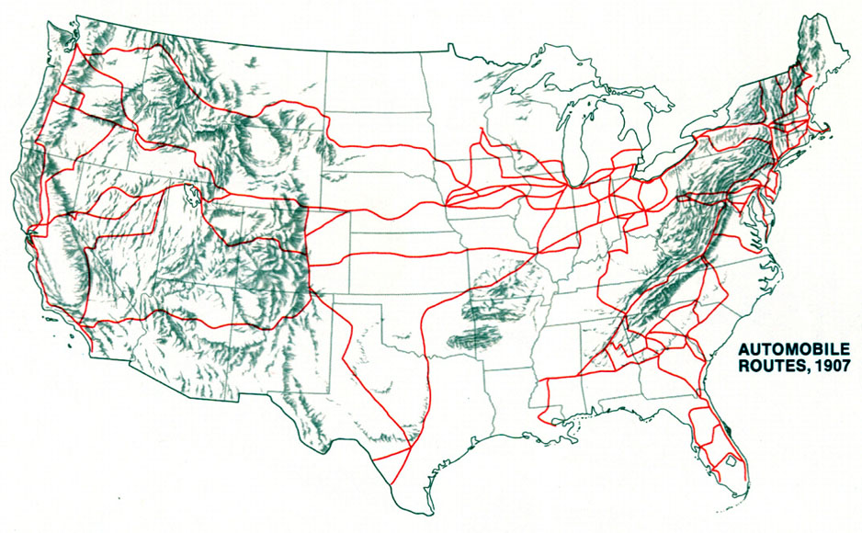
Match the terms with different ways of driving
own car rented car Driveaway
you are absolutely free
travel in style
it is most risky
it is most expensive
very reliable
arrange everything
in advance
you have to be 23
there are several limits
you cannot go where you want
you are absolutely free it is most expensive
travel in style you cannot go where you want
it is most risky there are several limits
very reliable you have to be 23
arrange everything in advance
Note: In some cases American English is used to preserve terminology and some other aspects

Slide 9
Links
http://en.wikipedia.org/wiki/File:Greensboro_road_signs.jpg
http://en.wikipedia.org/wiki/File:1993-Buick-Roadmaster-Estate.jpg
https://cdn.arguscarhire.com/img/suppliers/AU.gif
http://www.autodriveaway.com/about
http://www.autodriveaway.com/images/Logo.png
http://diydilettante.files.wordpress.com/2011/09/auto-roads-1907.jpg

