Slide 1

National Parks of the East
Tematická oblast | Angličtina: The USA
Datum vytvoření | 29. 12. 2012
Ročník | 2. - 4., sexta – oktáva, úroveň B1+
Stručný obsah | Přehledné seznámení s národními parky ve východní části USA + zajímavosti a praktické tipy.
Způsob využití | Jednotlivé stránky přinášejí informace o některých národních parcích v USA spolu s obrazovými stimuly. V závěru kontrolní úkol a odpověď.
Autor | Tomáš Kolenovský
Kód | VY_22_INOVACE_02_AKLN03
Gymnázium a Jazyková škola s právem státní jazykové zkoušky Zlín
Poznámka: prezentace je plně funkční při použití programu Microsoft PowerPoint 2010 a vyšší

Slide 2

Do you know any parks in the USA?
The are almost 400 parks in the US but most famous are
Yellowstone, Wyoming, est. 1872
Niagara Falls, New York, est. 1885
Yosemite, California, est. 1890
Mesa Verde, Colorado, est. 1906
Denali, Alaska, est. 1917
Grand Canyon, Arizona, est. 1919
Great Smoky Mountains, Tennessee, est. 1926
Everglades, Florida, est. 1934
Mammoth Cave, Kentucky, est. 1941

Slide 3
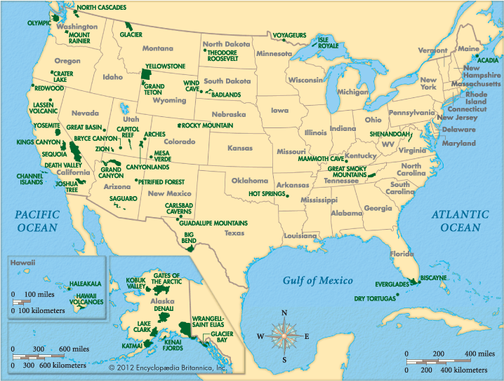
Where are they mostly located?
West!
Luckily you can find several beautiful parks in the eastern part as well (in case you don’t want to travel far to the west)

Slide 4
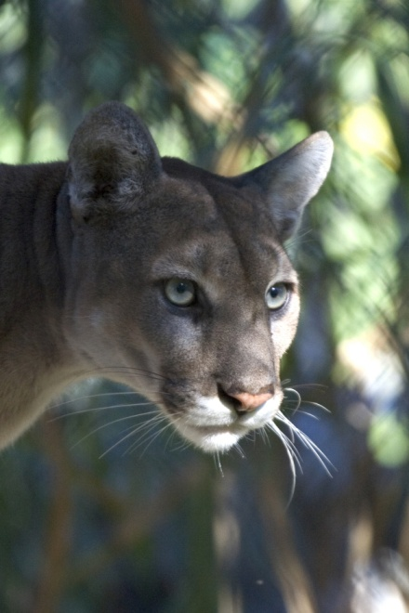
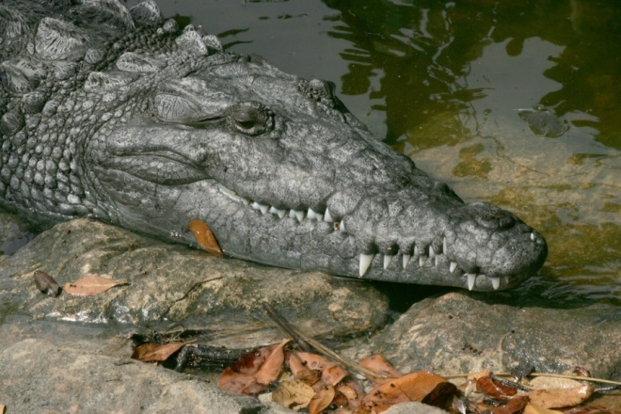
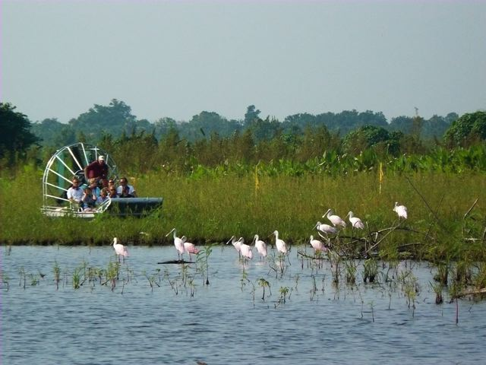
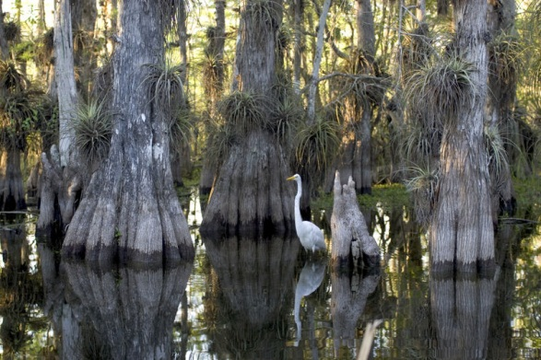
Everglades National Park
Where?
Florida, fly to Miami, then you can go to one of five main entrances
choose the entrance according to activity in the park.
Activity?
boat tours, biking, hiking, canoeing
explore curious flora and fauna in subtropical climate

Slide 5
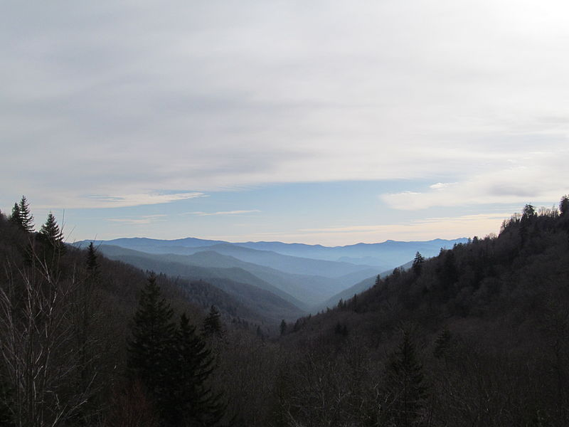

Great Smoky Mountains N.P.
Where?
creates the border between North Carolina and Tennessee
go by car as auto touring offers a variety of experiences
What to do there?
camping
backcountry – hike miles to get to a campsite
frontcountry – camp near your car in a developed campground with cold running water and restrooms
hiking, fishing, horse riding, wildlife viewing
You can visit Lake Lure NC, “Dirty Dancing” location, less than 2 hours drive east of the park

Slide 6
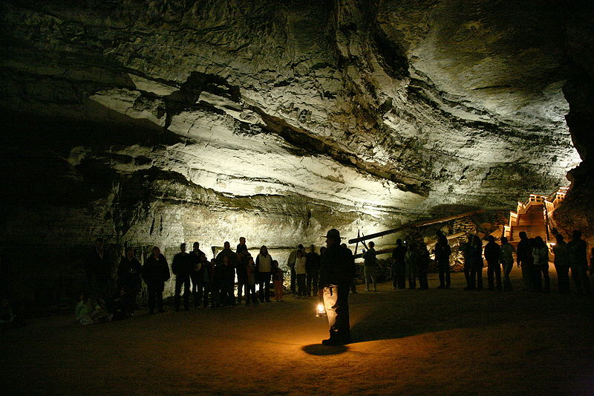
Mammoth Cave National Park
Where?
Kentucky
tours have been offered since 1816
the world’s longest known cave system
more than 390 miles (624 km) have been explored
Can we do something except visiting the caves?
fishing, canoeing and kayaking, Green River and Nolin River offer more than 30 miles of stunning wildlife
horseback riding, about 60 miles of trails

Slide 7
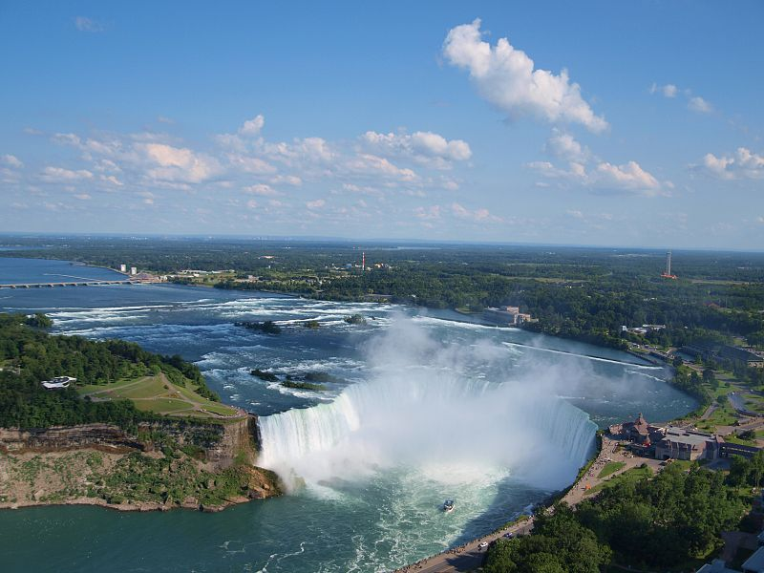
Niagara Falls State Park
Where?
creates international border between the USA and Canada
about 20 miles from Buffalo, New York
Niagara River connects Lake Erie and Lake Ontario
What is the best view?
walk across the Rainbow Bridge to Canada (don’t forget your passport) and go to see Horseshoe falls
take a boat tour, waterproof clothing is provided

Slide 8
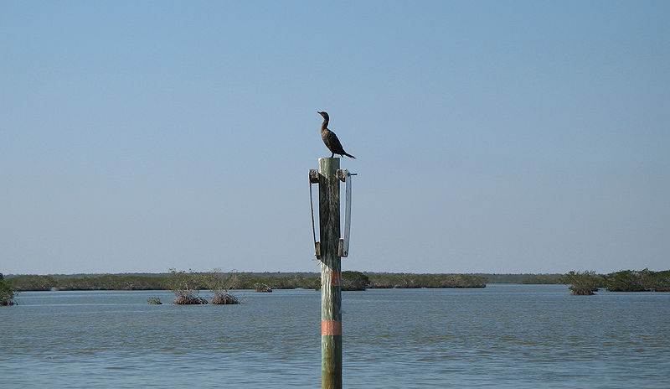
Does it snow in all parks in winter?
No, Everglades are mild and pleasant through the winter due to its subtropical climate!
Note: In some cases American English is used to preserve terminology and some other aspects

Slide 9
Links
http://www.nps.gov/index.htm
http://www.pbs.org/nationalparks/parks/
http://blog.izilwane.org/wp-content/uploads/2012/07/2000px-US-NationalParkService-ShadedLogo.png
http://www.nps.gov/ever/parknews/upload/crocodile.jpg
http://www.nps.gov/ever/parknews/upload/panther.jpg
http://www.globaltrekkers.com/images/everglades%5B1%5D.jpg
http://cs.wikipedia.org/wiki/Soubor:Everglades_National_Park_cypress.jpg
http://commons.wikimedia.org/wiki/File:View_from_Newfound_Gap_Road,_Great_Smoky_Mountains_National_Park,_NC.jpg
http://upload.wikimedia.org/wikipedia/en/0/00/Dirty_Dancing.jpg
http://commons.wikimedia.org/wiki/File:Everglades_001.jpg
http://kids.britannica.com/elementary/art-89532/The-United-States-has-many-national-parks-especially-in-the
http://commons.wikimedia.org/wiki/File:Mammoth_Cave_tour.jpg
http://commons.wikimedia.org/wiki/File:Canadian_Horseshoe_Falls_with_Buffalo_in_background.jpg
http://www.niagarafallsstatepark.com/Directions.aspx

