Slide 1

National Parks of the West
Tematická oblast | Angličtina: The USA
Datum vytvoření | 3. 1. 2013
Ročník | 2. - 4., sexta – oktáva, úroveň B1+
Stručný obsah | Přehledné seznámení s nejznámějšími národními parky v západní části USA + zajímavosti a praktické tipy.
Způsob využití | Jednotlivé stránky přinášejí informace o některých národních parcích v USA spolu s obrazovými stimuly. V závěru kontrolní úkol a odpovědi.
Autor | Tomáš Kolenovský
Kód | VY_22_INOVACE_02_AKLN04
Gymnázium a Jazyková škola s právem státní jazykové zkoušky Zlín
Poznámka: prezentace je plně funkční při použití programu Microsoft PowerPoint 2010 a vyšší

Slide 2
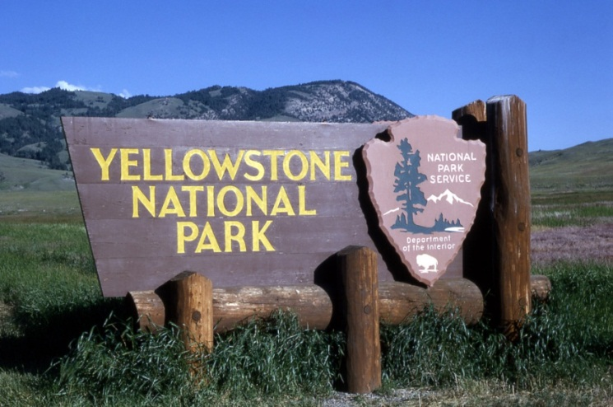
Do you remember any parks in the west?
Yellowstone, Wyoming, est. 1872
Yosemite, California, est. 1890
Denali, Alaska, est. 1917
Grand Canyon, Arizona, est. 1919

Slide 3
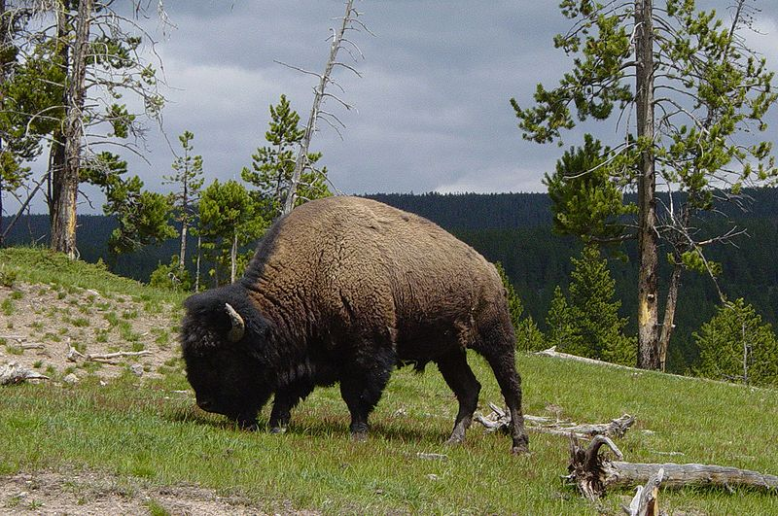
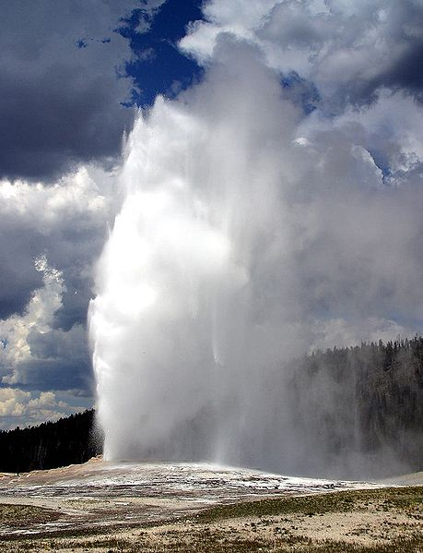
Yellowstone National Park
America’s first national park established in 1872
Where?
border of Wyoming, Montana and Idaho
What can we see there?
definitely buffalos and elks, if you are lucky grizzly bears, wolfs and other wild animals
hydrothermal features, fantastic sceneries
world's largest collection of geysers, Old Faithfull, most predictable, erupts every 60 to 110 minutes and reaches heights of 30-50 meters

Slide 4
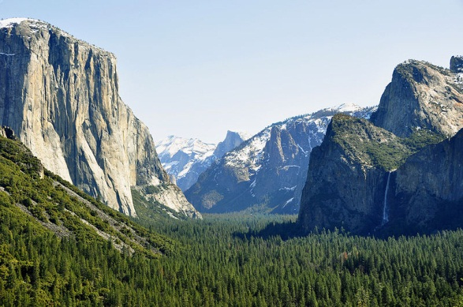
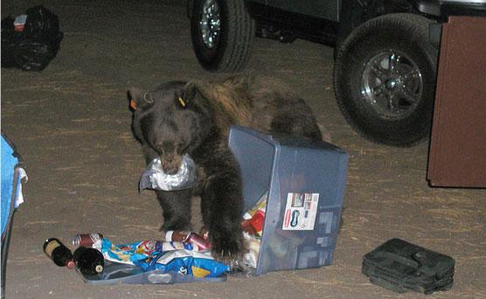
Yosemite National Park
Where?
California, about 4 hours driving east from San Francisco airport
it is big so give yourself 2-3 days to spend and enjoy the park
What to do?
rock climbing, El Capitan, the largest single monolith of granite in the world, more than 900 meters above the ground
see giant sequoias in the Mariposa Grove, countless waterfalls, other famous rocks, lakes and rivers
And mainly, BE AWARE OF black bears trying to get your food!

Slide 5
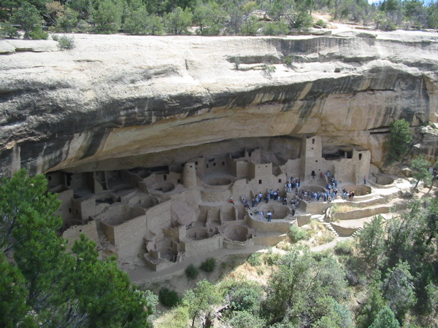
Mesa Verde National Park
Where?
Colorado, south-western corner
you need a car to see the park
Why Mesa Verde?
between A. D. 600 to A. D. 1300 home of Ancestral Pueblo people and means green table in Spanish
What to see there?
number of cliff dwellings and archaeological sites
Mesa Verde Visitor and Research Center
Chapin Mesa Archaeological Museum

Slide 6
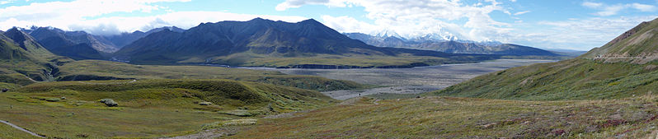
Denali National Park
Where?
Alaska, fly to Anchorage or Fairbanks, then use car, train or bus to Denali
there is just one road in the park, 92 miles long, but you can drive only the first 15 miles then you have to take a bus
What to see there?
Mount McKinley, of course (the highest peak in North America, 20 320 ft./6 194 m.
amazing scenery and wildlife in the area bigger than whole Moravia

Slide 7
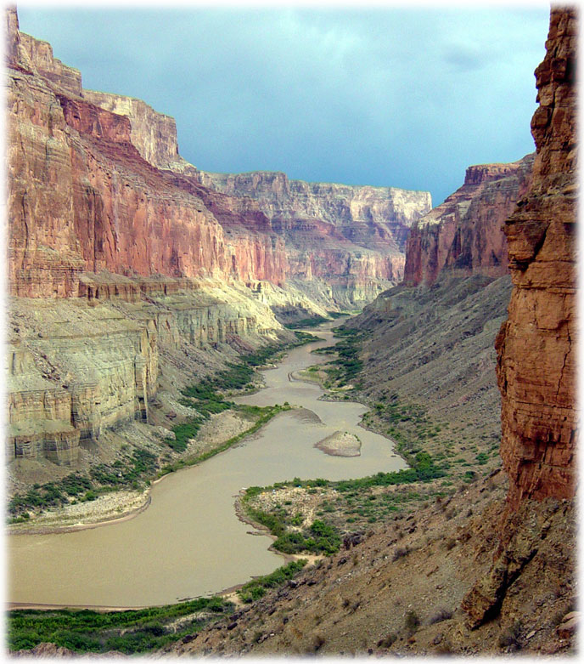
Grand Canyon National Park
Where?
northwest corner of Arizona, close to the borders of Utah and Nevada
Colorado river separates the park into South and North Rims, it is 227 mile long (446 km), 1 mile deep and in average 10 miles directly across
What to see there?
inspiring landscape, enormous size
unique combinations of geologic colour and erosional forms
if you go down, fantastic scenery from different perspective

Slide 8
Can you match the terms with their parks?
Yellowstone
Yosemite
Mesa Verde
Denali
Grand Canyon
Colorado River El Capitan Pueblo people Mt McKinley Old Faithfull Buffalo erosional forms Sequoia archaeological sites traveling by bus

Slide 9
Can you match the terms with their parks?
Yellowstone
Yosemite
Mesa Verde
Denali
Grand Canyon
Buffalo, Old Faithfull
Sequoia, El Capitan
Pueblo people, archaeological sites Mt McKinley, traveling by bus erosional forms, Colorado River
Note: In some cases American English is used to preserve terminology and some other aspects

Slide 10
Links
http://www.nps.gov/index.htm
http://www.pbs.org/nationalparks/parks/
http://www.nps.gov/yell/index.htm
http://commons.wikimedia.org/wiki/File:Bull_Bison_in_Mud_Volcano_Area.JPG
http://www.nps.gov/features/yell/tours/oldfaithful/oldfaith.htm
http://commons.wikimedia.org/wiki/File:Old_Faithfull-pdPhoto.jpg
http://commons.wikimedia.org/wiki/File:Yosemite_valley_tunnel_view_2010.JPG
http://www.nps.gov/yose/planyourvisit/bears.htm
http://www.yosemite.com/things-to-do
http://commons.wikimedia.org/wiki/File:Mesa_Verde_USA5.jpg
http://commons.wikimedia.org/wiki/File:Eilson_Visitors_Center_Panorma.jpg
http://www.nps.gov/grca/planyourvisit/whitewater-rafting.htm
http://www.nps.gov/grca/planyourvisit/images/2D0484.jpg

