Slide 1

New York City
Tematická oblast | Angličtina: The USA
Datum vytvoření | 4. 1. 2013
Ročník | 2. - 4., sexta – oktáva, úroveň B1+
Stručný obsah | Přehledné seznámení s městem New York + zajímavosti a praktické tipy pro návštěvy.
Způsob využití | Jednotlivé stránky přinášejí základní informace o městě New York spolu s obrazovými stimuly. V závěru kontrolní úkol a odpověď.
Autor | Tomáš Kolenovský
Kód | VY_22_INOVACE_02_AKLN05
Gymnázium a Jazyková škola s právem státní jazykové zkoušky Zlín
Poznámka: prezentace je plně funkční při použití programu Microsoft PowerPoint 2010 a vyšší

Slide 2
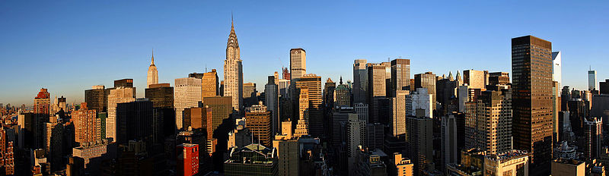
What do you imagine when you hear NYC?
Skyscrapers
Empire State Building
Statue of Liberty
Brooklyn Bridge
Central Park
Broadway
Times Square
Wall Street
New York Yankees
9/11
Manhattan
Bronx
What do most of the terms have in common?

Slide 3
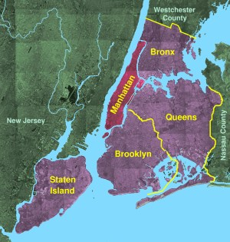
They are in Manhattan, one of five NY boroughs
The others are
Bronx
Queens
Brooklyn
Staten Island

Slide 4
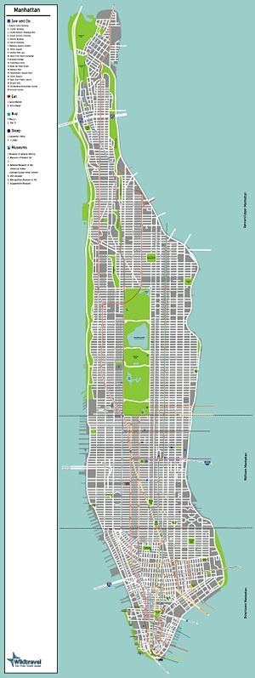
Getting around Manhattan
The Avenues
long, wide streets run north-south direction ( 11 of them)
The Streets
run east-west direction and start at 1st Street at the southern end (220 of them)
Walk ( 20 streets are about 1mile),
take subway or bus.
Cabs are more expensive.
Don’t drive!

Slide 5
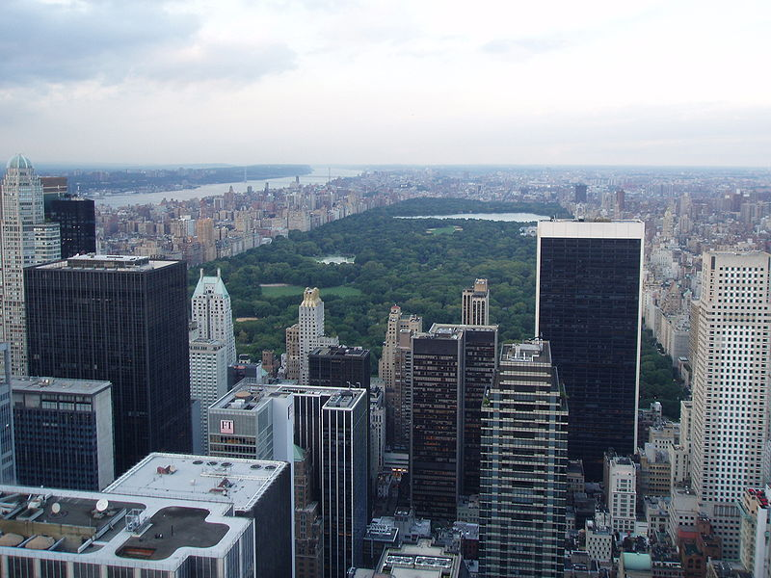
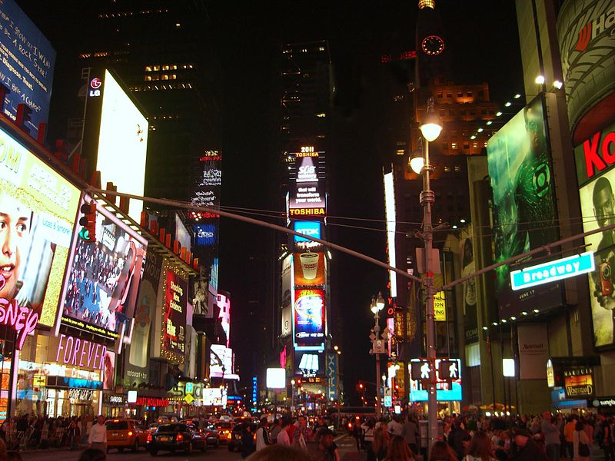
What to see in Manhattan?
Central Park
bordered by 110th and 59th streets and 8th and 5th avenues
huge park in the centre of Manhattan (count the streets and calculate the size)
Times Square
junction of Broadway and 7th Avenue, stretching from 42nd to 47th Street
centre of the world´s entertainment industry

Slide 6
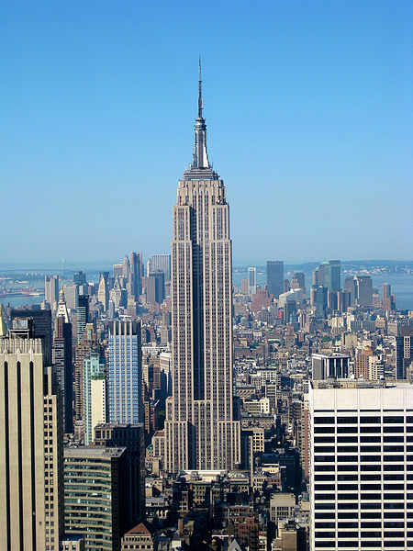
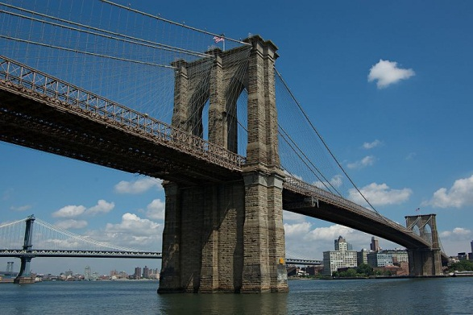
What to see in Manhattan?
Empire State Building
5th Avenue and West 34th Street
completed in 1931 and remained the world’s tallest building for 40 years
Brooklyn Bridge
connects southern part of Manhattan and Brooklyn
the longest suspension bridge when completed in 1883

Slide 7
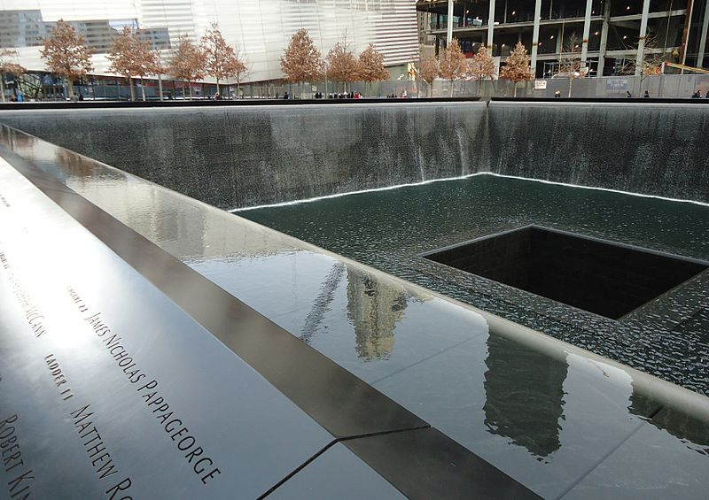
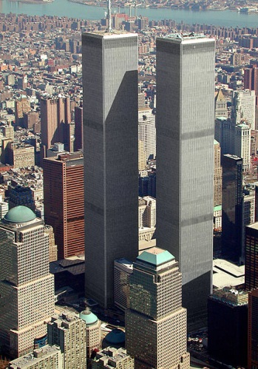
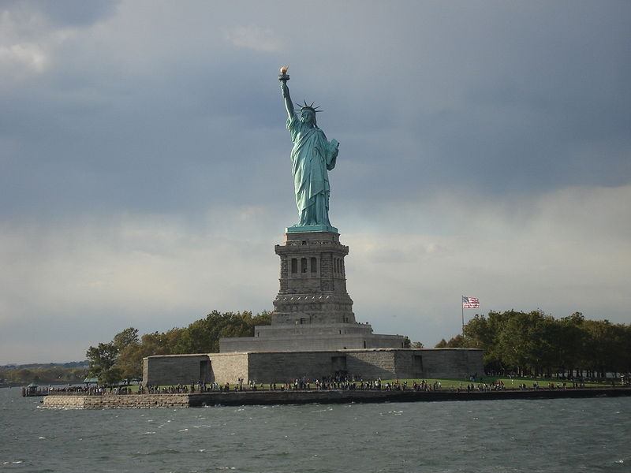
What to see in Manhattan?
9/11 Memorial
Albany St., Lower Manhattan
memorial and museum commemorating the September 11 2001
Statue of Liberty
Liberty Island so take a boat for closer look
NYC most recognizable historic landmark
French gift symbolizing freedom and welcoming immigrants

Slide 8

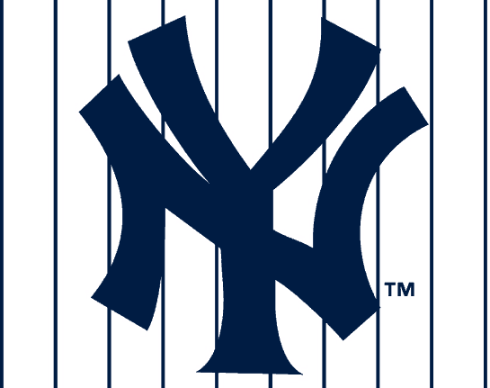

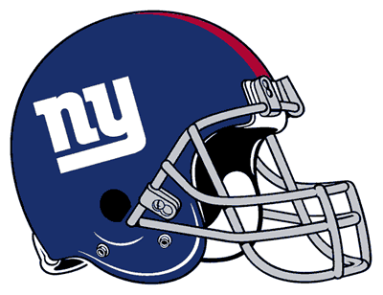
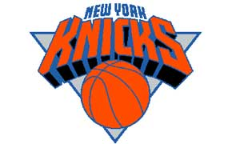

Rainy Days?
Museum Mile
section of 5th Avenue from 82nd to 105th Street, 10 museums
Broadway
choose from many musicals, plays or other shows
Shopping
watch Sex and the City to get the hottest shopping tips
Do you prefer sports?
New York Yankees New York Red Bulls New York Giants
Yankee Stadium Red Bull Arena MetLife Stadium
The Bronx, NY Harrison, NJ East Rutherford, NJ
NY Knicks NY Rangers
Madison Square Garden,
Manhattan, NY

Slide 9


Which landmark is not in NYC?

Slide 10
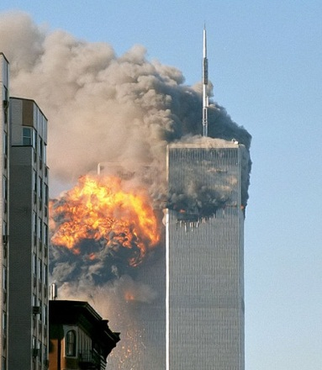
World Trade Center
Twin Towers were destroyed in the September 11 attacks in 2001
Note: In some cases American English is used to preserve terminology and some other aspects

Slide 11
Links
http://commons.wikimedia.org/wiki/File:Usgs_photo_five_boroughs_manhattan.jpg
http://commons.wikimedia.org/wiki/File:Pano_Manhattan2007_amk.jpg
http://wikitravel.org/en/File:Map-USA-Manhattan01.jpg
http://wikitravel.org/en/Manhattan
http://www.nycgo.com/must-see-nyc
http://www.nycgo.com/sports/
http://math.hws.edu/~cc5148/The%20Yankees/nyy-pin-logo.gif
http://www.newyorkredbulls.com/sites/editorial.newyorkredbulls.com/themes/mls_child/logo.png
http://newspaper.li/static/6b8848130d1d95debe7fc408407490d3.png
http://content.sportslogos.net/logos/1/20/full/144.gif
http://www.stopmikelupica.com/sml/new_york_knicks%20logo.jpg
http://commons.wikimedia.org/wiki/File:Central_Park-from_Rock_Center2.jpg
http://commons.wikimedia.org/wiki/File:4.28.11TimesSquareByLuigiNovi.jpg
http://en.wikipedia.org/wiki/File:Empire_State_Building_from_the_Top_of_the_Rock.jpg
http://commons.wikimedia.org/wiki/File:Brooklyn_Bridge_NY.jpg
http://commons.wikimedia.org/wiki/File:911_Memorial_fountain_and_pool_in_New_York_City.jpg
http://commons.wikimedia.org/wiki/File:Wtc_arial_march2001.jpg
http://commons.wikimedia.org/wiki/File:Statue_of_Liberty.JPG
http://www.imdb.com/media/rm38311424/tt0159206?ref_=tt_ov_i
http://commons.wikimedia.org/wiki/File:North_face_south_tower_after_plane_strike_9-11.jpg

