Slide 1

Las Vegas
Tematická oblast | Angličtina: The USA
Datum vytvoření | 5. 1. 2013
Ročník | 2. - 4., sexta – oktáva, úroveň B1+
Stručný obsah | Přehledné seznámení s městem Las Vegas + zajímavosti a praktické tipy pro návštěvy.
Způsob využití | Jednotlivé stránky přinášejí základní informace o městě Las Vegas spolu s obrazovými stimuly. V závěru kontrolní úkol a odpovědi.
Autor | Tomáš Kolenovský
Kód | VY_22_INOVACE_02_AKLN06
Gymnázium a Jazyková škola s právem státní jazykové zkoušky Zlín
Poznámka: prezentace je plně funkční při použití programu Microsoft PowerPoint 2010 a vyšší

Slide 2

Brainstorm
Strip
entertainment
casino
chips
Bugsy
desert
gambling
Hoover Dam
weddings
Nevada

Slide 3


History
1905 – Town of Las Vegas established
1931 – Gambling legalized in Nevada
1947 – Benjamin “Bugsy” Siegel opens Flamingo
since then a new hotel was opened almost every year for next 20 years
To get more details, watch

Slide 4
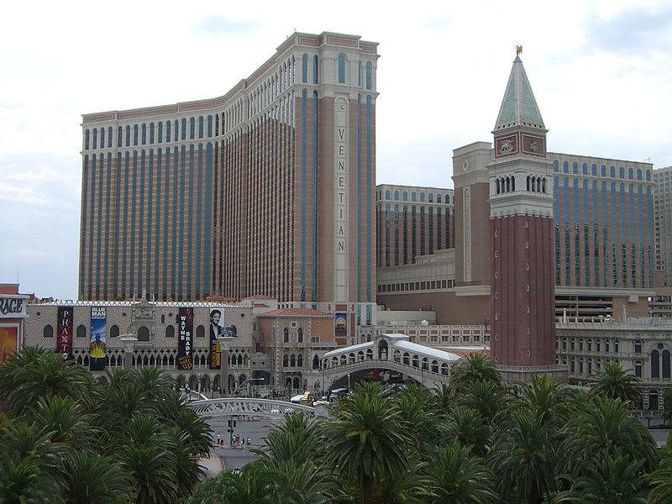
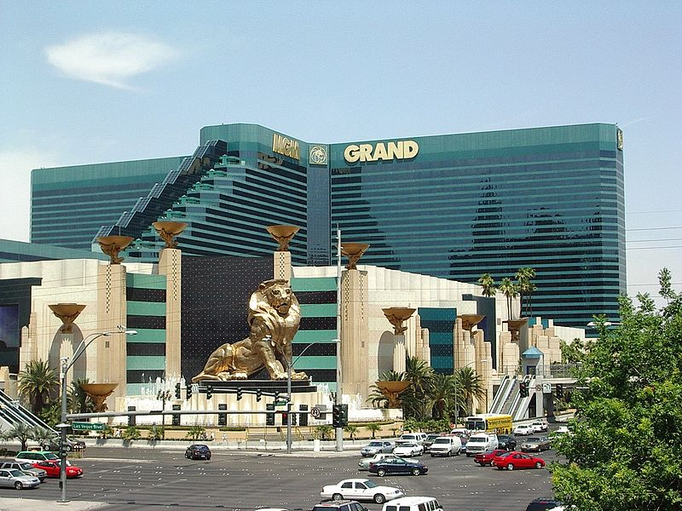
Today
The Las Vegas Strip
about 7 km long part of Las Vegas Boulevard where most of the famous hotels are
many of the world’s largest hotels are on the Strip (exact placing changes)
The Venetian and MGM Grand have each over 7 000 rooms

Slide 5

Night Activities
Gambling, gambling, more gambling
  you can find all sorts of games in all hotels’ casinos
Don’t like gambling?
  No problem! You can choose from more than 100 different shows to see in Vegas
Don’t want to spend much money?
  No worries, go anyway
  Stroll through various hotels and casinos and look around, you won’t believe what is possible

Slide 6
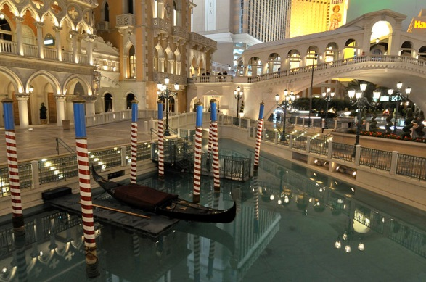
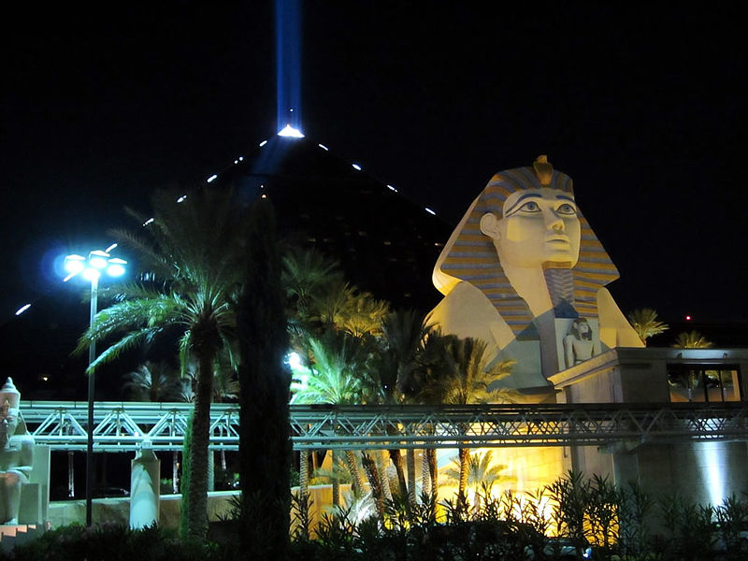
What is interesting about hotels?
Each has a theme and offers interesting attractions – often for free!
Venetian
  feel like you are in Venice with canals, gondolas and much more
Luxor
  30 story pyramid with world’s largest atrium
  shines the world's strongest beam of light into the sky

Slide 7
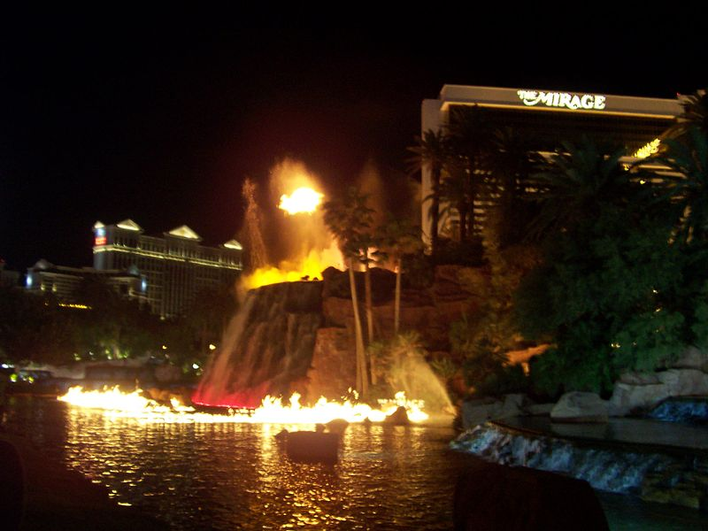
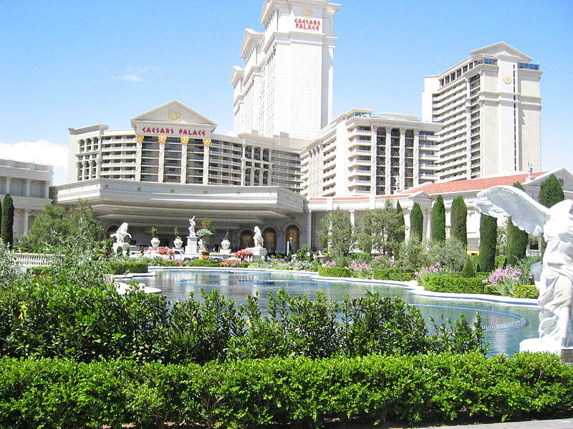
What is interesting about hotels?
Mirage
  tropical oasis in the desert
  enjoy beautiful waterfalls and The Mirage Volcano (erupts every hour)
Caesars Palace
  move back to ancient Rome
  experience The Fall of Atlantis (10 min. show , for free)
…and many more places, one night is not enough to see them all…

Slide 8
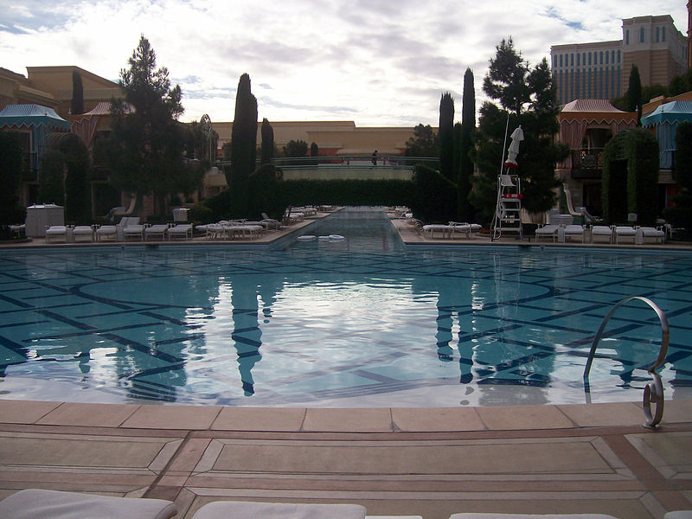
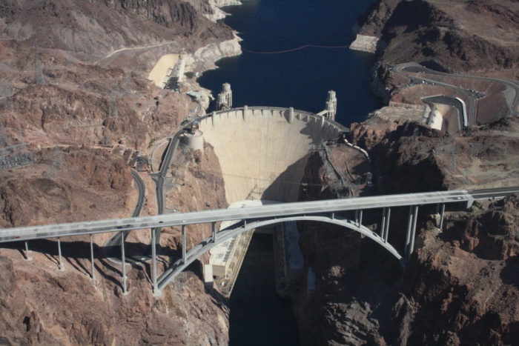
Day Activities
Relax by the pool
  most hotels have several pools to choose from
Go shopping
  it beats shopping anywhere else in the world
Fed up with the city?
          Visit Hoover dam
  the world’s largest dam at the time of its construction in the 1930s
  Lake Mead on the Colorado River is the largest reservoir in the USA

Slide 9
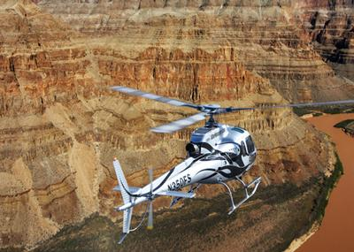
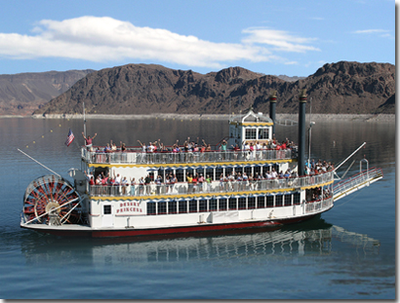
Day Activities
Fly to the Grand Canyon
  choose from various offers of trips by plane or helicopter
Go rafting
  experience the Colorado river and a picnic lunch on the beach
          See Lake Mead on board The Desert Princess
  an authentic, three-level, Mississippi-style paddle wheeler

Slide 10

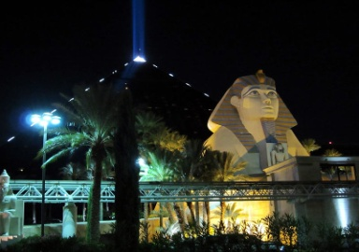




How expensive is Las Vegas?
          Hotels
          Shows
          Tours
          $30 - $80 $50 - $120 $100 - $400

Slide 11
How expensive is Las Vegas?
          Hotels
          $30 - $80
          Shows
          $50 - $120
          Tours
          $100 - $400
Note: In some cases American English is used to preserve terminology and some other aspects

Slide 12
Links
http://www.lasvegas.com/
http://www.vegas.com
http://www.lvcva.com/includes/images/shell/logo-header.png
http://www.lvcva.com/stats-and-facts/history-of-las-vegas/
http://www.impawards.com/1991/bugsy.html
http://www.impawards.com/1995/casino_ver1.html
http://www.funofart.com/top-20-largest-hotels-in-the-world/
http://commons.wikimedia.org/wiki/File:Venetian_Las_Vegas,_NV.jpg
http://commons.wikimedia.org/wiki/File:Mirage_volcano.jpg
http://commons.wikimedia.org/wiki/File:Caesarspalace.jpg
http://commons.wikimedia.org/wiki/File:Luxor_Light_%288226786205%29.jpg
http://commons.wikimedia.org/wiki/File:LasVegas_Casino_MGM_Grand.jpg
http://commons.wikimedia.org/wiki/File:Wynn_-_Pool2_-_2009-01-05.jpg
http://commons.wikimedia.org/wiki/File:Venetian_Hotel_Las_Vegas_%283279029014%29.jpg
http://commons.wikimedia.org/wiki/File:Hoover_Dam,_Colorado_River.JPG
http://www.lakemeadcruises.com/desertprincess.html
http://www.lakemeadcruises.com/images/d_princess.jpg
http://img0.svcdn.lasvegas.com/v2/cache/lasvegas/7C45C037228591BCF3F059D88F993875.jpg

