Slide 1

San Francisco
Tematická oblast | Angličtina: The USA
Datum vytvoření | 22. 2. 2013
Ročník | 2. - 4., sexta – oktáva, úroveň B1+
Stručný obsah | Přehledné seznámení s městem San Francisco + zajímavosti a praktické tipy pro návštěvy.
Způsob využití | Jednotlivé stránky přinášejí základní informace o městě San Francisco spolu s obrazovými stimuly. V závěru kontrolní úkol a odpověď.
Autor | Tomáš Kolenovský
Kód | VY_22_INOVACE_02_AKLN07
Gymnázium a Jazyková škola s právem státní jazykové zkoušky Zlín
Poznámka: prezentace je plně funkční při použití programu Microsoft PowerPoint 2010 a vyšší

Slide 2
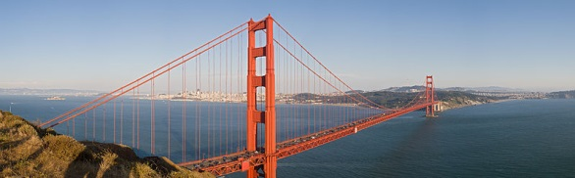
What do you imagine when you hear San Francisco?
“If you’re going to San Francisco,
Be sure to wear some flowers in your hair” by Scott McKenzie
  Fisherman’s Wharf
  Cable Car
  Alcatraz
  Nob Hill

Slide 3
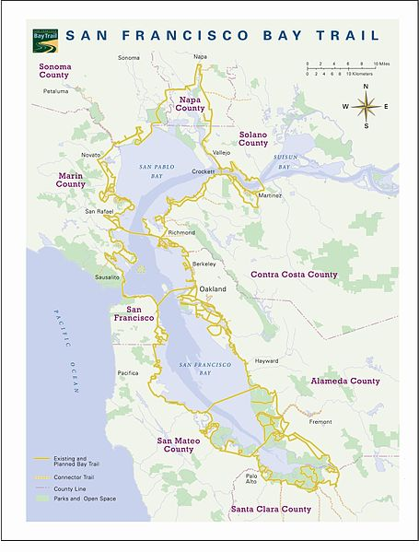

San Francisco
financial and cultural centre of Northern California
located on the west coast at the north end of San Francisco Peninsula creating San Francisco Bay
Golden Gate Bridge
Golden Gate – the opening of the SF Bay into the Pacific Ocean
apparently the most photographed bridge in the world
until 1964 the longest suspension bridge in the world (1280m)
until 1998 the tallest suspension towers above water (227m)

Slide 4
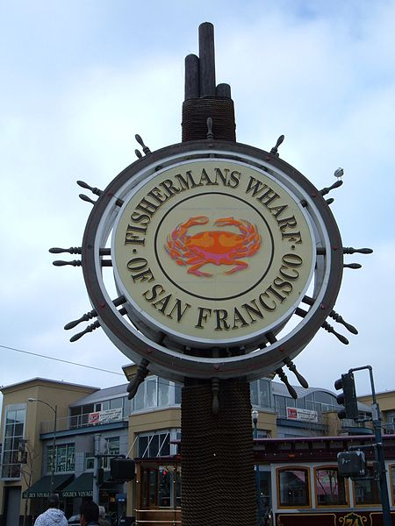
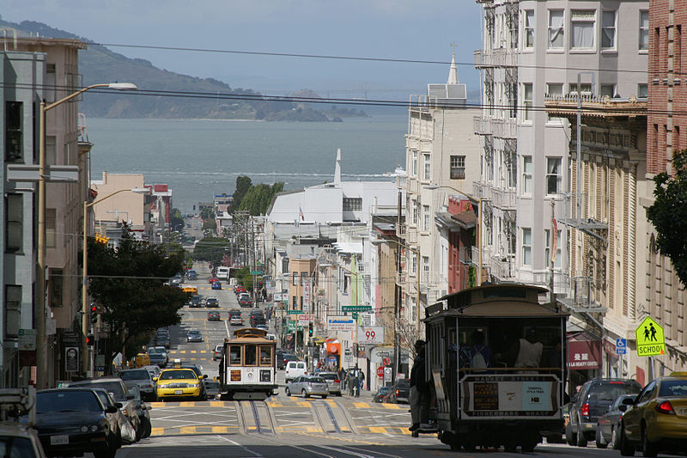
Fisherman’s Wharf
popular tourist destination and location of many famous places like Wax Museum, Aquarium, shopping centres and other tourist attractions
located on the north coast of San Francisco Peninsula
Nob Hill
rich district, “nob” is slang for upper-class
location of expensive hotels, Cable Car Barn, Grace Cathedral – a replica of Notre Dame in Paris, or Huntington Park with replica of a 16th century Roman fountain

Slide 5
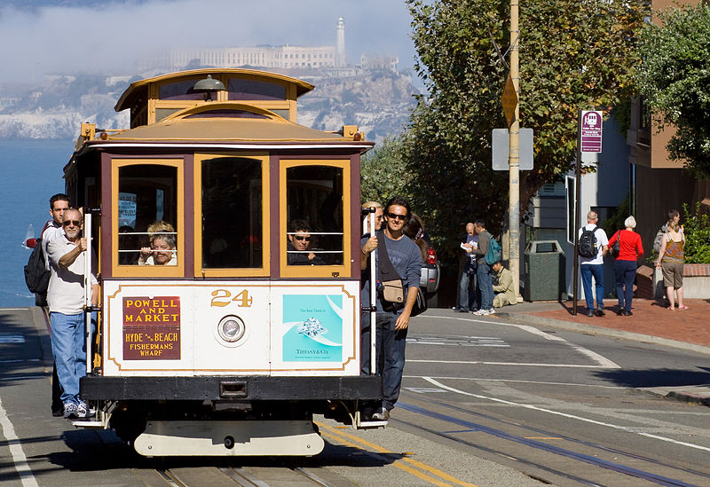
San Francisco Cable Car system
the world’s last manually operated cable car system
used by commuters, but most passengers are tourists
consists of three lines and serves about 7mil. people a year

Slide 6
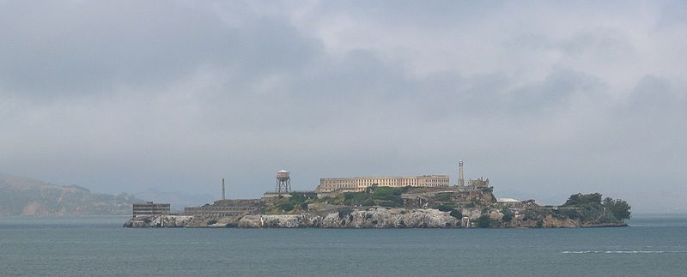
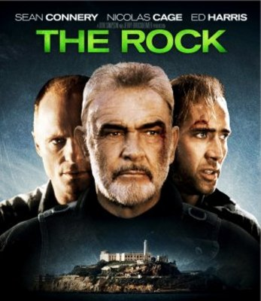
Alcatraz
small island about 2.4km offshore, often called “The Rock”
served as a lighthouse, military fort, military prison and federal prison, now it is open to tourists
as a federal prison it held the worst criminals but in 29 years nobody successfully escaped (although 36 of them tried)
!FOR MORE INFO WATCH!

Slide 7
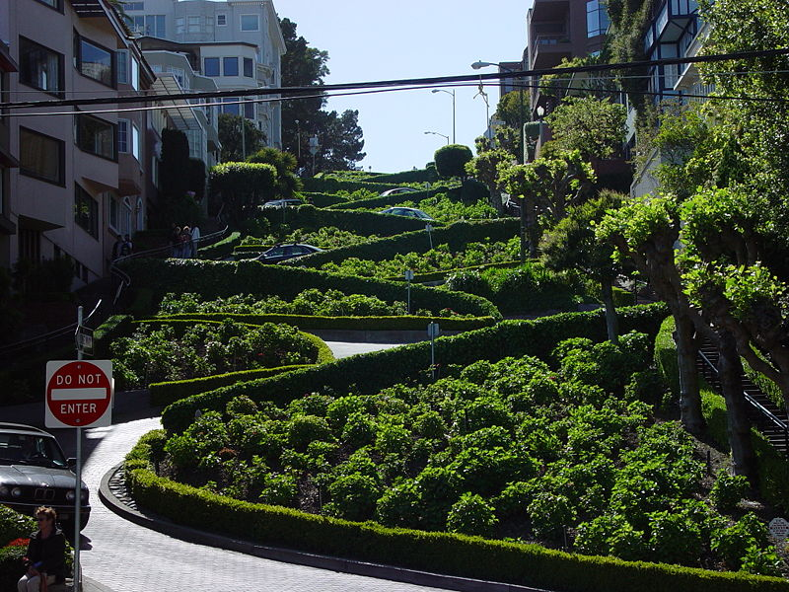
Is San Francisco flat?
NO!
Except Nob Hill there are more than 50 hills,
e.g. Russian Hill is most famous for Lombard Street
Note: In some cases American English is used to preserve terminology and some other aspects

Slide 8
Links
www.sanfrancisco.travel
http://www.sanfrancisco.com/
http://en.wikipedia.org/wiki/San_Francisco
http://commons.wikimedia.org/wiki/File:Panorama_of_Golden_Gate_Bridge.jpg?uselang=cs
http://commons.wikimedia.org/wiki/File:San_Francisco_Bay_Trail_Map.JPG
http://commons.wikimedia.org/wiki/File:Fisherman%27s_Wharf_sign.JPG?uselang=cs
http://commons.wikimedia.org/wiki/File:Nob_hill_view.jpg
http://commons.wikimedia.org/wiki/File:San_Francisco_Cable_Car_MC.jpg
http://commons.wikimedia.org/wiki/File:SF_Alcatraz_island_USA.jpg
http://www.iceposter.com/thumbs/MOV_48c55c16_b.jpg
http://commons.wikimedia.org/wiki/File:Lombard_Street.jpg

