Slide 1

Interstate 95 North
Tematická oblast | Angličtina: The USA
Datum vytvoření | 7. 3. 2013
Ročník | 2. - 4., sexta – oktáva, úroveň B1+
Stručný obsah | Přehledné seznámení s městy severovýchodu USA+ zajímavosti a praktické tipy na cesty.
Způsob využití | Jednotlivé stránky přinášejí základní informace o městech na severovýchodě USA spolu s obrazovými stimuly. V závěru kontrolní úkol a odpovědi.
Autor | Tomáš Kolenovský
Kód | VY_22_INOVACE_02_AKLN09
Gymnázium a Jazyková škola s právem státní jazykové zkoušky Zlín
Poznámka: prezentace je plně funkční při použití programu Microsoft PowerPoint 2010 a vyšší

Slide 2
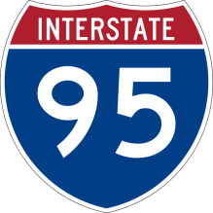
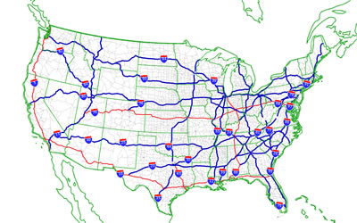
Interstate I 95
“Interstates” are high-speed highways in the USA
major freeways have one or two-digit numbers
odd numbers run north-south
even numbers from east to west

Slide 3
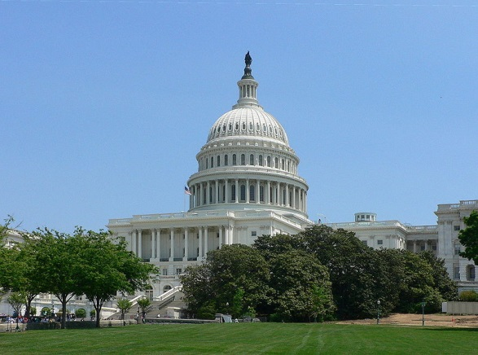
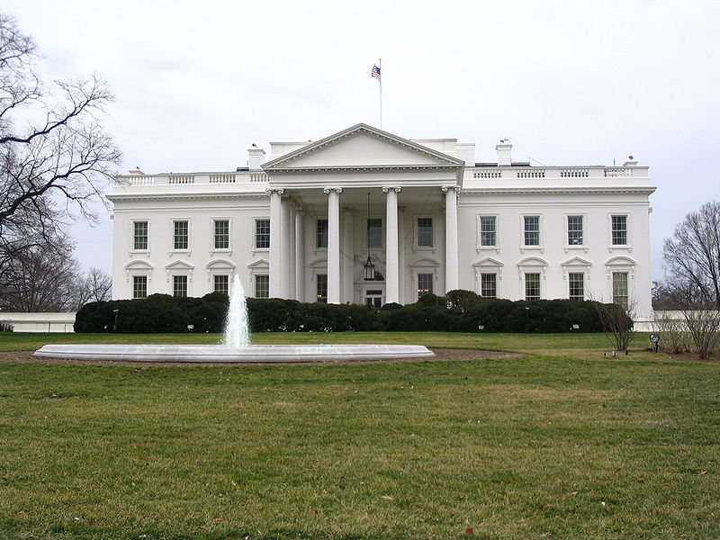
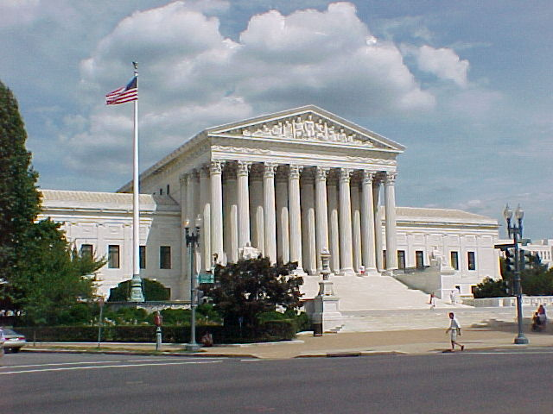
What is the most important city in the USA?
Washington D. C.
the capital of the United States
founded in 1791 and named in honour of George Washington
independent district, not a part of any U.S. state
home of the Congress, President and Supreme Court
U.S. Capitol
The White House

Slide 4
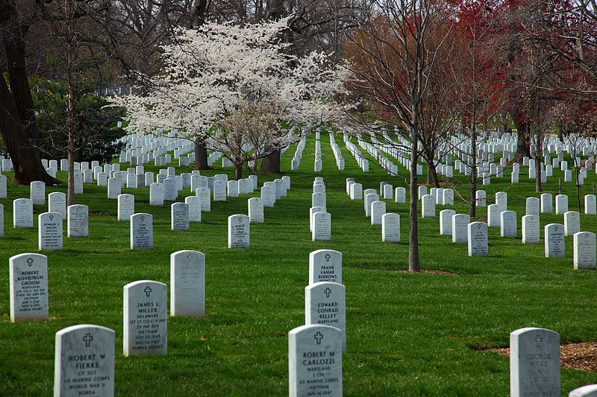
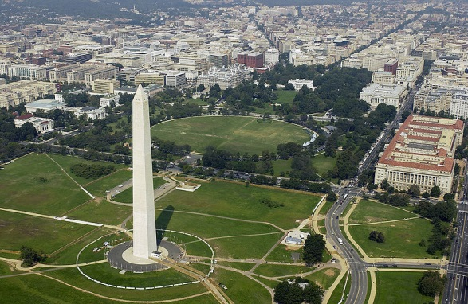
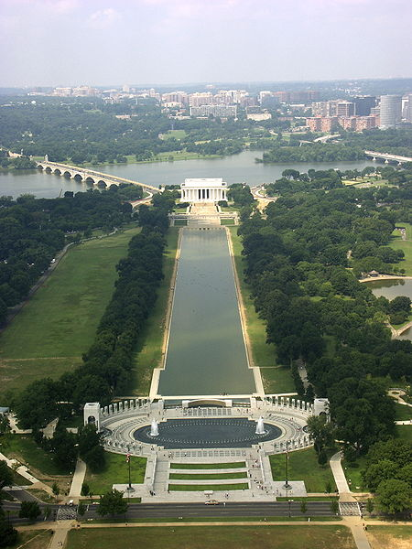
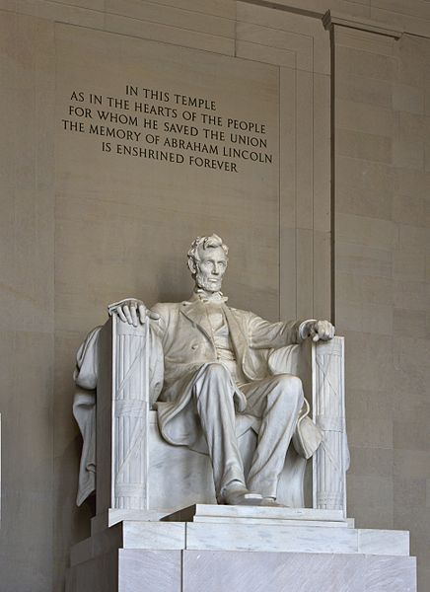
There are many world-famous sights
Arlington National Cemetery
typical for its white headstones
more than 285 000 honoured dead
Washington Monument
built to commemorate G. Washington
the world’s tallest stone structure (169m)
Lincoln Memorial
built to honour 16th U.S. President
located across from Washington Monument

Slide 5
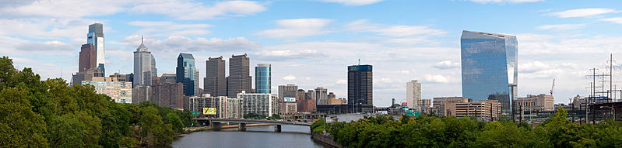
For more history drive I 95 north to reach
Philadelphia (nicknamed Philly)
founded in 1682 by William Penn as capital of Pennsylvania
the largest city and busiest port in British America, today the fifth most populous city
home to many national historical sites

Slide 6
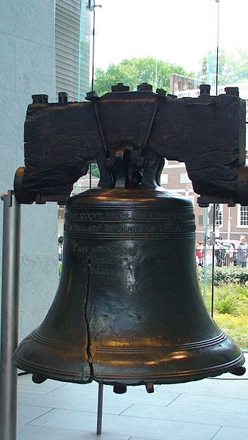
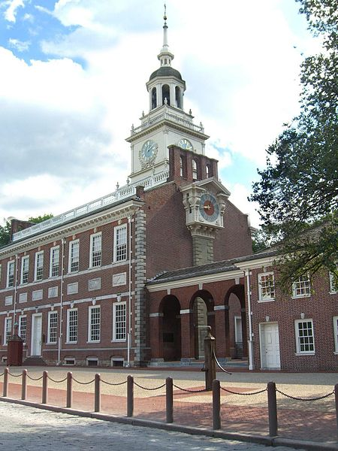
Liberty Bell
a symbol of American independence
made in 1752 in London
first cracked soon after arrival in Philadelphia
it was repaired but cracked again in 1846
Independence Hall
U.S. Constitution and Declaration of Independence were adopted here
listed as a World Heritage Site
first home of the Liberty Bell
you can see the original inkstand used to sign the Declaration
…and many more like Valley Forge National Park, National Constitution Center, Independence Seaport Museum...

Slide 7
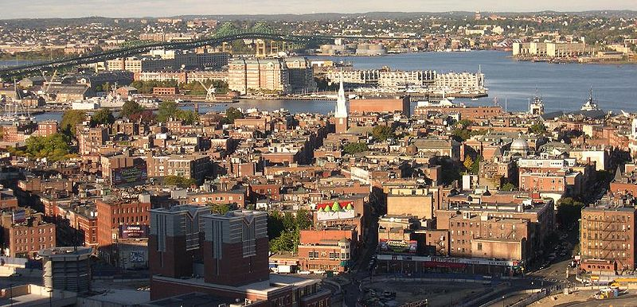
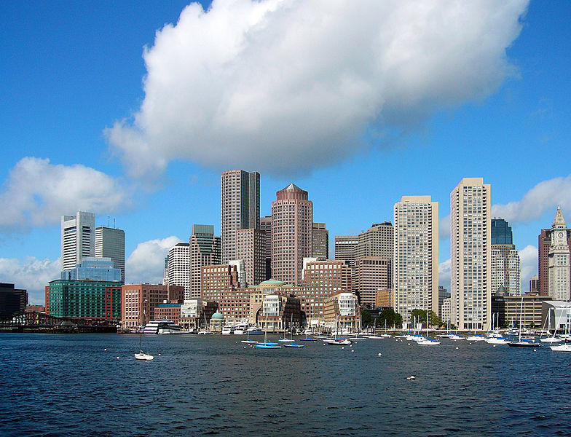
Even more history? Take I 95 north again, spend other 6 hours driving and get to
Boston
the capital of Massachusetts, founded in 1630 by Puritan colonists
place of several important events of the American Revolution, e.g. ...?
Boston Massacre, Boston Tea Party, Battle of Bunker Hill, Siege of Boston
today the economic and cultural centre of New England
a city of neighborhoods (with its own personality and distinct appeal)
a city of many “Firsts” (first public secondary school, first newspaper, first subway…
for more of them go to
http://www.cityofboston.gov/visitors/about/Firsts.asp

Slide 8
And what to see?
Hard to say as there are so many places…, but try
The Freedom Trail
16 historically significant sites located along a 2,5 mile urban walking trail
Emerald Necklace
a chain of nine parks linked by parkways and waterways
connects the Boston Common, the oldest American park, to Franklin Park
Walk to the Sea
experience the remarkable transformation of a small hilly peninsula into a great modern City
A lot of walking?
Nice change after sitting in a car for so long, isn’t it?

Slide 9
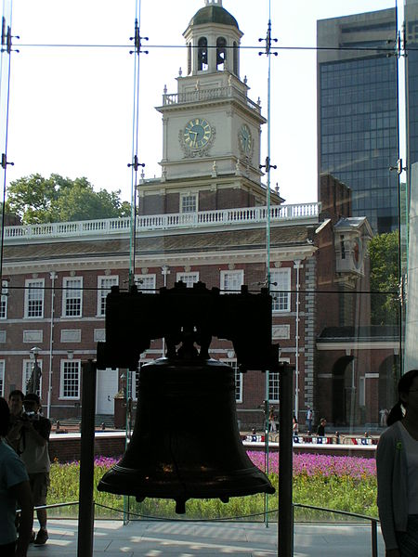
Does the Liberty Bell still ring?
NO!
Why not?
It is cracked and displayed in
The Liberty Bell Center
Note: In some cases American English is used to preserve terminology and some other aspects

Slide 10
Links
http://commons.wikimedia.org/wiki/File:I-95.svg
http://commons.wikimedia.org/wiki/File:US_capitol_building.jpg
http://commons.wikimedia.org/wiki/File:White_House_06.02.08.jpg
http://commons.wikimedia.org/wiki/File:US_Supreme_Court_%2835650678%29.jpg
http://commons.wikimedia.org/wiki/File:Spring-arlington-cemetery_-_Virginia_-_ForestWander.jpg?uselang=cs
http://commons.wikimedia.org/wiki/File:WashMonument_WhiteHouse.jpg
http://commons.wikimedia.org/wiki/File:Lincoln_Memorial_%28Lincoln_tall%29.jpg
http://commons.wikimedia.org/wiki/File:Lincorn_Memorial_Scenery.JPG
http://commons.wikimedia.org/wiki/File:GardenStreetBridgeSchuylkillRiverSkylinePhiladelphiaPennsylvania.jpg
http://commons.wikimedia.org/wiki/File:LibertyBell.jpg
http://commons.wikimedia.org/wiki/File:9.26.06IndependenceHallByLuigiNovi.jpg
http://www.visitphilly.com/history/philadelphia/independence-hall/
http://www.cityofboston.gov
http://en.wikipedia.org/wiki/Boston
http://commons.wikimedia.org/wiki/File:North_End,_Boston.jpg
http://commons.wikimedia.org/wiki/File:Boston_downtown_skyline.jpg
http://www.thefreedomtrail.org
http://www.walktothesea.com/
http://commons.wikimedia.org/wiki/File:Liberty_Bell,_Independence_Hall.jpg

