Slide 1

Interstate 10
Tematická oblast | Angličtina: The USA
Datum vytvoření | 8. 3. 2013
Ročník | 2. - 4., sexta – oktáva, úroveň B1+
Stručný obsah | Přehledné seznámení s jihem USA+ zajímavosti a praktické tipy na cesty.
Způsob využití | Jednotlivé stránky přinášejí základní informace o městech a místech na jihu USA spolu s obrazovými stimuly. V závěru kontrolní úkol a odpověď.
Autor | Tomáš Kolenovský
Kód | VY_22_INOVACE_02_AKLN10
Gymnázium a Jazyková škola s právem státní jazykové zkoušky Zlín
Poznámka: prezentace je plně funkční při použití programu Microsoft PowerPoint 2010 a vyšší

Slide 2

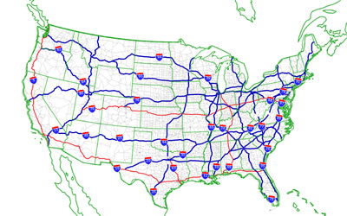
Interstate I 10
“Interstates” are high-speed highways in the USA
major freeways have one or two-digit numbers
odd numbers run north-south
even numbers from east to west

Slide 3
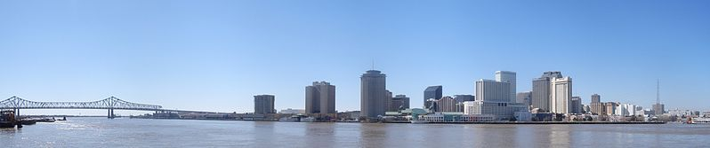
If you want to experience something not American, take I 10 and start in…
New Orleans
the largest city in Louisiana, named after a city in France
founded by French, later controlled by Spanish, in 1803 sold by Napoleon to the United States
a unique melting pot of culture, food and music
the birthplace of jazz and the Festival Capital of the World

Slide 4
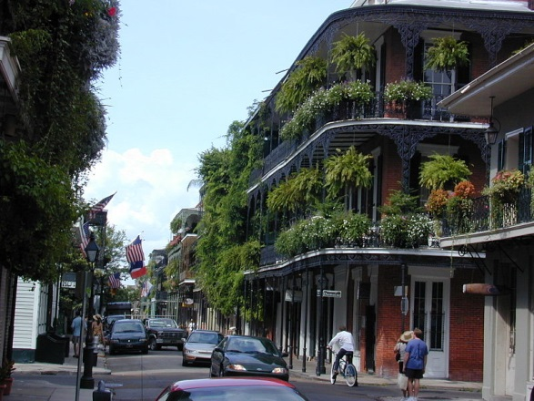
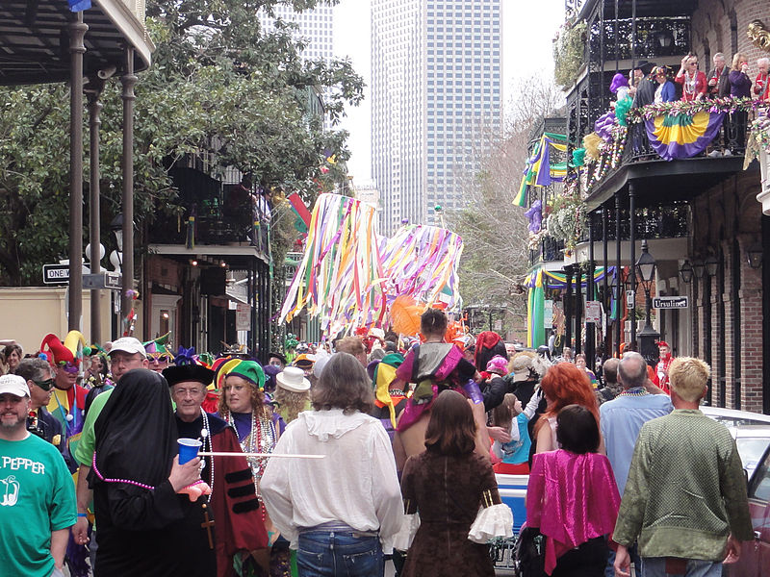
And what to see there?
French Quarter
oldest neighborhood and cultural centre
architectural mix of Spanish, French and American styles
full of bars, jazz and eccentricities
Mardi Gras (or any other festival)
meaning “Fat Tuesday”
47 days before Easter
big parades and celebrations
there are several different festivals each month, for full list go to
http://www.neworleansonline.com/neworleans/festivals/festivals.html

Slide 5
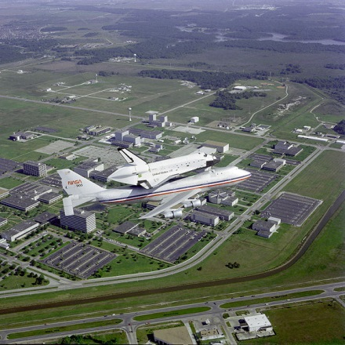
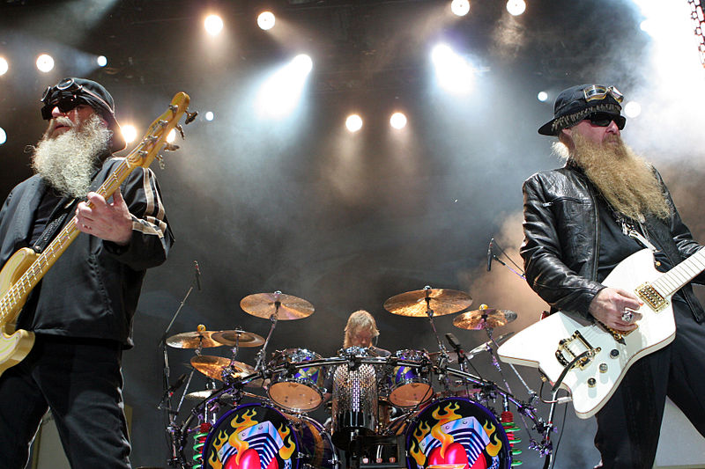
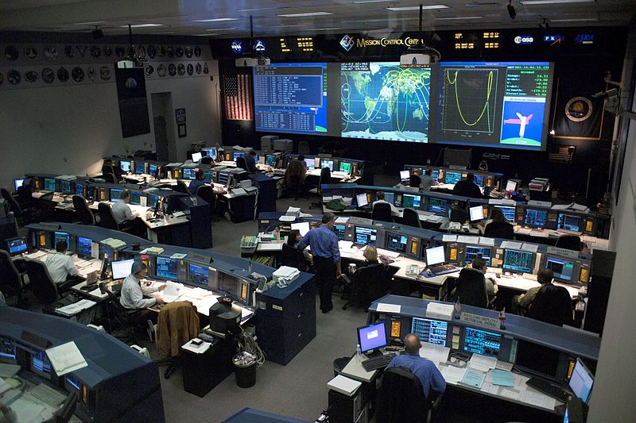
When you sober up go west to
Houston
the largest city in Texas, the fourth-largest in the USA (more than 2.1 mil. people)
famous for its Space Center Houston and ZZ Top
San Antonio
the second-largest city in Texas
worth visiting for its River Walk and The Alamo

Slide 6
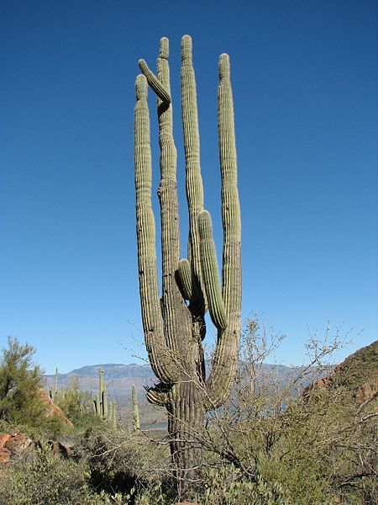
Keep going west (for about 8.5 hours) to reach
El Paso
border between Texas, New Mexico and Mexico
El Paso-Juarez is the largest international metroplex in the world
explored by the Spanish as early as 1598, it is full of history
or enjoy the nature in one of many parks while hiking, biking, climbing or horseback riding
6 more hours in the car and you get to
Phoenix
the capital and largest city of Arizona
yet you can find real cowboys, rugged mountains and cartoon-like cactuses
located in the Sonoran Desert, one of the wettest and greenest deserts in the USA

Slide 7

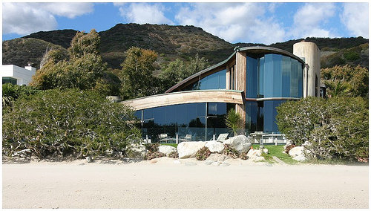
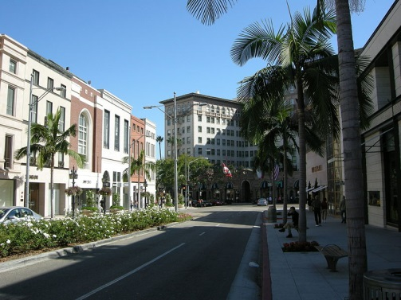
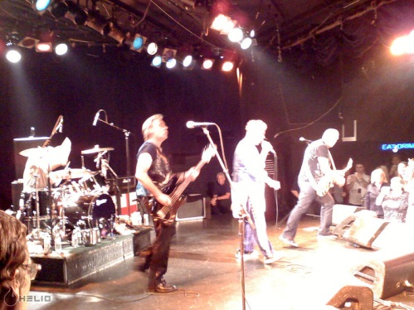
Still have a lack of water?
Survive 5.5 more hours of driving to arrive at
Los Angeles
choose any of its beautiful beaches to refresh yourself in cool water of the Pacific Ocean (to see what it is like in advance, watch…)
Then you can start your search for film stars
along the coast from Santa Monica to Malibu where some of them have their beach houses
in Beverly Hills, top luxury destination in L.A.
in West Hollywood in Sunset Blvd, with many famous clubs and restaurants

Slide 8
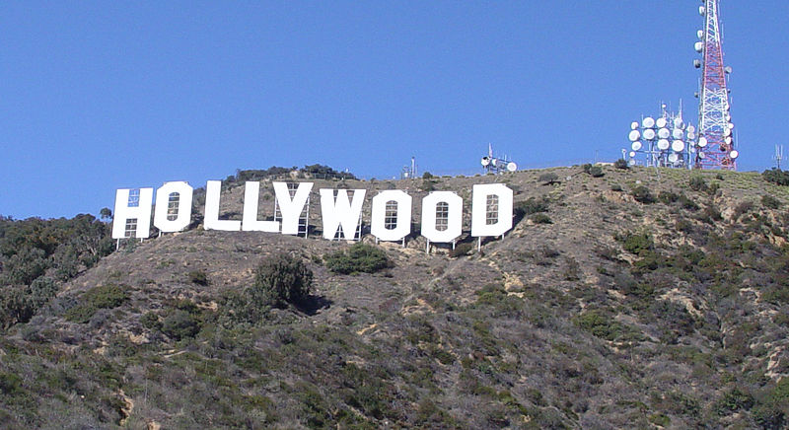
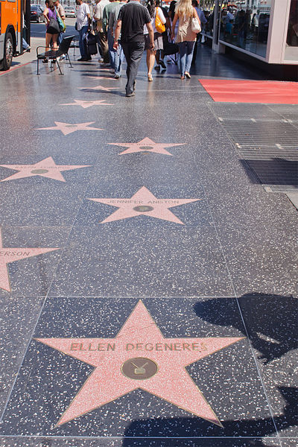
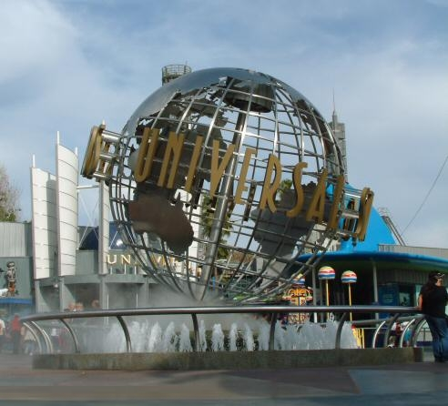
Or forget the stars and enjoy the famous places…
Hollywood and Hollywood sign
visible from various places
synonym for movie industry
in reality not that glamorous
Walk of Fame
a tribute to over 2000 artists
first star was placed in 1960
Universal Studios
the world-famous movie studio and theme park
Griffith Observatory, Santa Monica Pier, Venice Beach, Rodeo Drive, LA Zoo, many interesting buildings, museums…

Slide 9
What is Mardi Gras ?
Famous beach in Los Angeles
Famous festival in New Orleans
Famous French meal

Slide 10
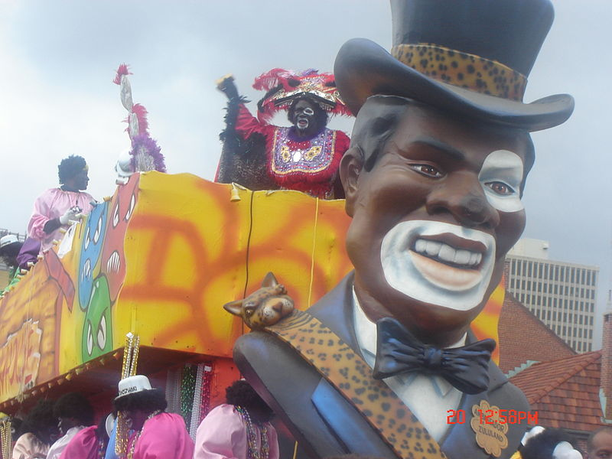
What is Mardi Gras ?
Famous beach in Los Angeles
Famous festival in New Orleans
Famous French meal
Note: In some cases American English is used to preserve terminology and some other aspects

Slide 11
Links
http://commons.wikimedia.org/wiki/File:I-10.svg
http://commons.wikimedia.org/wiki/File:NewOrleansPanoramic.jpg
http://en.wikipedia.org/wiki/New_Orleans
http://www.neworleansonline.com
http://commons.wikimedia.org/wiki/File:Altaner.jpg
http://commons.wikimedia.org/wiki/File:Up_Royal_St_Anne_2012.jpg
http://www.visithoustontexas.com/things-to-do/
http://commons.wikimedia.org/wiki/File:Challenger_Ferry_Flight_Flyover_of_Lyndon_B._Johnson_Space_Center.jpg
http://commons.wikimedia.org/wiki/File:Mission_control_center.jpg
http://commons.wikimedia.org/wiki/File:ZZ_Top_Live.jpg
http://visitelpaso.com/visitors/to_do/1-attractions/sections
http://visitphoenix.com/about-phoenix/index.aspx
http://commons.wikimedia.org/wiki/File:Saguaro_01.jpg
http://www.latourist.com/index.php?page=most-popular
http://img.csfd.cz/files/images/film/posters/000/075/75928_d371f1.jpg?h180
http://commons.wikimedia.org/wiki/File:John_Lautner_Segel_House.jpg
http://commons.wikimedia.org/wiki/File:Rodeo_drive,_03.JPG
http://commons.wikimedia.org/wiki/File:Sex_Pistols_at_the_Roxy,_2007-10-26.jpg
http://commons.wikimedia.org/wiki/File:Hollywood-Sign-cropped.jpg
http://commons.wikimedia.org/wiki/File:Hollywood_Walk_of_Fame_%287960322318%29.jpg
http://commons.wikimedia.org/wiki/File:Universal_Studios_Uniglobe.jpg
http://commons.wikimedia.org/wiki/File:Zulu2007H.jpg

