Slide 1

Interstate 90
Tematická oblast | Angličtina: The USA
Datum vytvoření | 9. 3. 2013
Ročník | 2. - 4., sexta – oktáva, úroveň B1+
Stručný obsah | Přehledné seznámení se severem USA+ zajímavosti a praktické tipy na cesty.
Způsob využití | Jednotlivé stránky přinášejí základní informace o městech a místech na severu USA spolu s obrazovými stimuly. V závěru kontrolní úkol a odpověď.
Autor | Tomáš Kolenovský
Kód | VY_22_INOVACE_02_AKLN11
Gymnázium a Jazyková škola s právem státní jazykové zkoušky Zlín
Poznámka: prezentace je plně funkční při použití programu Microsoft PowerPoint 2010 a vyšší

Slide 2

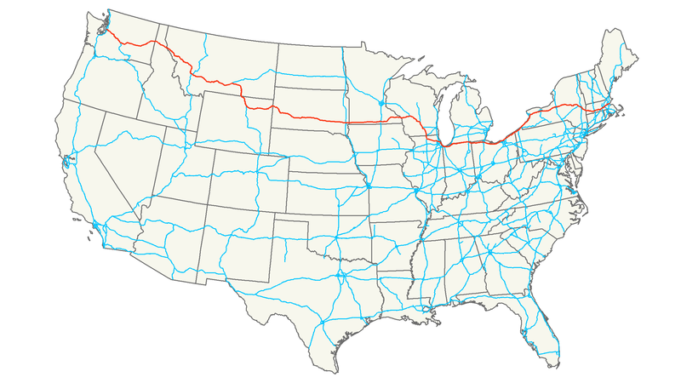
Interstate I 90
“Interstates” are high-speed highways in the USA
major freeways have one or two-digit numbers
odd numbers run north-south
even numbers from east to west

Slide 3
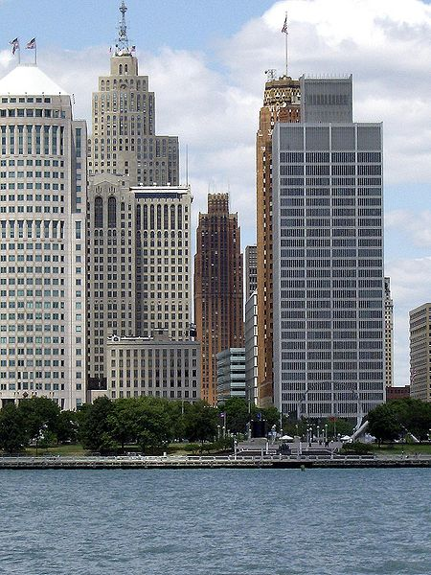
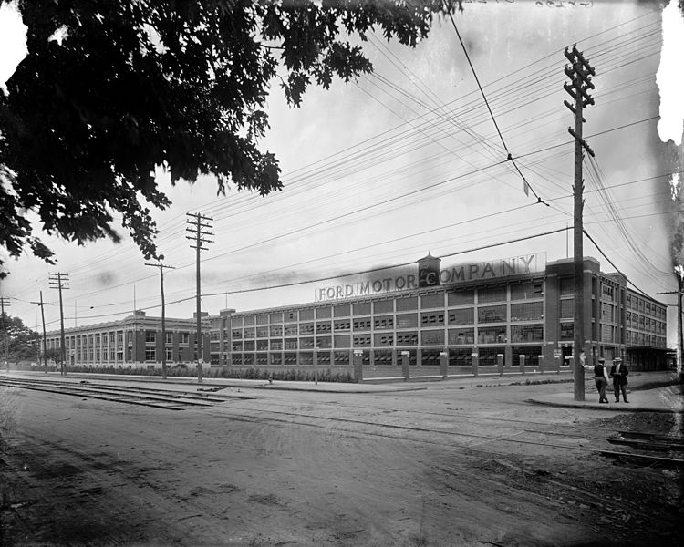
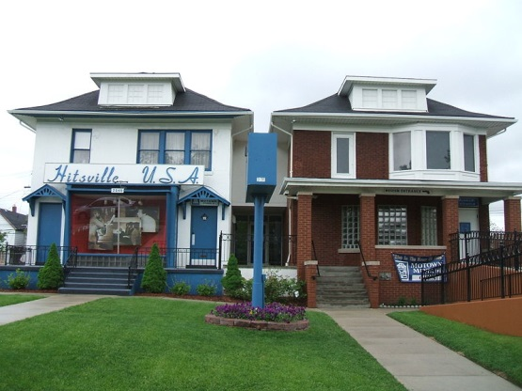
To see the north of the USA, try to drive from the east to west coast via I 90
Start in Boston, city full of history, continue to Buffalo to check Niagara Falls and then drive along Lake Erie to
Detroit
the most populous city in Michigan
The Motor City & Motown = Cars & Music
the home of Ford Motor Company (since 1903)
& famous recording studio (since 1959)
But you can also admire interesting architecture or rest in parks…

Slide 4
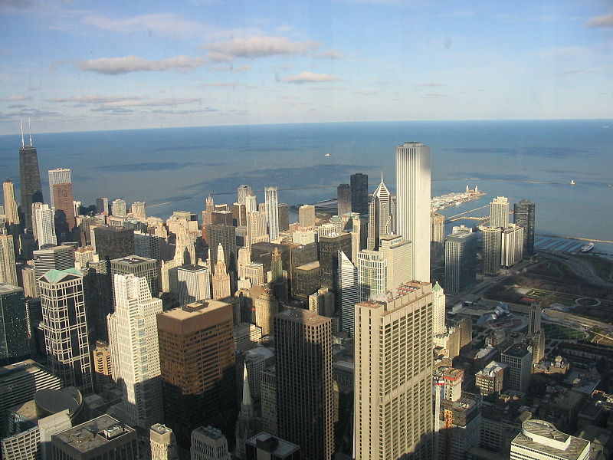
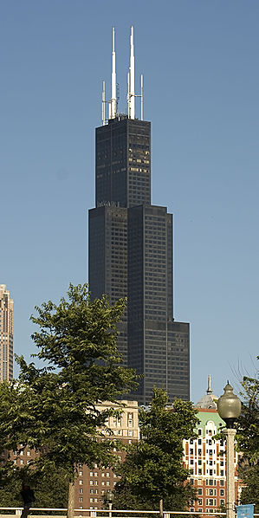
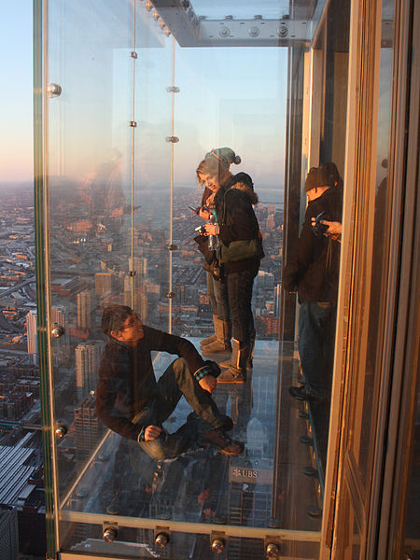
Your next stop should be
Chicago
the third-largest city in the USA (after NY and LA)
famous for its skyscrapers but also for its parks and beaches along Lake Michigan
See the city from Skydeck Chicago
glass-enclosed balcony
103rd floor of Willis Tower (formerly the Sears Tower)
412.4 meters above street level
the building is the tallest in the western hemisphere, the third in the world

Slide 5
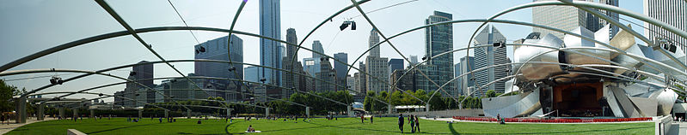
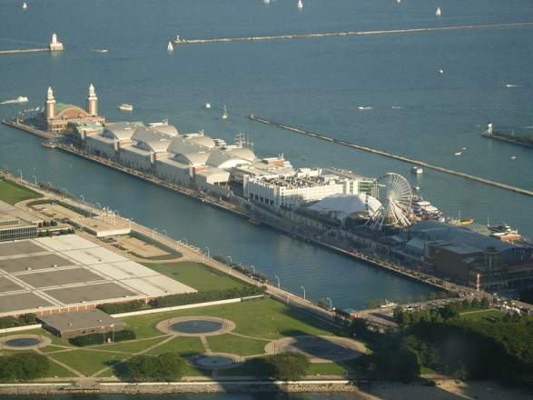
Millennium Park
although quite new (opened 2004), it has become one of the most popular attractions in Chicago
contains some great public art pieces, the most remarkable Jay Pritzker Pavilion with capacity of 11 000 visitors is a popular live performance venue
Navy Pier
the most popular tourist attraction
playground of entertainment, museums, activities, restaurants, shops, etc.

Slide 6
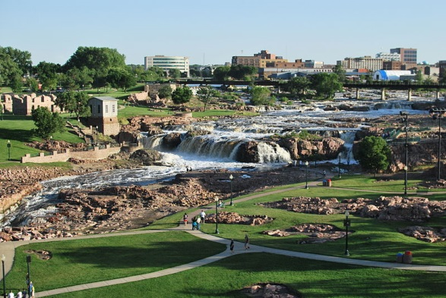
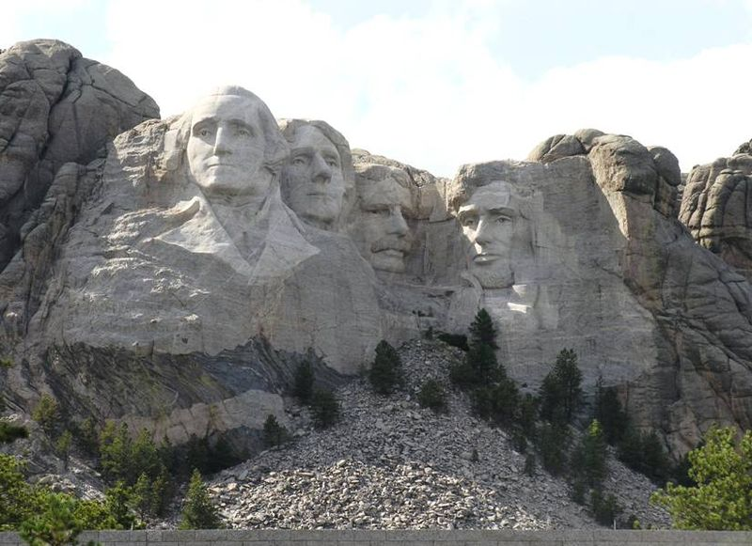
Leave Chicago, drive through Minnesota (that takes about 10 hours) and stop in
Sioux Falls
the largest city in South Dakota, however, completely different from previous cities with population slightly over 150 000
Falls Park, nice place to see the Big Sioux River, a focus of life throughout history
you can see some of the first buildings built in Sioux Falls
Mt. Rushmore
located in Black Hills National Forest in western South Dakota
visited by nearly 3 mil. people each year
a symbol of freedom and hope

Slide 7
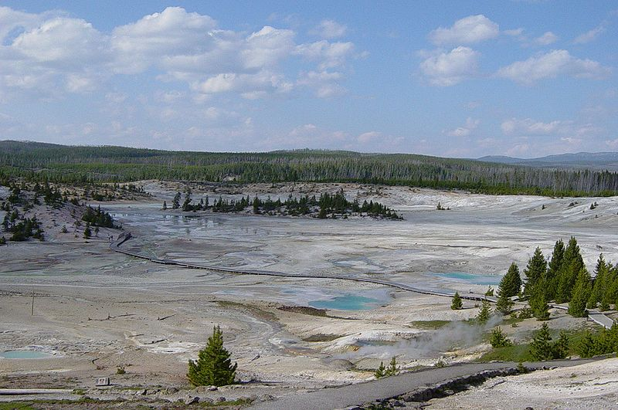
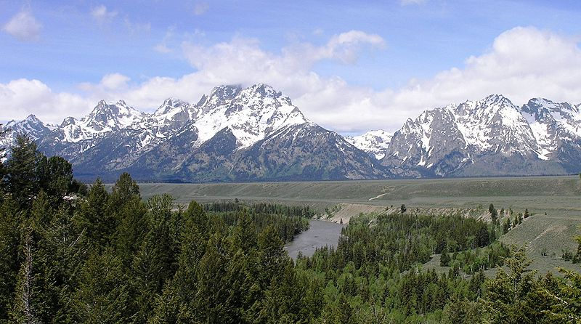
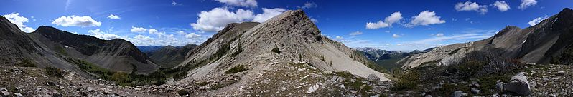
From Black Hills you come straight to Wyoming, a state with beautiful Rocky Mountains, full of National Forests and Parks like Yellowstone and Grand Teton
But if you decide to go back to civilization and continue on I 90 you can expect about 14 more hours of driving through fantastic nature and forests of the states of Montana and Idaho

Slide 8
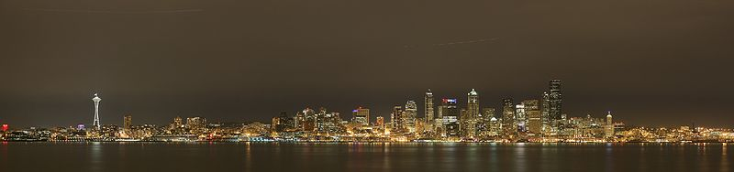
After several more state parks, national forests and Indian reservations in Washington state (don’t confuse with Washington D.C.) you get finally to the end of I 90 to
Seattle
a major coastal seaport city
interesting musical history – Ray Charles and Quincy Jones started their careers there, Jimi Hendrix was born in Seattle, Nirvana, Pearl Jam, Soundgarden, Alice in Chains are some of the famous local bands

Slide 9
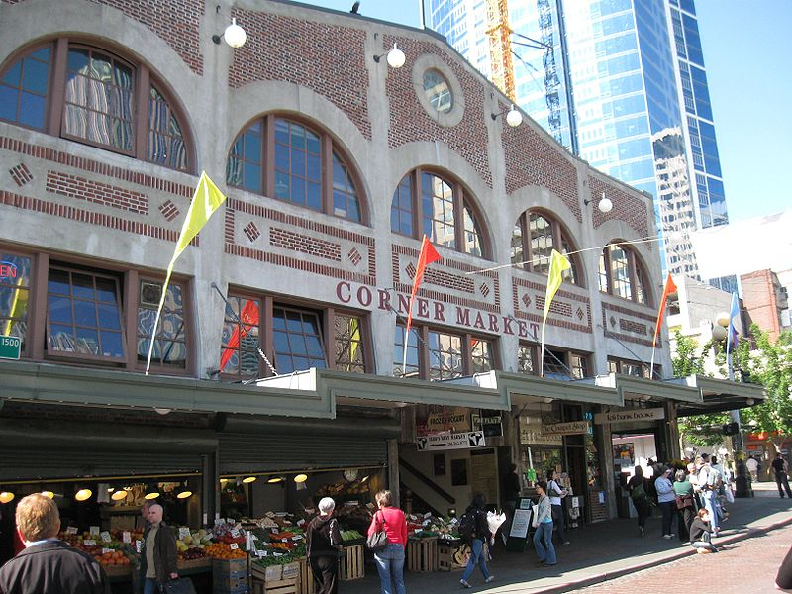
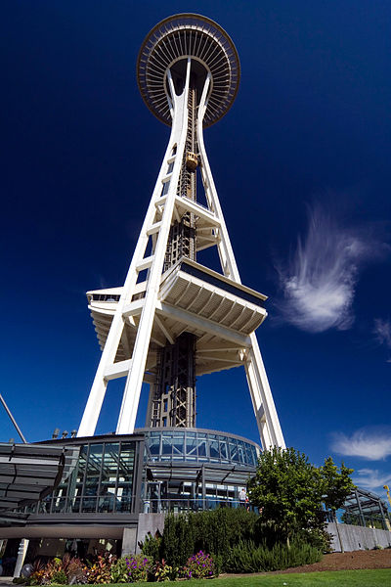
And major tourist attractions?
Pike Place Market
historic public market, in business since 1907
fresh seafood, fruits, vegetables and much more…
the first and original Starbucks is right there
Space Needle
an icon of the city, built for the 1962 World’s Fair
184 meters tall, gives a great view of the city
Boeing tour
see the Boeing factory in Everett
the biggest building by volume in the world
Washington State Ferries
nice part of Washington’s transportation system
you can get a quick and cheap sightseeing boat ride

Slide 10
The tallest building in the western hemisphere is in…
Buffalo
Chicago
Detroit
Note: In some cases American English is used to preserve terminology and some other aspects

Slide 11
Links
http://commons.wikimedia.org/wiki/File:Interstate_90_map.png
http://commons.wikimedia.org/wiki/File:I-90.svg
http://commons.wikimedia.org/wiki/File:DavidStottsitsamongDetroittowers.jpg
http://commons.wikimedia.org/wiki/File:Ford_Motor_Company,_Detroit,_Michigan.jpg
http://commons.wikimedia.org/wiki/File:Motown_detroit.JPG
http://content.time.com/time/travel/cityguide/article/0,31489,1994456_1994357_1994238,00.html
http://www.visitdetroit.com/
http://www.choosechicago.com
http://commons.wikimedia.org/wiki/File:Downtown_Chicago_Illinois_Nov05_img_2685.jpg
http://commons.wikimedia.org/wiki/File:Willis_Tower_glass_box.jpg
http://commons.wikimedia.org/wiki/File:KM_5939_sears_tower_august_2007_B.jpg
http://commons.wikimedia.org/wiki/File:Millennium_Park_Chicago_%283844497396%29.jpg
http://commons.wikimedia.org/wiki/File:Navy_Pier.JPG
http://visitsiouxfalls.com/visitors/things-to-do/falls-park//
http://commons.wikimedia.org/wiki/File:Sioux_falls_sd_lg.JPG
http://commons.wikimedia.org/wiki/File:Mt._rushmore.jpg
http://commons.wikimedia.org/wiki/File:Norris_Geyser_Basin_in_Yellowstone.JPG
http://commons.wikimedia.org/wiki/File:Snake_River_with_Teton_Range_in_background.JPG
http://commons.wikimedia.org/wiki/File:Headquarters_Pass_panorama.jpg
http://commons.wikimedia.org/wiki/File:Seattle_6.jpg
http://seattletimes.com/html/travel/2020948293_sightseeingsummerguidexml.html
http://commons.wikimedia.org/wiki/File:Seattle_Space_needle.jpg
http://commons.wikimedia.org/wiki/File:31_Pike_Place_Market_Sanitary_Market_building_south_end.jpg

