Slide 1

Mountain Resorts
Tematická oblast | Angličtina: The USA
Datum vytvoření | 19. 4. 2013
Ročník | 2. - 4., sexta – oktáva, úroveň B1+
Stručný obsah | Přehledné seznámení s horskými oblastmi středozápadu a západu USA+ zajímavosti a praktické tipy na cesty.
Způsob využití | Jednotlivé stránky přinášejí základní informace o zajímavých horských resortech USA spolu s obrazovými stimuly. V závěru kontrolní úkol a odpověď.
Autor | Tomáš Kolenovský
Kód | VY_22_INOVACE_02_AKLN12
Gymnázium a Jazyková škola s právem státní jazykové zkoušky Zlín
Poznámka: prezentace je plně funkční při použití programu Microsoft PowerPoint 2010 a vyšší

Slide 2
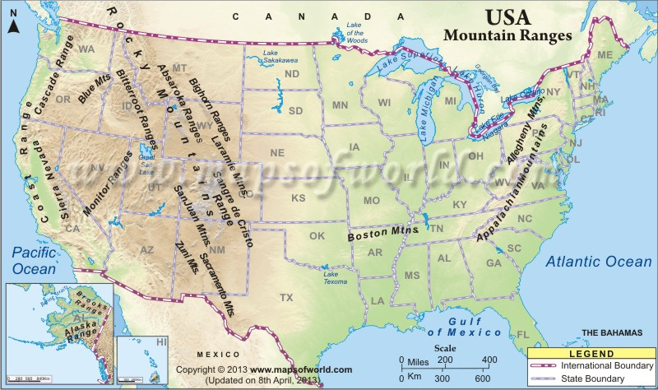
If you say mountains in the USA you imagine…
Rocky Mountains (Rockies),
Appalachian Mountains,
Sierra Nevada…

Slide 3
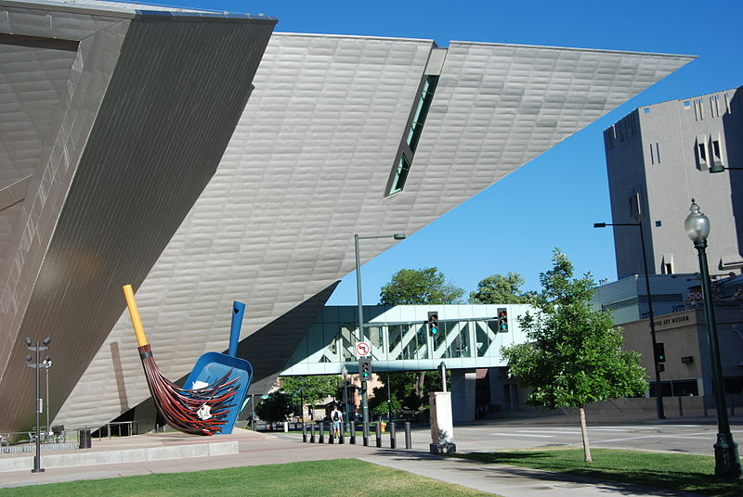
…but the most famous and the best place to start your journey is probably…
Denver
the largest city and the capital of Colorado
nicknamed The Mile-High City (its official elevation is 1609 m)
one of the highest major cities in the USA
Denver Art Museum
the building itself is an architectural work of art
inside you can see a world-famous American Indian art collection
You can walk to see many more downtown sights as Denver has one of the most walkable downtowns in the nation or
drive west to Golden to explore its Old West history, e.g. Coors Brewery Tour, Buffalo Bill Museum & Grave or Colorado Railroad Museum

Slide 4
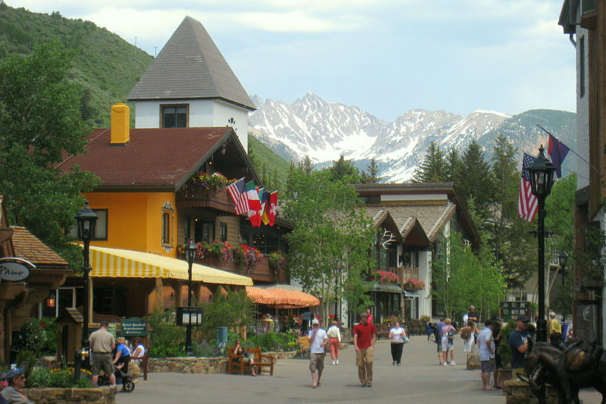
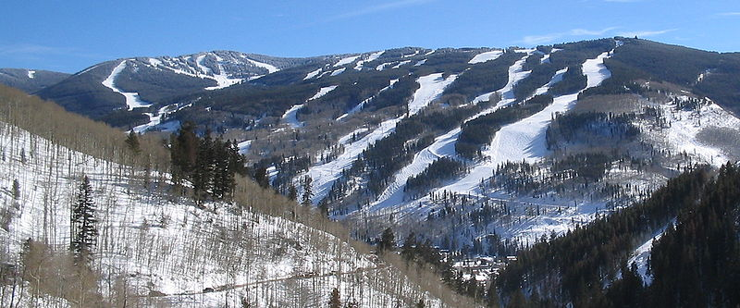
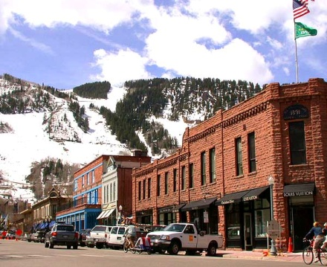
…and then hit the I 70 and hurry up to the real Rockies!
Vail
hosts 2015 Vail-Beaver Creek Alpine World Ski Championships
the largest single mountain ski resort in the United States, rises from 2470 up to 3530 m above sea level
Aspen
founded as a silver-mining camp in 1880
The Aspen Skiing Corporation was founded in 1946, hosting the FIS World Championships in 1950
today the most expensive and very posh resort, full of world celebrities

Slide 5

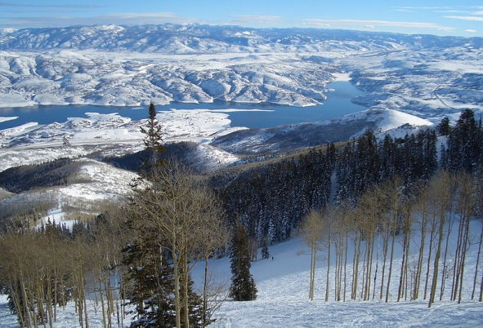
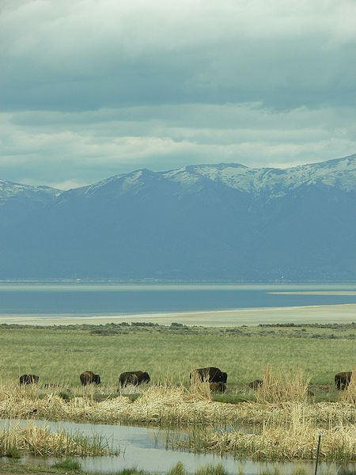
There would be a long list of other famous resorts in Colorado but to experience something different go to…
Salt Lake City, Utah
the organizer of 2002 Winter Olympics
its outdoor recreation tourist industry is based primarily on skiing
Deer Valley, Park City Mountain Resort and Snowbasin are all Winter Olympics venues
except many interesting sights in the city, there is the
Great Salt Lake
about 120 km long and 56 km wide
extremely salty because it has no outlet
Bridger Bay Beach is where you can come to float like a cork, because you cannot sink in the Great Salt Lake

Slide 6
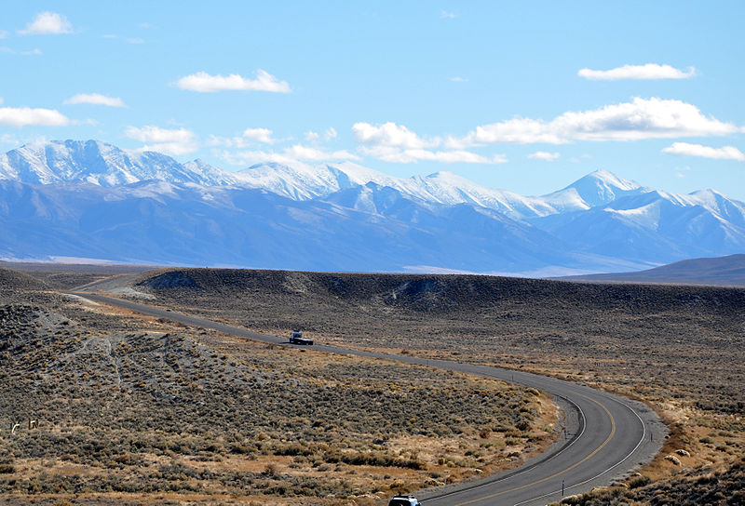
From Utah you need to cross the Nevada desert, either via I 80 or U.S. Route 50
Nevada part of US 50 was named The Loneliest Road in America by Life magazine in 1986 because of desolate areas with few or no signs of civilization
both roads offer fantastic mountain ranges and unforgettable night sky
After about 900 km of desert you reach California border and another beautiful place worth visiting…

Slide 7
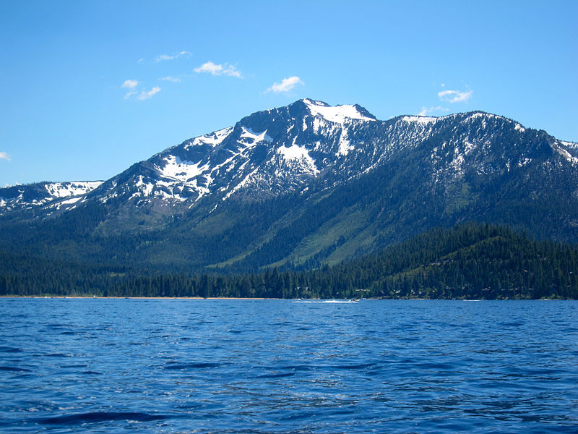


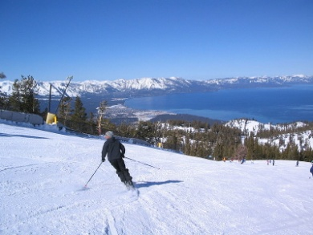

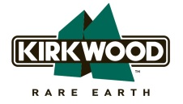



Lake Tahoe
located along the border between California and Nevada
the largest alpine lake in North America
elevation 1897m, depth 501m
major tourist attraction in CA&NV
skiing resorts in surrounding mountains on all sides, e.g.
the host of 1960 Winter Olympics
ski across the border line of CA&NV right “into” the lake
and 5 more to choose from…

Slide 8
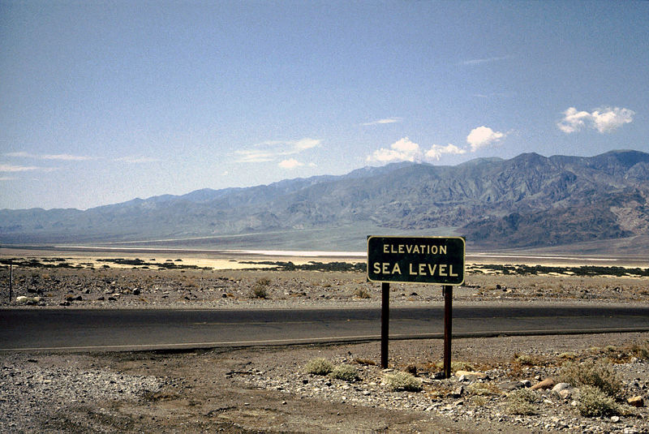
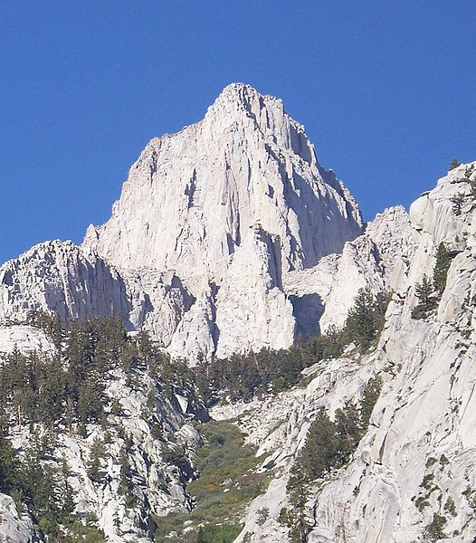
However, for a real summer challenge leave poetic Tahoe , follow
US 395 and go to Death Valley National Park
the hottest, driest and lowest area in North America
the record air temperature was 56.7°C in 1913
Badwater Basin is 86m bellow sea level
From here drive just over 130km to get to Mount Whitney, the highest summit in the contiguous United States
get a permit and hike from Whitney Portal (2550m) all the way up to 4421m summit
about 35km round trip, possible to do in 1day if you start before sunrise, are fit enough and manage altitude sickness

Slide 9
Last Winter Olympics hosted by the United States took place in
Squaw Valley
Lake Placid
Salt Lake City

Slide 10
Last Winter Olympics hosted by the United States took place in
Squaw Valley
Lake Placid
Salt Lake City
Note: In some cases American English is used to preserve terminology and some other aspects

Slide 11
Links
http://www.mapsofworld.com/usa/usa-maps/united-states-mountain-ranges-map.jpg
http://www.denver.org/what-to-do/must-see-denver
http://commons.wikimedia.org/wiki/File:Denver_Art_Gallery_02.JPG
http://commons.wikimedia.org/wiki/File:Vail_front_side.jpg
http://commons.wikimedia.org/wiki/File:Vail,_Colorado_-_street_view.jpg
http://commons.wikimedia.org/wiki/File:DSCN2988_downtownapsen_e_600.jpg
http://en.wikipedia.org/wiki/Aspen,_Colorado
http://commons.wikimedia.org/wiki/File:Deer-valley-Utah_Snow.jpg
http://www.utah.com/stateparks/great_salt_lake_facts.htm
http://commons.wikimedia.org/wiki/File:GSLview.JPG
http://commons.wikimedia.org/wiki/File:Toiyabe_Range.jpg
http://commons.wikimedia.org/wiki/File:Mt._Tallac,_Lake_Tahoe,_California.jpg
http://www.bayareaskibus.com/userfiles/image/squaw_valley_logo.jpg
http://www.skiheavenly.com/~/media/Global/Logos/logo_heavenly.ashx
http://www.visitrenotahoe.com/meetings-conventions/sneak-peek
http://www.tahoetopia.com/mt-rose
http://commons.wikimedia.org/wiki/File:Tahoe.JPG
http://www.nps.gov/deva/index.htm
http://commons.wikimedia.org/wiki/File:Death_Valley,19820817,Furnace_Creek,sea_level.jpg
http://en.wikipedia.org/wiki/Mount_Whitney
http://commons.wikimedia.org/wiki/File:East_Face_Mount_Whitney.jpg

