Slide 1

Rodina (Family) B1
Tematická oblast | Angličtina: Maturitní ústní zkouška
Datum vytvoření | 20.10.2012
Ročník | 2.až 4. ročník čtyřletého gymnázia /sexta až oktáva osmiletého gymnázia, úroveň B1
Stručný obsah | Vhodné jako doplněk k ústní části MZ – praktická forma nácviku maturitního zadání úkolu 1, 2, 4
Způsob využití | Napomáhá studentovi s pohotovým ovládáním nezbytných strategií potřebných ke zvládnutí ústní MZ a poskytuje podpůrnou slovní zásobu tématu a vhodné komunikační obraty.
Autor | Mgr. Jana Jiříkovská
Kód | VY_22_INOVACE_03_AJIR05
Gymnázium a Jazyková škola s právem státní jazykové zkoušky Zlín

Slide 2
Topic: Family B1
Task 1: Questions
Answer the following questions. Give detailed information if possible.
How would you describe your family?
Who do admire most in your family and why?
Tell us about your grandparents and your relationship with them.

Slide 3
What are the pros and cons of being an only child?
If you have a brother or sister, how do you help
each other?
On what occasions does your family meet?
What is a typical day in your family like?

Slide 4
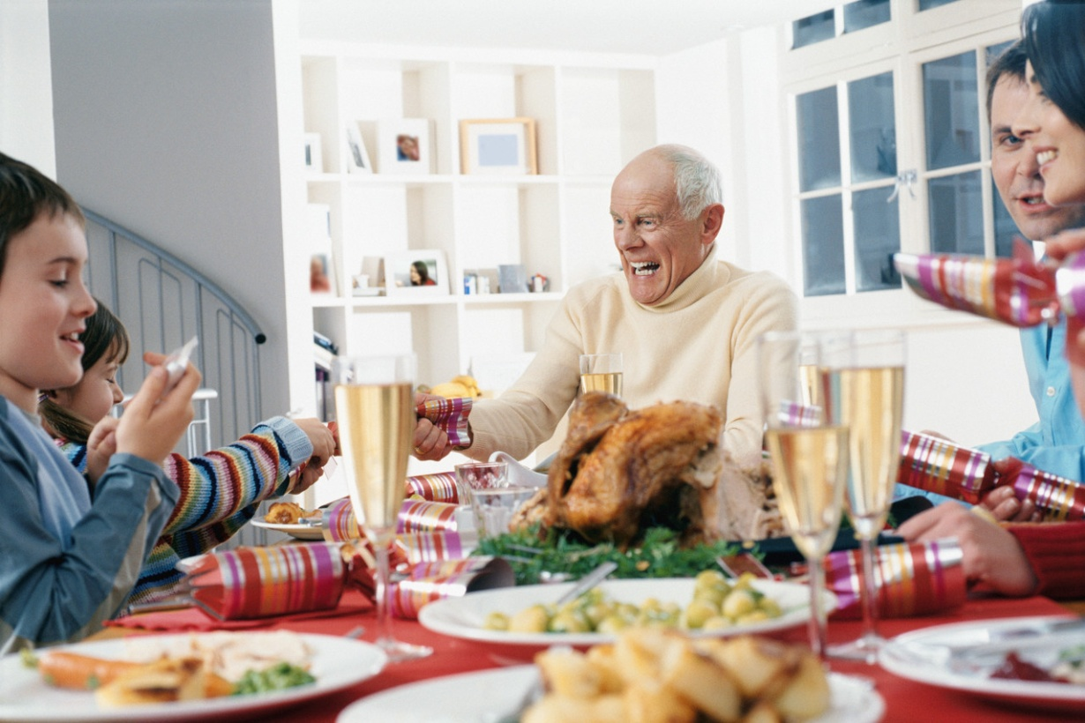
Family B1
Part 2: Task One
Describe the photo in detail and mention:
Location
Occasion
Activity
People
Atmosphere
Feelings

Slide 5
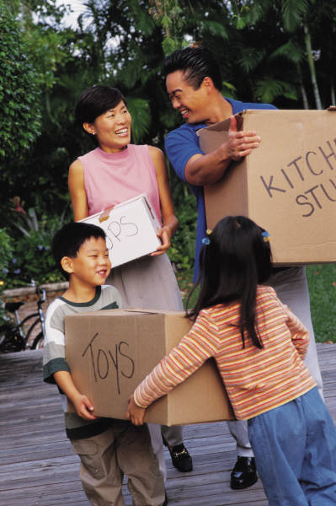

Family B1
Task 2: Part Two
Compare the two photos and consider the following points:
Occasions
Places
People
Atmosphere
Feelings

Slide 6
Family B1
Part 2: Task Three:
Tell me about …
…how your family celebrates holidays (e.g. Christmas).
…a memorable present you have been given.
…where you live.
…why people move.
…what your family likes doing in their free time.

Slide 7
Family B1
Part 4: Role play
Your mum´s birthday is coming soon. You and your brother/sister are planning a surprise party for her. Discuss the following:
When and where
Who to invite
Present(s)
Food
Decorations
Other

Slide 8
Family B1
Vocabulary Bank
a niece / a nephew
a cousin
a sister-in-law
a great-grand parent
an only child
a relative
a widow / a widower
a pensioner
a stepmother
relationship
an occasion
to look like
to take after
to admire sb
to have an argument
to move (in / out)
to get divorced
to make sb happy

Slide 9
Zdroje:
Microsoft Office Clipart 2012

