Slide 1

Společnost (Society) B1
Tematická oblast | Angličtina: Maturitní ústní zkouška
Datum vytvoření | 8.12.2012
Ročník | 2.až 4. ročník čtyřletého gymnázia / sexta až oktáva osmiletého gymnázia, úroveň B1
Stručný obsah | Vhodné jako doplněk k ústní části MZ – praktická forma nácviku maturitního zadání úkolu 1, 2, 4
Způsob využití | Napomáhá studentovi s pohotovým ovládáním nezbytných strategií potřebných ke zvládnutí ústní MZ a poskytuje podpůrnou slovní zásobu tématu a vhodné komunikační obraty.
Autor | Mgr. Jana Jiříkovská
Kód | VY_22_INOVACE_03_AJIR07
Gymnázium a Jazyková škola s právem státní jazykové zkoušky Zlín

Slide 2
Topic: Society B1
Task 1: Questions
Answer the following questions. Give detailed information if possible.
Describe some holiday customs your family celebrates (Christmas, Easter, birthday etc.)
Do you think it´s important for society to keep traditions? Why / why not?
Describe some typical pastime activities of the Czech people.

Slide 3
How is communication between people changing
in today´s world?
What kind of improvement would you like to see
in your society?
What´s it like to be a teenager?
What are some of the most important stages in
life?

Slide 4
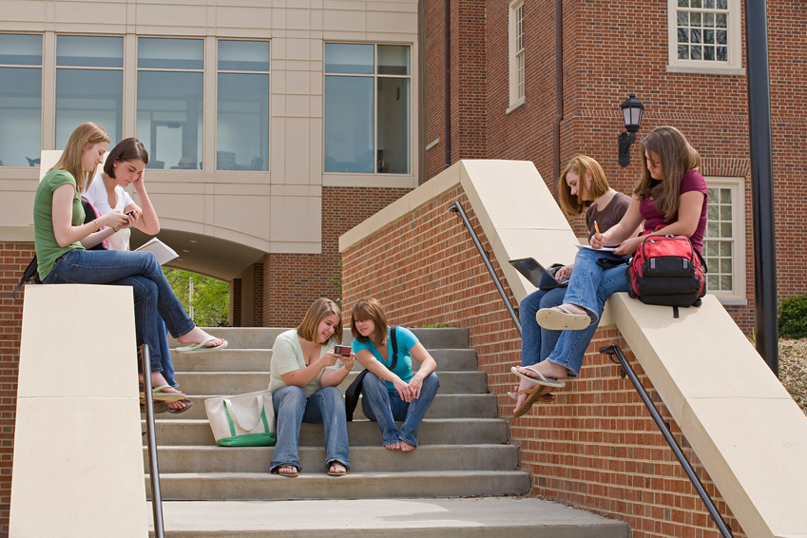
Society B1
Part 2: Task One
Describe the photo in detail and mention:
People
Location
Activity
Atmosphere
Feelings

Slide 5

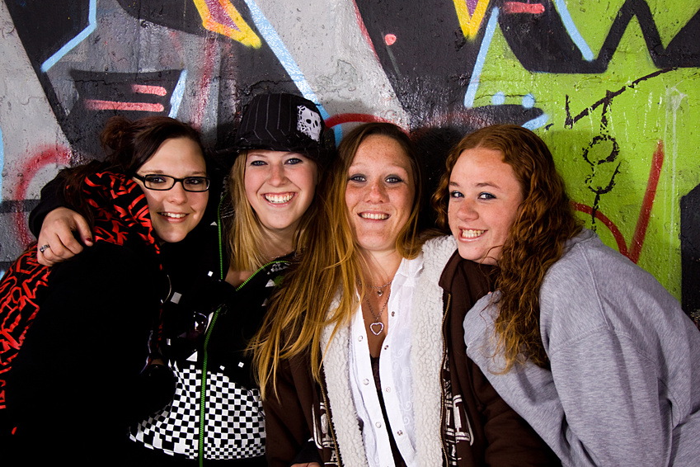
Society B1
Task 2: Part Two
Compare the two photos and consider the following points:
Location
Places
Activities
Feelings
Time
Other

Slide 6
Society B1
Part 2: Task Three:
Tell me about …
…how (young) people rebel against society. What do they rebel against?
…some of the most important problems in our society.
…the role of a woman and a man in today´s society.
…how the elderly contribute to society.
…the way technology changed our lives.
…what you consider to be good manners.
… the things you like (or don´t like) about the society you live in.

Slide 7
Society B1
Part 4: Role play
You are doing a project on problems in today´s world. Discuss with your classmate what to deal with in your work. You may include:
Drugs
Poverty
Homelessness
Unemployment
Communication
Other

Slide 8
Society B1
Vocabulary Bank
College
Entertainment
Graffiti
A stage (of life)
Latest technology
Improvement
A gadget
To rebel against
To consider
To value sth
To spend (time) doing sth
To behave
To misbehave
Good manners
Politeness
Behaviour
Unemployment
Homelessness
To be aware of sth
To be addicted to sth

Slide 9
Zdroje:
Microsoft Office Clipart 2012

