Slide 1

Společnost (Society) B2
Tematická oblast | Angličtina: Maturitní ústní zkouška
Datum vytvoření | 8.12.2012
Ročník | 3., 4. ročník čtyřletého gymnázia / septima, oktáva osmiletého gymnázia, úroveň B2
Stručný obsah | Vhodné jako doplněk k ústní části MZ – praktická forma nácviku maturitního zadání úkolu 1, 2, 4
Způsob využití | Napomáhá studentovi s pohotovým ovládáním nezbytných strategií potřebných ke zvládnutí ústní MZ a poskytuje podpůrnou slovní zásobu tématu a vhodné komunikační obraty.
Autor | Mgr. Jana Jiříkovská
Kód | VY_22_INOVACE_03_AJIR08
Gymnázium a Jazyková škola s právem státní jazykové zkoušky Zlín

Slide 2
Topic: Society B2
Task 1: Questions
Answer the following questions. Give detailed information if possible.
How do people behave to one another these days?
What is the role of grandparents in today´s society?
Is it good for children to go to nursery or kindergarten?

Slide 3
What problems does our society face?
Describe the Czech society.
What are the stereotypes said about Czech people? To what extent do you agree with them?
Is racism a problem in our country? What does the expression „xenophobia“ mean?
Why is the society we live in now often called a consumerist society?
How does the media influence society?

Slide 4
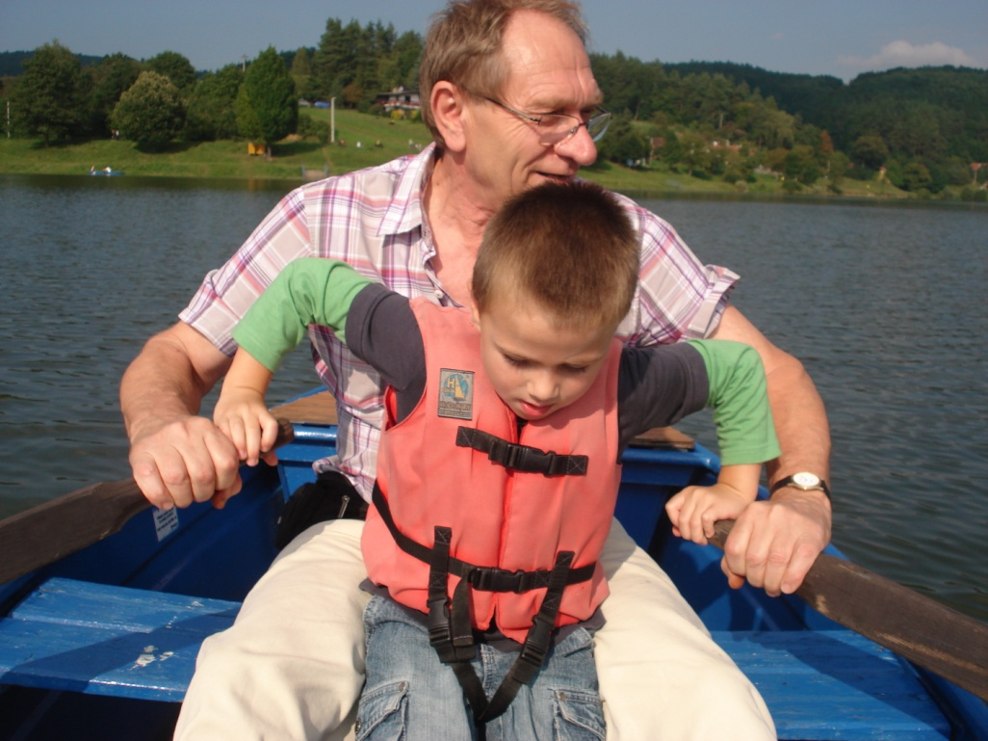
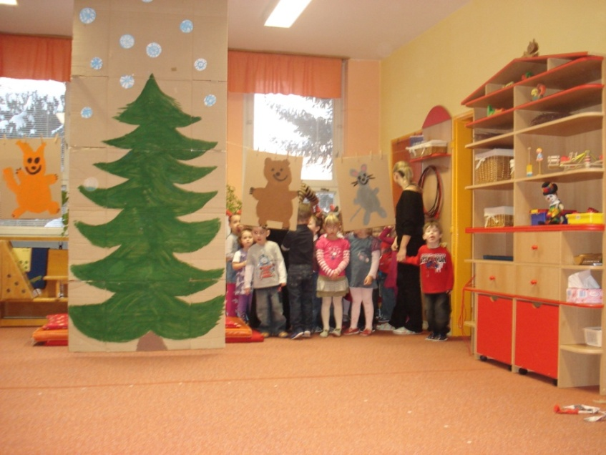
Society B2
Task 2: Part One: Compare and contrast the photos in detail and consider the following points:
Places
Ocassions
Activities
People
Atmosphere
Other

Slide 5
„
Society B2
Part 2: Task Two: Express and justify your opinion on the following statements.
„Parents know best.“ Do you agree with the statement? Why (not)?
„The modern generation of teenagers is less well behaved than previous generations of teenagers.“ What´s your opinion?
In a recent survey, these qualities of a partner were found important: sense of humour, intelligence, faithfulness and physical attractiveness. What´s your view on the matter?

Slide 6
Society B2
Part 4: Role play
You and your English speaking friend are participating in a common project involving getting to know different cultures. Your are going to make a calendar of various aspects of the life in each country. Discuss what to include.
Here are some ideas:
How / Where people live
Their typical pastime activites
The image of a typical teenager from each country
Famous people
Typical tradition(s)
Other

Slide 7
Society B2
Vocabulary Bank
Influential
To benefit from sth
To a certain extent
To face a problem
Insecurity
Corruption
Consumerism
Issues
Xenophobia
Xenophobic
A lack of sth
Have an impact on sth
To underestimate sb/sth
To exaggerate
To meet sb´s expectations
Consequences
To contribute to sth
Faithfulness
Consideration
Pastime

Slide 8
Zdroje:
Vlastní archiv (Jana Jiříkovská)

