Slide 1

Zvířata (animals, pets) B2
Tematická oblast | Maturitní ústní zkouška
Datum vytvoření | 13. 10. 2012
Ročník | 4., oktáva, úroveň B2
Stručný obsah | Vhodné jako doplněk k ústní části MZ – praktická forma nácviku částí 1, 2 a 4 zadání maturitního úkolu
Způsob využití | Pomáhá nacvičit a upevnit strategie nutné ke zvládnutí ústní MZ a poskytuje podpůrnou slovní zásobu k tématu a vhodné komunikační obraty
Autor | Mgr. Jiřina Juříčková
Kód | VY_22_INOVACE_03_AJUR21
Gymnázium a Jazyková škola s právem státní jazykové zkoušky Zlín

Slide 2
Topic: ANIMALS, PETS Part 1: Questions
B2
Why do you think people love animals?
What are the positives of the men – animal relationship? Can you see any negative aspects?
Do you think animals and people are good at working together?
What do you think about keeping animals in Zoos?

Slide 3
Topic: ANIMALS, PETS Part 1: Questions
B2
Do you think pets are important in people`s lives?
Do you think people spoil their pets?
Have you got a pet at home? What? Why?
Which animal is the best one to buy for children as a pet?

Slide 4
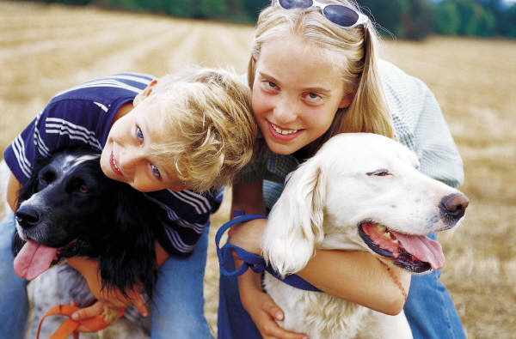
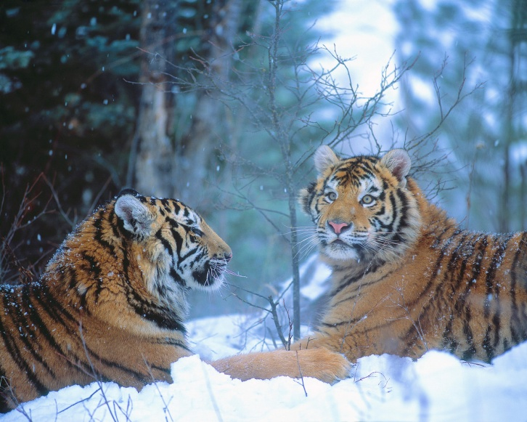
Topic: ANIMALS, PETS Part 2: Task 1: Compare and contrast the photos in detail and consider the following points
B2
Location
Animals
Activities
Atmosphere
Advantages - disadvantages
Other

Slide 5
Topic: ANIMALS, PETS Part 2: Task 2: Express and justify your opinion on the following statements:
B2
Scientists should be allowed to experiment on living animals in order to find cures for human diseases.
In zoos animals are kept in unnatural conditions and that is why zoos should be banned.
“Ecotourism” helps to protect wildlife.

Slide 6
Topic: ANIMALS, PETS Part 4: Role-play
B2
You have been invited to your friend`s birthday party and you would like to buy her a present. You have decided to buy a pet but have not decided what kind of. Discuss advantages and disadvantages of keeping suggested pets and choose the right one for your friend. Consider the following:
Dog - time to spend with
Mouse - food
Snake - special training
Goldfish - going for walk
Cat - illnesses
Turtle - equipment

Slide 7
Topic: ANIMALS, PETS Vocabulary bank:
B2
wilderness
natural habitat
endangered species
to treat
to experiment on
to suffer
to roam
animal conservation
unnatural conditions
regulations
fur
to spoil
attitude to
cage
pet shop
assistant dog
circus
train, training
to keep
to hunt for

Slide 8
Zdroje:
http://office.microsoft.com/cs-cz/images/results.aspx?qu=pets&ex=1&origin=FX010132103#ai:MP900316840|
http://office.microsoft.com/cs-cz/images/results.aspx?qu=wild+animals&ex=1#ai:MP900425298|

