Slide 1

Jídlo (Food, Meals) B2
Tematická oblast | Angličtina: ústní zkouška
Datum vytvoření | 1. 11. 2012
Ročník | 4., septima, oktáva, úroveň B2
Stručný obsah | Vhodné jako doplněk k ústní části MZ – praktická forma nácviku částí 1, 2 a 4 zadání maturitního úkolu
Způsob využití | Pomáhá nacvičit a upevnit strategie nutné ke zvládnutí ústní MZ a poskytuje podpůrnou slovní zásobu k tématu a vhodné komunikační obraty
Autor | Mgr. Jiřina Juříčková
Kód | VY_22_INOVACE_03_AJUR23
Gymnázium a Jazyková škola s právem státní jazykové zkoušky Zlín

Slide 2
Topic: Food, Meals
Part 1: Questions
B2
What does a healthy diet mean in your opinion?
Would you say that you have a healthy diet?
What could you do to improve your diet?
What are the two meanings of the word “diet”?

Slide 3
Topic: Food, Meals
Part 1: Questions
B2
What are the best ways of cooking?
How often do you eat out? On what occasions?
What meals can you prepare? Which one is your favourite?
Do you prepare traditional Czech cuisine at home?

Slide 4
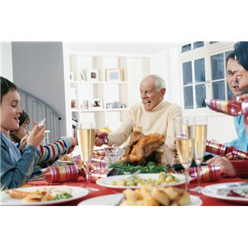
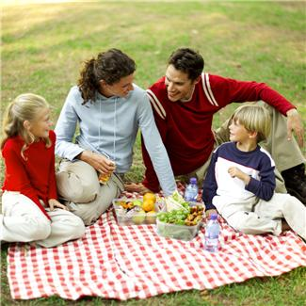
Topic: Food, Meals
Part 2: Task 1: Compare and contrast the photos in detail and consider the following points
B2
Place
Occasion
Food
Atmosphere
People
Other

Slide 5
Topic: Food Meals
Part 2: Task 2: Express and justify your opinion on the following statements:
B2
We should eat a lot of different types of food. We should not avoid sugar and fat.
A balanced diet is important for health and fitness.
Our eating habits have changed a lot over the last 20 years.

Slide 6
Topic: Food, Meals
Part 4: Role-play
B2
You are organising a party for a group of small children and you also want to prepare some meals. You have to decide what kind of food and drinks would be the most suitable. You also have to plan what to buy, who is going to buy it and where.
The following ideas may help you.
Cold meals x Hot meals
Soft drinks (still x fizzy)
Home made food x bought from a supermarket
Catering company
Sweets x Snacks

Slide 7
Topic: Food, Meals
Vocabulary bank:
B2
healthy diet
carbohydrates
proteins
vitamins
fat
fibre
to stew
to steam
lentils
allergy
balanced diet
eating habits
home made food
junk food
to eat out
to be on a diet
read meat
high in salt
organically grown
to become vegetarian

Slide 8
Zdroje:
http://office.microsoft.com/cs-cz/images/results.aspx?qu=meals&ex=1#ai:MP900422641|
http://office.microsoft.com/cs-cz/images/results.aspx?qu=meals&ex=1#ai:MP900422789|

