Slide 1

Životní prostředí (Environment) B2
Tematická oblast | Angličtina: Maturitní ústní zkouška
Datum vytvoření | 2. 11. 2012
Ročník | 4., septima, oktáva, úroveň B2
Stručný obsah | Vhodné jako doplněk k ústní části MZ – praktická forma nácviku částí 1, 2 a 4 zadání maturitního úkolu
Způsob využití | Pomáhá nacvičit a upevnit strategie nutné ke zvládnutí ústní MZ a poskytuje podpůrnou slovní zásobu k tématu a vhodné komunikační obraty
Autor | Tomáš Kolenovský
Kód | VY_22_INOVACE_03_AKLN10
Gymnázium a Jazyková škola s právem státní jazykové zkoušky Zlín

Slide 2
Topic: ENVIRONMENT Part 1: Questions
B2
Why do you think it is important to protect the environment?
What are the benefits of public transport? What are the drawbacks to it?
What recycling facilities are there in your town?
What could you do personally to protect local environment?

Slide 3
Topic: ENVIRONMENT Part 1: Questions
B2
What are the causes and effects of global warming?
What is the greenhouse effect?
What are the main environmental problems in your region?
What do you think the world will be like in 100 years?

Slide 4
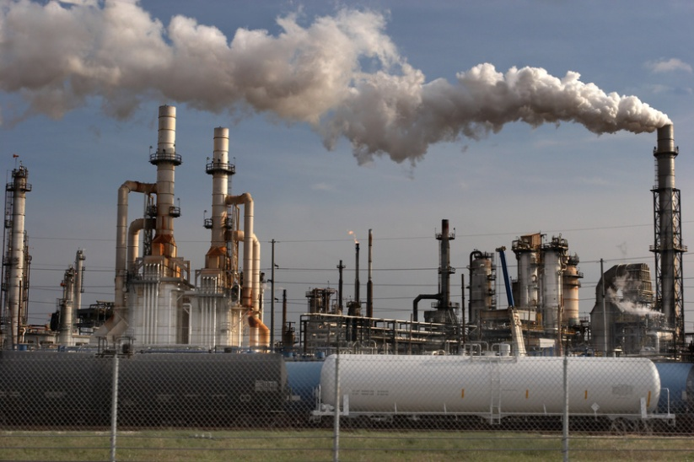
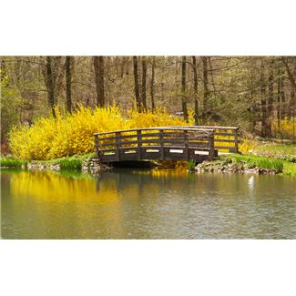
Topic: ENVIRONMENT Part 2: Task 1: Compare and contrast the photos in detail and consider the following points
B2
Location
Environment
Activities
Atmosphere
Effect on people
Other

Slide 5
Topic: ENVIRONMENT Part 2: Task 2: Express and justify your opinion on the following statements:
B2
We ought to stop using cars for unnecessary journeys and use public transport instead.
We should make a serious effort to waste less food.
People should be encouraged to use alternative sources of energy more.
Global warming is not a problem.

Slide 6
Topic: ENVIRONMENT Part 4: Role-play
B2
You have been asked to prepare a lecture about “The bright future for people and the environment”. Discuss advantages and disadvantages of suggested things which can improve the environment and choose 2 most practical and effective. Consider the following:
Collecting rainwater
Creating wildlife reserves
Using recycling areas
Not eating meat
Walking or cycling to work
Using environmentally friendly washing powders

Slide 7
Topic: ENVIRONMENT Vocabulary bank:
B2
protect the environment
benefits
drawbacks
recycling facilities
cause/to cause
effects
global warming
extreme weather
to absorb
cutting down trees
burning of fossil fuels
power stations
alternative energy
carbon dioxide
effort/serious effort
wildlife reserve
environmentally friendly
collect (water)
organically grown
to become vegetarian

Slide 8
Zdroje:
http://office.microsoft.com/cs-cz/images/results.aspx?qu=environment&ex=1&origin=FX010132103#ai:MP900448679|
http://office.microsoft.com/cs-cz/images/results.aspx?qu=environment&ex=1&origin=FX010132103#ai:MP900442325|

