Slide 1

Každodenní život (Everyday Life) B2
Tematická oblast | Angličtina: Maturitní ústní zkouška
Datum vytvoření | 4. 11. 2012
Ročník | 4., septima, oktáva, úroveň B2
Stručný obsah | Vhodné jako doplněk k ústní části MZ – praktická forma nácviku částí 1, 2 a 4 zadání maturitního úkolu
Způsob využití | Pomáhá nacvičit a upevnit strategie nutné ke zvládnutí ústní MZ a poskytuje podpůrnou slovní zásobu k tématu a vhodné komunikační obraty
Autor | Tomáš Kolenovský
Kód | VY_22_INOVACE_03_AKLN12
Gymnázium a Jazyková škola s právem státní jazykové zkoušky Zlín

Slide 2
Topic: Everyday Life
Part 1: Questions
B2
What are your typical morning procedures?
What means of transport do you usually use to get to school?
What is the average time you spend travelling/at school every day?
How many after-school activities do you participate in?

Slide 3
Topic: Everyday Life
Part 1: Questions
B2
How much time do you spend doing the housework?
Would you like to take up any new activity at the weekends?
What do you do to keep fit?
How often do you eat out?

Slide 4
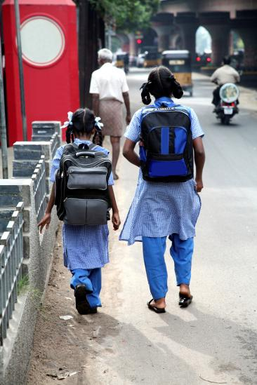
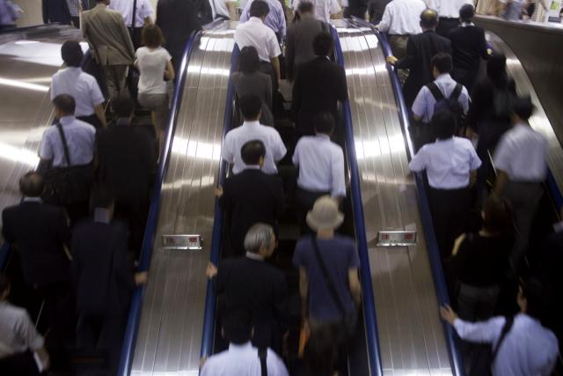
Topic: Everyday Life
Part 2: Task 1: Compare and contrast the photos in detail and consider the following points
B2
Location
People
Activities
Atmosphere
Convenience
Other

Slide 5
Topic: Everyday Life
Part 2: Task 2: Express and justify your opinion on the following statements:
B2
Our parents should not ask us to do any housework, we are too busy studying.
Mobile phones should be banned at schools completely.
School canteens offer bad food for a lot of money.
Using public transport to travel to school should be free.
We do not have enough free time.

Slide 6
Topic: Everyday Life
Part 4: Role-play
B2
You have decided to organize a fancy dress party in your house. With your friend discuss the following points:
the theme of the party
how many people to invite
how to provide some refreshment
how to organize music
finances

Slide 7
Topic: Everyday Life
Vocabulary bank:
B2
routine
chores
hobby
comb/brush
get dressed
feed pets
get changed
take off
put on
locker
school canteen
take a nap
part-time job
commute
take up
go out/eat out
play the piano/violin/flute
visit relatives
go to concerts
packed with activities
healthy diet/lifestyle
keep fit

Slide 8
Zdroje:
http://office.microsoft.com/cs-cz/images/results.aspx?qu=akademick%C3%A9#ai:MP900432947|
http://office.microsoft.com/cs-cz/images/results.aspx?qu=doprava#ai:MP900438866|

