Slide 1

Angličtina: William I
Tematická oblast | Angličtina: Významné osobnosti britské a americké historie
Datum vytvoření | 29.6.2013
Ročník | 3. - 4., septima – oktáva
Stručný obsah | Základní informace o králi Vilému I
Způsob využití | Snímky prezentují základní informace o králi Vilému I jako jedné z významných osobností britské historie. Součástí jsou kontrolní otázky a závěrečné shrnutí obsahu.
Autor | Mgr. Marie Gajzlerová
Kód | VY_32_INOVACE_02_AGAJ01
Gymnázium a Jazyková škola s právem státní jazykové zkoušky Zlín

Slide 2
Who is it?
It is a man
He was the King of England
He was the Duke of Normandy
He defeated King Harold II at the Battle of Hastings in 1066
He was called the Conqueror

Slide 3
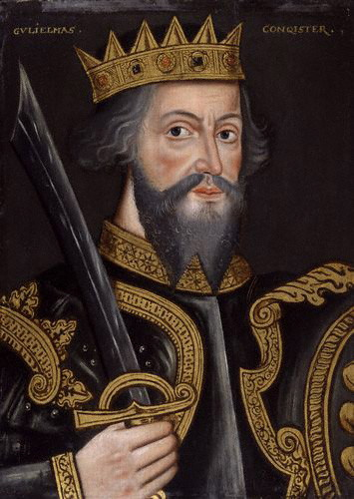
William I

Slide 4
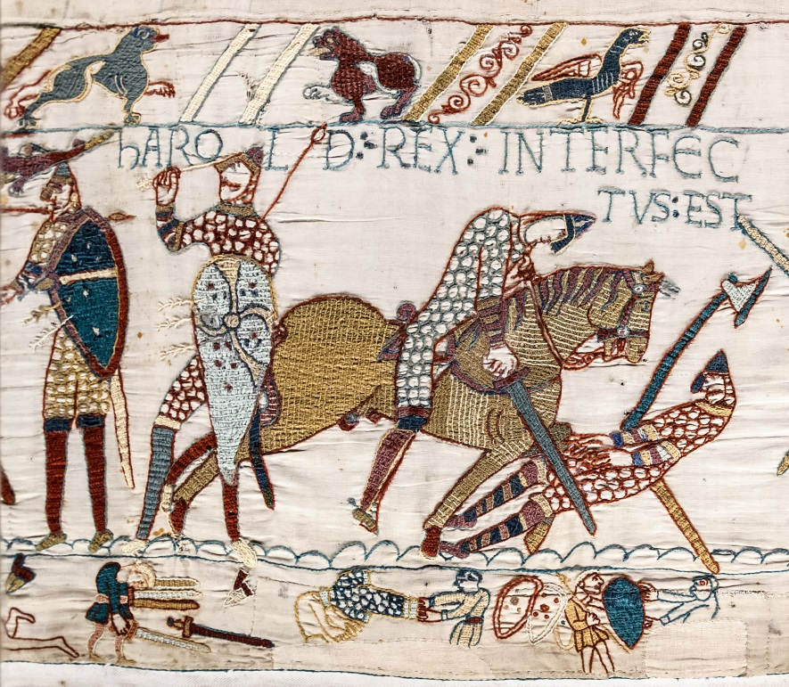
William I (the Conqueror) (1027-1087)
the king of England from 1066 to 1087
he was the Duke of Normandy, in northern France
invaded England and
defeated King Harold II
at the Battle of Hastings
in 1066
The Norman Conquest

Slide 5
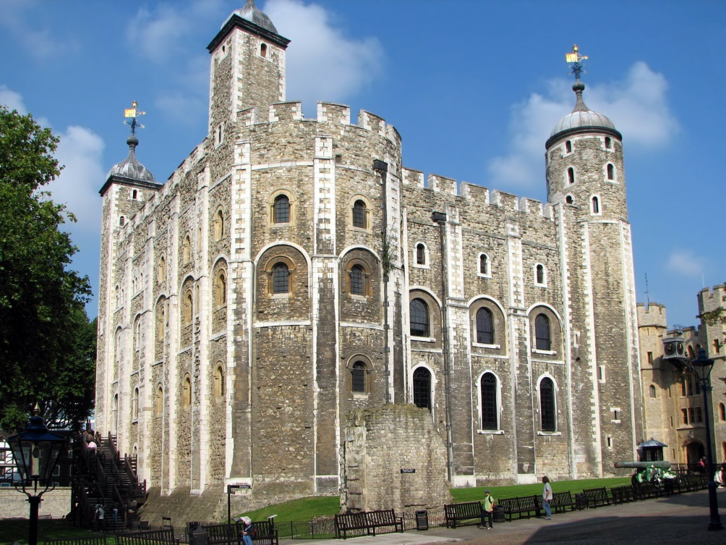
gave power and land in England to other Normans
built many castles to control the English people, e.g. The White Tower, a central tower
at the Tower of
London

Slide 6
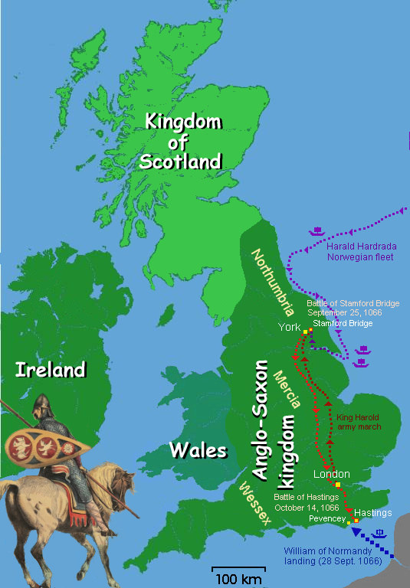
The Battle of Hastings
a famous battle in English history
1066
William the Conqueror defeated king Harold II and became King of England
fought near Hastings on the south coast of England

Slide 7
TASK 1: Answer the following questions about William the Conqueror:
Who was William the Conqueror?
What do you know about the Battle of Hastings?
Who did William defeat at that battle?
Where is Hastings?
What do we call the event of 1066 when the Normans defeated the English and took control of England?

Slide 8
TASK 2: Work in pairs and talk about William I. The following words can help you.
king
duke
battle
defeat
castle
power
invade
conquest

Slide 9
Zdroje
Oxford Guide to British and America Culture. Oxford University Press, 1999.
http://upload.wikimedia.org/wikipedia/commons/6/6e/William_the_Conqueror_by_an_unknown_artist_circa_1620.jpg. 29.6.2013
http://upload.wikimedia.org/wikipedia/commons/e/e7/Battle_of_Hastings_map.jpg. 29.6.2013
http://upload.wikimedia.org/wikipedia/commons/b/bb/Bayeux_Tapestry_scene57_Harold_death.jpg?uselang=cs. 29.6.2013
http://commons.wikimedia.org/wiki/File:Tower_of_London_White_Tower.jpg. 29.6.2013
Obrázky fungují jako hypertextové odkazy
Pokud ne, zdrojem je Microsoft Powerpoint Klipart
QUINION, Michael (1996). “Inkhorn terms: Invented words that didn't make it.” World Wide Words. <http://www.worldwidewords.org/articles/1.3.2009.

