Slide 1

Angličtina: Henry VIII
Tematická oblast | Angličtina: Významné osobnosti britské a americké historie
Datum vytvoření | 23.6.2013
Ročník | 3. - 4., septima – oktáva
Stručný obsah | Základní informace o Jindřichu VIII
Způsob využití | Snímky prezentují základní informace o králi Jindřichu VIII jako jedné z významných osobností britské historie. Součástí jsou kontrolní otázky a závěrečné shrnutí obsahu.
Autor | Mgr. Marie Gajzlerová
Kód | VY_32_INOVACE_02_AGAJ02
Gymnázium a Jazyková škola s právem státní jazykové zkoušky Zlín

Slide 2
Who is it?
It is a man
He was a king of England
He ruled in the 16th century
He was the second monarch of the Tudor dynasty
England became protestant during his reign
He had six wives and three children

Slide 3
HENRY VIII

Slide 4
Henry VIII (1491-1547)
one of the most famous of all English kings
had six wives
the Pope refused to give him permission for divorce
made himself head of the Church of England
the beginning of Protestantism in England

Slide 5
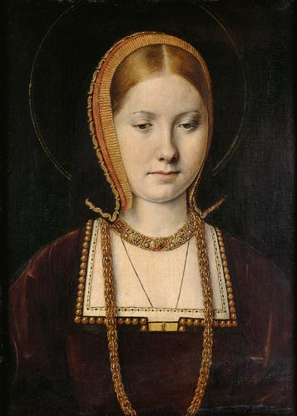
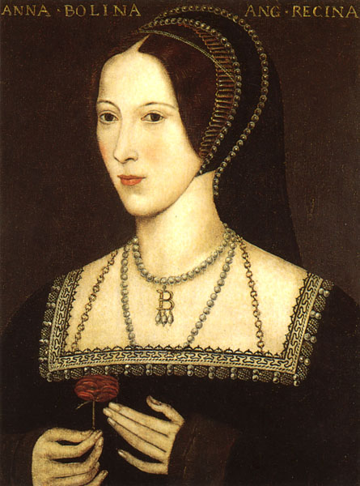
WIVES
Catherine of Aragon (divorced) →Mary I.
2. Anne Boleyn (executed)→Elizabeth I

Slide 6
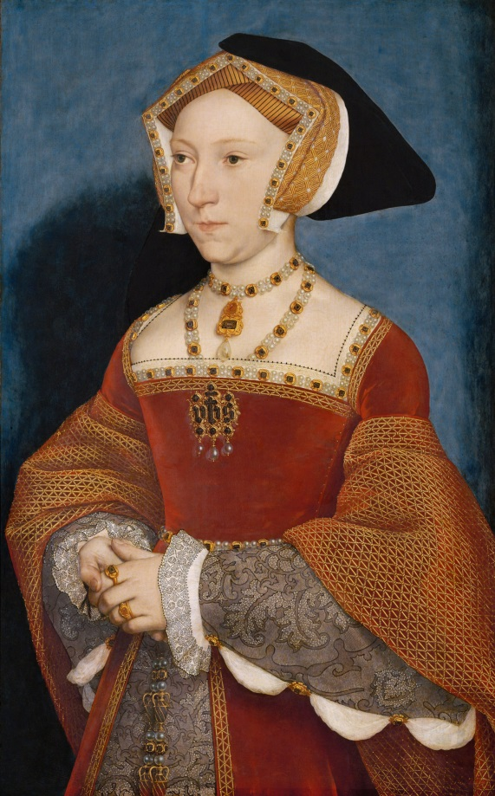
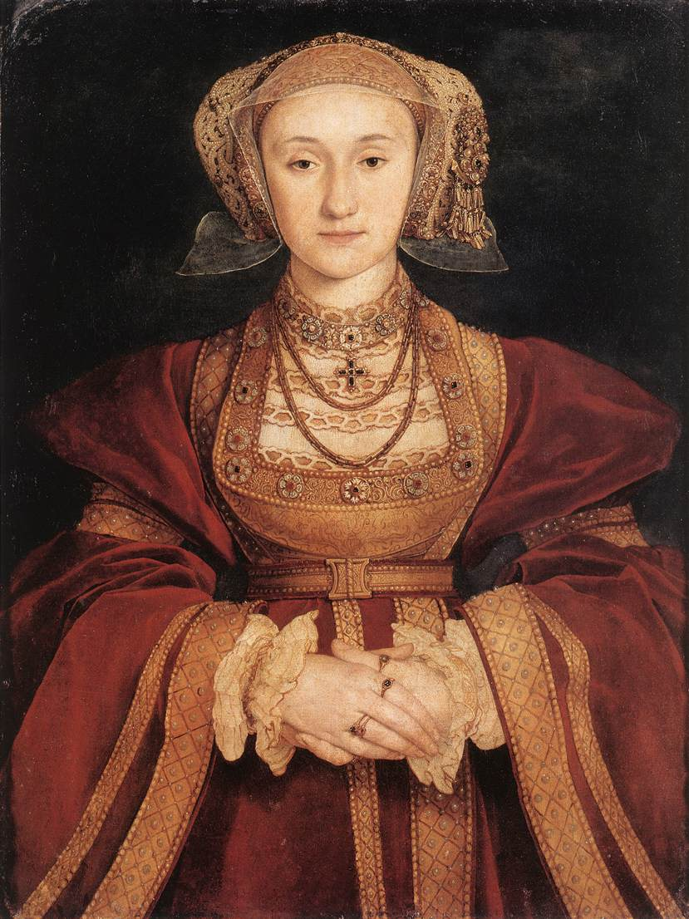
3. Jane Seymour (died)→ Edward VI
4. Anne of Cleves (divorced)

Slide 7
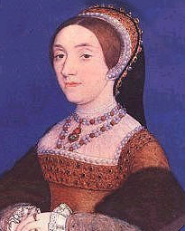
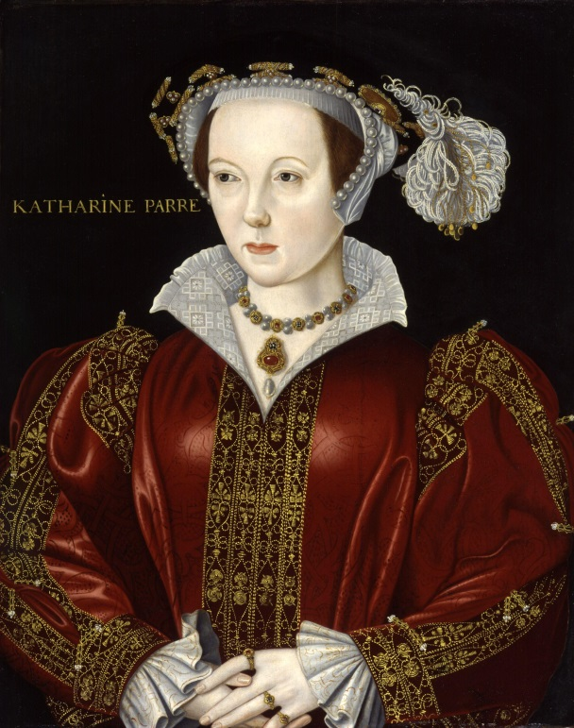
5. Catherine Howard (executed)
6. Catherine Parr (survived)

Slide 8
TASK 1: Answer the following questions about Henry VIII:
How many wives did Henry VIII have?
Who was his first wife?
Who was their child?
Why did Henry want to divorce her?
Did the Pope give him permission?
What did Henry do after the Pope´s decision?
Who was his second wife?
Who was their child?
How did this wife die?
Who was his third wife?
Who was their child?
Who were his fourth, fifth and sixth wives?

Slide 9
TASK 2: Work in pairs and talk about Henry VIII. The following words can help you.
king
wives
marry
divorce
Pope
permission
refuse
Protestantism
dynasty
execute

Slide 10
Zdroje
Oxford Guide to British and America Culture. Oxford University Press, 1999.
http://upload.wikimedia.org/wikipedia/commons/0/0e/Anneboleyn2.jpg. 23.6.2013
http://upload.wikimedia.org/wikipedia/commons/b/b0/Michel_Sittow_002.jpg. 23.6.2013
http://upload.wikimedia.org/wikipedia/commons/6/68/Hans_Holbein_d._J._032b.jpg. 23.6.2013
http://upload.wikimedia.org/wikipedia/commons/5/54/AnneCleves.jpg. 23.6.2013
http://upload.wikimedia.org/wikipedia/commons/3/32/HowardCatherine02.jpeg. 23.6.2013
http://upload.wikimedia.org/wikipedia/commons/4/49/Catherine_Parr_from_NPG.jpg. 23.6.2013
Obrázky fungují jako hypertextové odkazy
Pokud ne, zdrojem je Microsoft Powerpoint Klipart

