Slide 1

Angličtina: Queen Elizabeth I
Tematická oblast | Angličtina: Významné osobnosti britské a americké historie
Datum vytvoření | 24.6.2013
Ročník | 3. - 4., septima – oktáva
Stručný obsah | Základní informace o královně Alžbětě I
Způsob využití | Snímky prezentují základní informace o královně Alžbětě jako jedné z významných osobností britské historie. Součástí jsou kontrolní otázky a závěrečné shrnutí obsahu.
Autor | Mgr. Marie Gajzlerová
Kód | VY_32_INOVACE_02_AGAJ04
Gymnázium a Jazyková škola s právem státní jazykové zkoušky Zlín

Slide 2
Who is it?
It is a woman
She ruled in the 16th century
William Shakespeare lived at that time
She never got married
She is called the “Virgin Queen“
The country became firmly protestant during her reign
Her sister was Mary I
She is the daughter of Henry VIII and Anne Boleyn

Slide 3
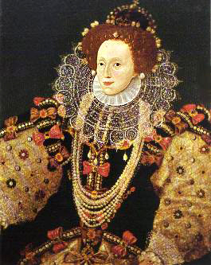
ELIZABETH I

Slide 4
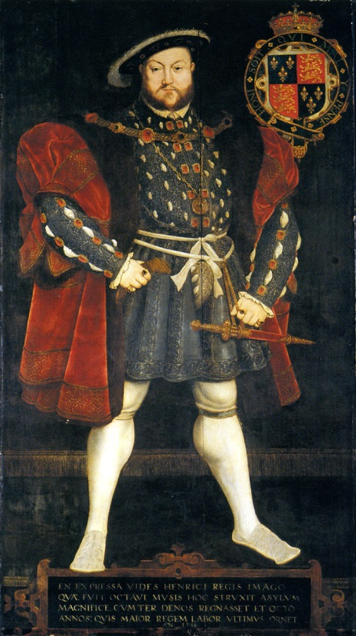
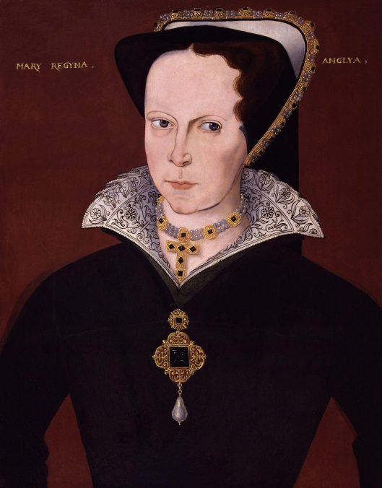
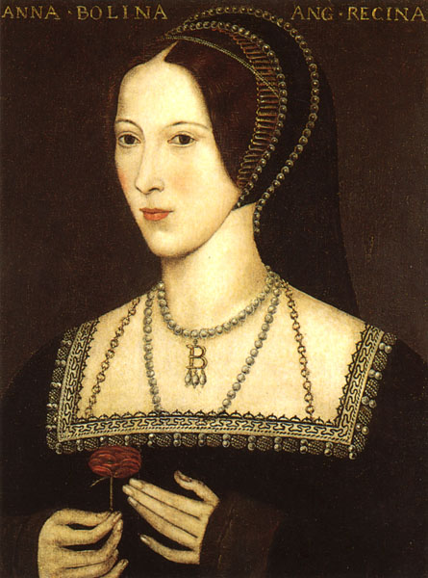
Elizabeth I
(1533-1603)
queen of England and Ireland after the death of her sister Mary I
Tudor dynasty
daughter of King Henry VIII and Anne Boleyn
MARY I ANNE BOLEYN HENRY VIII

Slide 5
strong and clever woman
controlled the difficult political and religious situation of the time with great skill
the country´s economy grew very strong
England became firmly Protestant
known as the “Virgin Queen“
Virginia named after her
William Shakespeare

Slide 6
TASK 1:
Answer the following questions about Queen Elizabeth I:
Which century did Elizabeth I rule?
Who were her parents?
Who was her sister?
Was she successful queen?
Which dynasty does she belong to?
Which famous author lived at that time?
What was her nickname?
Why was she called like that?
Which state in the USA was named after her?

Slide 7
TASK 2:
Work in pairs and talk about Queen Elizabeth I. The following words can help you.
queen
sister
father
mother
successful
Shakespeare
virgin
Protestant
dynasty
century

Slide 8
Zdroje
Oxford Guide to British and America Culture. Oxford University Press, 1999.
http://commons.wikimedia.org/wiki/File:Eliza1.JPG. 23.6.2013.
http://commons.wikimedia.org/wiki/File:Holbein_henry8_full_length.jpg. 23.6.2013
http://commons.wikimedia.org/wiki/File:Queen_Mary_I_from_NPG.jpg. 23.6.2013
http://commons.wikimedia.org/wiki/File:Anneboleyn2.jpg. 23.6.2013
Obrázky fungují jako hypertextové odkazy
Pokud ne, zdrojem je Microsoft Powerpoint Klipart
QUINION, Michael (1996). “Inkhorn terms: Invented words that didn't make it.” World Wide Words. <http://www.worldwidewords.org/articles/1.3.2009.

