Slide 1

Angličtina: James I
Tematická oblast | Angličtina: Významné osobnosti britské a americké historie
Datum vytvoření | 30.6.2013
Ročník | 3. - 4., septima – oktáva
Stručný obsah | Základní informace o králi Jakubu I
Způsob využití | Snímky prezentují základní informace o králi Jakubu I jako jedné z významných osobností britské historie. Součástí jsou kontrolní otázky a závěrečné shrnutí obsahu.
Autor | Mgr. Marie Gajzlerová
Kód | VY_32_INOVACE_02_AGAJ05
Gymnázium a Jazyková škola s právem státní jazykové zkoušky Zlín

Slide 2
Who is it?
It is a man
He was the king of England and of Scotland
His mother was Mary Queen of Scots
He was a relative of Elizabeth I
He was not a popular king in England and Roman Catholic opposition led to the Gunpowder Plot
He belongs to the Stuart dynasty

Slide 3
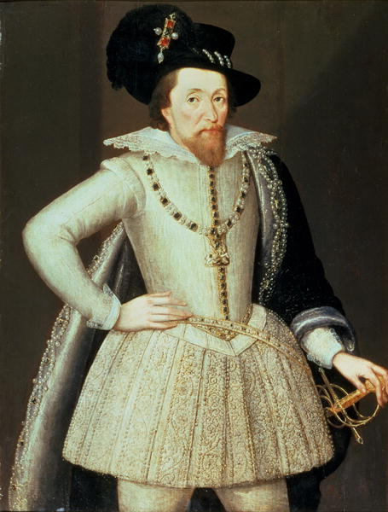
James I

Slide 4
James I (1566-1625)
the king of England from 1603 to 1625
the king of Scotland (as James VI) from 1567 to 1625
his mother was Mary Queen of Scots
as a relative of Elizabeth I he became King of England after she died, uniting England and Scotland under one government
the House of Stuart

Slide 5
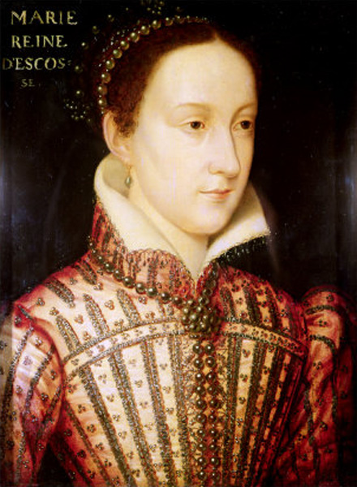
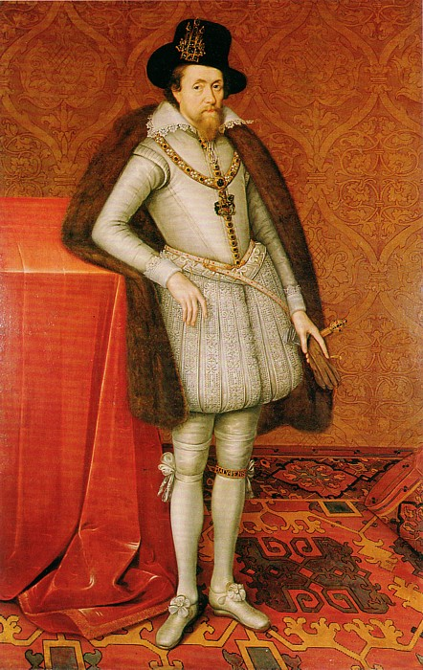
Mary Queen of Scots, his mother
James I

Slide 6
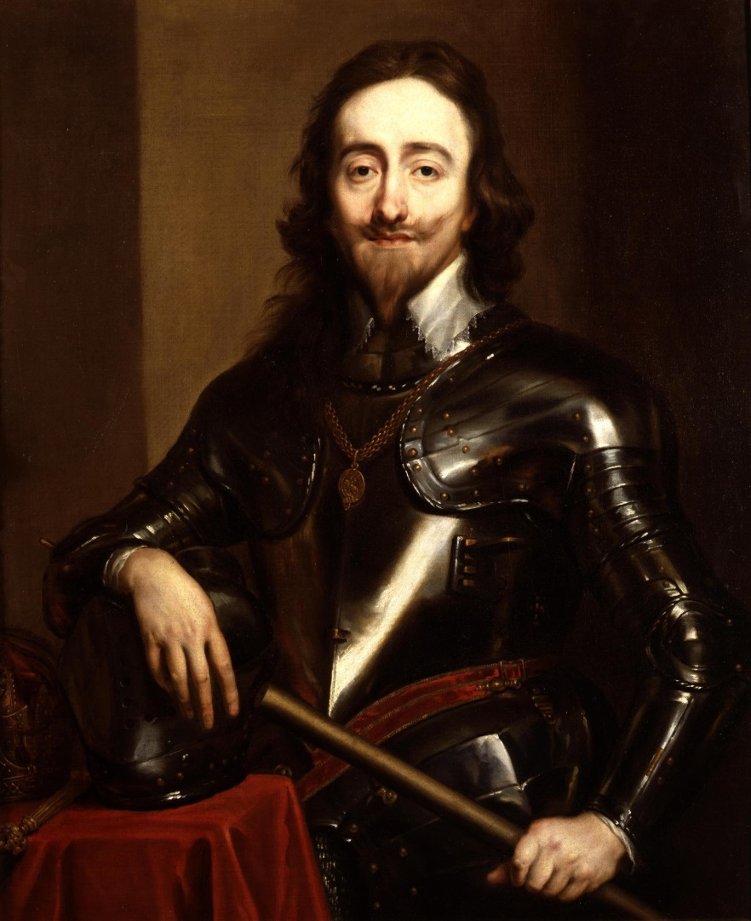
His son Charles I became king after James died

Slide 7
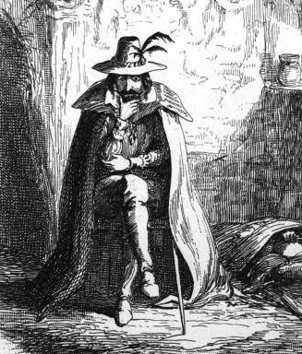
The Gunpowder Plot
A secret plan by a group of Roman Catholics to blow up the Houses of Parliament and kill King James I in 1605.
They put gunpowder in the cellars
before the opening of Parliament
by the King on 5 November.
The plan was revealed and one
of the group, Guy Fawkes, was
jailed and his body was quartered.
His companions were arrested and executed.

Slide 8
TASK 1: Answer the following questions about James I:
Which century did he live?
Who was his mother?
Which dynasty does he belong to?
Who was his son?
Why did he become the King of England?
What is the Gunpowder Plot?

Slide 9
TASK 2: Work in pairs and talk about James I. The following words can help you.
king
dynasty
century
relative
mother
plot
gunpowder
arrest

Slide 10
Zdroje
Oxford Guide to British and America Culture. Oxford University Press, 1999.
Obrázky fungují jako hypertextové odkazy
Pokud ne, zdrojem je Microsoft Powerpoint Klipart
http://upload.wikimedia.org/wikipedia/commons/4/43/James_VI_and_I_%28dressed_in_white%29.jpg. 30.6.2013
http://upload.wikimedia.org/wikipedia/commons/4/46/Charles_I_%281630s%29.jpg. 30.6.2013
http://upload.wikimedia.org/wikipedia/commons/1/1f/Mary_Stuart_Queen.jpg. 30.6.2013
http://upload.wikimedia.org/wikipedia/commons/d/dc/James_I%2C_VI_by_John_de_Critz%2C_c.1606..png. 30.6.2013
http://upload.wikimedia.org/wikipedia/commons/d/d0/Guy_Fawkes_by_Cruikshank.jpg. 30.6.2013
QUINION, Michael (1996). “Inkhorn terms: Invented words that didn't make

