Slide 1

Angličtina: Queen Victoria
Tematická oblast | Angličtina: Významné osobnosti britské a americké historie
Datum vytvoření | 23.6.2013
Ročník | 3. - 4., septima – oktáva
Stručný obsah | Základní informace o královně Viktorii
Způsob využití | Snímky prezentují základní informace o královně Viktorii jako jedné z významných osobností britské historie. Součástí jsou kontrolní otázky a závěrečné shrnutí obsahu.
Autor | Mgr. Marie Gajzlerová
Kód | VY_32_INOVACE_02_AGAJ08
Gymnázium a Jazyková škola s právem státní jazykové zkoušky Zlín

Slide 2
Who is it?
It is a woman
She ruled in the 19th century
Her rule was the longest of any British king or queen
During her reign Britain became the dominant political and industrial power of the world
Her husband was Prince Albert
She had nine children

Slide 3
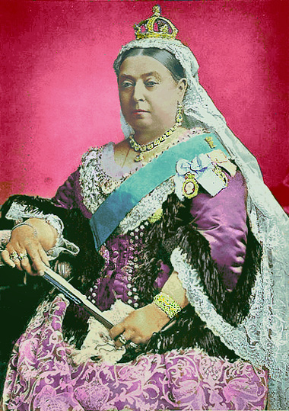
VICTORIA

Slide 4
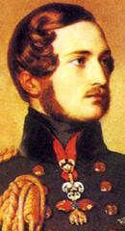
Victoria (1819-1901)
ruled the longest of any British king or queen,
from 1837 to 1901
married her cousin Prince Albert of
Saxe-Coburg-Gotha
nine children
the Empress of India
Albert died at the age of 42→Victoria took
no further part in public affairs
remembered as a bad-tempered old woman
in her early life - a happy and enthusiastic queen, popular with ordinary people.
Charles Dickens

Slide 5
The Victorian Age
It was a time of tremendous change in the lives of all Britons.
Britain became the most powerful country in the world with the largest Empire that had ever existed.
Britain ruled one fifth of the world´s surface and one quarter of the people.
Britain´s greatest period of world power and industrial development.

Slide 6
Industrial revolution
began in 1750
Britain developed from agriculture society into an industrial nation
Industry had a great effect on British social and economic life
People moved from the countryside to work in the rapidly growing cities

Slide 7
TASK 1: Answer the following questions about Queen Victoria:
How long did the queen Victoria rule?
How many children did she have?
Who was her husband?
What was queen Victoria like?
Which famous author lived in the Victorian Age?
Was the British Empire big at that time?
What do you know about the Victorian Age?
When did the Industrial revolution start?
How did Britain change during that time?

Slide 8
TASK 2: Work in pairs and talk about Queen Victoria. The following words can help you.
queen
husband
children
change
industrial development
world power
rule
title

Slide 9
Zdroje
Oxford Guide to British and America Culture. Oxford University Press, 1999.
Obrázky fungují jako hypertextové odkazy
Pokud ne, zdrojem je Microsoft Powerpoint Klipart
http://commons.wikimedia.org/wiki/File:Queen_Victoria_Golden_Jubilee.jpg. 23.6.2013
http://upload.wikimedia.org/wikipedia/commons/a/a0/Prince_albert.jpg. 23.6.2013
http://commons.wikimedia.org/whttp://commons.wikimedia.org/wiki/File:Queen_Victoria_Golden_Jubilee.jpgiki/File:Queen_Victoria_Golden_Jubilee.jpghttp://commons.wikimedia.org/wiki/File:Queen_Victoria_Golden_Jubilee.jpghttp://commons.wikimedia.org/wiki/File:Queen_Victoria_Golden_Jubilee.jpghttp://commons.wikimedia.org/wiki/File:Queen_Victoria_Golden_Jubilee.jpg>>>
http://commons.wikimedia.org/wiki/File:Queen_Victoria_Golden_Jubilee.jpg

