Slide 1

Angličtina: Horatio Nelson
Tematická oblast | Angličtina: Významné osobnosti britské a americké historie
Datum vytvoření | 30.6.2013
Ročník | 3. - 4., septima – oktáva
Stručný obsah | Základní informace o admirálu Horatio Nelsonovi
Způsob využití | Snímky prezentují základní informace o admirálu Horatio Nelsonovi jako jedné z významných osobností britské historie. Součástí jsou kontrolní otázky a závěrečné shrnutí obsahu.
Autor | Mgr. Marie Gajzlerová
Kód | VY_32_INOVACE_02_AGAJ09
Gymnázium a Jazyková škola s právem státní jazykové zkoušky Zlín

Slide 2
Who is it?
It is a man
He was a national hero
He was an English admiral
He became famous for winning a number of sea battles against the French in the 1790s
He lost his right arm and right eye in different battles
His most famous victory was at Cape Trafalgar in 1805

Slide 3
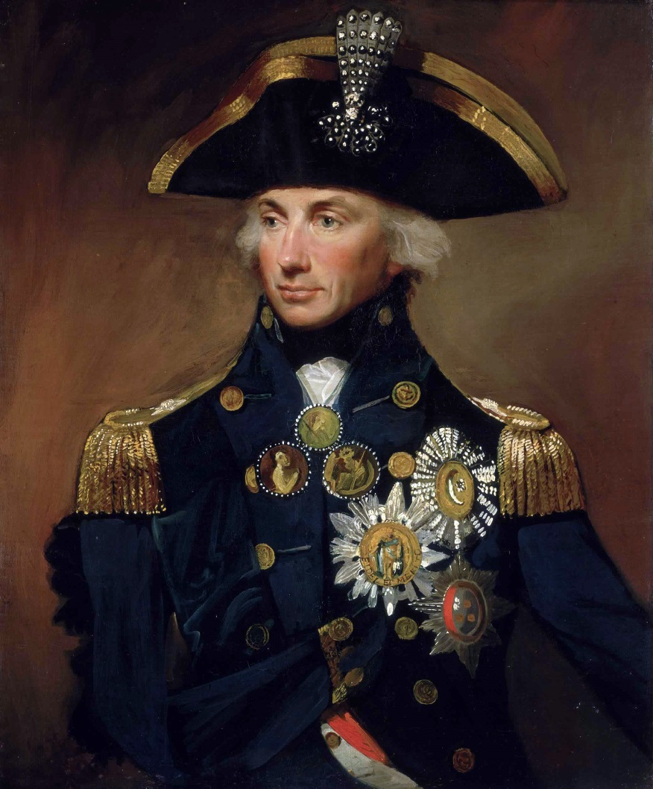
Horatio Nelson

Slide 4
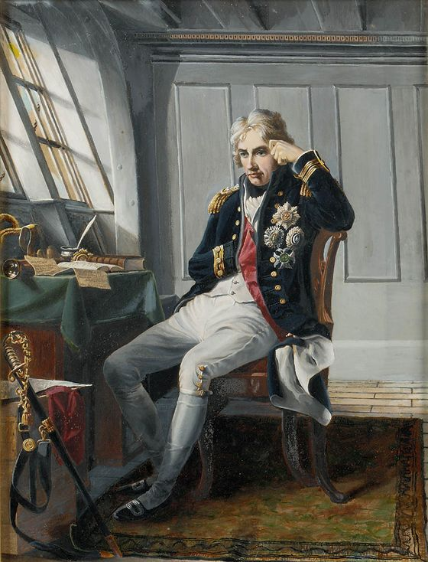
Horatio Nelson (1758-1805)
was a British admiral famous for his service in the Royal Navy, particularly during
the Napoleonic Wars
won a number of sea battles
against the French in the 1790s
his victories strengthened
British military power at sea
and prevented Napoleon´s forces
attacking Britain
he was made a viscount in 1801

Slide 5
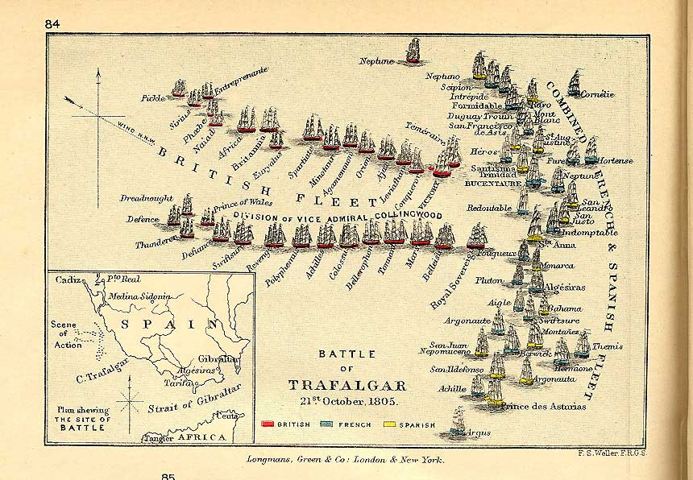
he was wounded several times in combat, losing one arm and the sight in one eye
of his several victories, the best known and most notable was the Battle of Trafalgar in 1805, during which he was shot and killed

Slide 6
The Battle of Trafalgar
an important sea battle in 1805
the English commanded by lord Nelson defeated both the French and the Spanish
it was fought near Cape Trafalgar, in south-west Spain, during Napoleonic Wars
Nelson was badly wounded on his ship, HMS Victory
the victory established Britain as the world´s leading power at sea for many years

Slide 7
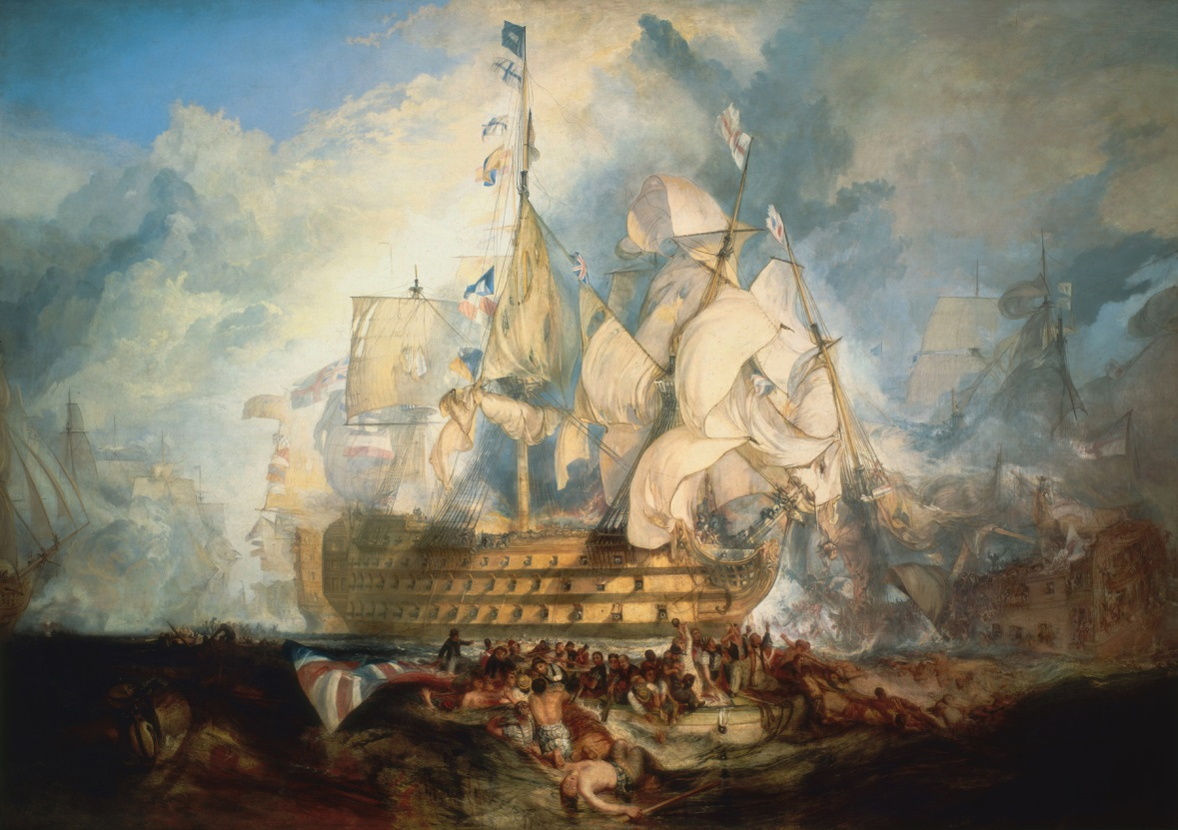
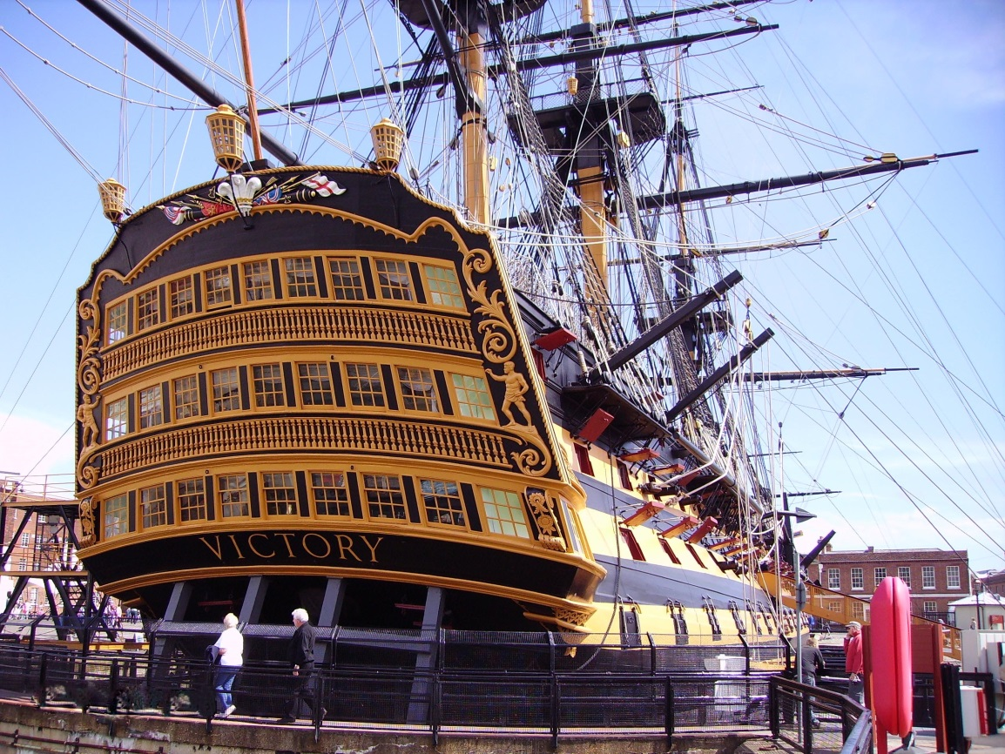
HMS Victory the Battle of Trafalgar
HMS Victory

Slide 8
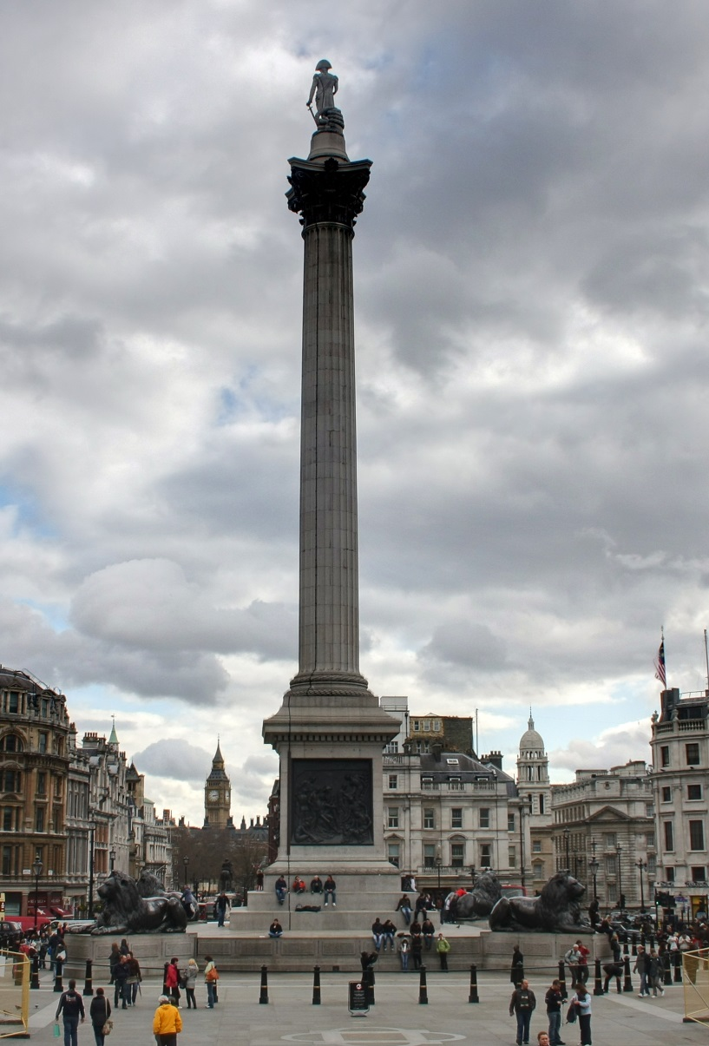
Trafalgar Square
a large square in central London
it was named in honour of Lord Nelson´s victory at the Battle of Trafalgar
Nelson´s Column is in the centre of the square

Slide 9
TASK 1: Answer the following questions about Horatio Nelson:
Who was Horatio Nelson?
How did he become famous?
What was his most famous victory?
Where was the Battle of Trafalgar fought?
Who did Nelson fight against in this battle?
How did the battle end?
What is the name of his famous ship?
What happened to Admiral Nelson at the Battle of Trafalgar?

Slide 10
TASK 2: Work in pairs and talk about Horatio Nelson. The following words can help you.
admiral
hero
battle
victory
square
column
ship
wound

Slide 11
Zdroje
Oxford Guide to British and America Culture. Oxford University Press, 1999.
Obrázky fungují jako hypertextové odkazy
Pokud ne, zdrojem je Microsoft Powerpoint Klipart
http://upload.wikimedia.org/wikipedia/commons/7/72/HoratioNelson1.jpg. 30.6.2013
http://upload.wikimedia.org/wikipedia/commons/f/f6/Lord_Nelson_before_Trafalgar.jpg. 30.6.2013
http://upload.wikimedia.org/wikipedia/commons/2/29/Turner%2C_The_Battle_of_Trafalgar_%281822%29.jpg. 30.6.2013
http://upload.wikimedia.org/wikipedia/commons/1/1a/HMSVictory.jpg. 30.6.2013
http://upload.wikimedia.org/wikipedia/commons/5/5b/TrafalgarBattle.jpg. 30.6.2013
http://upload.wikimedia.org/wikipedia/commons/e/e6/Trafalgar_Square-2.jpg?uselang=cs. 30.6.2013
http://didn't make

