Slide 1

Angličtina: Winston Churchill
Tematická oblast | Angličtina: Významné osobnosti britské a americké historie
Datum vytvoření | 29.6.2013
Ročník | 3. - 4., septima – oktáva
Stručný obsah | Základní informace o Winstonu Churchillovi
Způsob využití | Snímky prezentují základní informace o Winstonu Churchillovi jako jedné z významných osobností britské historie. Součástí jsou kontrolní otázky a závěrečné shrnutí obsahu.
Autor | Mgr. Marie Gajzlerová
Kód | VY_32_INOVACE_02_AGAJ10
Gymnázium a Jazyková škola s právem státní jazykové zkoušky Zlín

Slide 2
Who is it?
It is a man
He was a politician
He was one of the Britain´s greatest statesman
He became Prime Minister
He was made a knight
He won the Nobel Prize for literature
He was famous for smoking a large cigar and making a V-sign for “victory“
He was referred to as “Winnie“

Slide 3
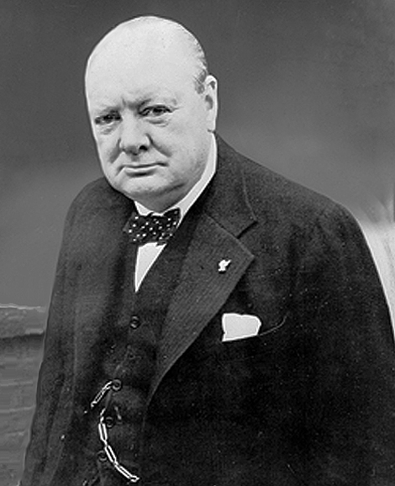
Winston Churchill

Slide 4
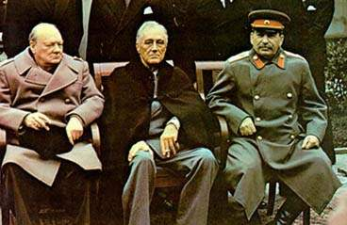
Sir Winston Churchill (1874-1965)
a British politician
known chiefly for his leadership of the United Kingdom during World War II
served as Prime Minister of the United Kingdom from 1940 to 1945 and again from 1951 to 1955
refused to surrender to
the Nazis
Yalta Conference 1945 – W. Churchill, F.D.Roosevelt, J.Stalin

Slide 5
Churchill was…
a statesman
an officer in the British Army
a historical writer
a journalist
an artist
a Member of Parliament
Minister of Defence
Prime Minister

Slide 6
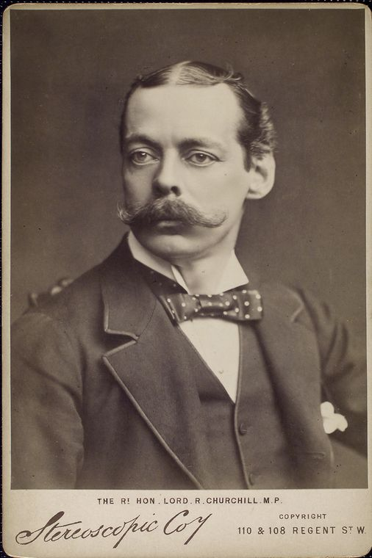
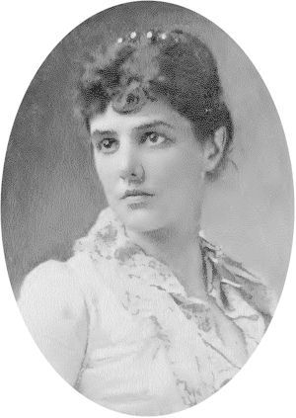
Winston Leonard Spencer Churchill´s parents
Lord Randolph Churchill, father (British)
Jennie Jerome, Lady Randolph Churchill, mother (American)

Slide 7
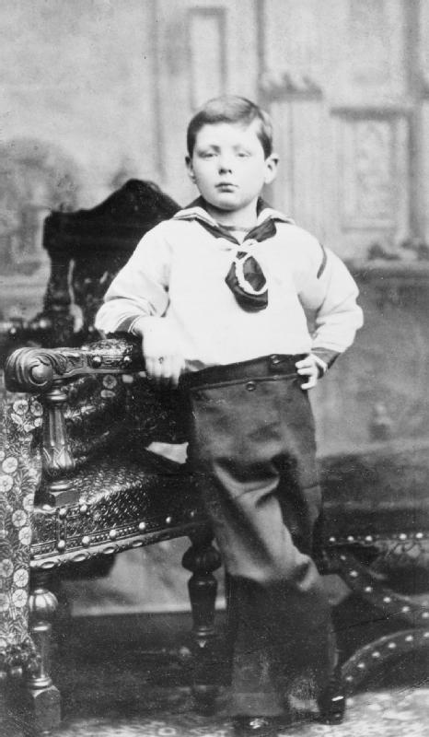
Winston Churchill as a young boy, aged 7

Slide 8
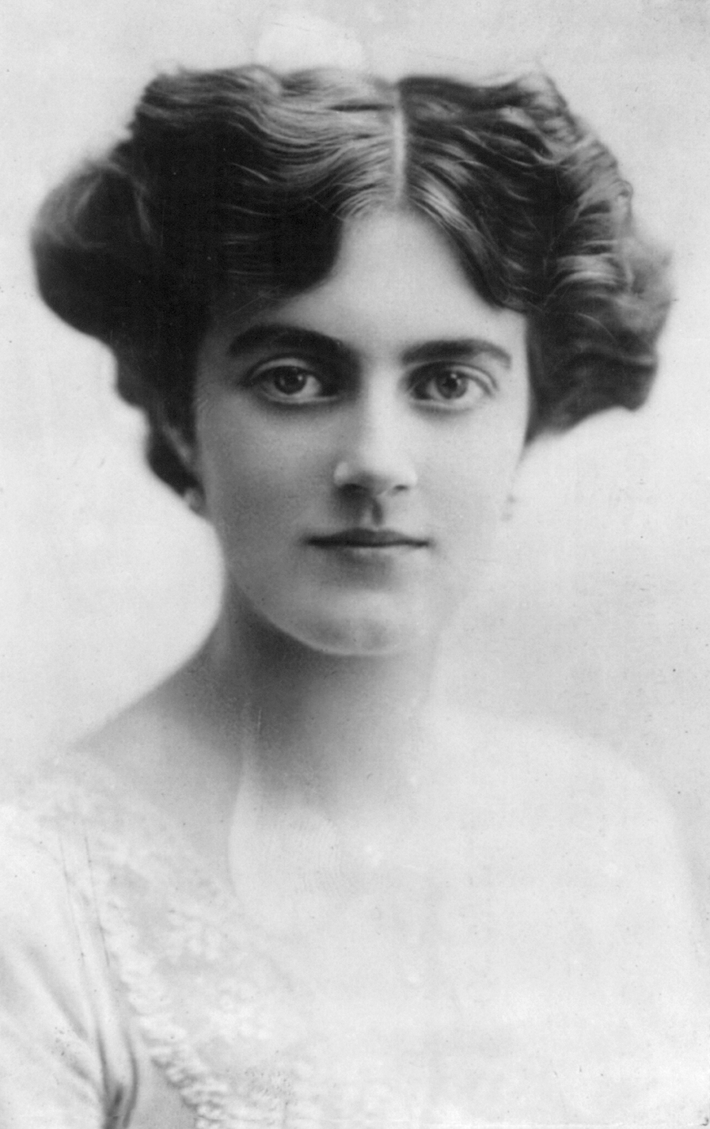
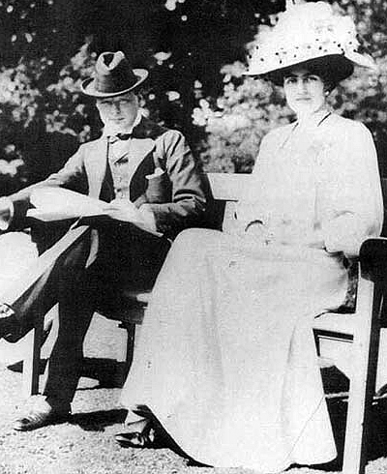
Winston Churchill with fiancée Clementine Hozier shortly before their marriage in 1908
Clementine Churchill

Slide 9
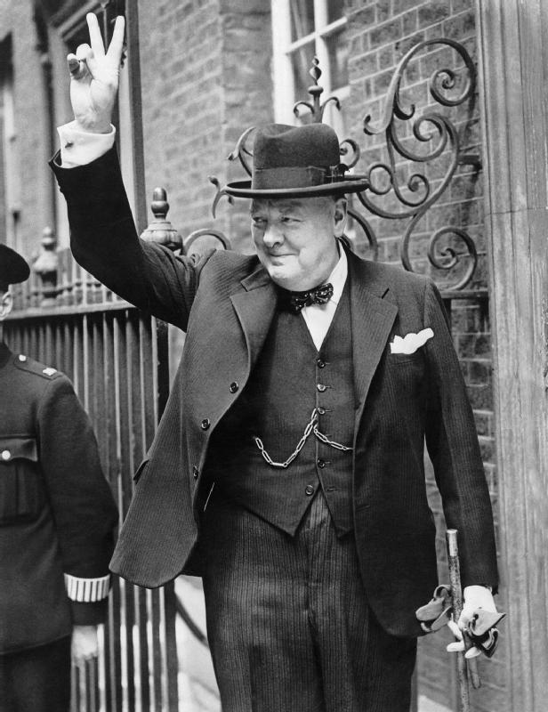
Churchill is famous for
smoking a large cigar
making a V-sign for “victory“
quotes

Slide 10
Winston Churchill´s quotes
“We make a living by what we get, but we make a life by what we give.“
“If you are going to go through hell, keep going.“
“The problems of victory are more agreeable than those of defeat, but they are no less difficult.“
Nancy Astor: “Sir, if you were my husband, I would give you poison.” Churchill: “If I were your husband I would take it.”
“I would say to the House, as I said to those who have joined this government: I have nothing to offer but blood, toil, tears and sweat.”

Slide 11
TASK 1: Answer the following questions about Winston Churchill:
Who was Winston Churchill?
What is he famous for?
Do you remember any of his famous quotes?
Were both of his parents British?
What was the name of his wife?

Slide 12
TASK 2: Work in pairs and talk about Winston Churchill. The following words can help you.
statesman
quotes
cigar
V-sign
Prime minister
World War II
surrender
leadership

Slide 13
Zdroje
Oxford Guide to British and America Culture. Oxford University Press, 1999.
Obrázky fungují jako hypertextové odkazy
Pokud ne, zdrojem je Microsoft Powerpoint Klipart
http://upload.wikimedia.org/wikipedia/commons/f/fc/Clementine_Churchill_1915.jpg?uselang=cs. 29.6.2013
http://upload.wikimedia.org/wikipedia/commons/8/87/Winston_Churchill_%281874-1965%29_with_fianc%C3%A9e_Clementine_Hozier_%281885-1977%29_shortly_before_their_marriage_in_1908.jpg?uselang=cs. 29.6.2013
http://upload.wikimedia.org/wikipedia/commons/a/ae/Randolph_churchill_nypl.jpeg. 29.6.2013
http://upload.wikimedia.org/wikipedia/commons/9/97/Jennie_Jerome%2C_Lady_Randolph_Churchill.jpg. 29.6.2013

Slide 14
http://upload.wikimedia.org/wikipedia/commons/8/82/Churchill_1881_ZZZ_7555D.jpg. 29.6.2013
http://upload.wikimedia.org/wikipedia/commons/3/35/Churchill_portrait_NYP_45063.jpg. 29.6.2013
http://upload.wikimedia.org/wikipedia/commons/c/cd/Churchill_V_sign_HU_55521.jpg. 29.6.2013
http://jpetrie.myweb.uga.edu/bulldog.html. 29.6.2013
http://upload.wikimedia.org/wikipedia/commons/b/b0/Yalta_summit_1945_with_Churchill%2C_Roosevelt%2C_Stalin_tight_crop.jpg. 29.6.2013

