Slide 1

Angličtina: Christopher Columbus
Tematická oblast | Angličtina: Významné osobnosti britské a americké historie
Datum vytvoření | 2.7.2013
Ročník | 3. - 4., septima – oktáva
Stručný obsah | Základní informace o Kryštofu Kolumbovi
Způsob využití | Snímky prezentují základní informace o Kryštofu Kolumbovi jako jedné z významných osobností americké historie. Součástí jsou kontrolní otázky a závěrečné shrnutí obsahu.
Autor | Mgr. Marie Gajzlerová
Kód | VY_32_INOVACE_02_AGAJ11
Gymnázium a Jazyková škola s právem státní jazykové zkoušky Zlín

Slide 2
Who is it?
It is a man
He was the Italian explorer
He was the first European to discover America
He thought he had found the coast of Asia and continued to believe this for the rest of his life

Slide 3
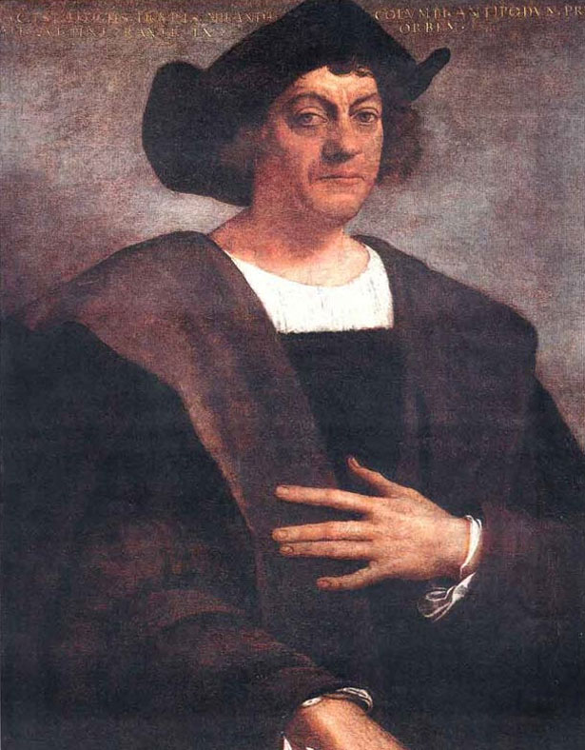
Christopher Columbus

Slide 4
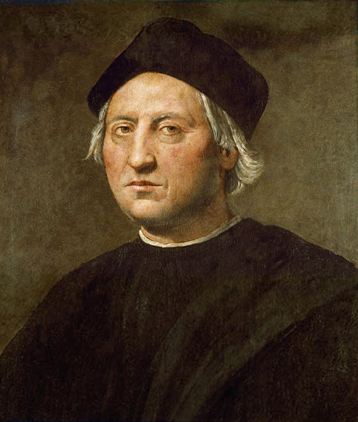
Christopher Columbus (1451-1506)
the Italian explorer
the first European to discover America in 1492
persuaded King Ferdinand and Queen Isabella of Spain to pay for his attempt to
find a new route to Asia by
crossing the Atlantic Ocean
reached the Bahamas but thought
he had found the coast of Asia

Slide 5
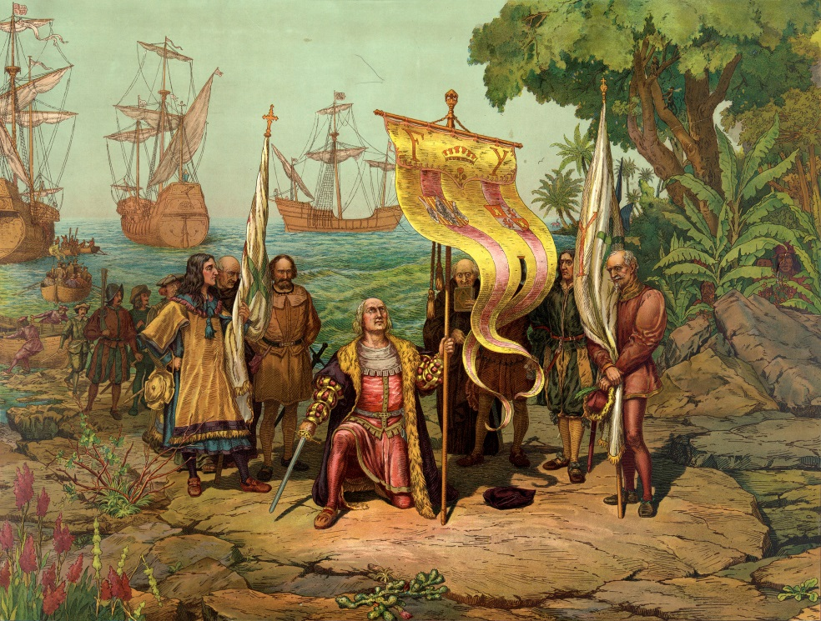
never realized that in fact he had discovered a continent between Europe and Asia
called the native people “Indians“
made three more journeys to America → not successful → lost
favour and died in
poverty
Christopher Columbus
arrives in America

Slide 6
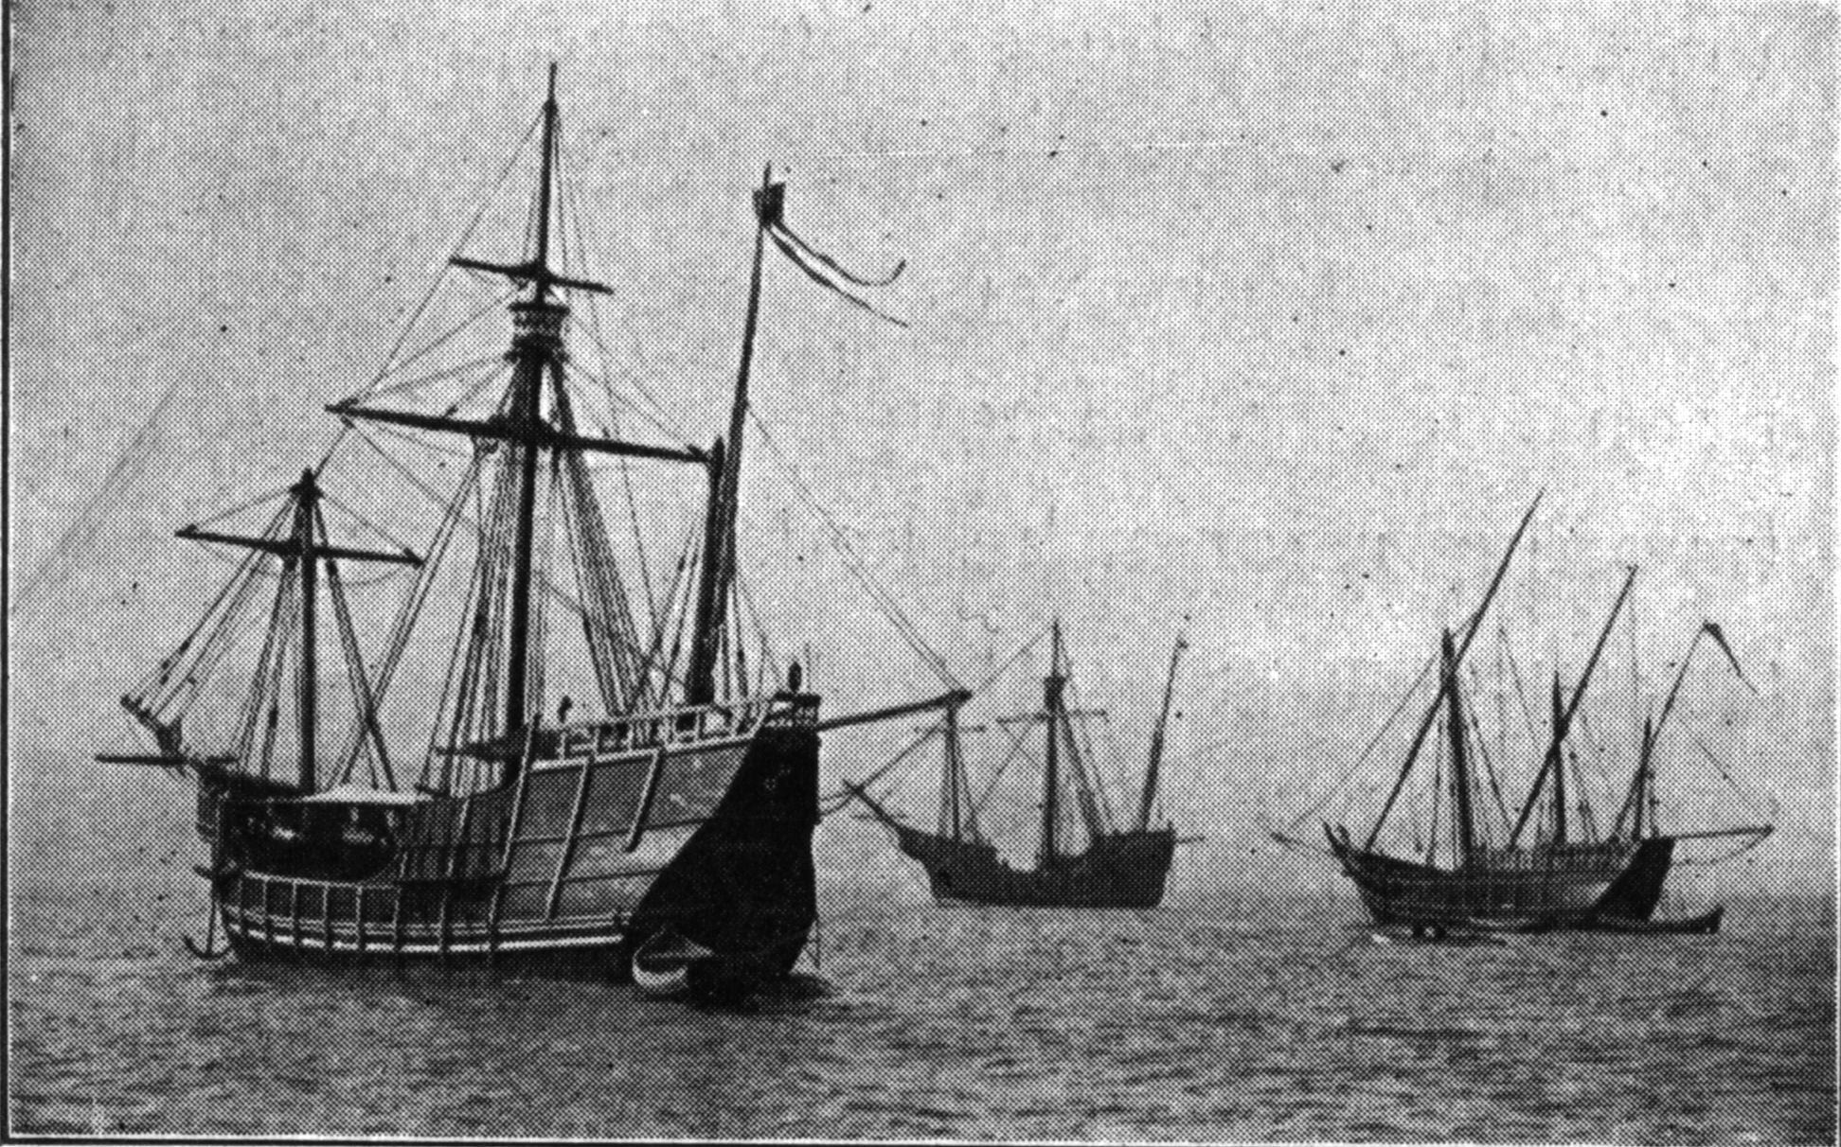
Columbus´s ships
Nina
Pinta
Santa Maria

Slide 7
TASK 1: Answer the following questions about Christopher Columbus:
What nationality was Columbus?
Who financed his journey?
When did he start his voyage?
Where did he want to go?
Where did he arrive?
Did he realize that he arrived in America?
How many journeys did he make?
What are the names of his ships?
Was he famous when he died?

Slide 8
TASK 2: Work in pairs and talk about Christopher Columbus. The following words can help you.
explorer
route
voyage
arrive
ship
Indians
discover
journey

Slide 9
Zdroje
Oxford Guide to British and America Culture. Oxford University Press, 1999.
Obrázky fungují jako hypertextové odkazy
Pokud ne, zdrojem je Microsoft Powerpoint Klipart
http://upload.wikimedia.org/wikipedia/commons/0/06/CristobalColon.jpg. 2.7.2013
http://upload.wikimedia.org/wikipedia/commons/1/14/Ridolfo_Ghirlandaio_Columbus.jpg. 2.7.2013
http://upload.wikimedia.org/wikipedia/commons/9/95/Columbus_Taking_Possession.jpg. 2.7.2013
http://upload.wikimedia.org/wikipedia/commons/f/f7/1893_Nina_Pinta_Santa_Maria_replicas.jpg. 2.7.2013

