Slide 1

Angličtina: George Washington
Tematická oblast | Angličtina: Významné osobnosti britské a americké historie
Datum vytvoření | 4.7.2013
Ročník | 3. - 4., septima – oktáva
Stručný obsah | Základní informace o Georgi Washingtonovi
Způsob využití | Snímky prezentují základní informace o Georgi Washingtonovi jako jedné z významných osobností americké historie. Součástí jsou kontrolní otázky a závěrečné shrnutí obsahu.
Autor | Mgr. Marie Gajzlerová
Kód | VY_32_INOVACE_02_AGAJ12
Gymnázium a Jazyková škola s právem státní jazykové zkoušky Zlín

Slide 2
Who is it?
It is a man
He is called “the Father of His Country“
He was the commander-in-chief of the Continental Army during the American Revolutionary War
He was one of the Founding Fathers of the United States
He was the 1st American President

Slide 3
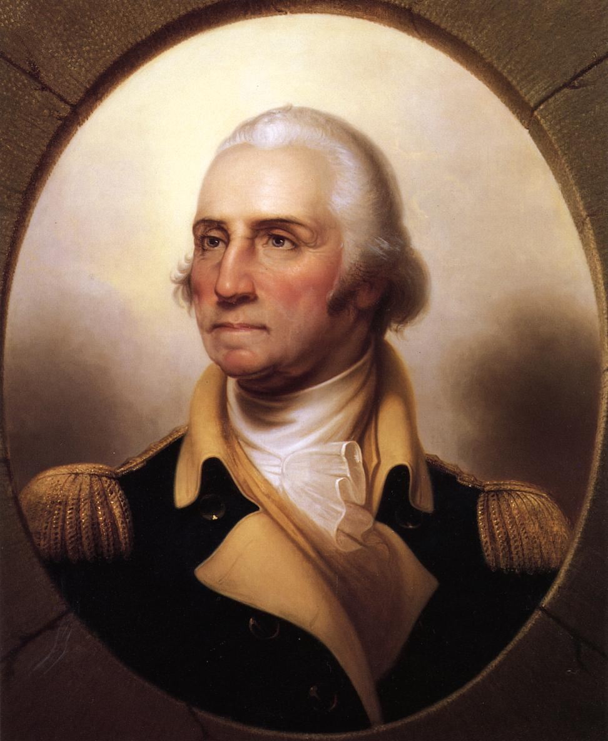
George Washington

Slide 4
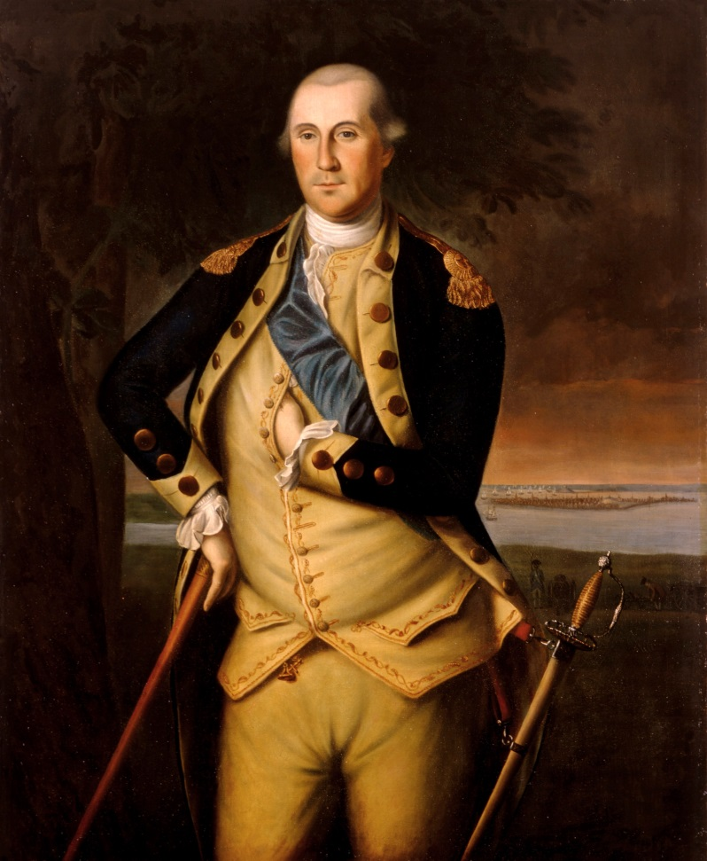
George Washington (1732-99)
the first US President (1789-97)
he served two terms in office, refused to stand as a candidate for a third time
chosen by the Continental
Congress in 1775 to be
commander-in-chief of
the Continental Army in
the American Revolution
gave his important approval
for the American Constitution

Slide 5
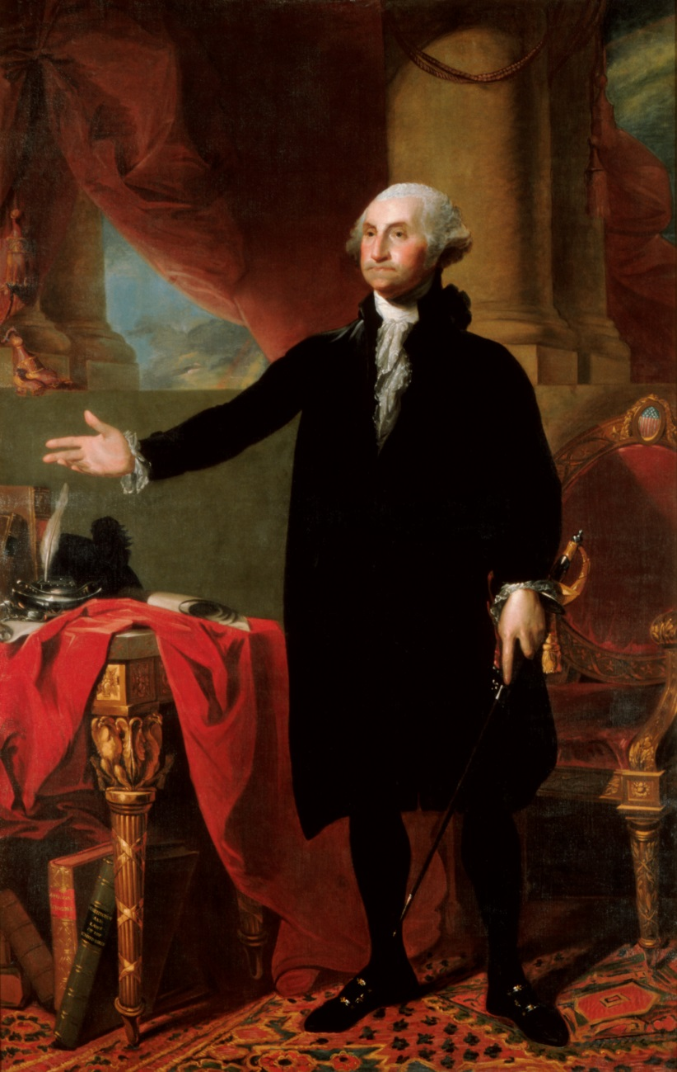
retired from the presidency in 1797 and returned to his home, Mount Vernon
his memory is honoured by the Washington Monument and the names of the country´s capital city, a state, government buildings, schools, streets, mountains, etc.

Slide 6
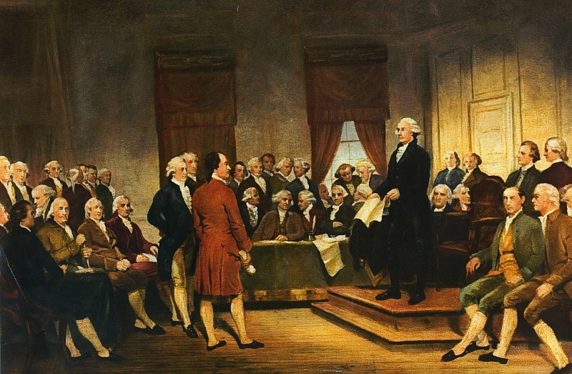
the Founding Fathers
The Americans who established the form of the US government at the Federal Constitutional Convention in Philadelphia (1787) when they created and signed the American Constitution.
Washington at Constitutional
Convention of 1787,
signing of U.S. Constitution →

Slide 7
TASK 1: Answer the following questions about George Washington:
Who was George Washington?
How many times was he elected as President?
What function did he have in the American Revolution?
When did he retire from the presidency?
Who are the Founding Fathers?

Slide 8
TASK 2: Work in pairs and talk about George Washington. The following words can help you.
President
elect
revolution
commander-in-chief
Constitution
convention
honour
retire

Slide 9
Zdroje
Oxford Guide to British and America Culture. Oxford University Press, 1999.
Obrázky fungují jako hypertextové odkazy
Pokud ne, zdrojem je Microsoft Powerpoint Klipart
http://upload.wikimedia.org/wikipedia/commons/8/88/Portrait_of_George_Washington.jpeg. 4.7.2013
http://upload.wikimedia.org/wikipedia/commons/c/ce/George_Washington_by_Peale_1776.jpg. 4.7.2013
http://upload.wikimedia.org/wikipedia/commons/2/2c/Gwashington.jpeg. 4.7.2013
http://upload.wikimedia.org/wikipedia/commons/2/29/Washington_Constitutional_Convention_1787.jpg. 4.7.2013
http://uploaWashington.jpeghttp://upload.wikimedia.org/wikipedia/commons/8/8s: Invented words that didn't make

