Slide 1

Angličtina: Benjamin Franklin
Tematická oblast | Angličtina: Významné osobnosti britské a americké historie
Datum vytvoření | 5.7.2013
Ročník | 3. - 4., septima – oktáva
Stručný obsah | Základní informace o Benjaminu Franklinovi
Způsob využití | Snímky prezentují základní informace o Benjaminu Franklinovi jako jedné z významných osobností americké historie. Součástí jsou kontrolní otázky a závěrečné shrnutí obsahu.
Autor | Mgr. Marie Gajzlerová
Kód | VY_32_INOVACE_02_AGAJ13
Gymnázium a Jazyková škola s právem státní jazykové zkoušky Zlín

Slide 2
Who is it?
It is a man
He was one of America´s most famous Founding Fathers
He was a wise and clever political leader, writer and printer, and a scientist who invented many things
He helped to write the Declaration of Independence and the American Constitution

Slide 3
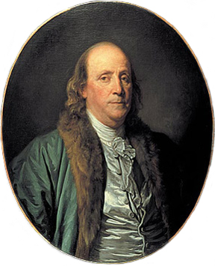
Benjamin Franklin

Slide 4
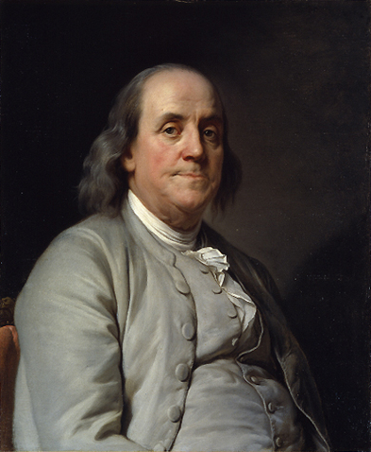
Benjamin Franklin (1706-90)
a political leader
a writer
a printer
a scientist
the Founding Father
helped to write the
Declaration of Independence
and the American Constitution

Slide 5
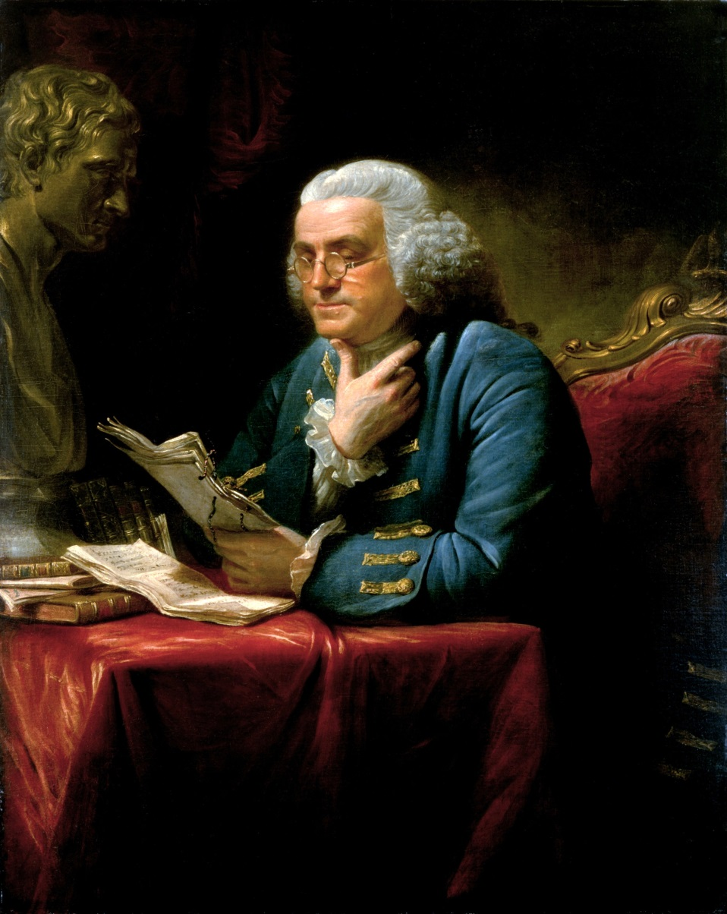
in 1776 went to France and persuaded the French to send money and military forces for the American Revolution
published Poor Richard´s Almanach

Slide 6
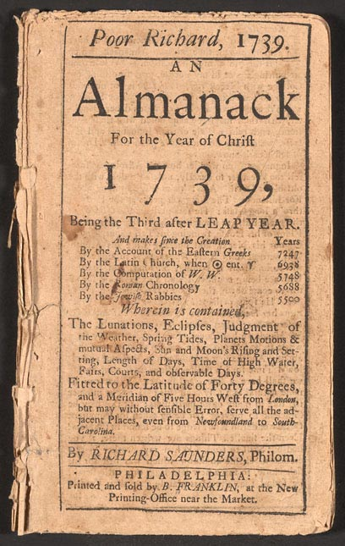
Poor Richard´s Almanach
written under the name of Richard Saunders
contained useful information on important
dates, anniversaries etc., as well
as wise advice in the form
of sayings and verses, such as
“Early to bed and early to rise
makes a man healthy, wealthy and
wise.“
“Fish and visitors stink in three days."

Slide 7
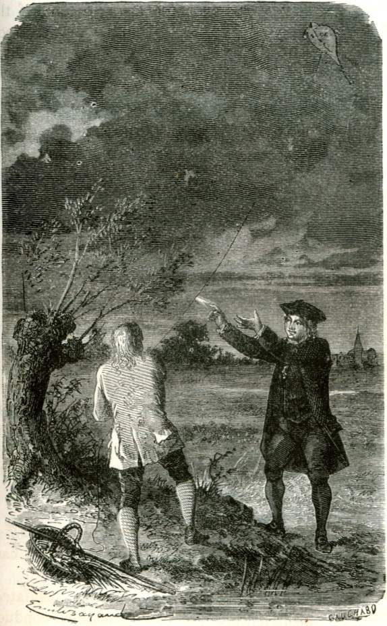
Franklin´s inventions
as a scientist, he was a major figure in the American Enlightenment and the history of physics for his discoveries and theories regarding electricity
proved that lightning is electricity by
flying a kite in a storm
Benjamin Franklin's kite experiment →
his inventions included e.g.:
the lightning rod, bifocals,
glass armonica, Franklin stove, etc.

Slide 8
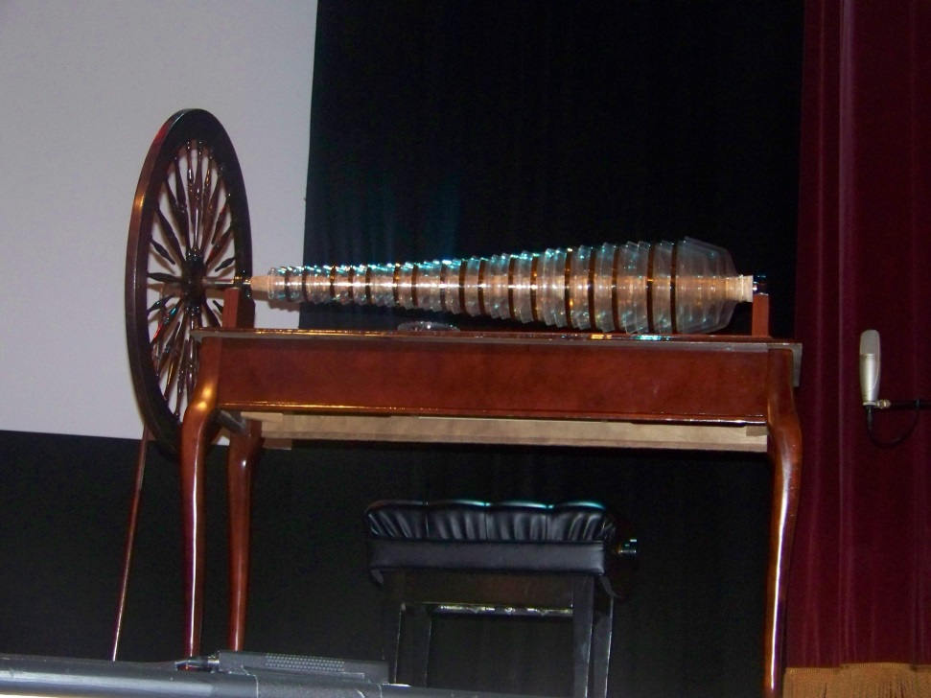
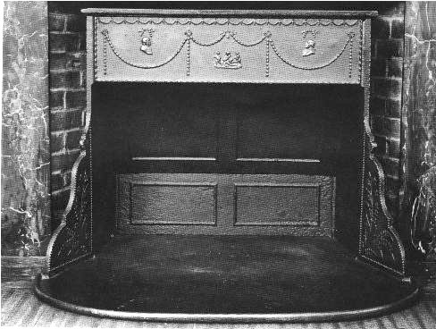
← Franklin's glass harmonica, also known as the glass armonica- a type of musical instrument
← Franklin stove- a metal-lined fireplace

Slide 9
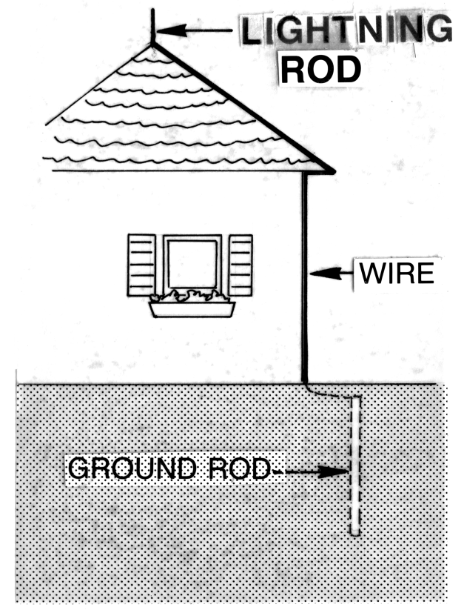
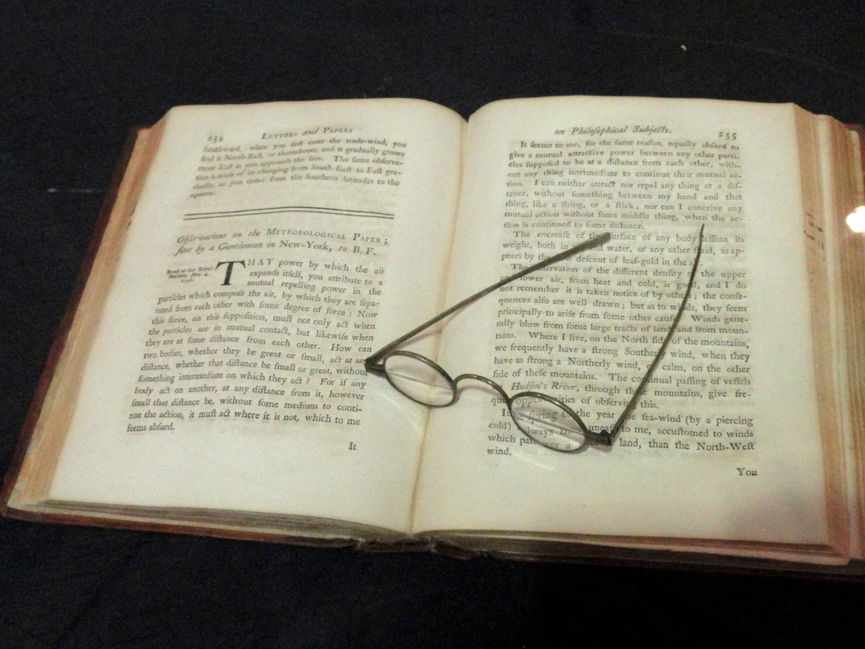
Bifocals by Benjamin Franklin →
←Lightning rod diagram

Slide 10
TASK 1: Answer the following questions about Benjamin Franklin:
Who was Benjamin Franklin?
Which two important documents of American history did he help to write?
What did he publish? What does it include?
What did he invent?
Do you think that these inventions are useful?
What did he do in France in 1776?

Slide 11
TASK 2: Work in pairs and talk about Benjamin Franklin. The following words can help you.
politician
scientist
writer
Founding Father
write
publish
persuade
invent

Slide 12
Zdroje
Oxford Guide to British and America Culture. Oxford University Press, 1999.
Obrázky fungují jako hypertextové odkazy
Pokud ne, zdrojem je Microsoft Powerpoint Klipart
http://upload.wikimedia.org/wikipedia/commons/2/2f/Benjamin_Franklin_by_Jean-Baptiste_Greuze.jpg. 5.7.2013
http://upload.wikimedia.org/wikipedia/commons/c/cc/BenFranklinDuplessis.jpg. 5.7.2013
http://upload.wikimedia.org/wikipedia/commons/a/a3/Benjamin_Franklin_1767.jpg. 5.7.2013
http://upload.wikimedia.org/wikipedia/commons/8/81/Poor_Richard_Almanack_1739.jpg. 5.7.2013
http://upload.wikimedia.org/wikipedia/commons/1/1e/Glassarmonica.jpg. 5.7.2013

Slide 13
http://upload.wikimedia.org/wikipedia/commons/b/b3/Franklin_stove.jpg. 5.7.2013
http://upload.wikimedia.org/wikipedia/commons/f/fd/Franklin_lightning_engraving.jpg. 5.7.2013
http://upload.wikimedia.org/wikipedia/commons/6/6e/Light_Rod_%28PSF%29.png. 5.7.2013
http://upload.wikimedia.org/wikipedia/commons/b/b7/Bifocals_by_Benjamin_Franklin_-_Franklin_Institue_-_DSC06605.JPG. 5.7.2013

