Slide 1

Angličtina: Thomas Jefferson
Tematická oblast | Angličtina: Významné osobnosti britské a americké historie
Datum vytvoření | 4.7.2013
Ročník | 3. - 4., septima – oktáva
Stručný obsah | Základní informace o Thomasi Jeffersonovi
Způsob využití | Snímky prezentují základní informace o Thomasi Jeffersonovi jako jedné z významných osobností americké historie. Součástí jsou kontrolní otázky a závěrečné shrnutí obsahu.
Autor | Mgr. Marie Gajzlerová
Kód | VY_32_INOVACE_02_AGAJ14
Gymnázium a Jazyková škola s právem státní jazykové zkoušky Zlín

Slide 2
Who is it?
It is a man
He was the 3rd US President
He was one of the nation´s Founding Fathers
He wrote most of the Declaration of Independence
As the President, he supported the Louisiana Purchase

Slide 3
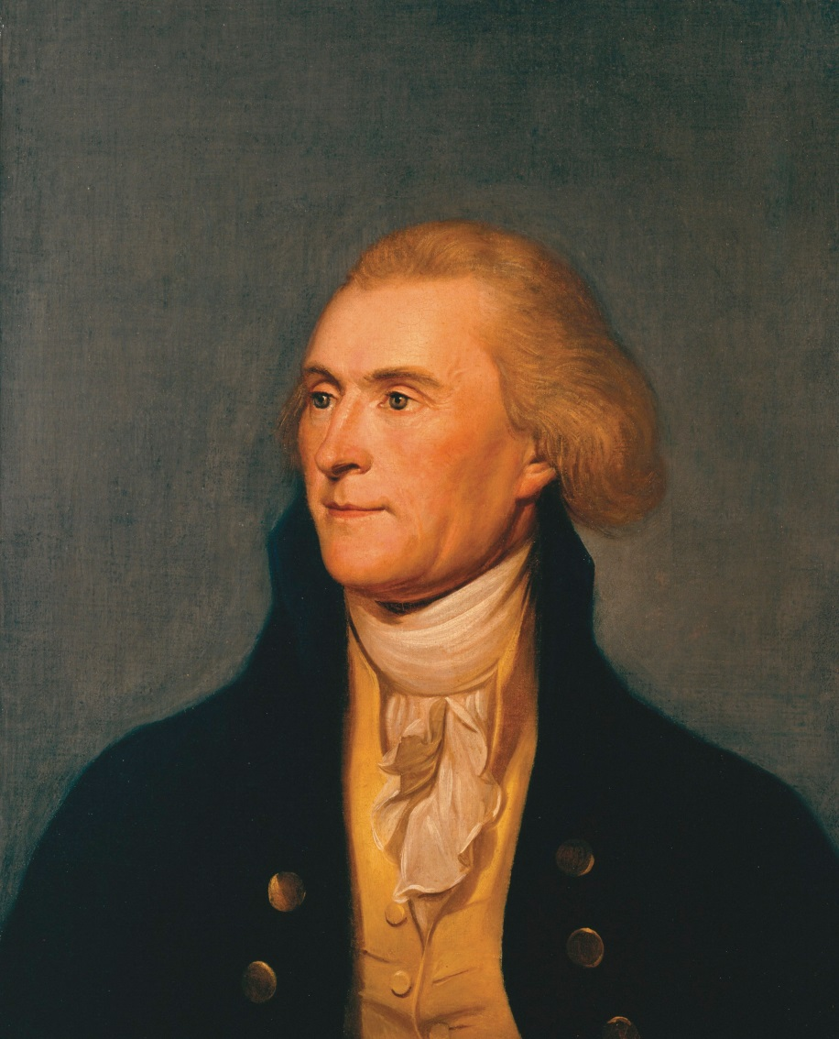
Thomas Jefferson

Slide 4
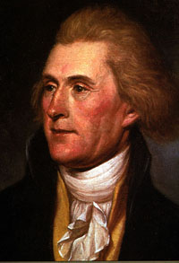
Thomas Jefferson (1743-1826)
the third US President (1801-9)
the governor of Virginia (1779-81)
established the University of Virginia (1819)
one of the Founding Fathers
wrote most of the Declaration of
Independence
supported the Louisiana Purchase
helped design Washington DC
died on the 50th anniversary of
the Declaration of Independence

Slide 5
The Declaration of Independence
The document in which the thirteen colonies declared that they were independent of Britain and stated the principles of the new government. One of its most famous sentences is this:
“We hold these truths to be self-evident: that all men are created equal; that they are endowed by their creator with certain inalienable rights; that among these are life, liberty, and the pursuit of happiness.“

Slide 6
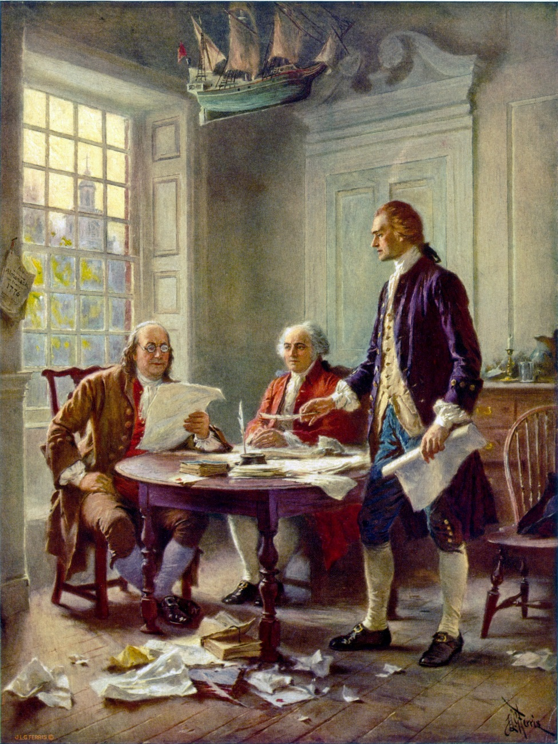
Thomas Jefferson (right), Benjamin Franklin (left), and John Adams (center) meet at Jefferson's lodgings, in Philadelphia, to review a draft of the Declaration of Independence.

Slide 7
TASK 1: Answer the following questions about Thomas Jefferson:
Who was Thomas Jefferson?
What did he support?
What was he before he became the President?
What did he establish?
What did he help to write?
What is the Declaration of Independence?
When did he die?

Slide 8
TASK 2: Work in pairs and talk about Thomas Jefferson. The following words can help you.
President
Governor
Founding father
declaration
support
establish
design
anniversary

Slide 9
Zdroje
Oxford Guide to British and America Culture. Oxford University Press, 1999.
Obrázky fungují jako hypertextové odkazy
Pokud ne, zdrojem je Microsoft Powerpoint Klipart
http://upload.wikimedia.org/wikipedia/commons/b/bc/ThomasJeffersonStateRoomPortrait.jpg. 4.7.2013
http://upload.wikimedia.org/wikipedia/commons/4/4b/Thomas_Jefferson_rev.jpg. 4.7.2013
http://upload.wikimedia.org/wikipedia/commons/d/d6/Writing_the_Declaration_of_Independence_1776_cph.3g09904.jpg. 4.7.2013
http://upload.wikimedia.org/wikipedia/commons/b/bc/ThomasJeffersonStateRoomPortrait.jpghttp://upload.wikimedia.org/wikipedia/commons/b/bc/ThomasJeffersonStateRoomPortrait.jpghttp://upload.wikimedia.org/wikipedia/commons/b/bc/ThomasJeffersonStateRoomPortrait.jpgorg/wikipedia/commons/8/8s: Invented words that didn't make

