Slide 1

Angličtina: Martin Luther King
Tematická oblast | Angličtina: Významné osobnosti britské a americké historie
Datum vytvoření | 1.7.2013
Ročník | 3. - 4., septima – oktáva
Stručný obsah | Základní informace o Martinu Lutheru Kingovi
Způsob využití | Snímky prezentují základní informace o Martinu Lutheru Kingovi jako jedné z významných osobností americké historie. Součástí jsou kontrolní otázky a závěrečné shrnutí obsahu.
Autor | Mgr. Marie Gajzlerová
Kód | VY_32_INOVACE_02_AGAJ16
Gymnázium a Jazyková škola s právem státní jazykové zkoušky Zlín

Slide 2
Who is it?
It is a man
His birthday, 15 January, is an American federal holiday
He was an African-American Baptist minister
He led several campaigns against segregation and racism
He was the leader of the Civil Rights Movement

Slide 3
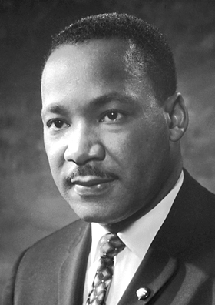
Martin Luther King

Slide 4
Martin Luther King (1929-68)
the most important leader of the US civil rights movement
an African-American Baptist minister
in 1963 led about 25000 people on a protest march to Washington DC
made there his famous “I have a dream“ speech at the Lincoln Memorial
awarded the Nobel Peace Prize in 1964

Slide 5
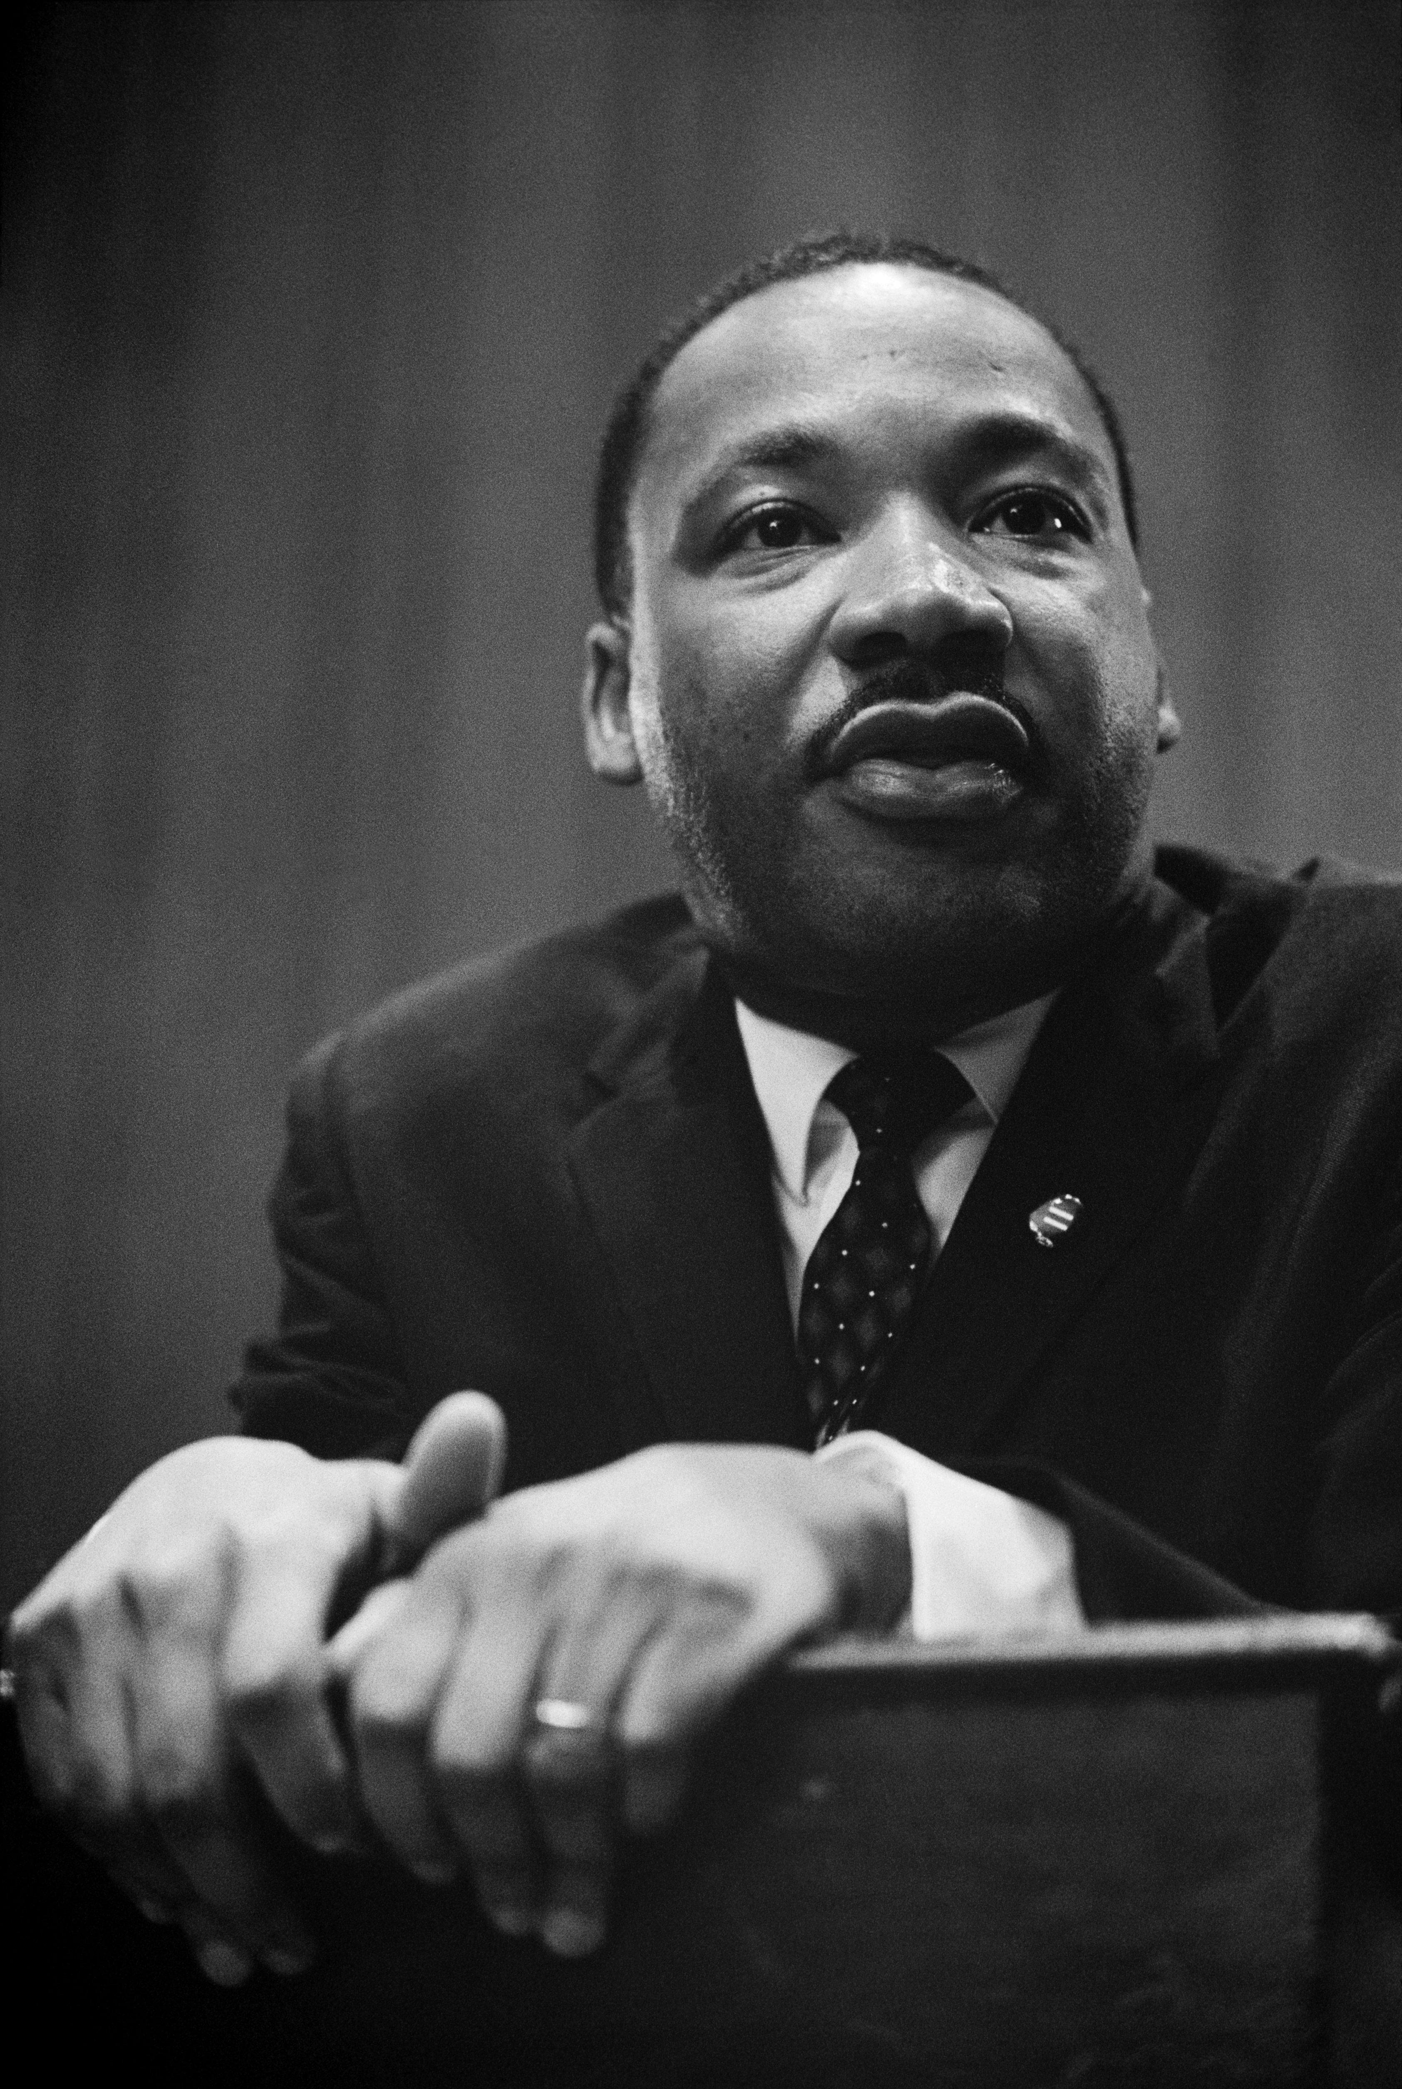
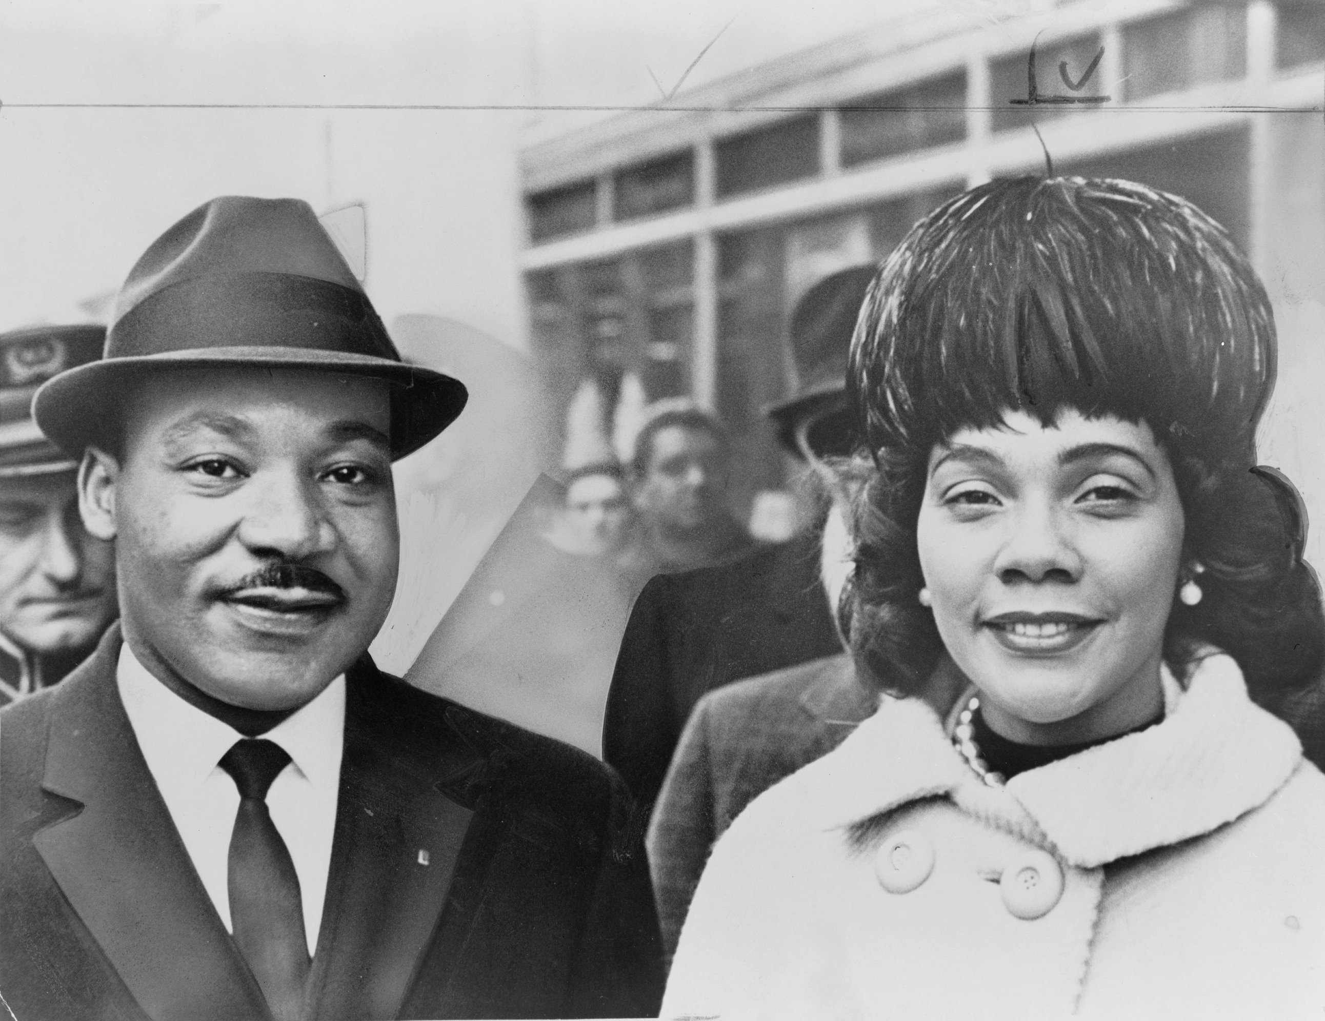
inspired by Mahatma Gandhi's success with non-violent activism
murdered in 1968 in Memphis, Tennessee by Earl Ray

Slide 6
“I have a dream“
a public speech by American activist Martin Luther King, Jr.
delivered by King on August 28, 1963, in which he called for an end to racism in the United States
“I have a dream that my four little children will one day live in a nation where they will not be judged by the color of their skin but by the content of their character.“
<http://www.youtube.com/watch?v=MgYzJGmBXU8>

Slide 7
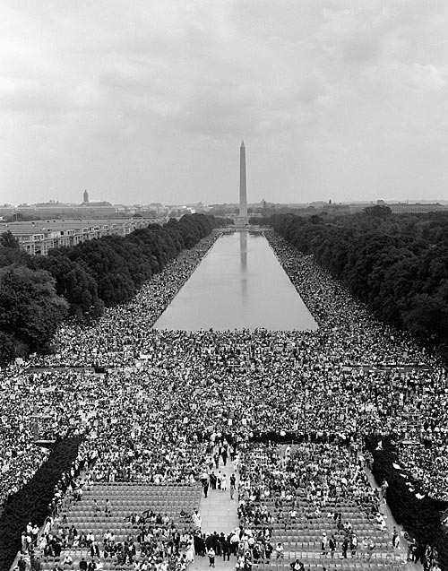
Washington, D.C.
Lincoln Memorial, Aug. 28, 1963
from the steps of the memorial King delivered his famous I Have a Dream speech

Slide 8
TASK 1: Answer the following questions about Martin Luther King:
What was the dream of Martin Luther King?
Do you think his dream has come true?
What did Martin Luther King fight for?
How did he want to fight?
Which Nobel Prize did he receive?
Where and when did he give his famous speech?
Who did he admire?
How did he die?

Slide 9
TASK 2: Work in pairs and talk about Martin Luther King. The following words can help you.
campaign
segregation
racism
Movement
speech
march
non-violent
inspired

Slide 10
Zdroje
Oxford Guide to British and America Culture. Oxford University Press, 1999.
Obrázky fungují jako hypertextové odkazy
Pokud ne, zdrojem je Microsoft Powerpoint Klipart
http://upload.wikimedia.org/wikipedia/commons/0/0d/Martin_Luther_King_press_conference_01269u_edit.jpg?uselang=cs. 1.7.2013
http://upload.wikimedia.org/wikipedia/commons/0/05/Martin_Luther_King%2C_Jr..jpg?uselang=cs. 1.7.2013
http://www.youtube.com/watch?v=MgYzJGmBXU8. 1.7.2013
http://upload.wikimedia.org/wikipedia/commons/c/cd/IhaveadreamMarines.jpg?uselang=cs. 1.7.2013
http://upload.wikimedia.org/wikipedia/commons/9/95/Martin_Luther_King_Jr_NYWTS_5.jpg. 1.7.2013
QUINION, Michael (1996). “Inkhorn terms: Invented words that didn't make

