Slide 1

Angličtina: John F. Kennedy
Tematická oblast | Angličtina: Významné osobnosti britské a americké historie
Datum vytvoření | 3.7.2013
Ročník | 3. - 4., septima – oktáva
Stručný obsah | Základní informace o Johnu F. Kennedym
Způsob využití | Snímky prezentují základní informace o Johnu F. Kennedym jako jedné z významných osobností americké historie. Součástí jsou kontrolní otázky a závěrečné shrnutí obsahu.
Autor | Mgr. Marie Gajzlerová
Kód | VY_32_INOVACE_02_AGAJ17
Gymnázium a Jazyková škola s právem státní jazykové zkoušky Zlín

Slide 2
Who is it?
It is a man
He was the 35th US President
He was the country´s youngest president
He was the Roman Catholic ever to be elected
His wife´s name was Jackie
He was murdered in Dallas

Slide 3
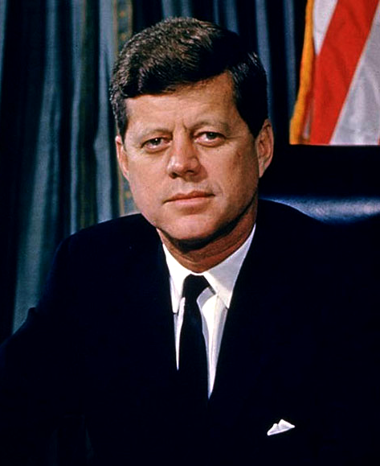
John F. Kennedy

Slide 4
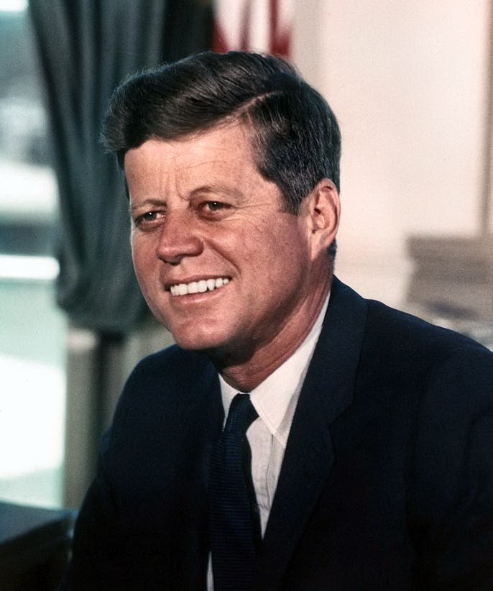
John Fitzgerald Kennedy (1917-63)
the 35th US President (1961-3)
known informally as Jack Kennedy or JFK
first elected to the House of
Representatives and then to the
Senate
his greatest success as President →
dealing with the Cuban missile
crises
his worst failure →the Bay of Pigs
incident

Slide 5
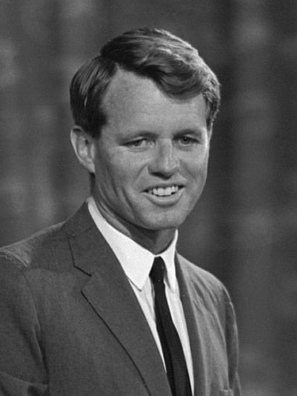
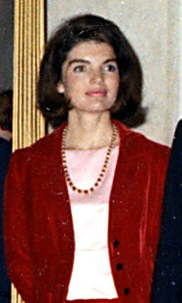
worked with his brother, US Attorney General Robert Kennedy, to support the Civil rights movement
his wife was Jackie Kennedy
←Robert Kennedy
Jackie Kennedy →

Slide 6
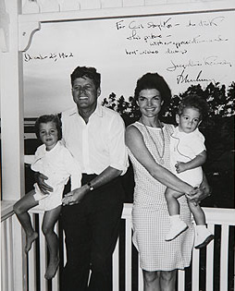
John F. Kennedy,
First Lady Jacqueline Kennedy,
with children
John F. Kennedy, Jr.
and Caroline Kennedy

Slide 7
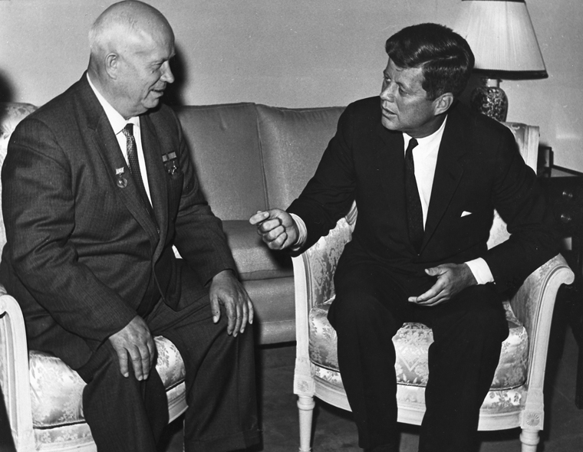
Cuban missile crises
in 1962 between the US and USSR
President Kennedy became aware that there were Soviet nuclear weapons in Cuba and sent US Navy to stop Soviet ships from bringing more
the Soviet leader Nikita
Khrushchev ordered the
Russian ships to turn back
and later removed all the
weapons
John F. Kennedy, Nikita Khrushchev →

Slide 8
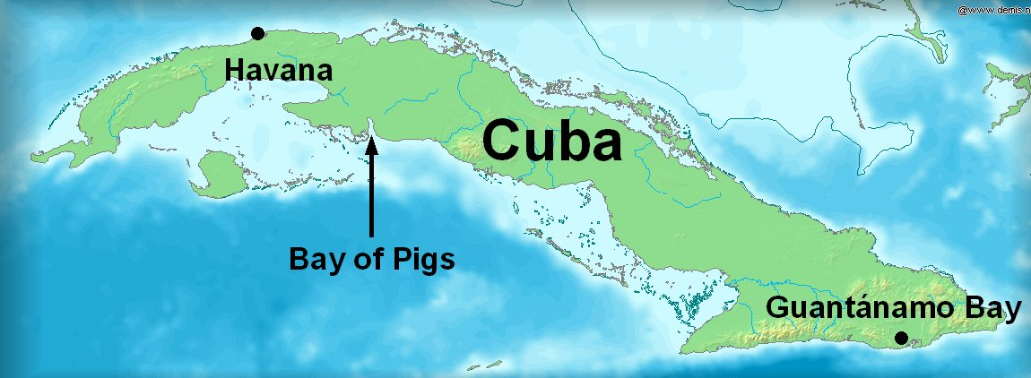
The Bay of Pigs
a bay on the south-west coast of Cuba
in 1961 about 1500 Cuban exiles landed there in an attempt to end the rule of Fidel Castro
the attempt failed, causing great embarrassment to the US President Kennedy

Slide 9
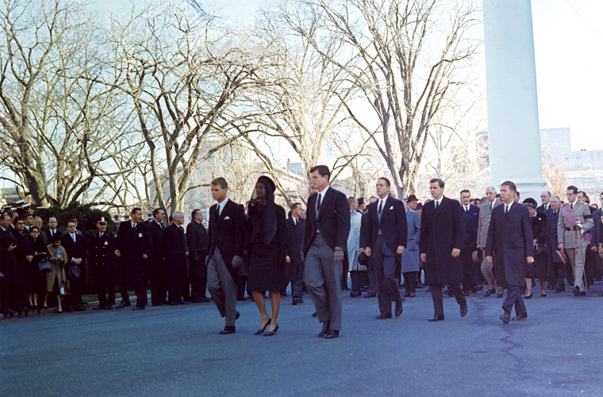
The assassination of JFK
Kennedy was shot and killed probably by Lee Harvey Oswald (was himself shot and killed only two days after the assassination)
in November 1963
Dallas, Texas
Kennedy family leading
funeral procession,
25 November 1963

Slide 10
TASK 1: Answer the following questions about JFK:
When did he become the US President?
What was his greatest success as President?
What was his worst failure as President?
What do you know about these events?
What is his wife´s name?
What did he and his brother support?
When and where was he assassinated?

Slide 11
TASK 2: Work in pairs and talk about JFK. The following words can help you.
President
elect
youngest
Roman Catholic
wife
success
failure
assassination

Slide 12
Zdroje
Oxford Guide to British and America Culture. Oxford University Press, 1999.
Obrázky fungují jako hypertextové odkazy
Pokud ne, zdrojem je Microsoft Powerpoint Klipart
http://upload.wikimedia.org/wikipedia/commons/6/6e/JohnFK.png?uselang=cs. 3.7.2013
http://upload.wikimedia.org/wikipedia/commons/c/c3/John_F._Kennedy%2C_White_House_color_photo_portrait.jpg?uselang=cs. 3.7.2013
http://upload.wikimedia.org/wikipedia/commons/b/bd/Robert_F_Kennedy_crop.jpg. 3.7.2013
http://upload.wikimedia.org/wikipedia/commons/1/18/Jackie_JFK_Earl_Warren.jpg. 3.7.2013
http://upload.wikimedia.org/wikipedia/commons/6/6e/JohnFK.png?uselang=

Slide 13
http://upload.wikimedia.org/wikipedia/commons/7/7e/John_Kennedy%2C_Nikita_Khrushchev_1961.jpg?uselang=cs. 3.7.2013
http://upload.wikimedia.org/wikipedia/commons/0/05/Kennedy_family_Christmas_1962.jpg?uselang=cs. 3.7.2013
http://upload.wikimedia.org/wikipedia/commons/7/78/BayofPigs.jpg 3.7.2013
http://upload.wikimedia.org/wikipedia/commons/7/7e/John_Kennedy%2C_Nikita_Khrushchev_1961.jpg?uselang=cs. 3.7.2013

