Slide 1

Angličtina: Franklin D Roosevelt
Tematická oblast | Angličtina: Významné osobnosti britské a americké historie
Datum vytvoření | 5.7.2013
Ročník | 3. - 4., septima – oktáva
Stručný obsah | Základní informace o Franklinu D Rooseveltovi
Způsob využití | Snímky prezentují základní informace o Franklinu D Rooseveltovi jako jedné z významných osobností americké historie. Součástí jsou kontrolní otázky a závěrečné shrnutí obsahu.
Autor | Mgr. Marie Gajzlerová
Kód | VY_32_INOVACE_02_AGAJ18
Gymnázium a Jazyková škola s právem státní jazykové zkoušky Zlín

Slide 2
Who is it?
It is a man
He was the 32nd US President
He was known informally as FDR
He was the only President elected four times
He suffered from polio
He died while President just before the war ended

Slide 3
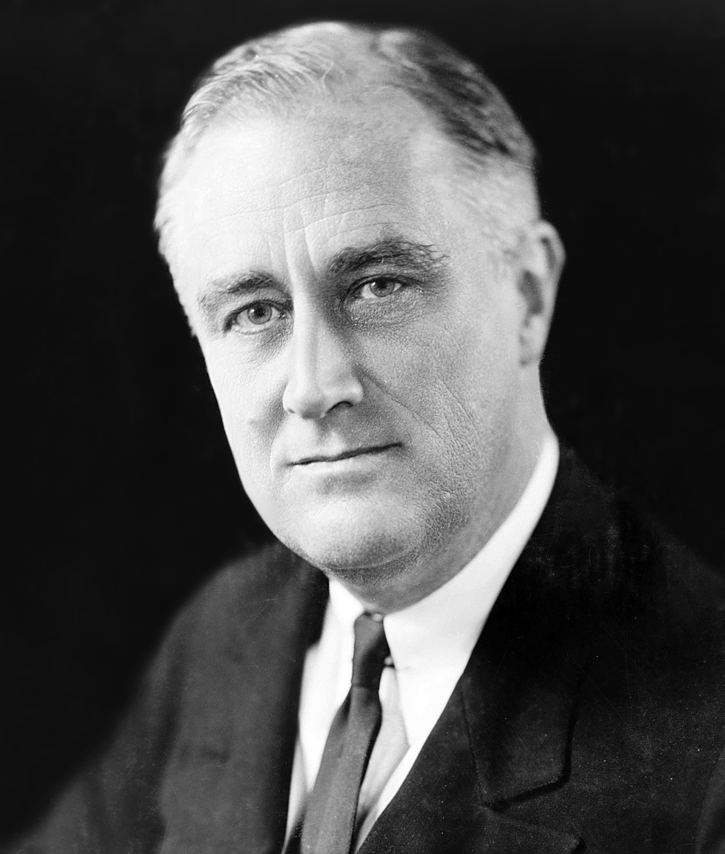
Franklin D Roosevelt

Slide 4
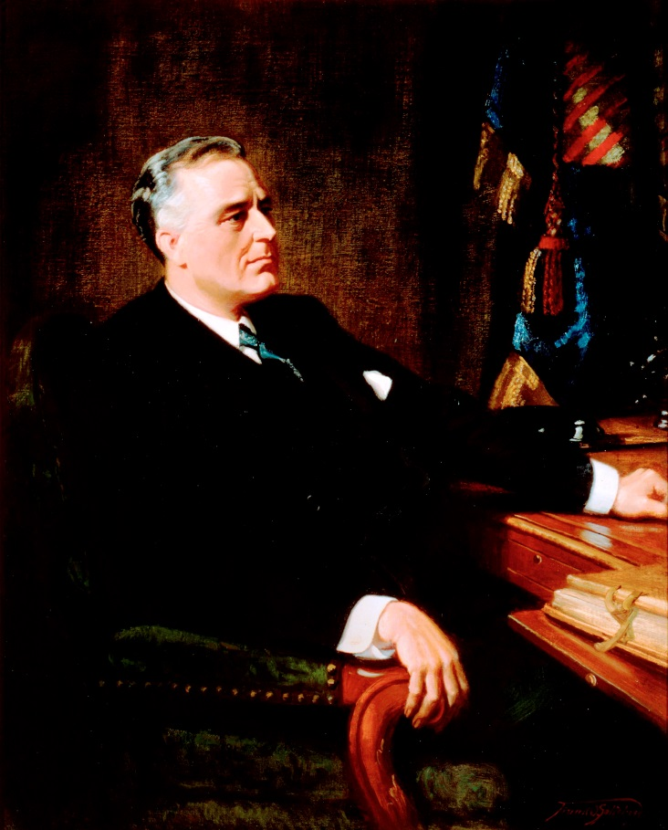
Franklin Delano Roosevelt
(1882-1945)
the 32nd US President (1933-45)
the only one to be elected four times
a Democratic politician
Governor of New York before
becoming President
as President , introduced his New
Deal programme → helped the
US to recover from the Great
Depression

Slide 5
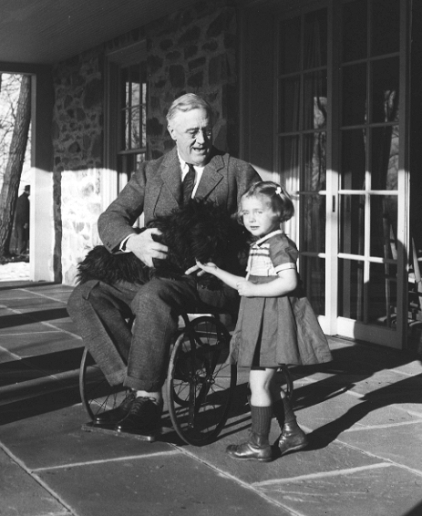
supported Britain with the Lend-Lease plan before the US entered WW II
from 1921 he suffered from the polio and could hardly walk without help
Wheelchair photo, 1941→

Slide 6
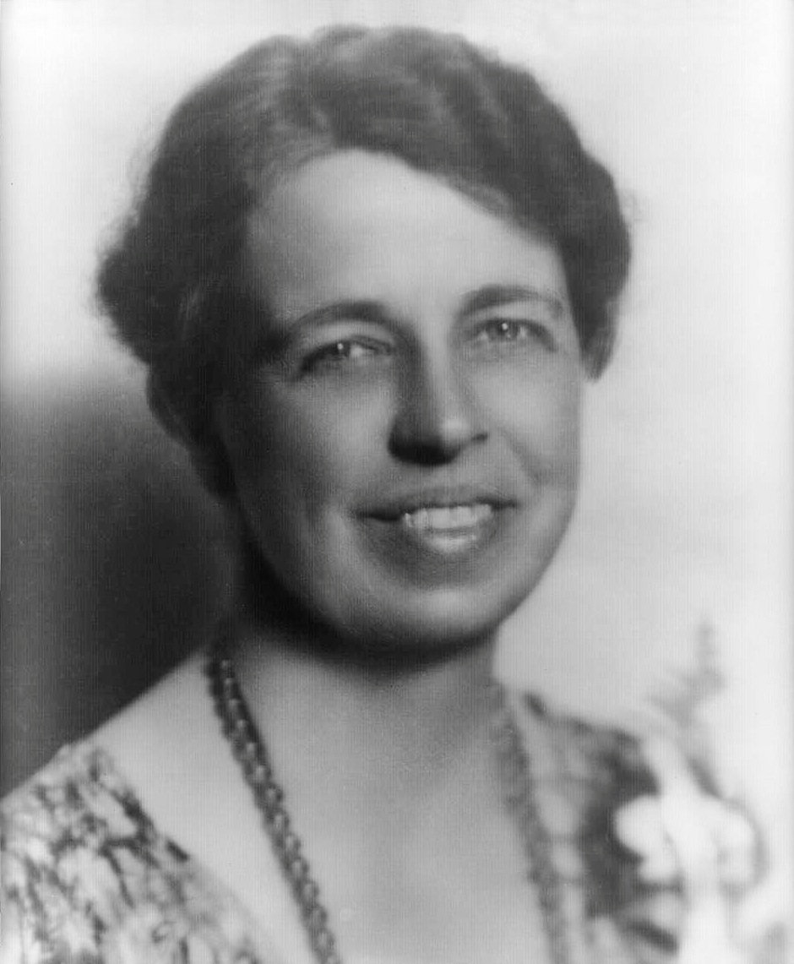
Eleanor Roosevelt
the wife of FDR
marriage in 1905
known for supporting the rights of women and minority groups

Slide 7
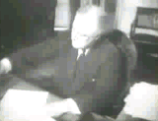
The Lend-Lease Act (1941)
the US lent military and other equipment to countries at war with Germany, first to Britain and the Commonwealth and then to other countries
the programme cost the
US $50 billion
encouraged the Americans
to want to enter the war
Franklin D. Roosevelt signing
the Lend-Lease Act, in 1941 →

Slide 8
New Deal programme
begun by FDR in 1930s to end the Great Depression
introduced new economic and social measures
made the national government more powerful

Slide 9
TASK 1:
Answer the following questions about FDR:
Who was Franklin D Roosevelt?
How many times was he elected as President?
How did he support Britain and other countries before the US entered WW II?
What did he introduce as President ? And why?
What did he suffer from?
Who was his wife?
What did she support?

Slide 10
TASK 2:
Work in pairs and talk about FDR. The following words can help you.
President
elect
Democratic
suffer
polio
support
governor
wife

Slide 11
Zdroje
Oxford Guide to British and America Culture. Oxford University Press, 1999.
Obrázky fungují jako hypertextové odkazy
Pokud ne, zdrojem je Microsoft Powerpoint Klipart
http://upload.wikimedia.org/wikipedia/commons/b/b8/FDR_in_1933.jpg. 5.7.2013
http://upload.wikimedia.org/wikipedia/commons/2/29/Froosevelt.jpeg. 5.7.2013
http://upload.wikimedia.org/wikipedia/commons/b/be/Roosevelt_in_a_wheelchair.jpg. 5.7.2013
http://upload.wikimedia.org/wikipedia/commons/2/22/Eleanor_Roosevelt_portrait_1933.jpg. 5.7.2013
http://upload.wikimedia.org/wikipedia/commons/c/c4/FDRoosevelt.gif. 5.7.2013

