Slide 1

Angličtina: Harry S Truman
Tematická oblast | Angličtina: Významné osobnosti britské a americké historie
Datum vytvoření | 3.7.2013
Ročník | 3. - 4., septima – oktáva
Stručný obsah | Základní informace o Harry Trumanovi
Způsob využití | Snímky prezentují základní informace o Harry Trumanovi jako jedné z významných osobností americké historie. Součástí jsou kontrolní otázky a závěrečné shrnutí obsahu.
Autor | Mgr. Marie Gajzlerová
Kód | VY_32_INOVACE_02_AGAJ19
Gymnázium a Jazyková škola s právem státní jazykové zkoušky Zlín

Slide 2
Who is it?
It is a man
He was the 33rd US President
He gave permission for the first atomic bombs to be dropped on Japan
He was strongly opposed to Communism
His government began the Marshall Plan and helped to establish the United Nations and NATO

Slide 3
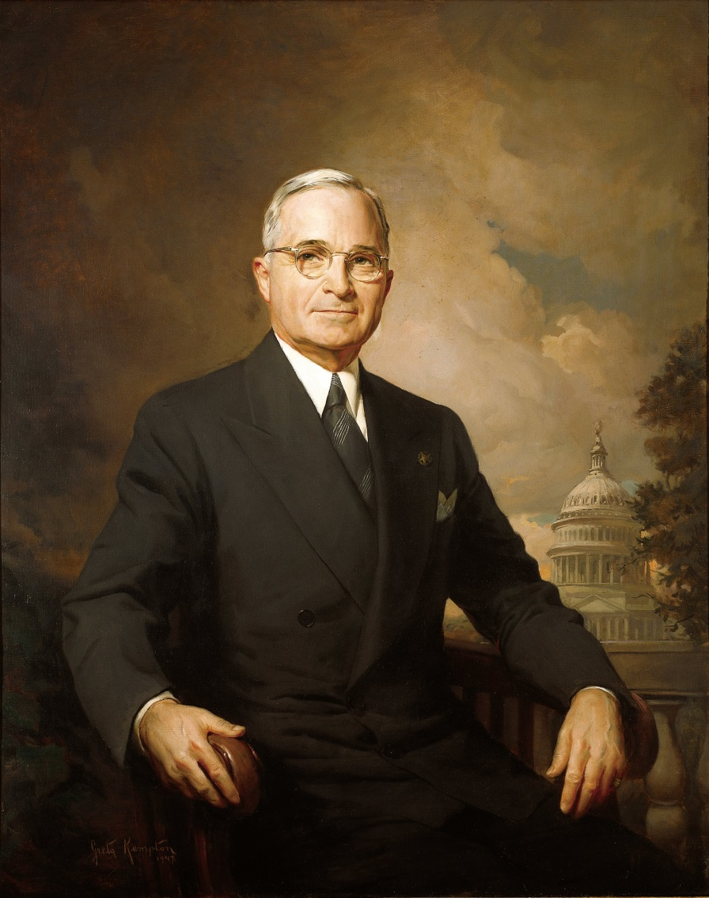
Harry S Truman

Slide 4
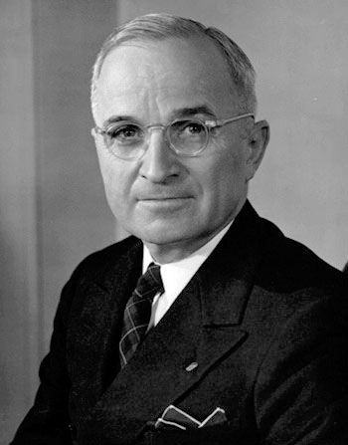
Harry S Truman (1884-1972)
the 33rd US President (1945-53)
was Vice-President under Franklin D Roosevelt
replaced Roosevelt when he died in 1945
won the 1948 election
gave permission for the first atomic
bombs to be dropped on Japan (1945)
his government began the Marshall
plan, helped to establish the United
Nations and NATO

Slide 5
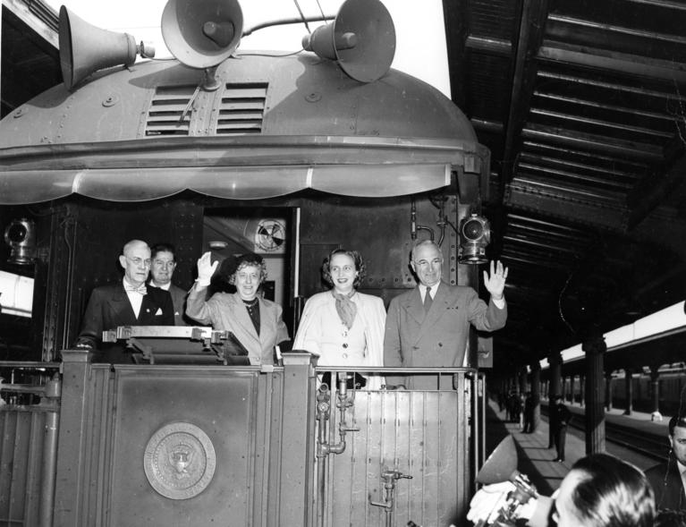
began the Truman Doctrine
involved the US in the Korean War
President Truman and
his wife and daughter
waving from the train
during the 1948 campaign

Slide 6
The Truman Doctrine
A policy announced in 1947 by President Truman in which he promised US financial and military help for Greece, Turkey and other countries threatened by Communism.

Slide 7
The Marshall Plan
a very large programme of US economic aid to 17 European countries after World War II
its official title - the European Recovery Program
named after the person who set it up, US secretary of State George C Marshall
Marshall received the Nobel Prize for peace in 1953

Slide 8
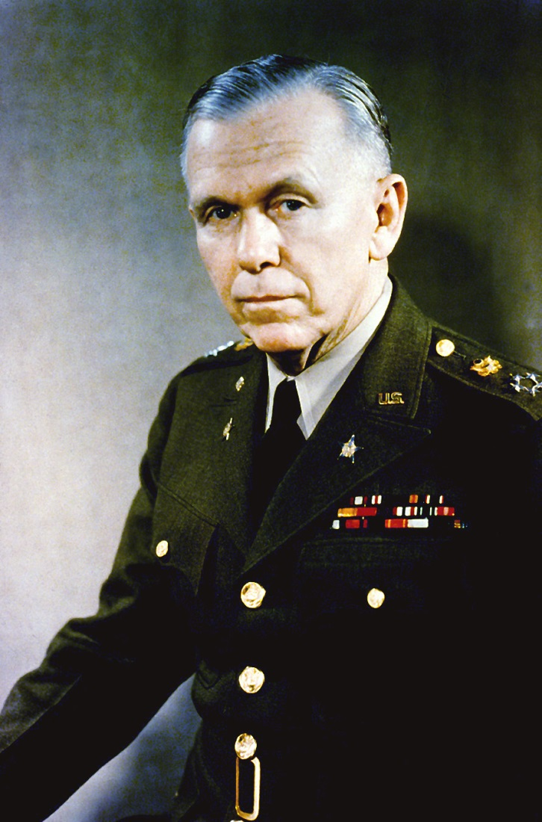
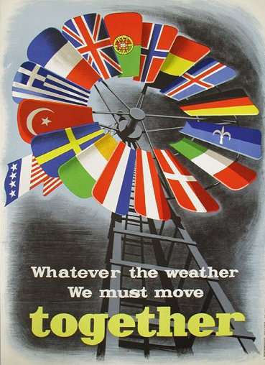
George C Marshall
Marshall Plan poster

Slide 9
TASK 1: Answer the following questions about Harry Truman:
When did he become the President?
Who was he preceded by?
What did he give permission for in 1945?
What is the Marshall Plan?
What is the Truman Doctrine?
What did his government establish?

Slide 10
TASK 2: Work in pairs and talk about Harry S Truman. The following words can help you.
President
Vice-President
replace
oppose
permission
economic aid
military help
establish

Slide 11
Zdroje
Oxford Guide to British and America Culture. Oxford University Press, 1999.
Obrázky fungují jako hypertextové odkazy
Pokud ne, zdrojem je Microsoft Powerpoint Klipart
http://upload.wikimedia.org/wikipedia/commons/e/e6/HarryTruman.jpg. 3.7.2013
http://upload.wikimedia.org/wikipedia/commons/9/92/Harry-truman.jpg. 3.7.2013
http://upload.wikimedia.org/wikipedia/commons/4/4e/Truman_with_wife_and_daughter.jpg. 3.7.2013
http://upload.wikimedia.org/wikipedia/commons/9/91/General_George_C._Marshall%2C_official_military_photo%2C_1946.JPEG. 3.7.2013
http://upload.wikimedia.org/wikipedia/commons/b/b3/Marshall_Plan_poster.JPG. 3.7.2013

