Slide 1

Angličtina: Richard Nixon
Tematická oblast | Angličtina: Významné osobnosti britské a americké historie
Datum vytvoření | 2.7.2013
Ročník | 3. - 4., septima – oktáva
Stručný obsah | Základní informace o Richardu Nixonovi
Způsob využití | Snímky prezentují základní informace o Richardu Nixonovi jako jedné z významných osobností americké historie. Součástí jsou kontrolní otázky a závěrečné shrnutí obsahu.
Autor | Mgr. Marie Gajzlerová
Kód | VY_32_INOVACE_02_AGAJ20
Gymnázium a Jazyková škola s právem státní jazykové zkoušky Zlín

Slide 2
Who is it?
It is a man
He was the 37th US President
He was successful in ending the Vietnam War
He was the only President to resign
He is remembered because of Watergate scandal

Slide 3
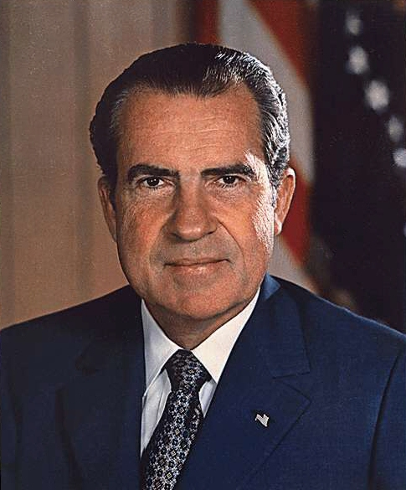
Richard Nixon

Slide 4
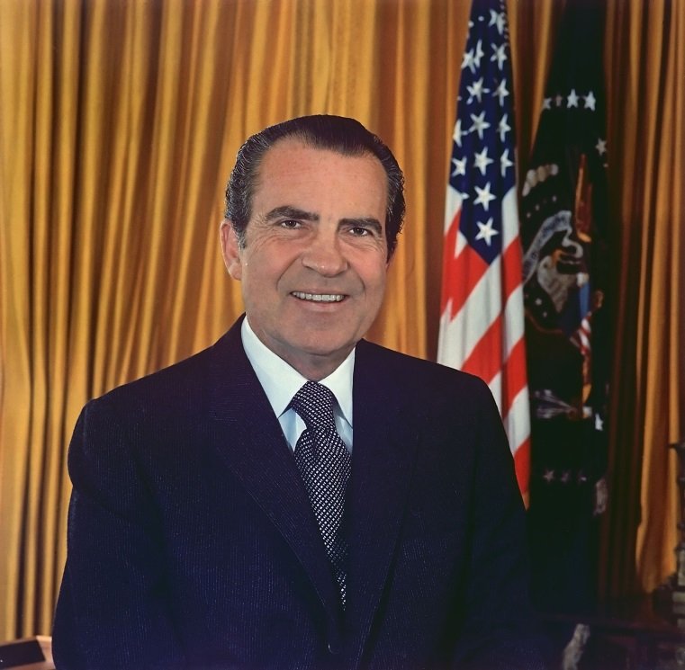
Richard Milhous Nixon (1913-94)
the 37th US President (1969-74)
the only one to resign
elected to the House of Representatives in 1946
elected to the US Senate in 1950
Vice-president under President
Eisenhower
defeated by John F. Kennedy in
the 1960 election for President

Slide 5
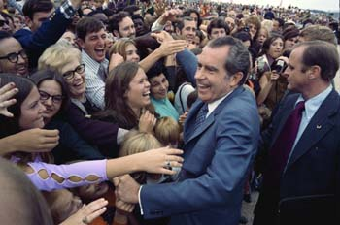
successful in ending the Vietnam War
mainly remembered to leave office because of the Watergate Scandal
His nickname- “Tricky Dick“- was often not direct and honest in his dealings with people
Nixon´s campaign

Slide 6
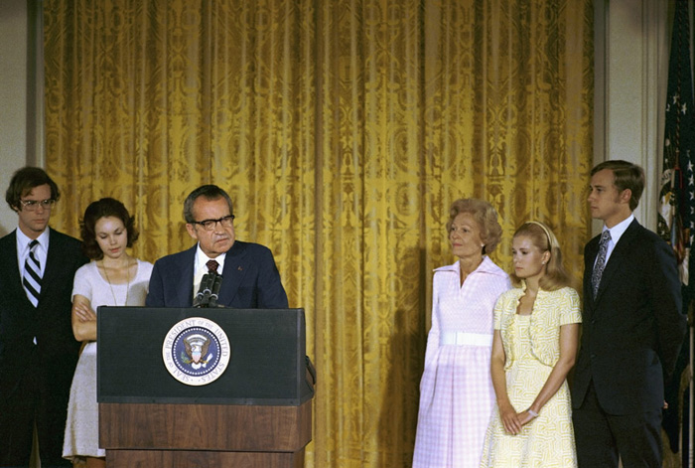
Watergate
the US political scandal that forced President Nixon to leave office in 1974
involved Republican Party members who in 1972 tried to steal information from the offices of the Democratic Party in the Watergate building in Washington DC
Richard Nixon´s resignation
speech

Slide 7
TASK 1: Answer the following questions about Richard Nixon:
What was Nixon´s political career before he became the President?
Who defeated him in the 1960 elections for President?
What was he successful in during his Presidency?
What is he mainly remembered for?
Why did he have to resign?
What was his nickname?

Slide 8
TASK 2: Work in pairs and talk about Richard Nixon. The following words can help you.
President
elect
election
defeat
information
scandal
resign
nickname

Slide 9
Zdroje
Oxford Guide to British and America Culture. Oxford University Press, 1999.
Obrázky fungují jako hypertextové odkazy
Pokud ne, zdrojem je Microsoft Powerpoint Klipart
http://upload.wikimedia.org/wikipedia/commons/2/20/Richard_Nixon.jpg. 2.7.2013
http://upload.wikimedia.org/wikipedia/commons/6/63/RichardNixon.jpg. 2.7.2013
http://upload.wikimedia.org/wikipedia/commons/2/20/Nixon_campaigns.jpg. 2.7.2013
http://upload.wikimedia.org/wikipedia/commons/5/57/Richard_Nixon%27s_resignation_speech.jpg. 2.7.2013
httha1996). “Inkhorn terms: Invented words that didn't make

