Slide 2
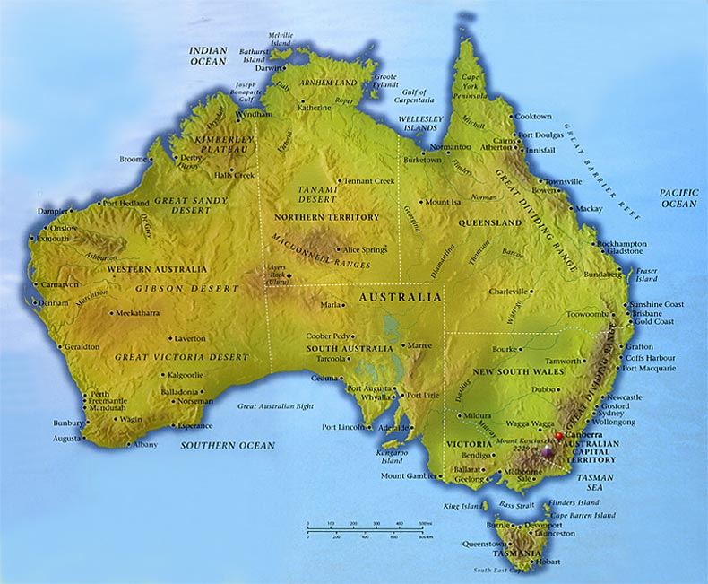

Slide 3
Basic facts
7, 686 million sq km / 6th largest in the world /
situated in the Southern hemisphere
washed by the Pacific,Indian and Southern
Oceans
The smallest,flattest,driest and least populated
continent
called Down Under
consists of 6 states and 2 territories

Slide 4
Do you know that about Australia ?
Australia has more beaches than any other nation
The national hazards include cyclones, forest fires and severe droughts.
Eucalyptus - the fastest growing tree in the world / 10 m per year /
The nearest country - Papua New Guinea
The national flower - a wattle
The major colours of the countryside :
red / Red Centre /
blue / the sky /
green / rainforests, eucalyptus trees /
Australia follows a decimal currency
5, 10, 20, 50 cent coins
5, 10, 20, 50, 100 dollar notes

Slide 5
The landscape
hills, mountains, deserts, rainforests, wonderful beaches
3 main parts:
Western Plateau
Central Lowlands
Eastern Highlands
2/3 of the continent is desert / Gibson, Great Victoria, Great Sandy /
mountain ranges in the South East and Tasmania / The Blue
and Snowy Mountains
the highest mountain – Mt. Kosciusco /2,228m, the A. Alps/
lowlands stretch from QLD down to NSW and VIC

Slide 6
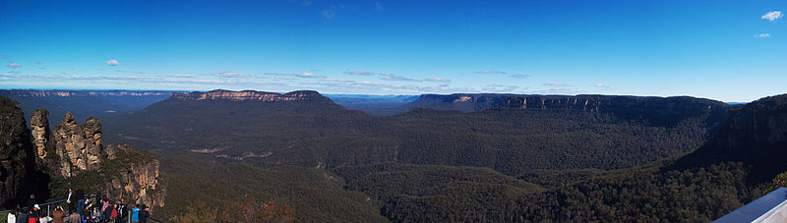
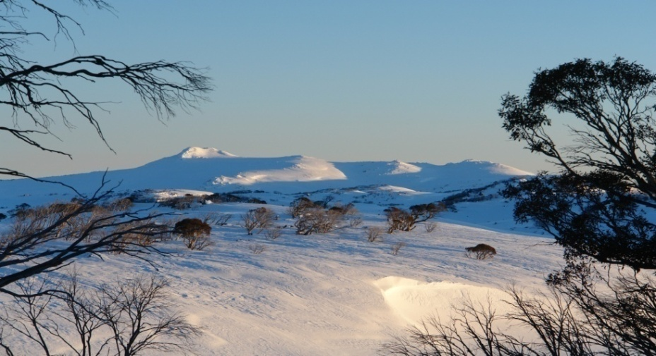
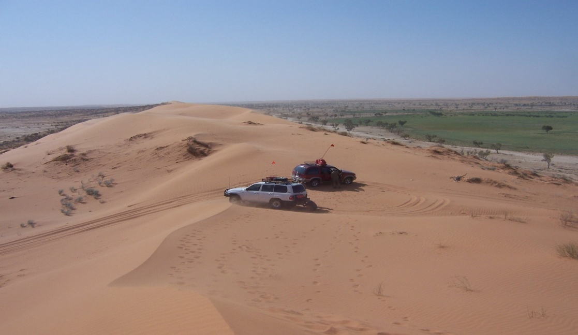
The Blue Mountains
The Snowy Mountains
Big Red – The Simpson Desert

Slide 7
Do you know the answers?
What does Australia consist of?
How much of the country is desert?
Which part of Australia is the
hottest in summer?
4. What is the highest mountain ?
Where is it?

Slide 8
The answers
6 states and 2 territories
2/3
The outback / The Red Centre /
Mt. Kosciusco The Australian Alps

Slide 9
The climate
tropical , subtropical, temperate
in the North – 2 seasons / wet and dry /
November – April heavy rains
June - October sunny , dry
Tasmania - wetter and cooler
the outback - often above 50 degrees C
the seasons are opposite to our country

Slide 10
Transport
by car
the Pacific Highway /Sydney – the Gold Coast/
the Stuart Highway / Darwin – Augusta/ SA/
the Eyre Highway / Perth – Adelaide /
by train
the Ghan / Adelaide - Darwin /
the Indian – Pacific / Sydney - Perth /
by plane

Slide 11
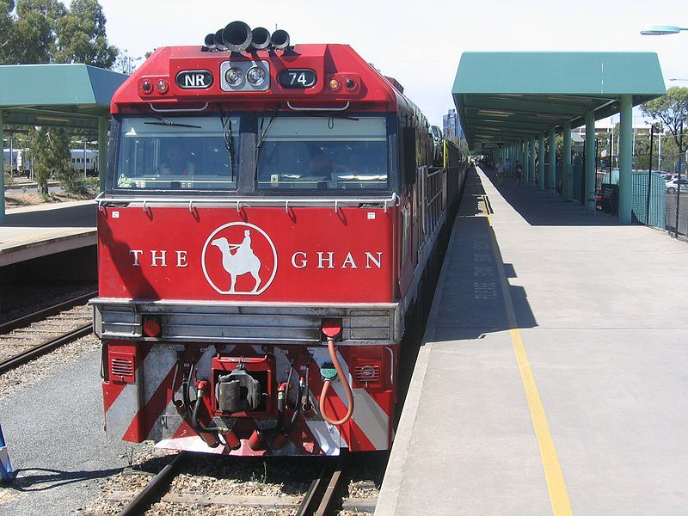
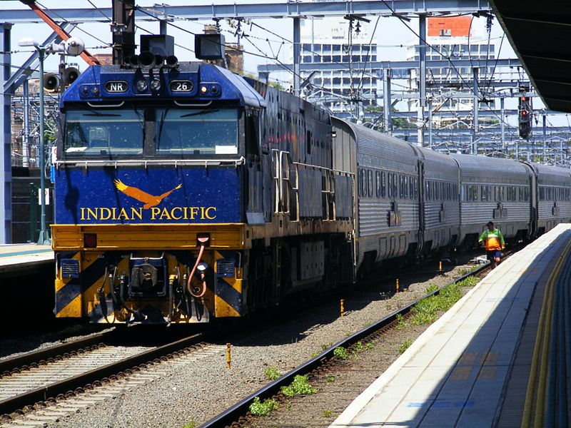
Transcontinental
trains

Slide 12
Economy
rich in minerals / gold, silver, diamonds,
iron ore, zinc, copper, oil, …/
wheat, wool / ¼ of the world´s production /,
wine, fruit
cattle and sheep breeding
export - Asia, the USA
70 % population - in services

Slide 13
Resources
www.en.wikipedia.org/australia
www.en.wikipedia.org/australia/economy
www.en.wikipedia.org/transportinaustralia

