Slide 1

Angličtina: Australia – Political System
Tematická oblast | Angličtina: Australia
Datum vytvoření | 12.5. 2013
Ročník | 2. - 4., sexta – oktáva, B1
Stručný obsah | Informace o politickém systému, včetně základních údajů o Britském společenství
Způsob využití | Seznámení s politickým systémem v Austrálii a a Britským společenstvím. Doplněno o ilustrace a fotografie. V průběhu kontrolní otázka a odpověď.
Autor | Mgr. Jarmila Pytelová
Kód | VY_32_INOVACE_03_APYT02
Gymnázium a Jazyková škola s právem státní jazykové zkoušky Zlín

Slide 2

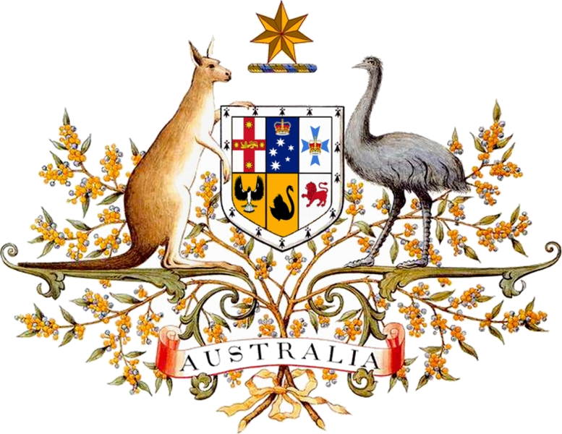
The Australian flag
The coat of arms

Slide 3
Do you know ?
the name of the 7- pointed star on the
Australian flag ?
why there are the emu and the kangaroo on
the court of arms ?

Slide 4
The answers
the Commonwealth Star
Australia is a forward – moving country. Both
animals cannot go backwards.

Slide 5

Australia – the member of the Commonwealth
53 member states
a free association of the UK and its former colonies
the British monarch – their symbolic head
political and cultural links

Slide 6
Basic facts
The Commonwealth of Australia – 1st January 1901
The constitutional monarchy
The head of state - the British Queen
The Governor – General
The Prime Minister – the Head of the Government
The Parliament - the House of Representatives / 150 members /
the Senate / 76 members /
The most powerful political parties – Labour Party
Liberal Party
National Party

Slide 7
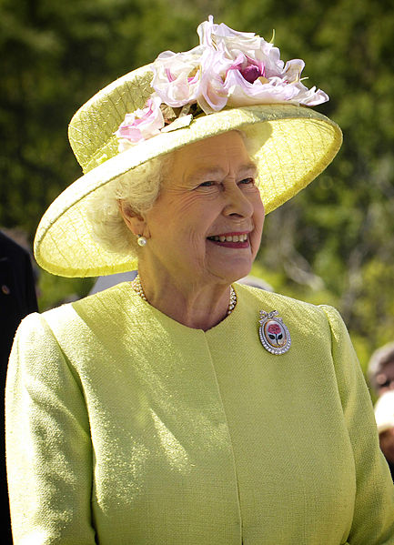
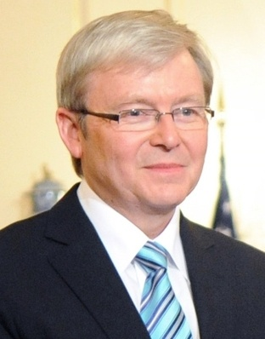
Kevin Rudd - the PM
The Queen – the Head of
Australia

Slide 8
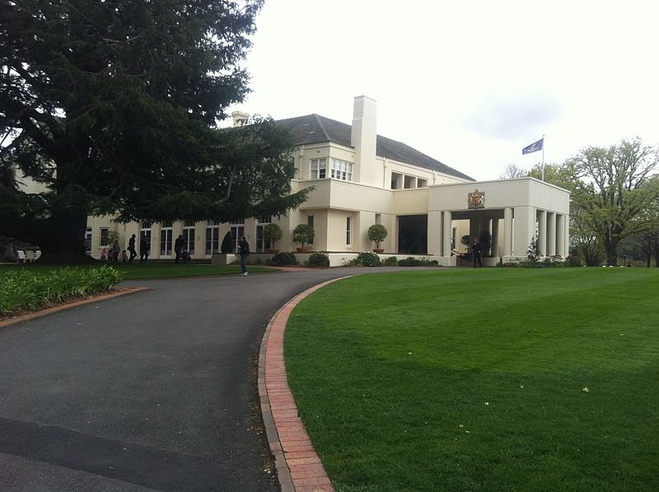
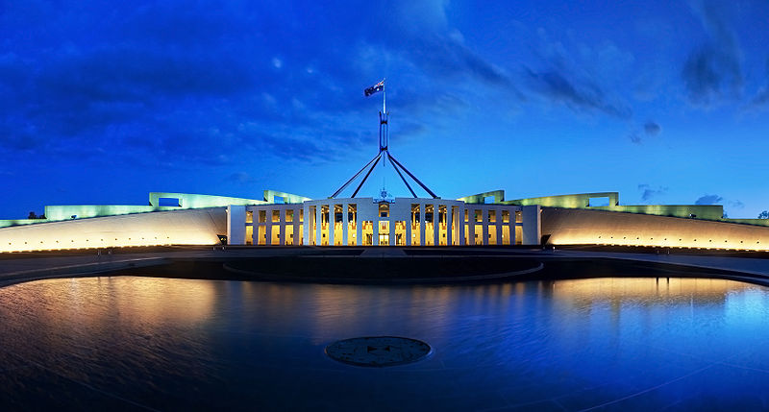
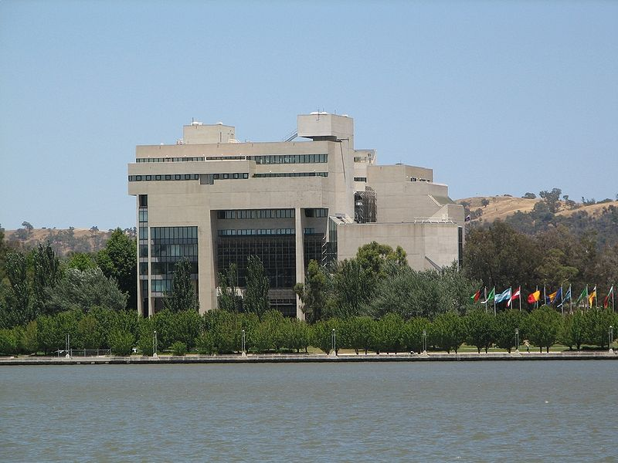
The Parliament House – the seat of the Government
Yarralumla – the seat of the Governor General
The High Court in Canberra

Slide 9
Sentence completion
The Queen is a ……………………. head of Australia.
The Commonwealth is formed by the UK and its …………. colonies.
………………. is the seat of the Federal Government.
The Parliament consists of the …………………….. and the ……………….. .
………………. can be seen only in the Southern hemisphere.

Slide 10
The solution
The Queen is a symbolic head of Australia.
The Commonwealth is formed by the UK and its former colonies.
The Parliament House is the seat of the Federal Government.
The Parliament consists of the House of Representatives and the Senate.
The Southern Cross Constellation can be seen only in the Southern
hemisphere.

Slide 11

Resources
www.en.wikipedia.org/ australia/government
www.en.wikipedia.org./commonwealth

