Slide 2
The early history
50,000 years ago – first Aborigines arrived from
Indonesia
17th century – New Holland / Dutch sailors and
explorers – the West and the North /
Abel Tasman
1770 - James Cook explored and mapped the
eastern coast / NSW /

Slide 3

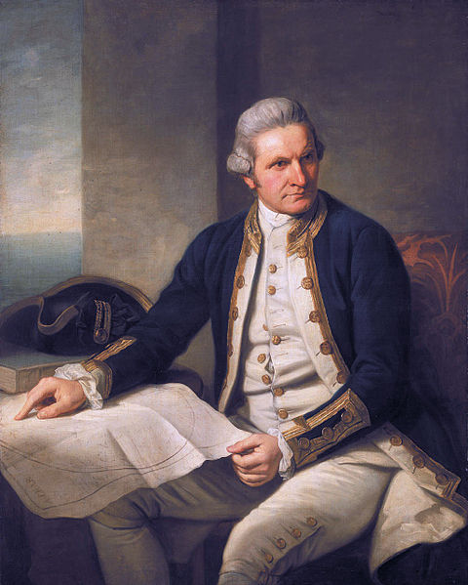
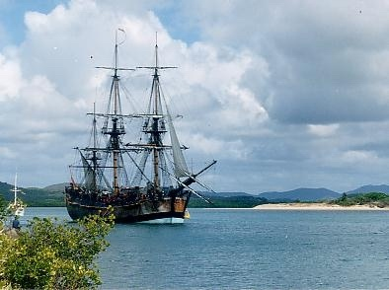
Endavour replica anchored in Cooktown harbour / QLD /
James Cook
the British explorer

Slide 4
Australia - a penal colony
January 1788 - the First Fleet landed at Botany Bay
approx. 750 convicts + soldiers with their families
26th January 1788 - the arrival of the First Fleet at
Port Jackson / now part of Sydney /
the first British colony was founded
1860s - transports of prisoners stopped

Slide 5
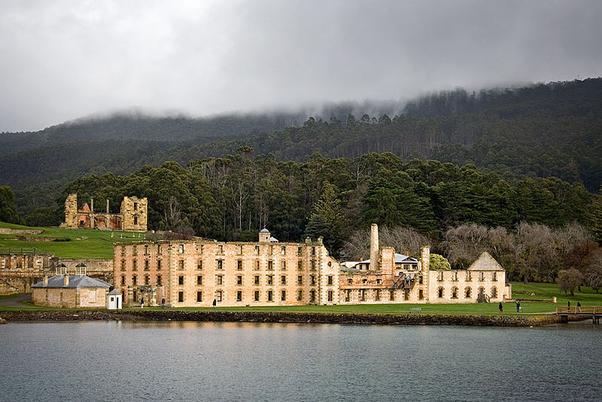
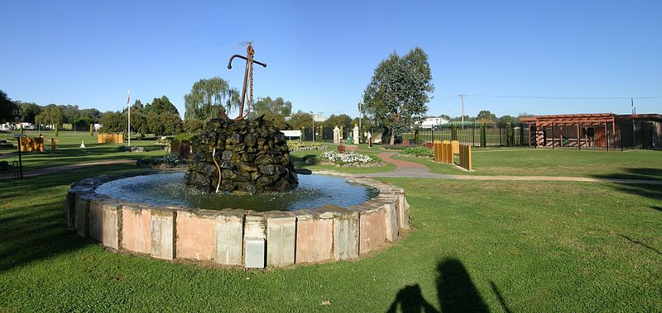
Port Arthur
a penal settlement / TAS /
The First Fleet Memorial
Convicts are named on stone tablets
along garden pathways

Slide 6
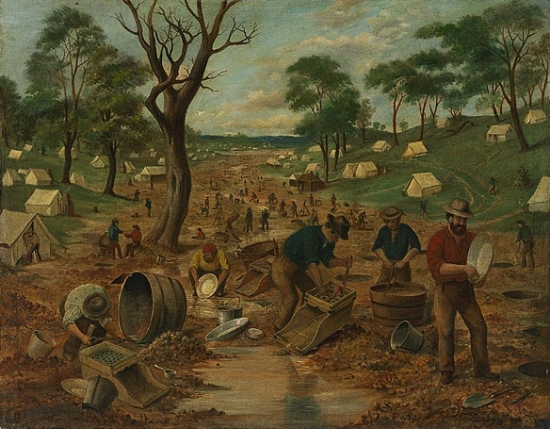
The Gold Rush
1851 - started in the east / NSW/
the growth of the population / 400,000 in 1851 x over 1 mil. in 1862

Slide 7
Why did the population grow so sharply ?

Slide 8

Those who didn´t find enough gold to pay the return journey had to stay there.

Slide 9

1st January 1901 - The Commonwealth
of Australia
Australia Day celebrated in Perth, WA

Slide 10
Resources:
www.en.wikipedia.org/historyofaustralia
www.en.wikipedia.org/goldrush

