Slide 2
Do you know Aborigines?
arrived from Indonesia 50, 000 years ago
more than 500 tribes and languages
they were nomads
no written language
tools made from bones, stone, wood
men were hunters
women looked for plants and small animals

Slide 3
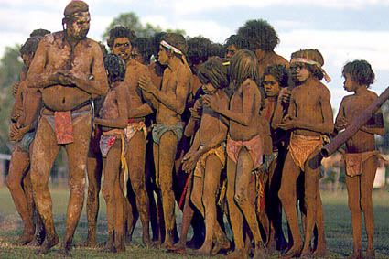
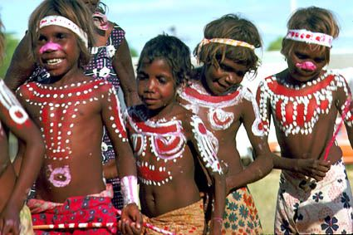

Slide 4

Dreamtime
A sacred period for Aborigines
The earth / nature and people / was formed by Aboriginal gods
The gods turned into rocks, trees, stars
Stories about these gods
Music, dance, paintings

Slide 5
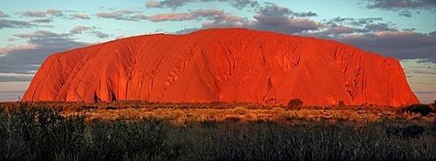
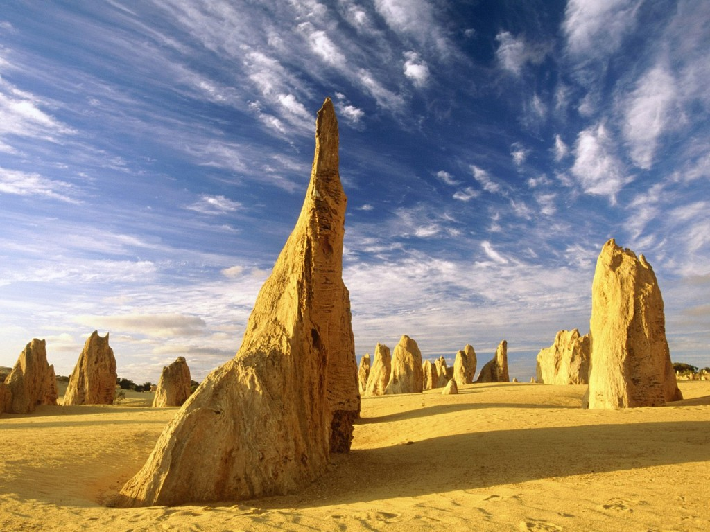
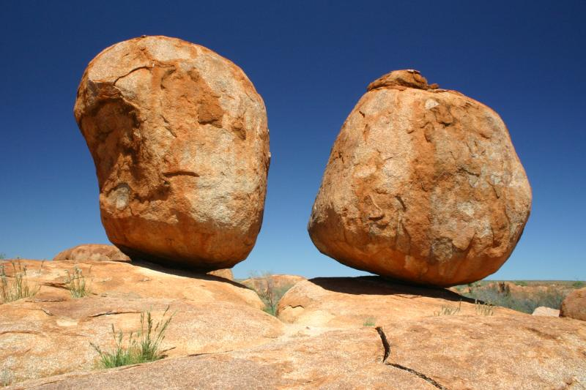
Places associated with the Dreamtime
Uluru
Devil´s Marbles
The Pinnacles

Slide 6
Can you answer these questions?
Why is Ayers Rock connected with
the Dreamtime?
How were Aboriginal legends kept
alive?
Name a typical weapon used by
Aborigines.

Slide 7
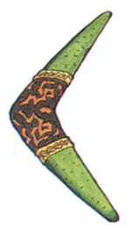
The correct answers
There are rock paintings in the caves
inside the rock
By storytelling , songs and dances.
A boomerang

Slide 8

Aborigines nowadays
the end of traditional lifestyle
their population declined
2% of the total population / 500, 000 /
poverty, alcohol, disease
lower levels of education and life expectancy
their art, musical instruments and artefacts in museums
successful sportswomen

Slide 9
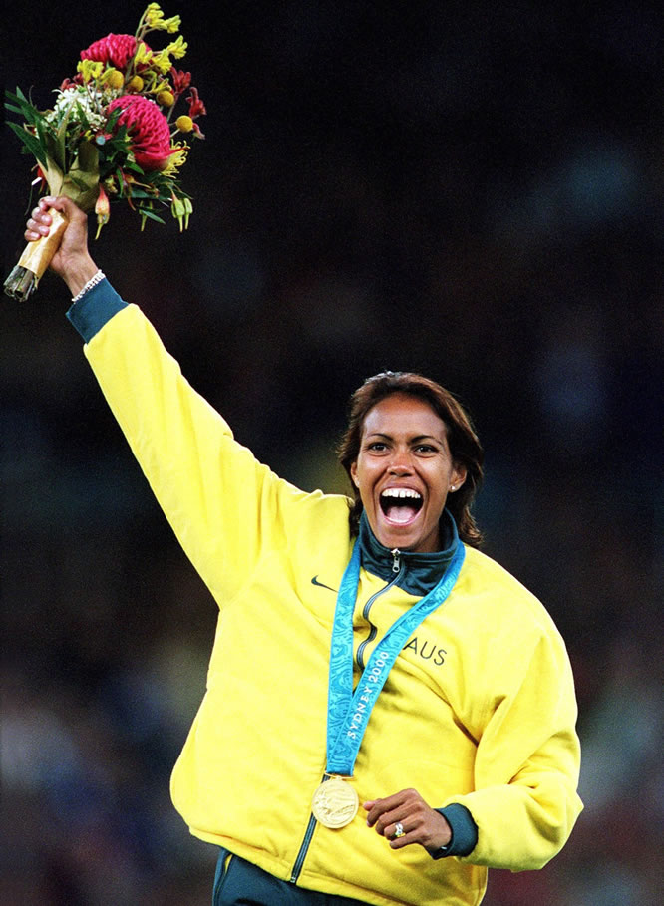
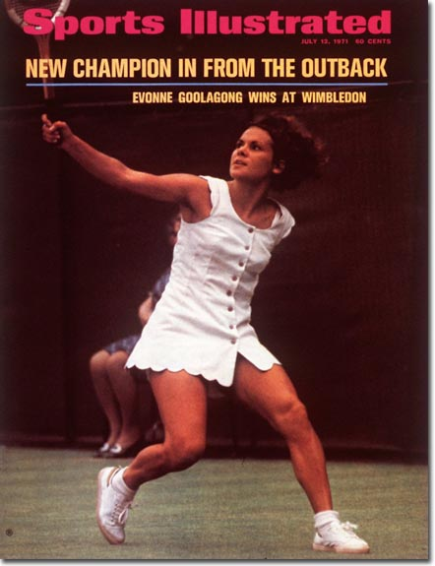
Evonne Goolagong – a tennis player
Cathy Freeman – a runner

Slide 10

Resources:
www.en.wikipedia.org/indigenousaustralians
www.en.wikipedia.org/dreamtime
www.infinityholidays.com.au

