Slide 2
Population - basic facts
25 million
80 % - European ancestors
¾ British
Italian, Greek, German
15 % - Asia / Chinese, Indian, Vietnamese, Philippino … /
2,5 % - Aborigines
2 of every 7 Australians - born in another country
low density - 3 inhabitants / sq km
¾ of the population - in cities and coastal areas
the most populated states and the largest cities:
NSW - 7million Sydney – 4,6 million
VIC - 6 million Melbourne – 4,2 million
QLD - 5 million Brisbane – 2,1 million
the outback - large uninhabited areas

Slide 3
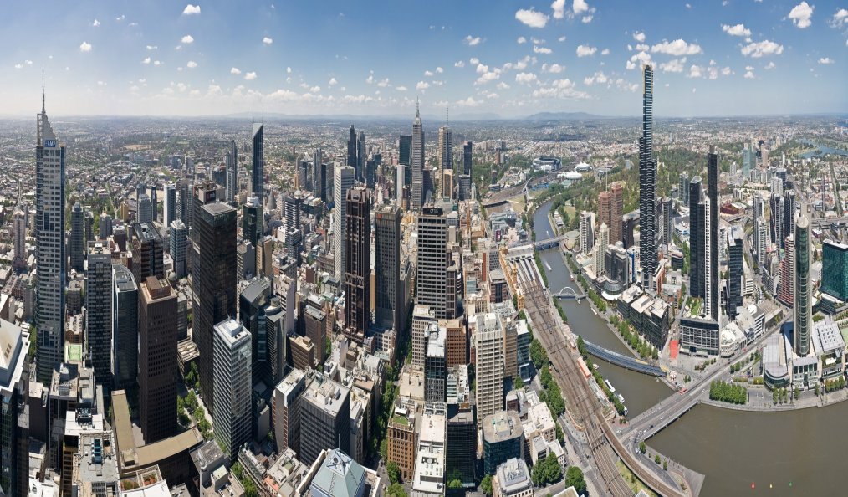
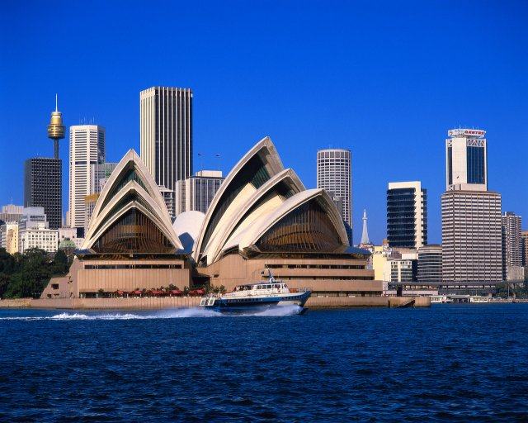
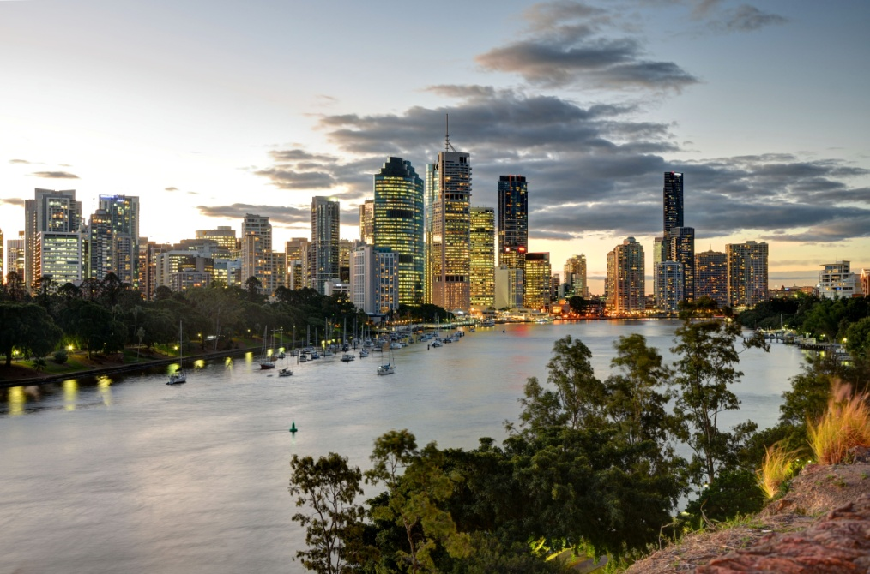
Melbourne
Sydney
Brisbane

Slide 4
Languages
Australian English – 80 %
Aboriginal languages - 20 languages in use
fauna,flora , nature words/ koala, dingo, billabong/
other languages: Indian, Chinese, Vietnamese, Italian, Greek
Do you know 1 million Australians speak a little or no English at all ?

Slide 5
Can you match the Australian words and expressions to their British E. synonyms ?
joey a) friend
tucker b) a long time
bucks c) badly paid job
billabong d) food
dunny e) kangaroo baby
bludger f) Australian dollars
mate g) outside toilet
bush telegraph h) dead arm of the river
yonks i) lazy person
peanuts j) local gossip network

Slide 6
Solution
e
d
f
h
g
i
a
j
b
c

Slide 7
Australian English
called Strine
influenced by Cockney dialect
innovative
lots of shortened words / Aussie, vegies,barbie /
lots of suffixes / tin – tinnie /
pronunciation / ei pronounced ai , such as day,
mate /
strong accent
unique words / jumbuck, bush, swagman, … /

Slide 8

Complete full words of these shortened ones
blowie
sunnies
bizzo
greenie
hubby
bickie
mozzie
footy
roo
coldie

Slide 9
Solution
blowfly
sunglasses
business
environmentalist
husband
biscuit
mosquito
football
kangaroo
cold beer

Slide 10
Resources :
www.en.wikipedia.org/populationofaustralia
www.en.wikipedia.org/australia/languages
www.en.wikipedia.org/australianenglish

