Slide 2
Basic facts
a mixture of
native Australian food / called bush tucker /
Mediterranean / Greek, Italian cuisine /
Southeast Asian / Indian,Thai,Chinese,Vietnamese
almost any cuisine in the world available
meat – beef, lamb, fish, game
popular fast food chains – McDonald´s, KFC, Pizza Hut
take – away food / meat pies, sausage rolls/
picnics and barbecues - addicted

Slide 3
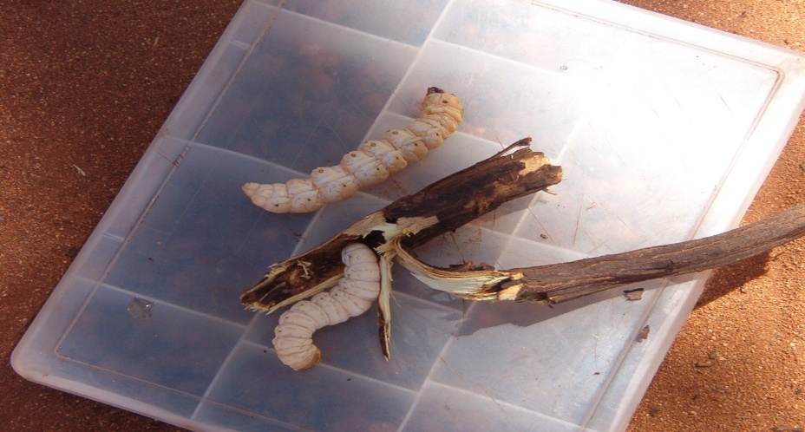
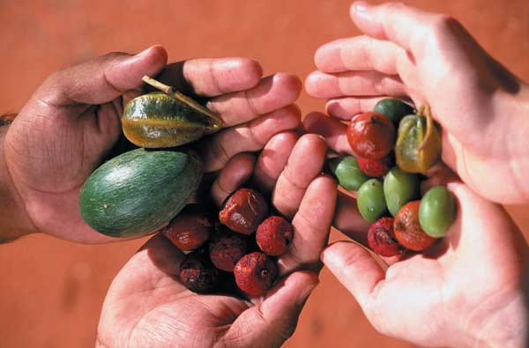
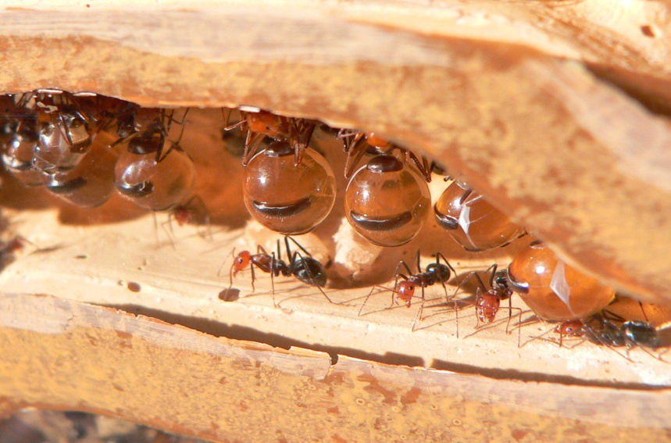
Bush tucker
Witchetty grubs
large wood - eating larvae
Bush berries
Honey - ants

Slide 4

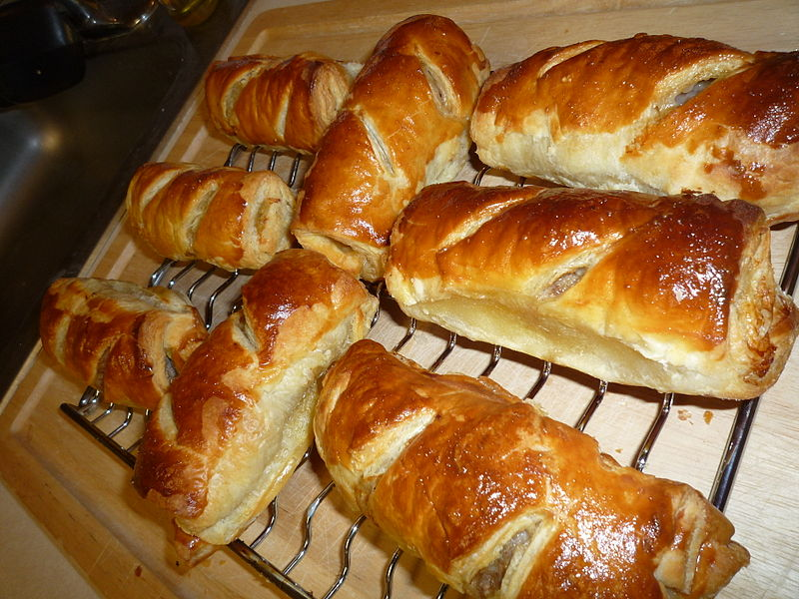
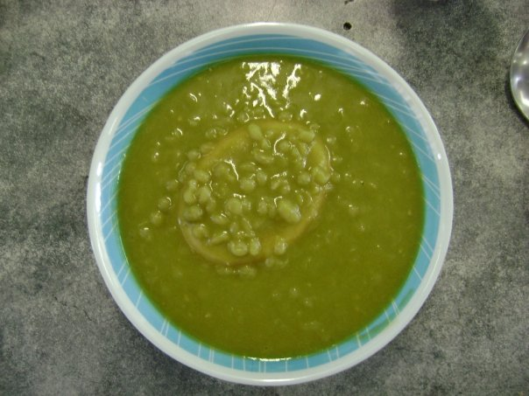
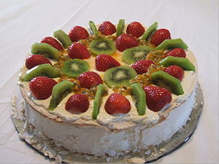
Traditional and popular
sausage rolls
A pie floater – meat pie in thick pea soup
Pavlova dessert with fruit and cream

Slide 5
Drinks
coffee – Italian influence
quality wines
alcohol sold in special shops only / bottle shops /
beer : stand and drink at the bar
special troughs around the bar / for rubbish, food, … /

Slide 6
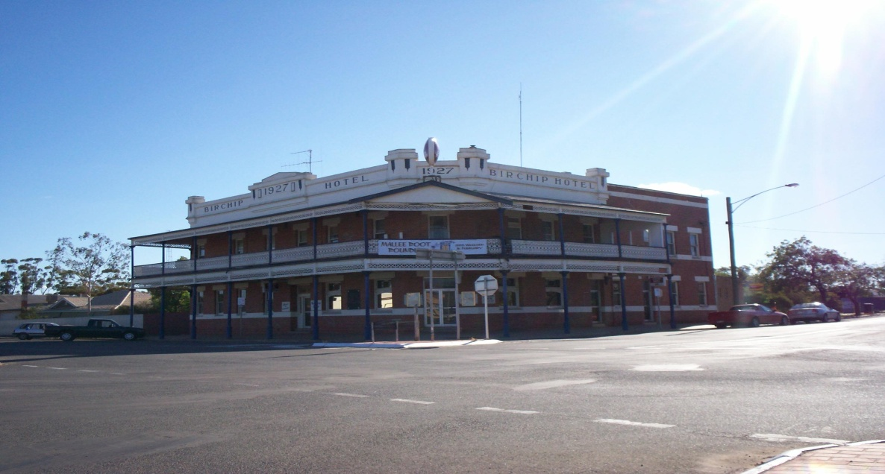
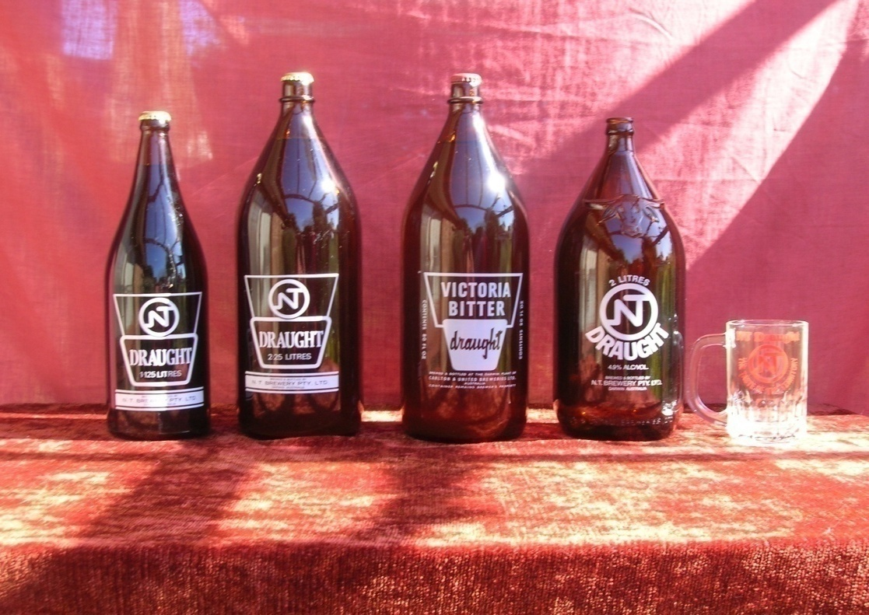
Australian pub
bottled beer

Slide 7
What is B.Y.O. ?

Slide 8
A restaurant where you can bring your own alcohol.

Slide 9
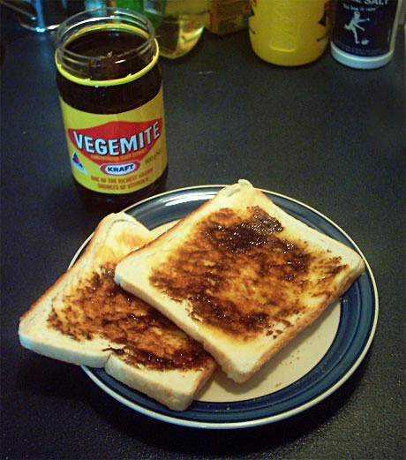
Vegemite
made from yeast
unique taste – a bit saulty
full of vitamins
served spread on a cracker or a toast with butter

Slide 10
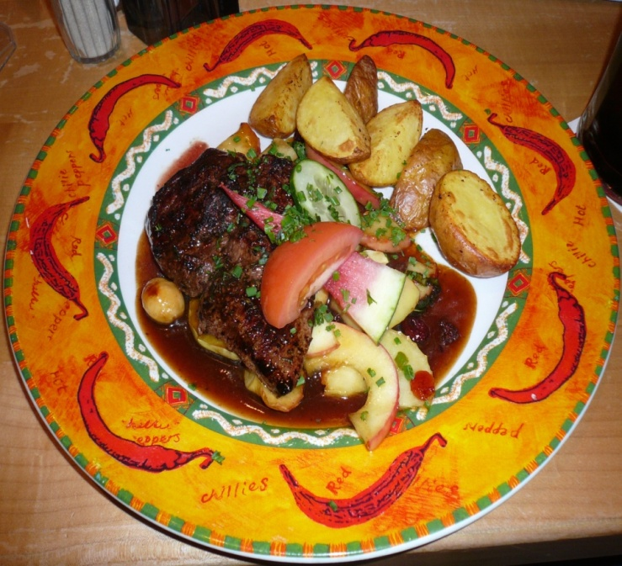
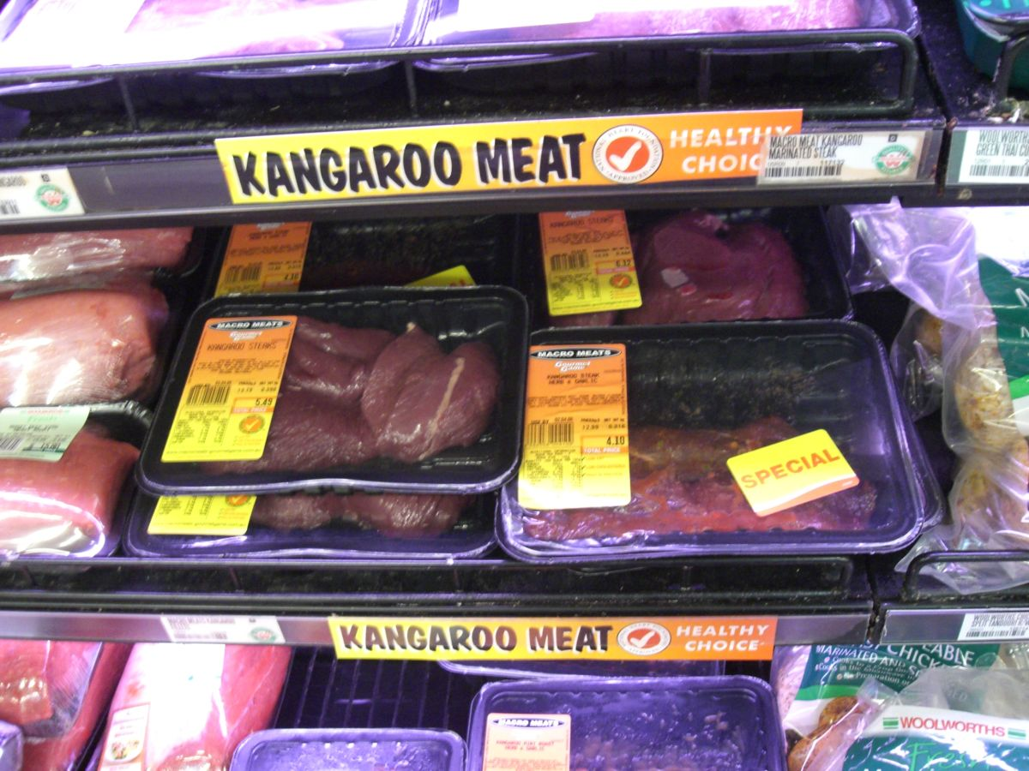
Kangaroo meat
red, tender
a bit sweet flavour
high in proteins
low in fat
similar to beef
packed in supermarkets / fillets, steaks
kanga bangas / sausages /

Slide 11
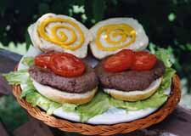
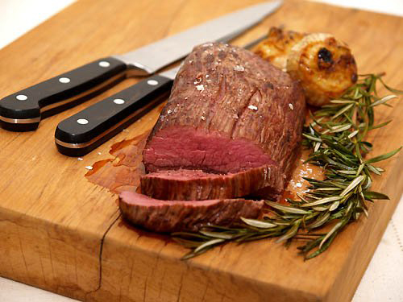
Emu meat
low – fat
lean
red
emuburger
roasted emu

Slide 12
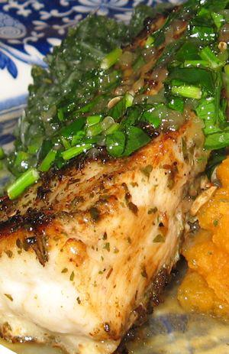
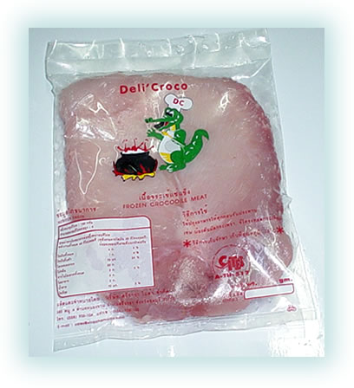
Crocodile meat
low – fat
white
higher cholesterol level
popular barbecue meat

Slide 13
Resources:
www.en.wikipedia.org/australiancuisine
www.en.wikipedia.org/iconicaustralianfoods
www.bushtuckerrecipes.com
www.en.wikipedia.org./kangaroomeat

