Slide 2
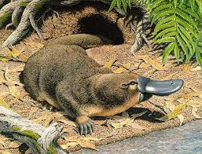
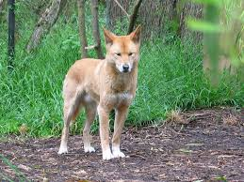
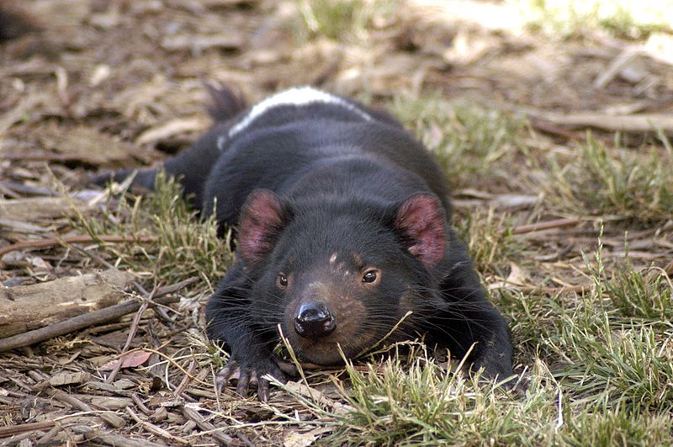
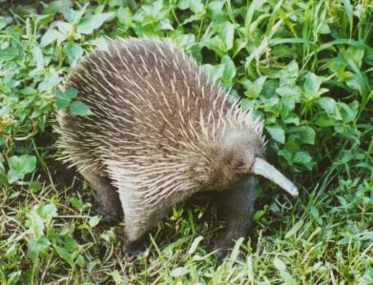
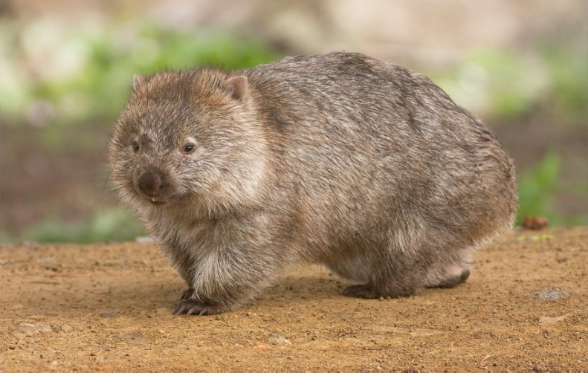
Do
platypus
dingo
you
know
wombat
Tasmanian devil
these?
echidna

Slide 3
Why do these animals live only in Australia?

Slide 4
The continent had been separated from other parts of the world before the first
Europeans settled here.

Slide 5
Animal species
over 260 species of marsupials / koala, kangaroo,
wombat, … /
over 750 species of birds / lyrebird, kookaburra,
cockatoo, parrots, … /
a large range of reptiles / crocodile, lizard, snakes /
marine creatures / dolphin, penguin , shark, 4,000
species of fish /

Slide 6
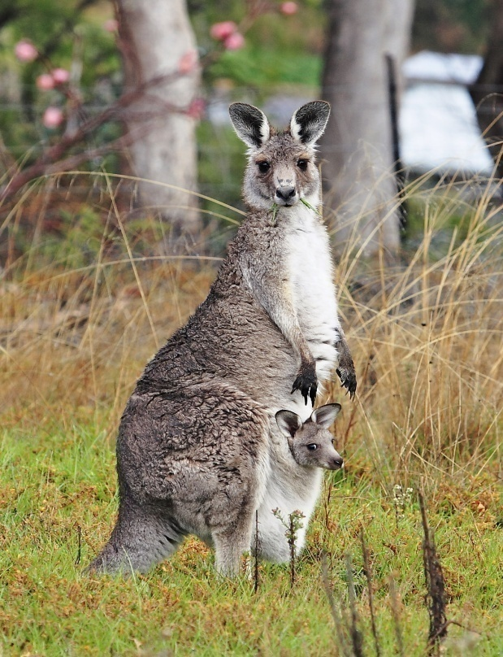
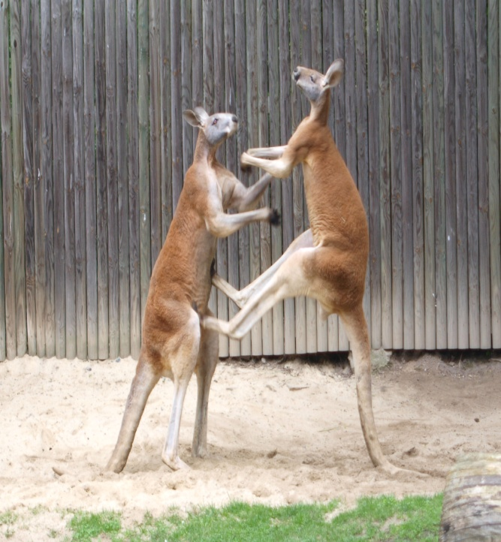
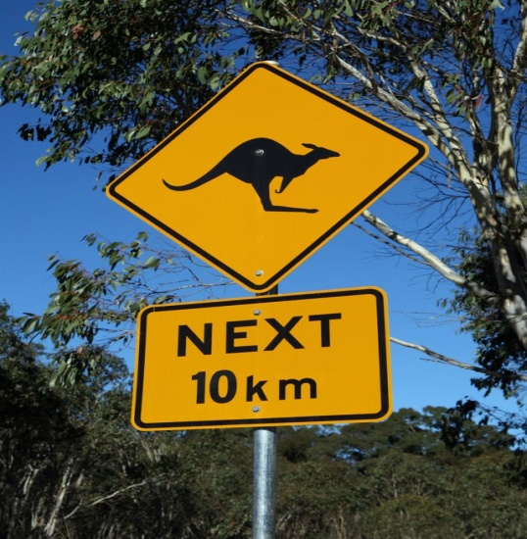
THE KANGAROO
gangurru in Aboriginal languages
60 kinds / the red one = boomer /
- 2,4 m high
- 70 – 90 kg
- jumps more than 4 m
strong back legs and the tail
eats grass and leaves
has a pouch for its baby
their fights look like boxing
on the Australian one - dollar coin

Slide 7
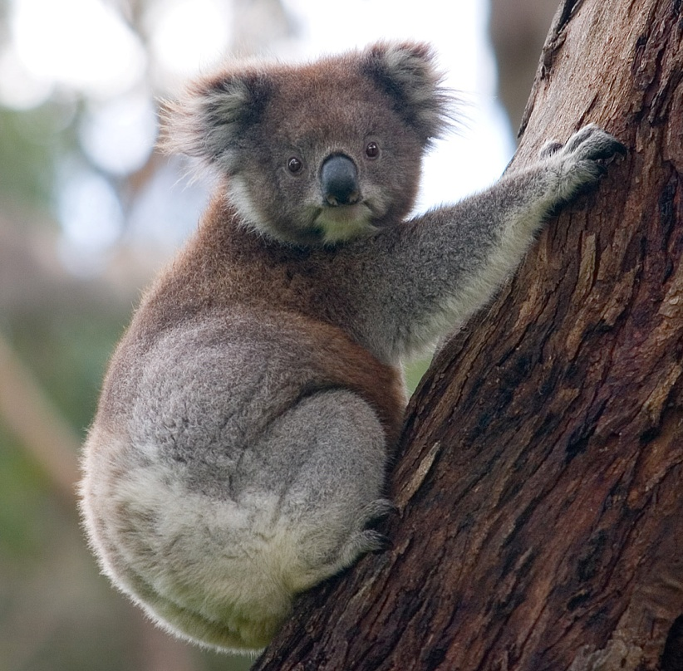
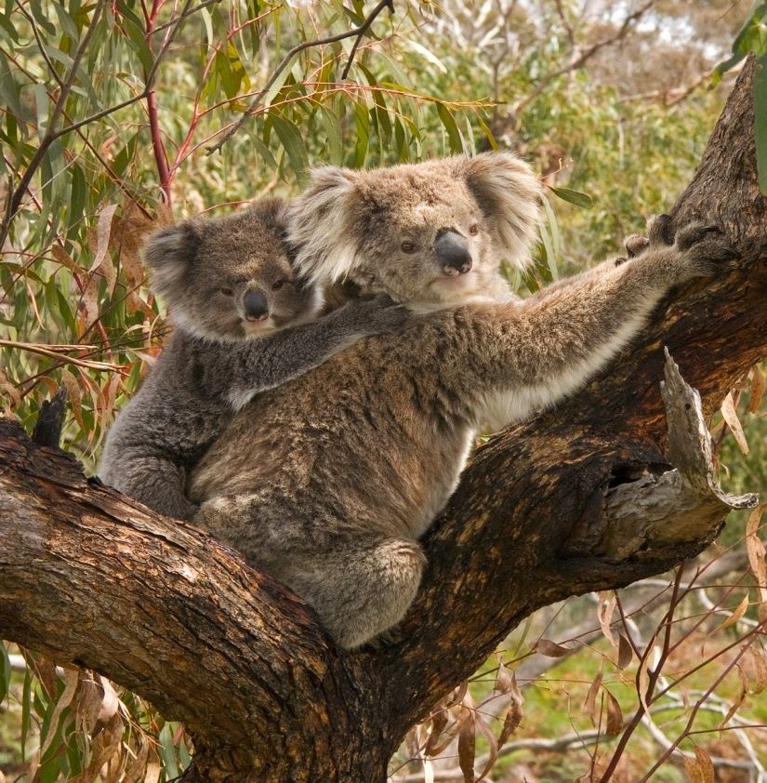
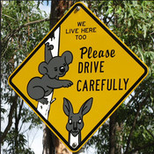
The koala
from Aboriginal word no drink
in eucalyptus trees
sleeps 18 hours a day
has a pouch on its front
babies are born blind and hairless
babies spend 6 months in the pouch

Slide 8
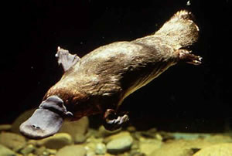
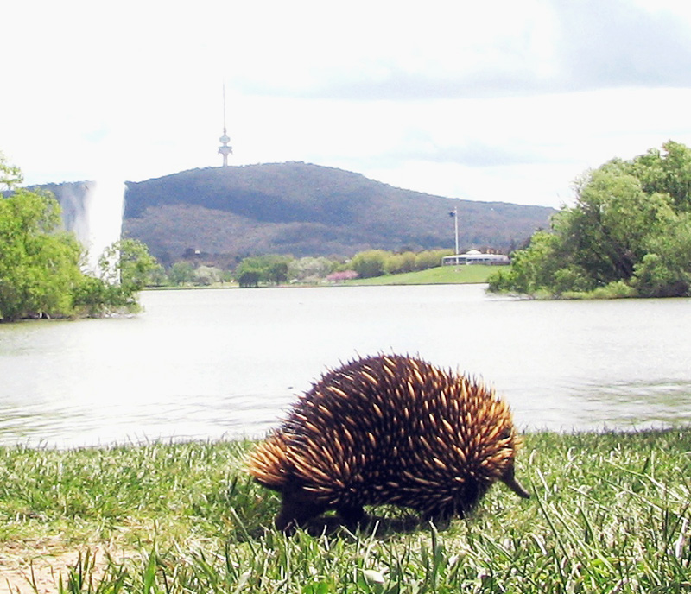
The platypus
a small furry mammal
lives on river banks / in water and on land/
lays eggs
has a duck – like bill and feet
shuts eyes and ears in water
on a 20-cent coin
The echidna
babies are born from eggs
drinks mother´s milk
catches food with its long tongue
eats ants and termites
has no teeth

Slide 9
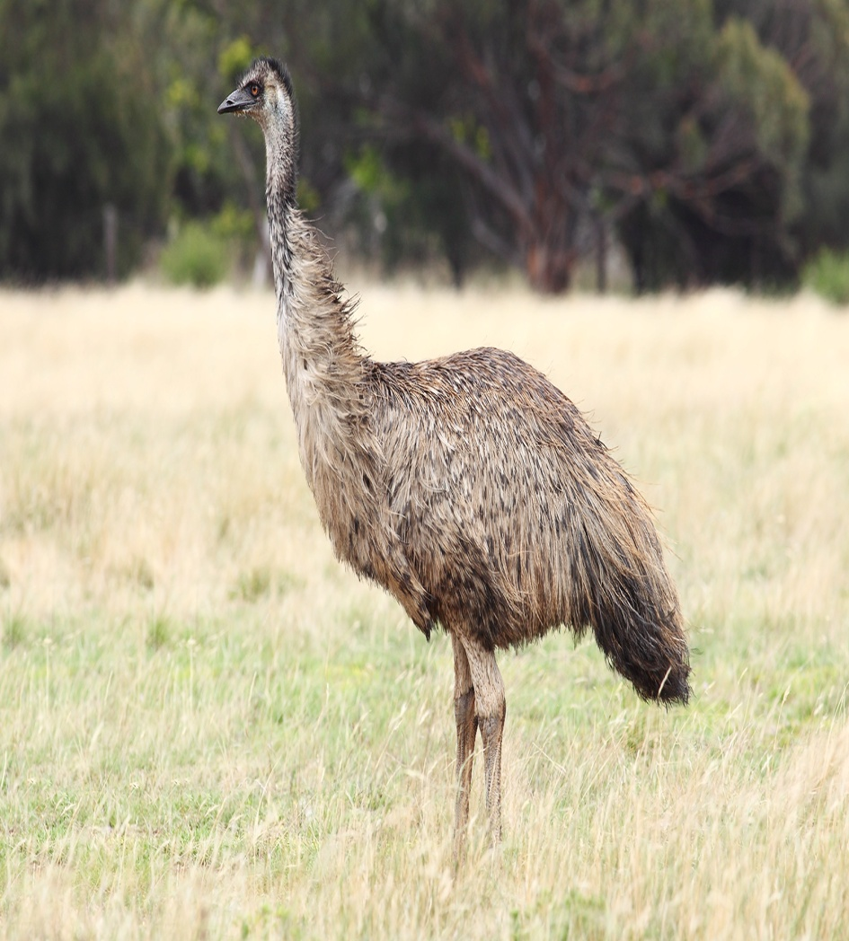
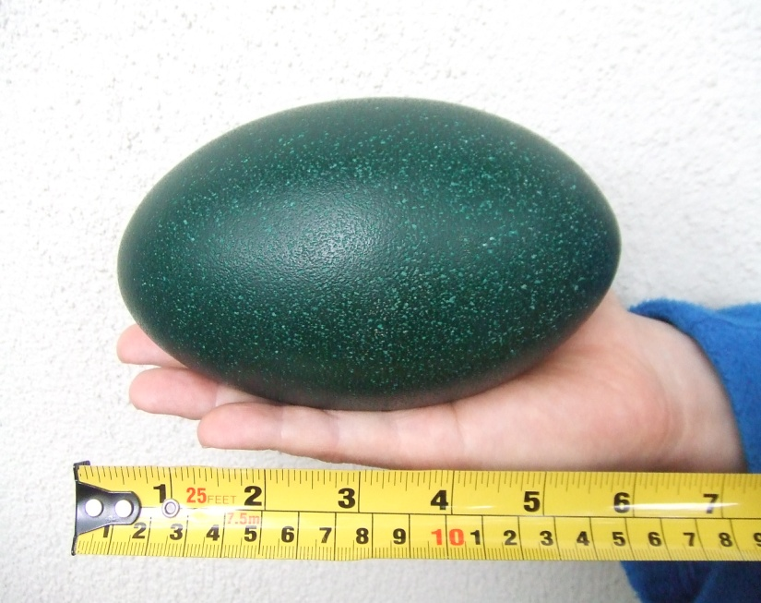
The emu
similar to ostrich
3 toes on each foot
2 m tall and 35 kg
runs very fast / 50km /hour
cannot fly
on the 50 – cent coin

Slide 10
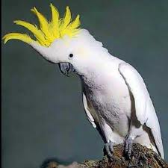
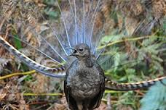
Birds
The cockatoo
a big and white bird
lives over 100 years
very intelligent
trained to talk
The lyrebird
lives on the ground
has a beautiful long tail
an excellent imitator/ a crying baby,
a mobile phone, a car engine …/

Slide 11

Whose cry sounds like somebody´s
laughing ?

Slide 12
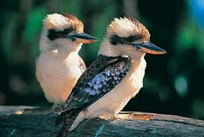
The kookaburra

Slide 13
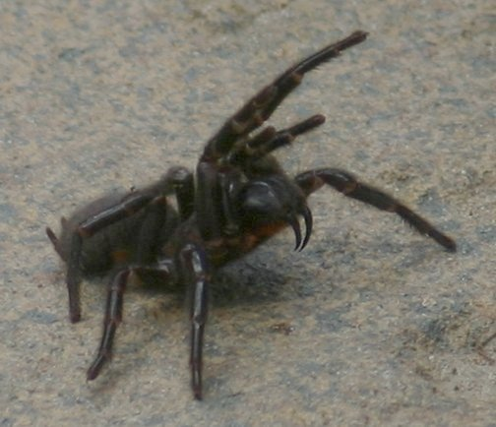
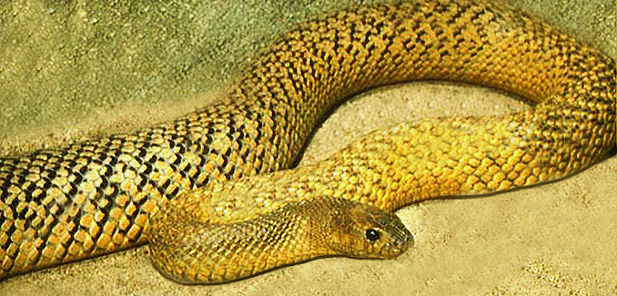
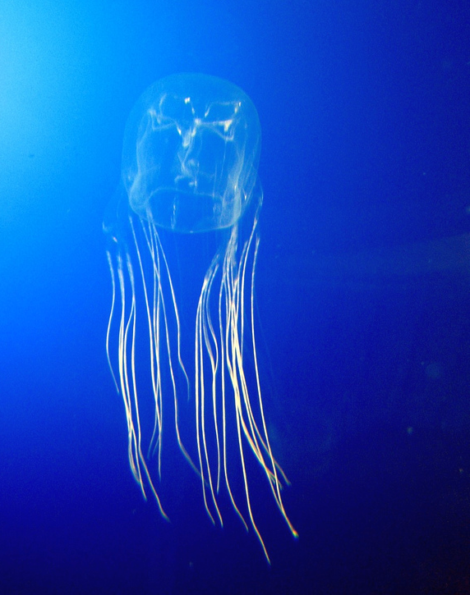
Do you know ?
The box jellyfish is the world´s most poisonous marine creature
The Sydney Funnel Spider is the world´s most deadly spider / in less than 2 hours /
The inland taipan is the most poisonous snake
Tasmanian Pine is the world´s oldest tree / 10,500 years /

Slide 14
Resources:
www.en.wikipedia.org/faunaofaustralia
www.en.wikipedia.org/kangaroo
www.en.wikipedia.org/koala
www.en.wikipedia.org/emu
www.en.wikipedia.org/platypus
www.en.wikipedia.org/echidna
www.en.wikipedia.org/birdsofaustralia
www.en.wikipedia.org/reptilesofaustralia
www.en.wikipedia.org/insectofaustralia

