Slide 2
Basic facts
a variety of festivals all the year round
national and local festivals / music, arts, sport, … /
Sydney and Melbourne – festival cities
South Australia – The State of Festivals
public holidays : New Year´s Day / 26th January /
Australia Day
Good Friday and Easter Monday
ANZAC Day / 25th April /
Queen´s Birthday / 2nd Monday in June x WA in September/
Christmas Day
Boxing Day

Slide 3
AUSTRALIA DAY
celebrated on 26th January
commemorates the foundation of the 1st British settlement
Sydney Harbour – the centre of the celebrations
Ferrython / 4 ferries compete to pass under the Bridge first /
new immigrants receive the Australian citizenship
playing and watching sports
barbecues
fireworks

Slide 4
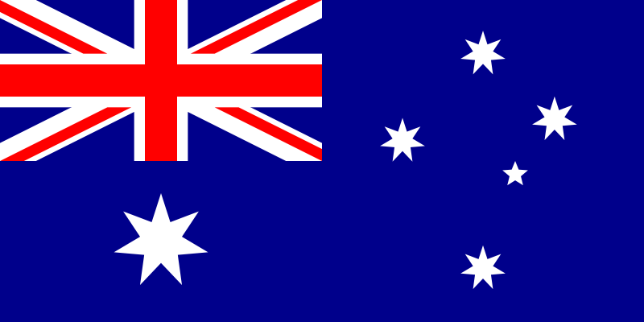
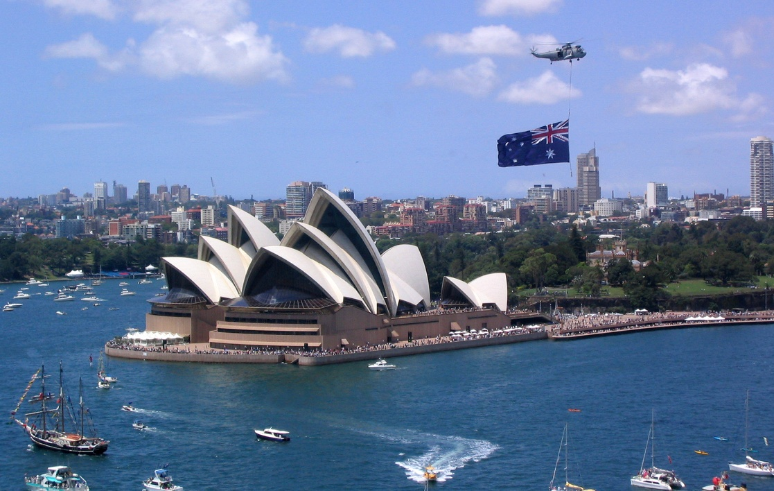
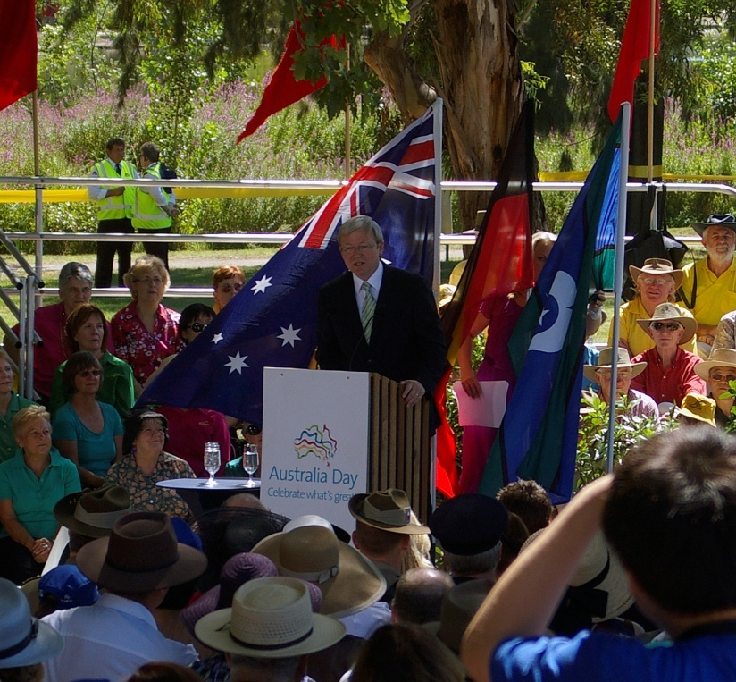
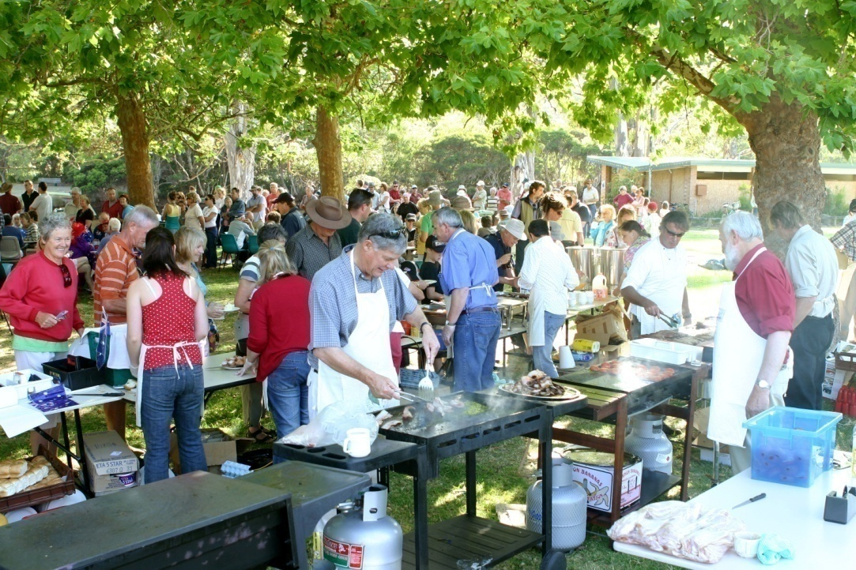
AUSTRALIA
DAY

Slide 5
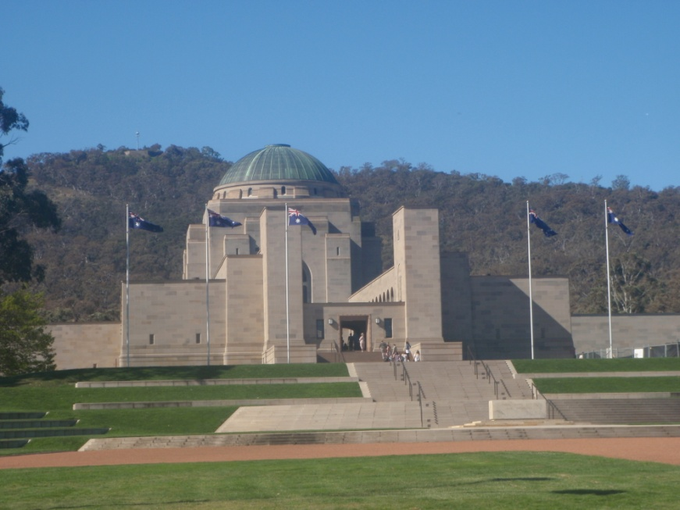
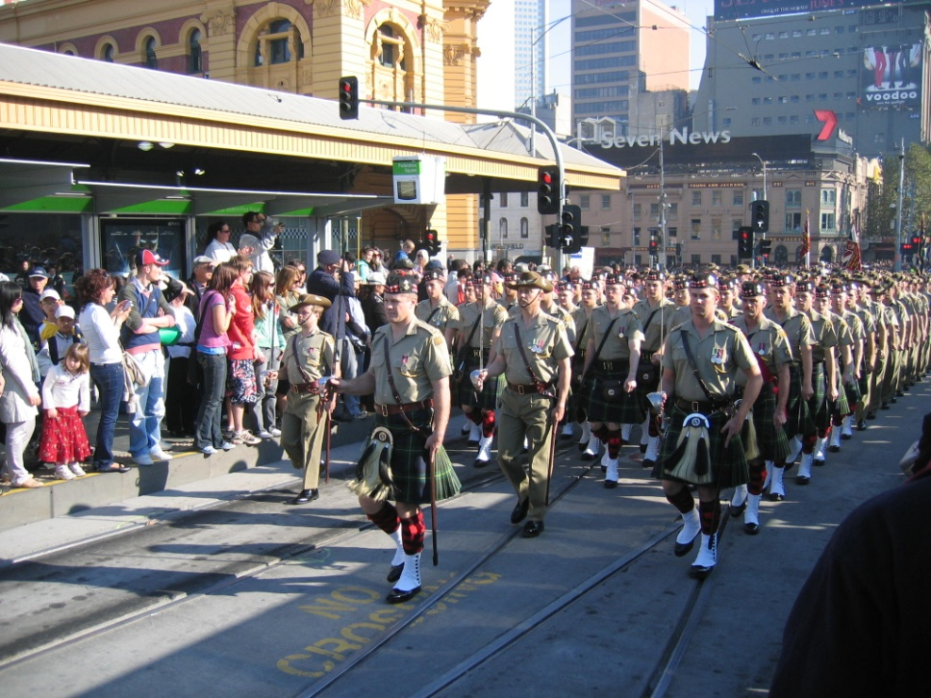
ANZAC DAY
celebrated on 25th April
remembers Australian soldiers died in World Wars
the morning mass at war memorials
war veterans march in parades
The Australian War Memorial- ACT

Slide 6
What does ANZAC
mean ?

Slide 7
Australia and New Zealand
Army Corps

Slide 8
Christmas Time
a variety of traditions is kept / multicultural society /
80 % - similar to British Christmas
Christmas and Boxing Day
Jingle Bells and other carols
Christmas pudding
red fur – coated Santa Claus riding a sleigh
BUT in Australia
wear summer clothes
have Christmas dinner on the beach
-- turkey, ham or chicken with roasted vegetables
-- barbecue
sending Christmas cards
New Year´s Eve – the biggest celebrations in Sydney

Slide 9
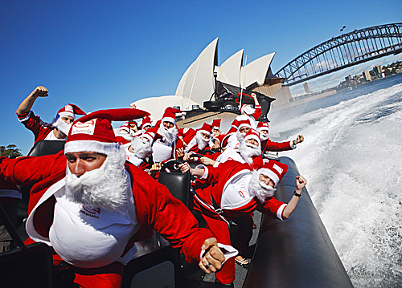
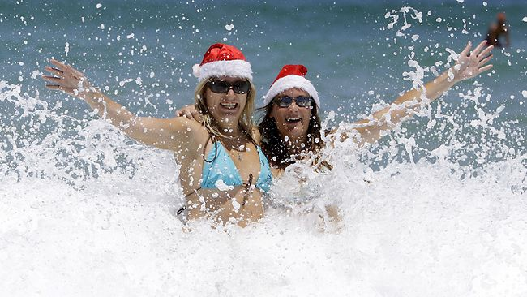
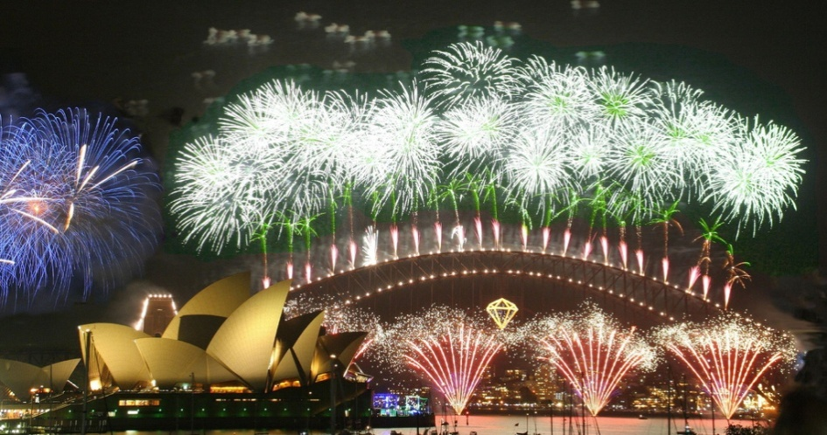
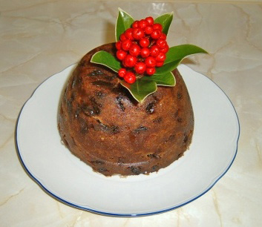
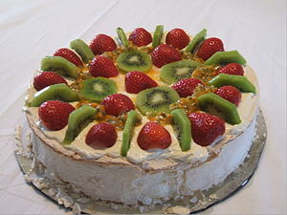
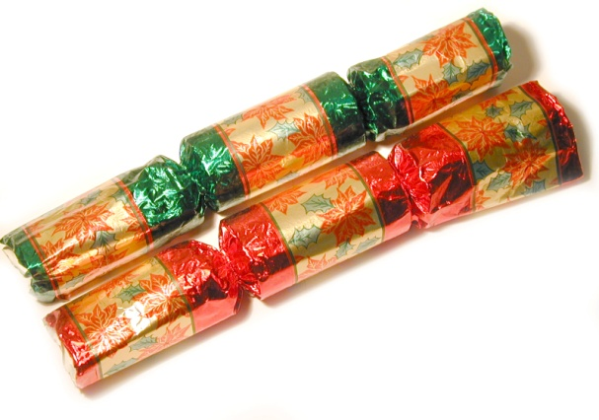
XMAS

Slide 10
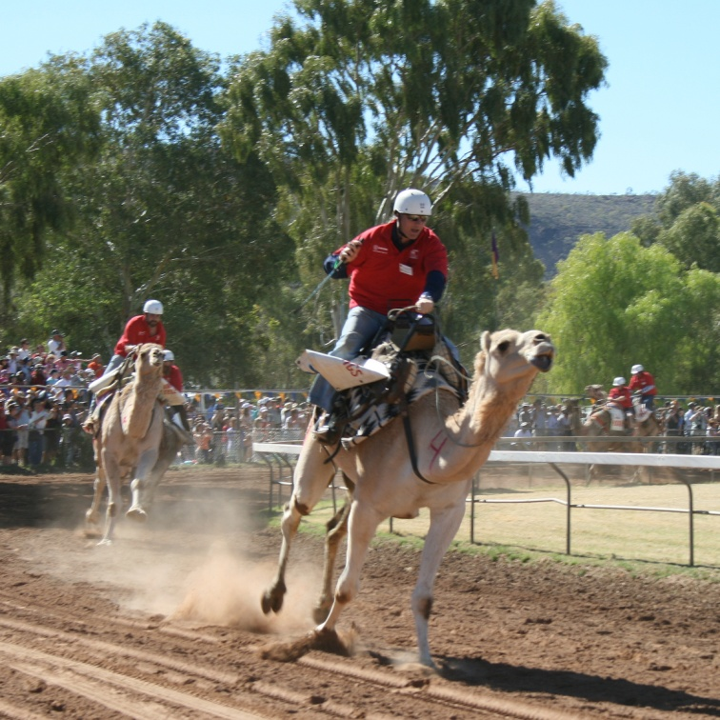
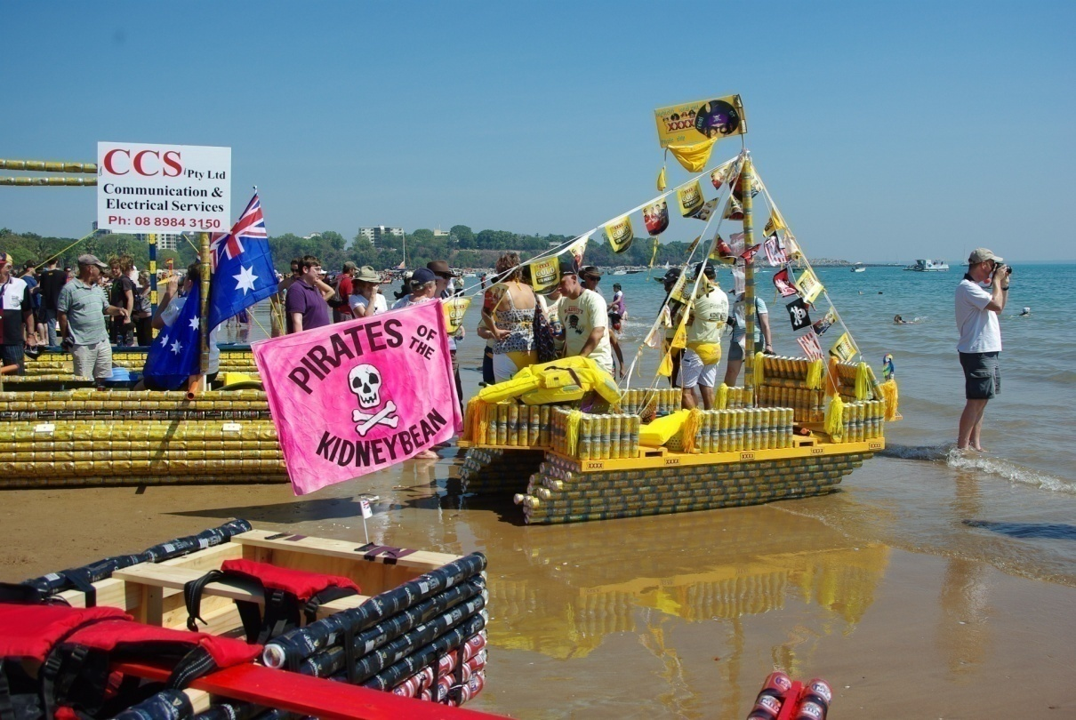
Other popular festivals
Beer Car Regatta Darwin
Camel Cup Darwin

Slide 11
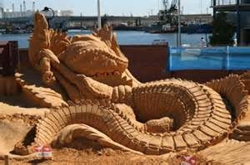
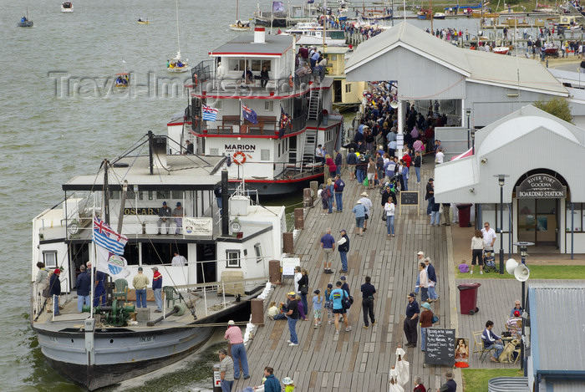
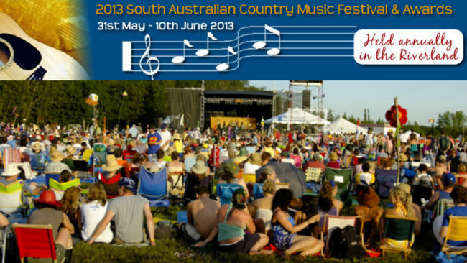
… and these ?
Sand Sculpture Exhibition
Australian Wooden Boat Festival
Country Music Festival

Slide 12

Resources:
www.en.wikipedia.org/festivalsinaustralia
www.en.wikipedia.org/australiaday
www.en.wikipedia.org/anzacday

