Slide 2
Do you know …. ?
3 top popular sports in Australia ?
any sporting events held in Australia?
when and where in Australia the Summer
Olympic Games took place ?

Slide 3
Check your answers
Australian Rules Football
Cricket
Horse racing
Australian Open / Grand Slam tennis tournament/
Grand Final / Australian football/
F1 motor racing / Melbourne /
Sydney – Hobart Boat race
Melbourne 1956
Sydney 2000

Slide 4
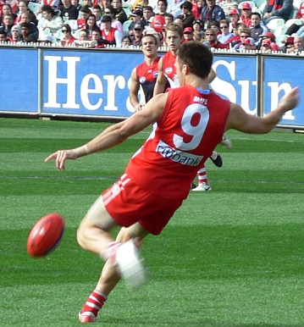
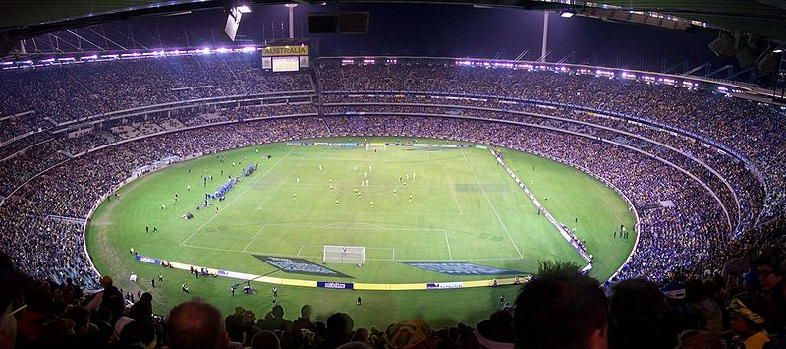
Australian Rules Football
2 teams of 18 players
played on an oval field
the oval ball can be kicked or carried
Grand Final – Melbourne last week in September
Melbourne Cricket Ground – the world´s largest
/ 100,000 spectators /

Slide 5
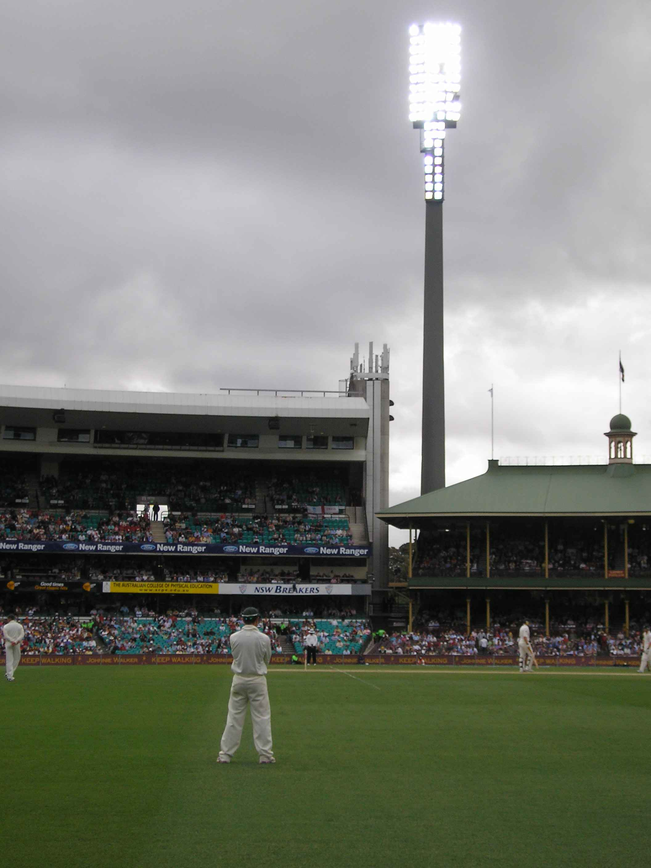
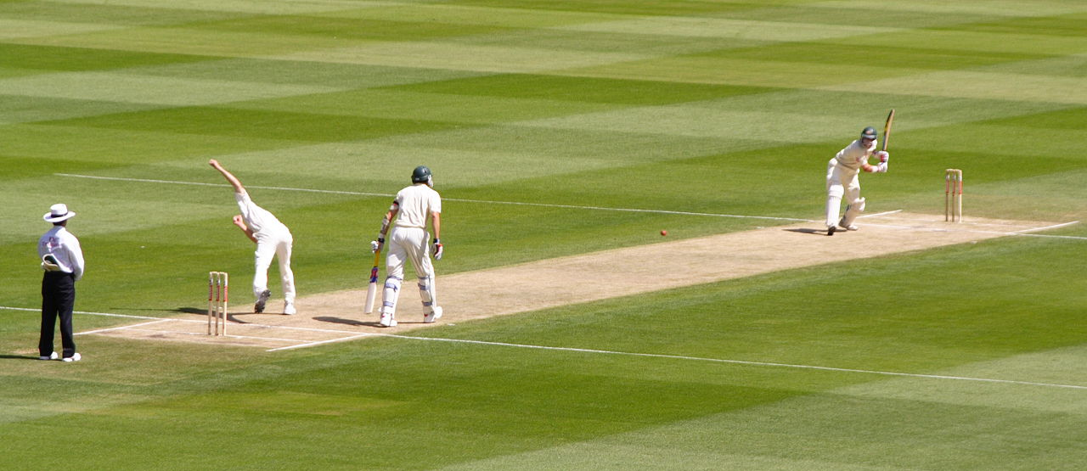
CRICKET
2 teams of 11 players in white
5 – day matches / traditional/
1-day or 3-hour match / modern, gripping /
one of the best teams in the world
spectators – polite, no rude gestures
Sydney Cricket Ground / 40,000 spectators /
Sydney Cricket Ground

Slide 6
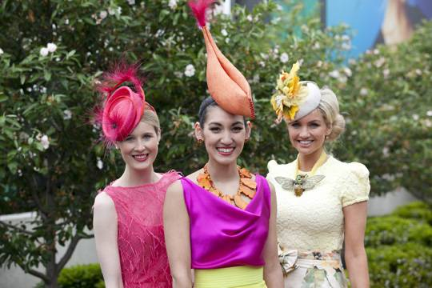
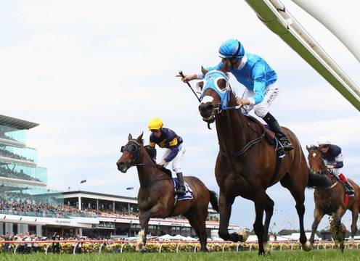
HORSE RACING
Melbourne Cup
first Tuesday in November
the biggest horse race
crowded pubs all over Australia
on Tv and radio
Fashion on the field

Slide 7

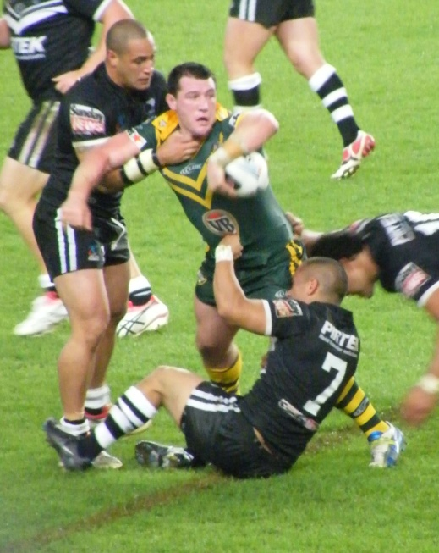
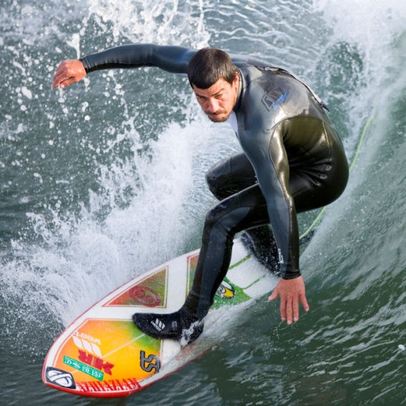
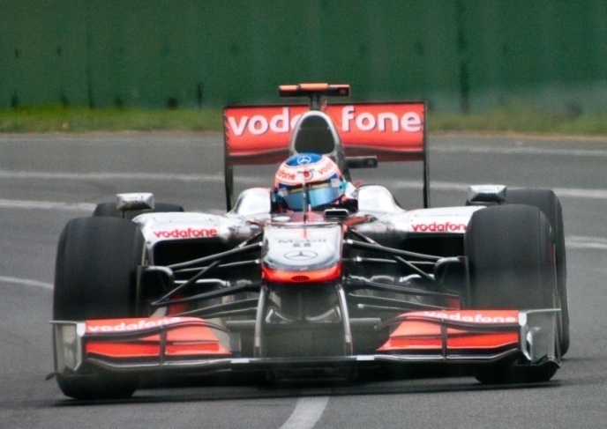
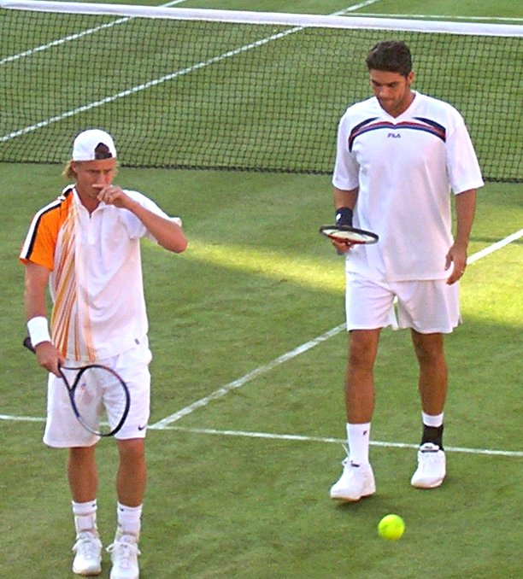
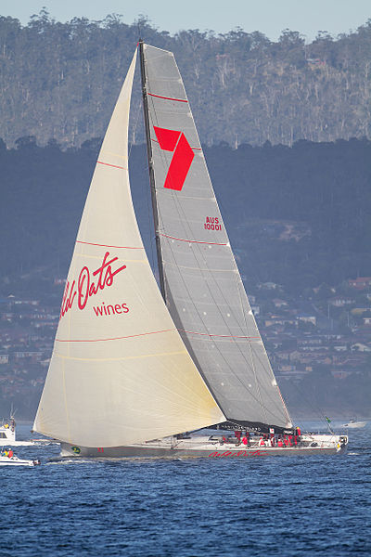
Other popular sports

Slide 8
Which sports are / were these
Australians successful in ?
Lleyton Hewitt
Ian Thorpe
Cathy Freeman
Rod Laver

Slide 9
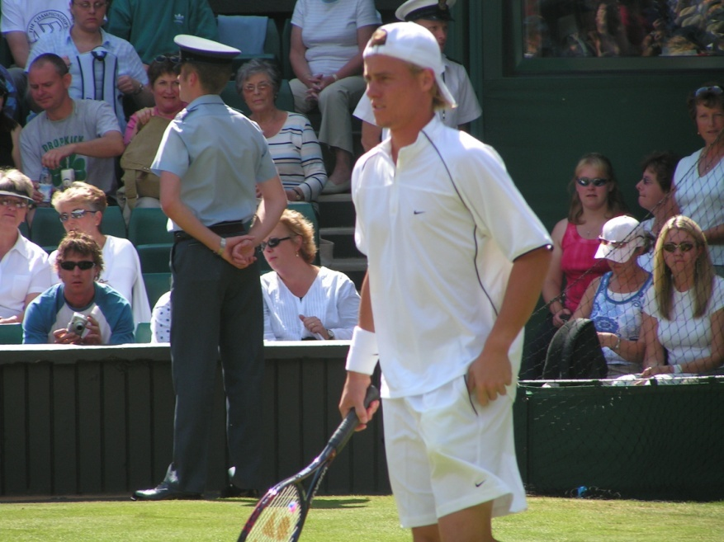
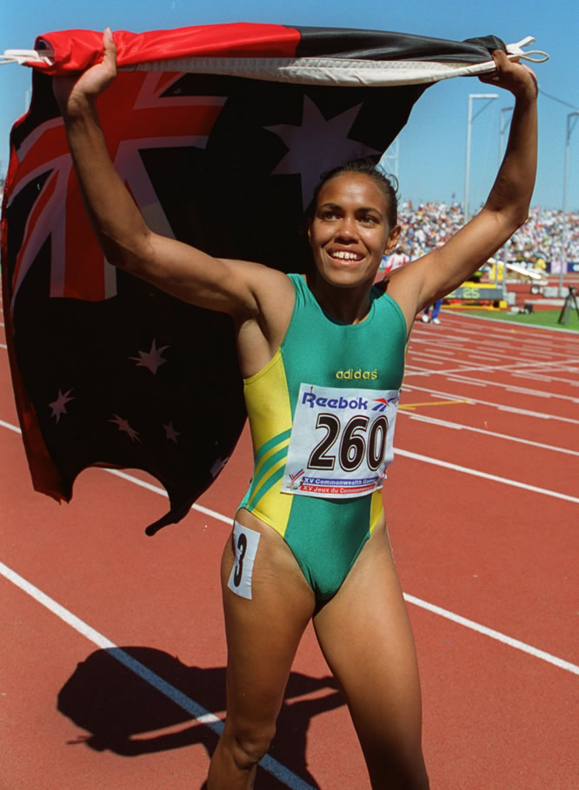
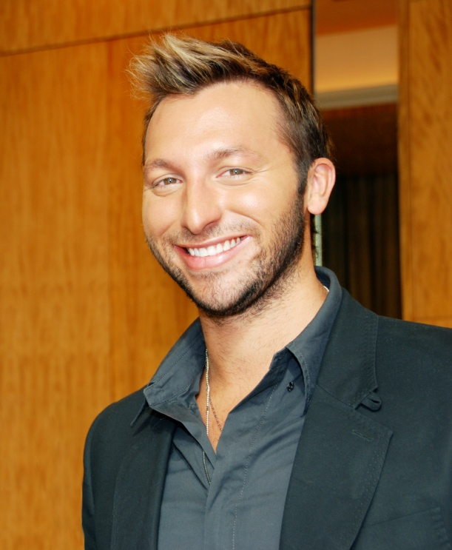
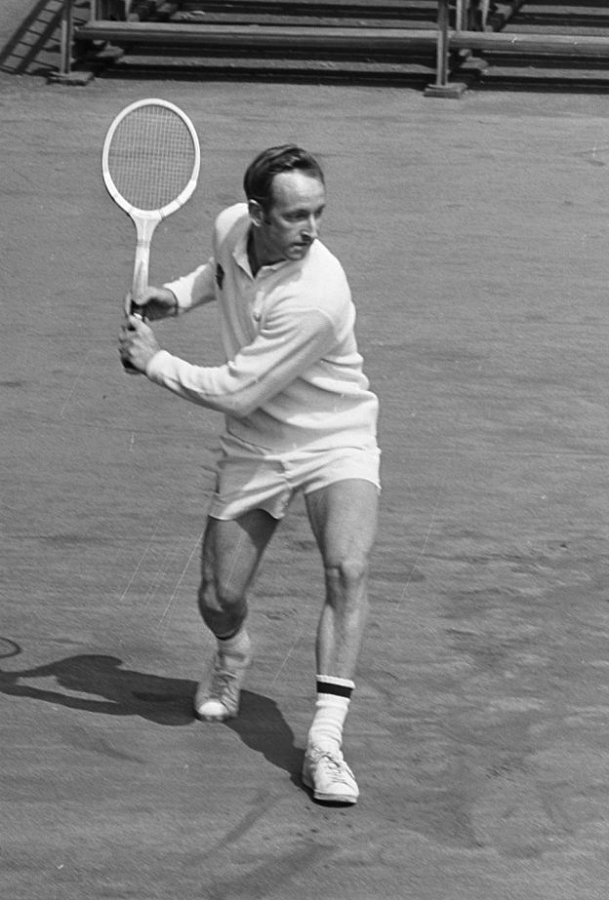
Lleyton Hewitt
Wimbledon 2002
Cathy Freeman
400m race Sydney OG
Ian Thorpe
a swimmer
6 Olympic gold medals
Rod Laver
Wimbledon
Champion 4x

Slide 10
Resources:
www.en.wikipedia.org/sportinaustralia
www.en.wikipedia.org/australianrulesfootball
www.en.wikipedia.org/cricketinaustralia
www.en.wikipedia.org/horseracinginaustralia
www.en.wikipedia.org/tennisinaustralia
www.en.wikipedia.org/motosportinaustralia

