Slide 2
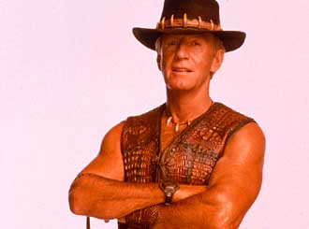
Film
Aussiewood - Australian actors and directors who became
successful in Hollywood
Well known actors and actresses born in Australia:
Mel Gibson
Hugh Jackman
Nicole Kidman
Cate Blanchett
Crocodile Dundee – the most financially
successful film

Slide 3
Match the films with their stars
Leathal Weapon Hugh Jackman
Elizabeth I Nicole Kidman
X –men Mel Gibson
Australia Cate Blanchett

Slide 4
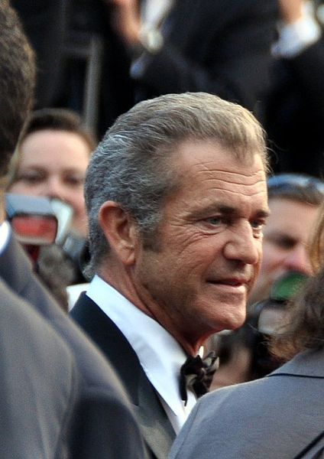
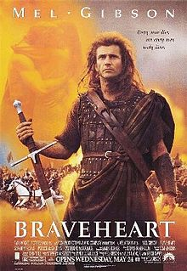
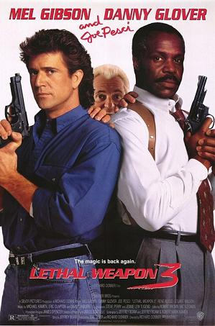
MEL
GIBSON

Slide 5
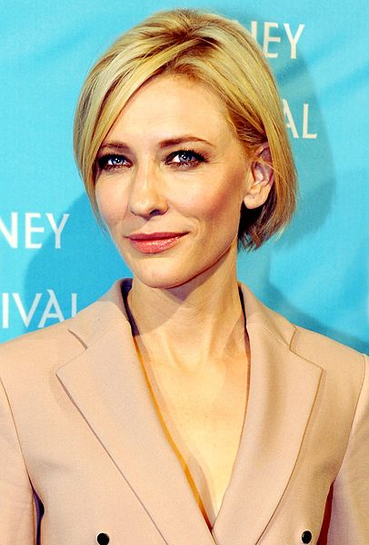
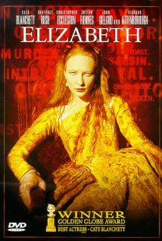
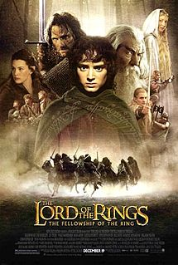
CATE
BLANCHETT

Slide 6
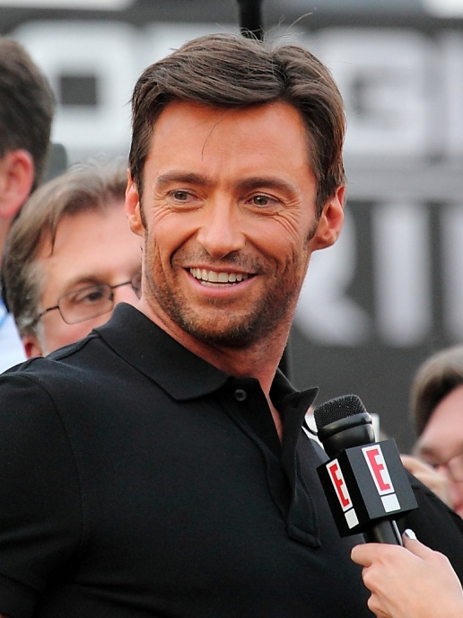
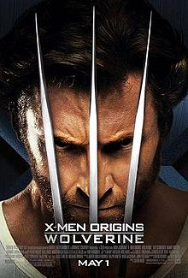
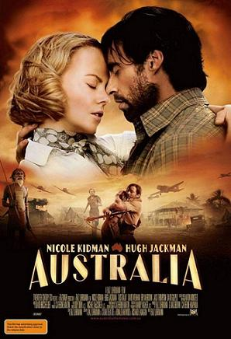
HUGH
JACKMAN

Slide 7
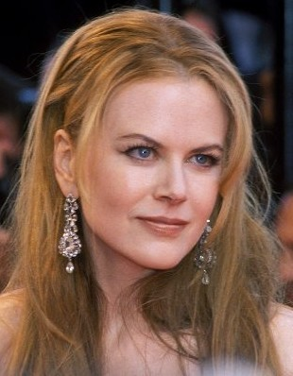
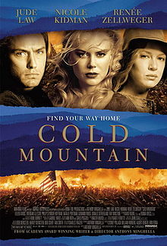
NICOLE
KIDMAN

Slide 8
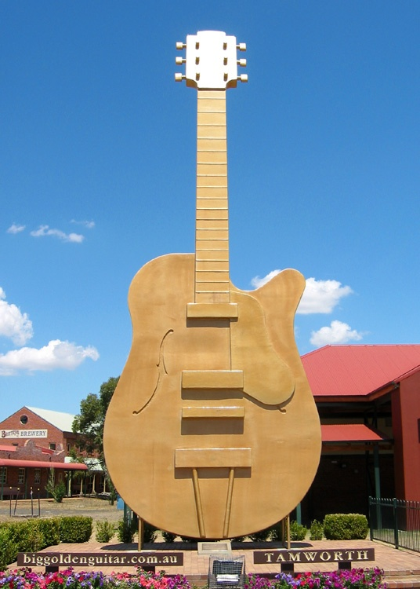
MUSIC
pop music - Kylie Minogue
rock music - AC / DC , INXS
pop and disco music - The Bee Gees
country music - festival in Tamworth
classical music - Sydney Opera House

Slide 9
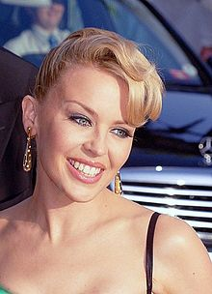
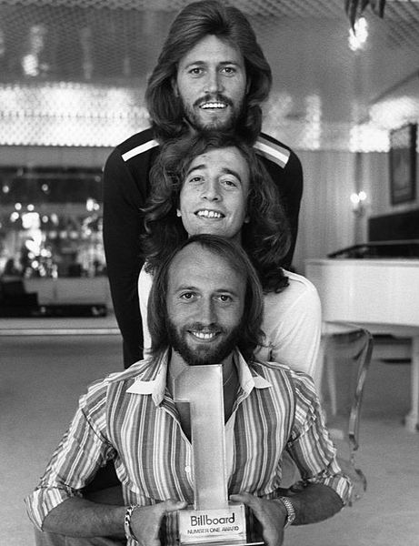
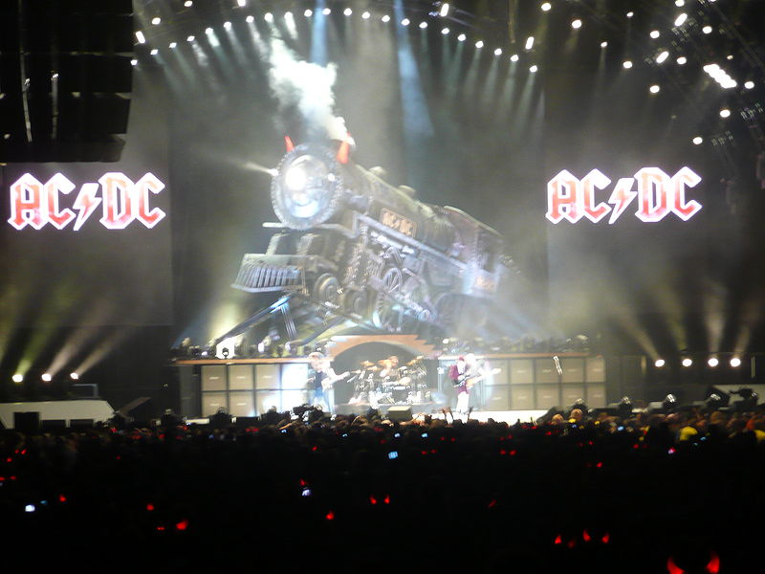
KYLIE
MINOGUE
THE BEE GEES

Slide 10
Australian TV
1956 – regular broadcasting started
influenced by the USA / Big Brother, Wheel of
Fortune /
popular Australian serials
Home and Away
Neighbours / K. Minogue started
her career 20 years ago /
Mc Leod´s Daughters / broadcast
in 60 countries /

Slide 11
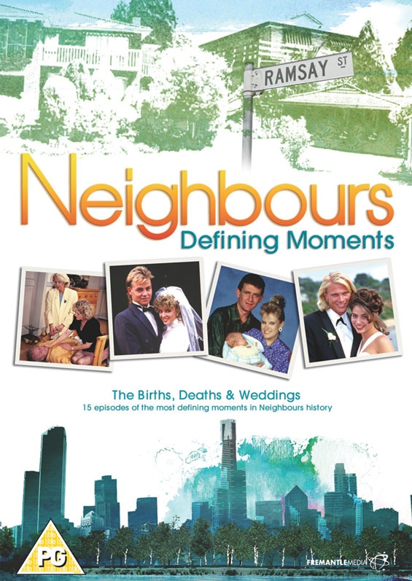
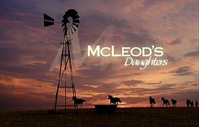
Have you
seen
them ?

Slide 12
Resources:
www.en.wikipedia.org/cinemaofaustralia
www.en.wikipedia.org/melgibson
www.en.wikipedia.org/hughjackman
www.en.wikipedia.org/nicolekidman
www.en.wikipedia.org/paulhogan
www.en.wikipedia.org/musicofaustralia
www.en.wikipedia.org/televisioninaustralia

