Slide 2
Basic facts
the capital city since 1927
between Sydney and Melbourne
120 km from the sea
the population of 360,000
Kanbarra = a meeting place / Aboriginal word /
the greenest Australian city

Slide 3
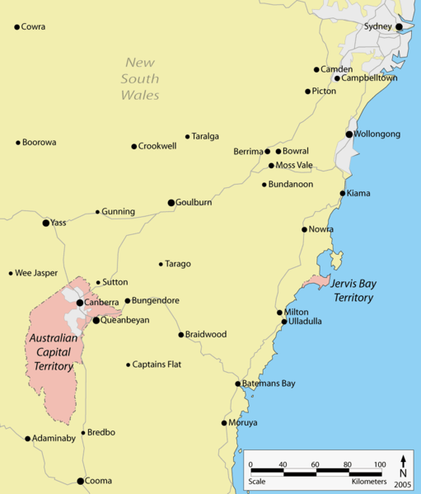
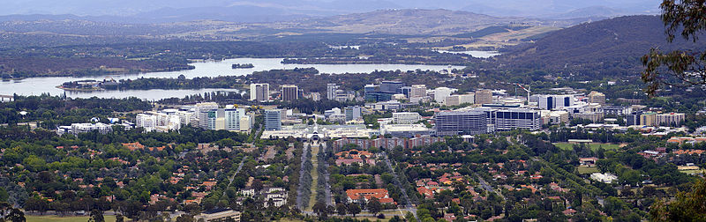
C
A
N
B E R R A

Slide 4
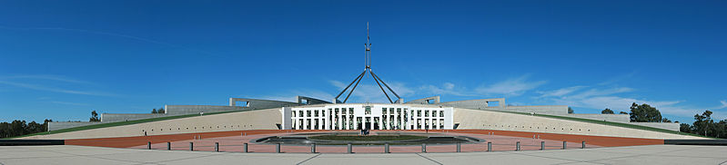
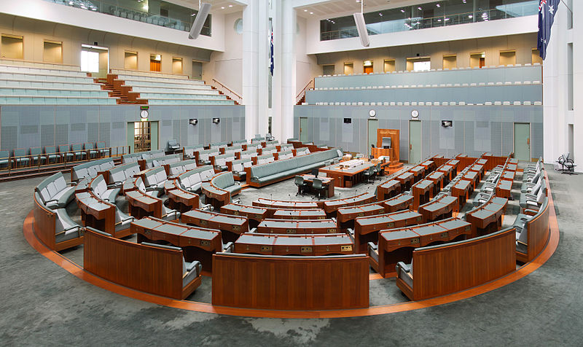
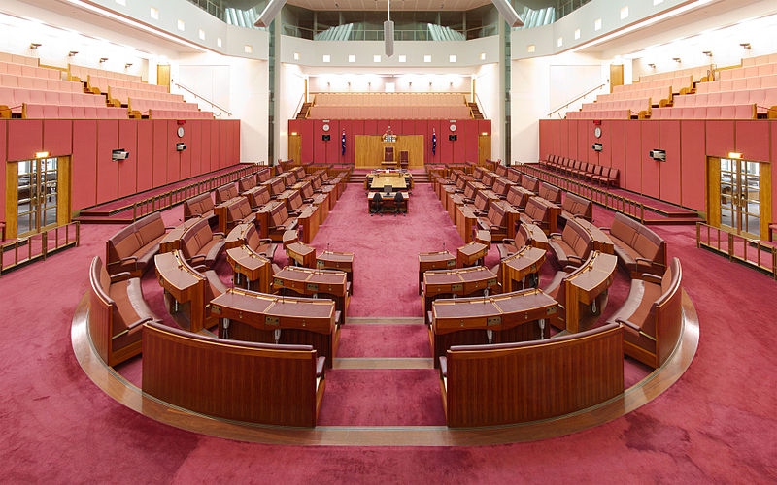
Canberra - The Parliament House / 1988/
The seat of the Federal Government
The House of Representatives
The Senate

Slide 5
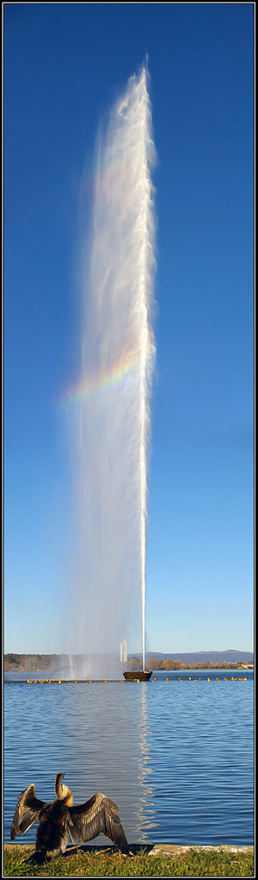
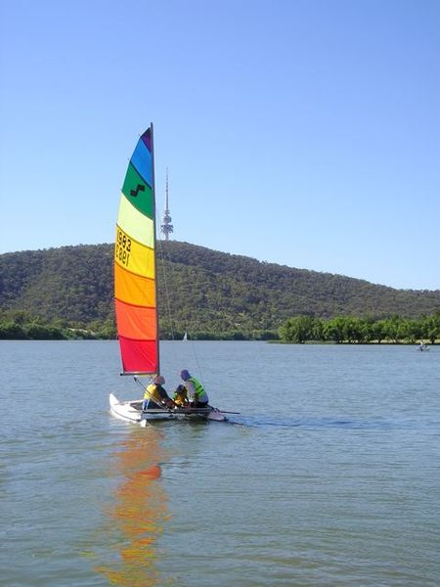
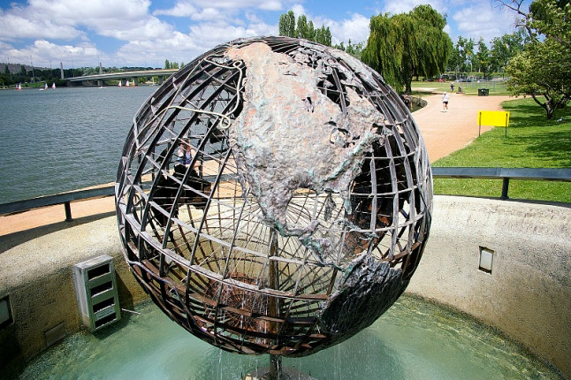
Lake Burley Griffin
named after the city designer
in the middle of Canberra
the artificial lake
Captain Cook Memorial
Cook Memorial Water Jet /150m/

Slide 6
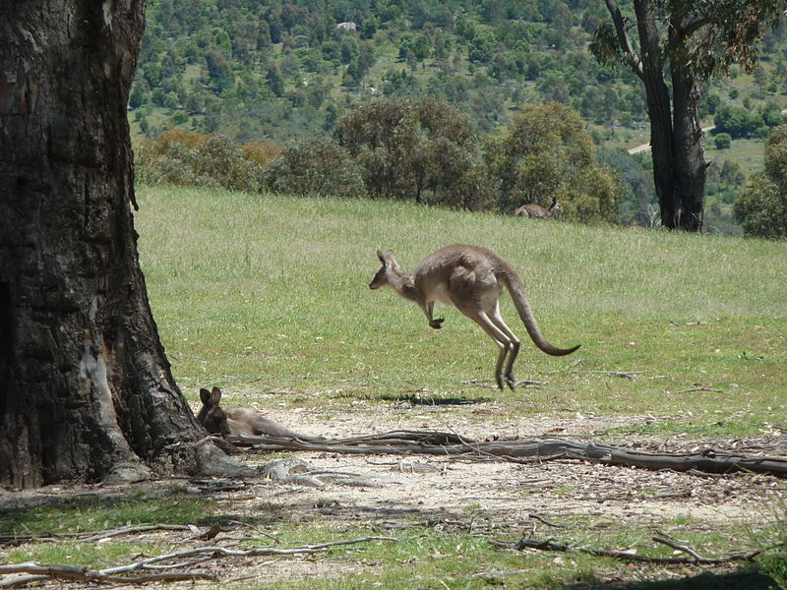
Canberra is the only Australian city
where you can
meet

Slide 7
It is worth seeing
The National Botanic Garden
the largest living collection of native flora
over 6,000 kinds of trees, bushes, flowers
rainforest walk
The National Museum of Australia
- the history of the continent
- the largest collection of Aboriginal bark paintings + stone tools
The National Gallery of Australia
- Western Art / Picasso, Monet, Warhol, … /
- Aboriginal Art
- Aboriginal Memorial / commemorates those who died in wars with
invaders/
The National Dinosaur Museum
- the largest in the Southern hemisphere

Slide 8
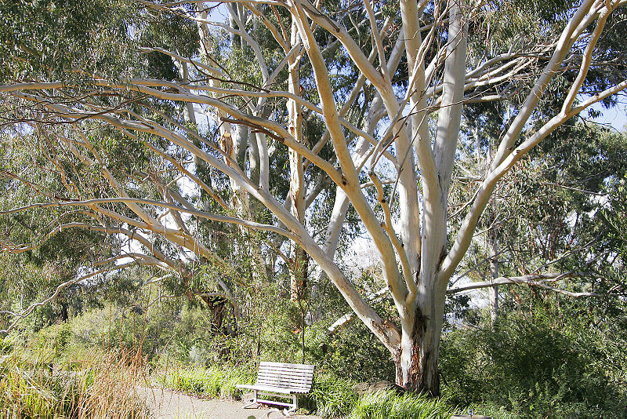
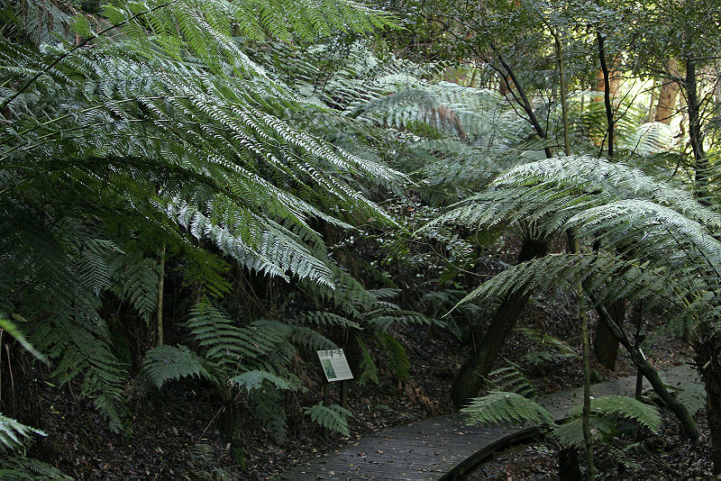
The Botanic Gardens
Rainforest

Slide 9
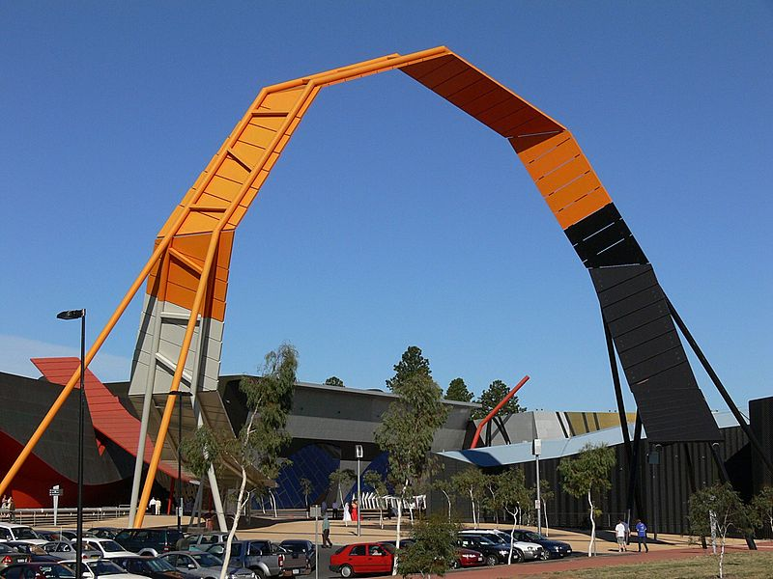
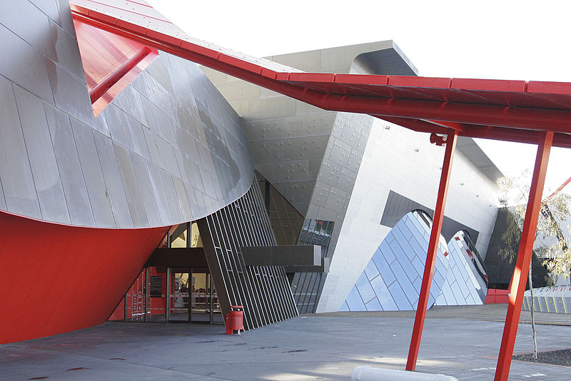
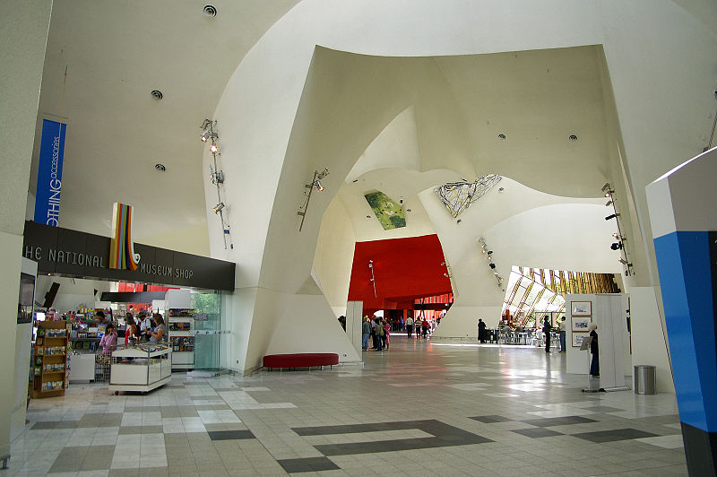
The National
Museum of Australia

Slide 10
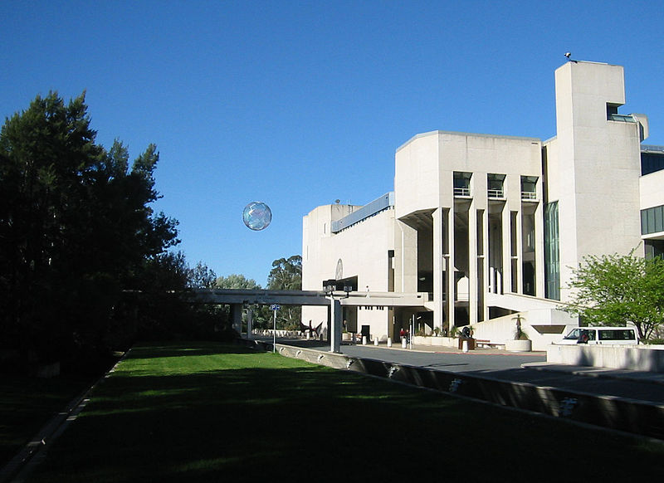
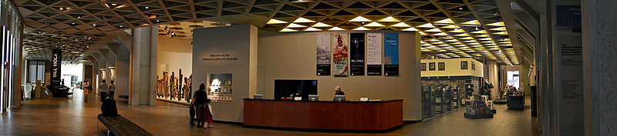
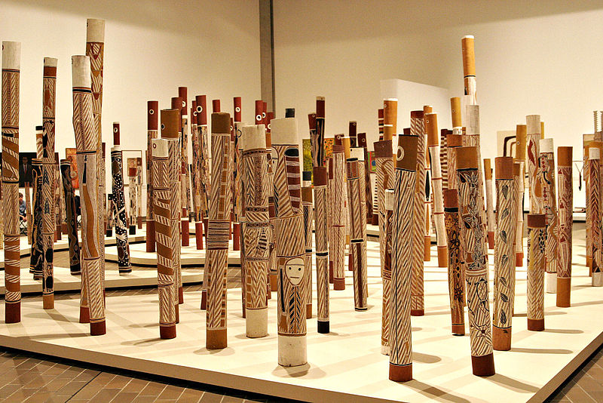
The National Gallery
The Aboriginal Memorial

Slide 11
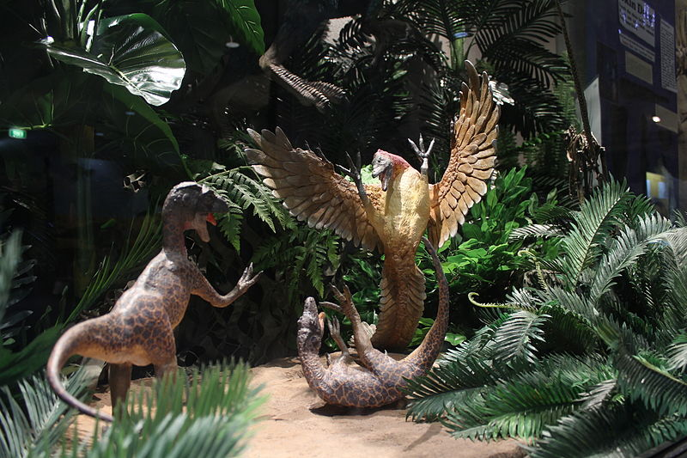
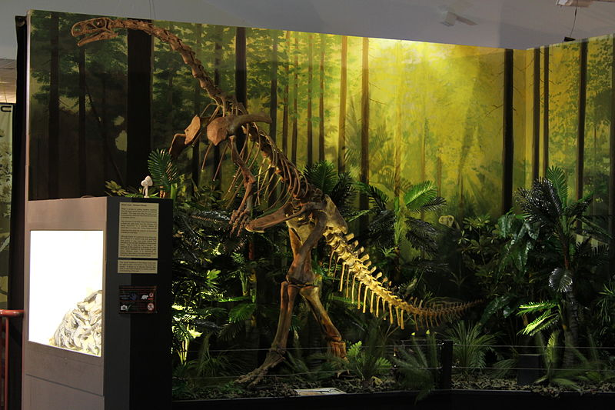
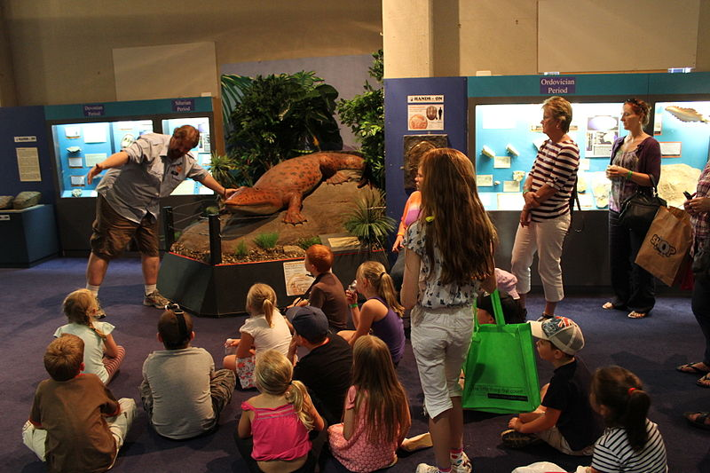
The National
Dinosaur Museum

Slide 12
Which sight in Canberra
is the most visited ?

Slide 13
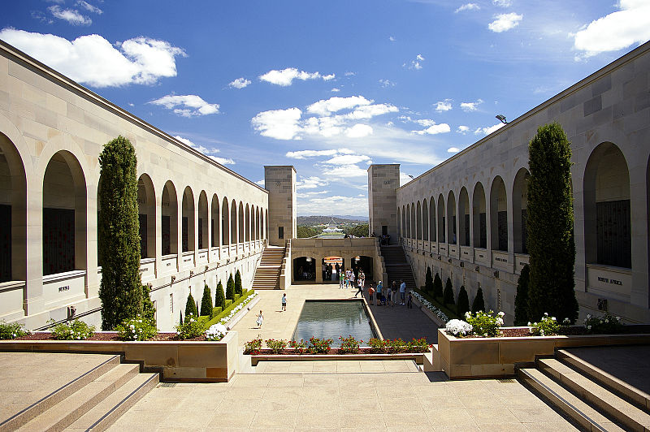
The Australian
War Memorial

Slide 14
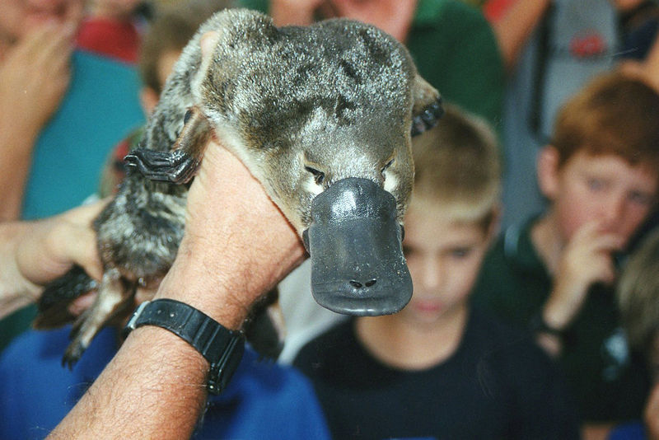
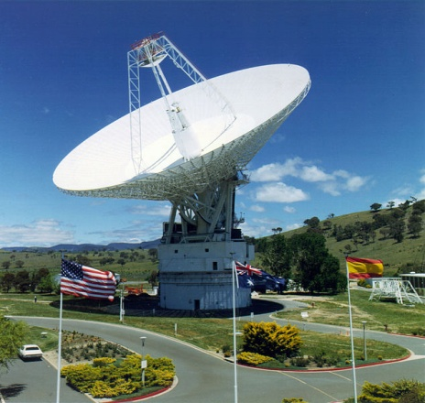
Surroundings of Canberra
Tidbinbilla Nature Reserve
a native habitat for wildlife
a variety of bushwalks/up 6 hours /
picnics, campfires
Tidbinbilla Deep Space Tracking Station – co-operates with NASA

Slide 15
Resources:
www.en.wikipedia.org/canberra
www.en.wikipedia.org/canberra/artsandentertainment
www.en.wikipedia.org/lakeburleygriffin

