Slide 2

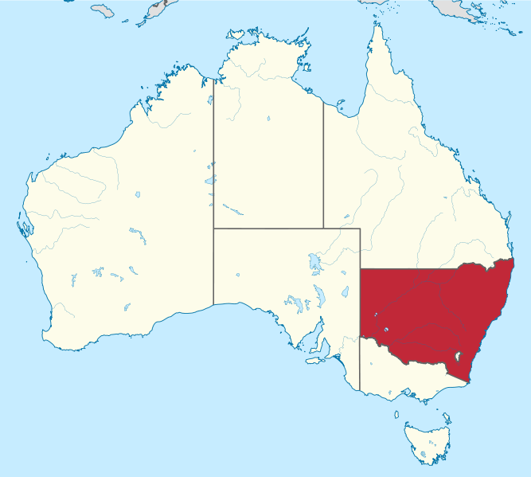

Slide 3
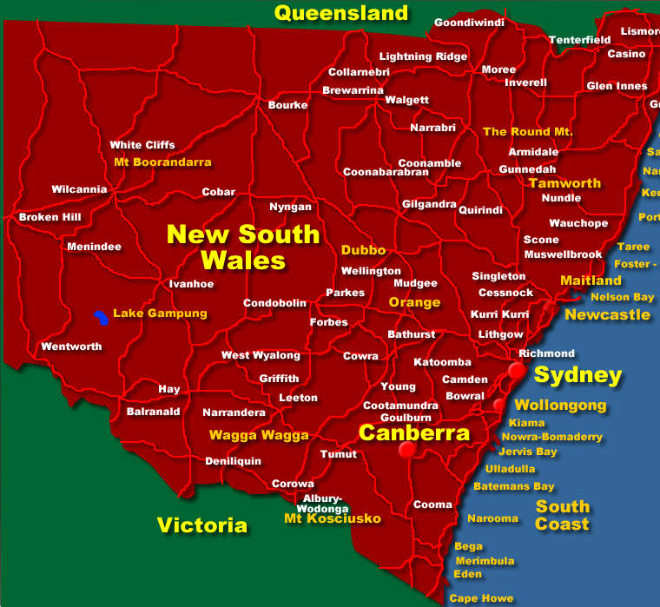

Slide 4
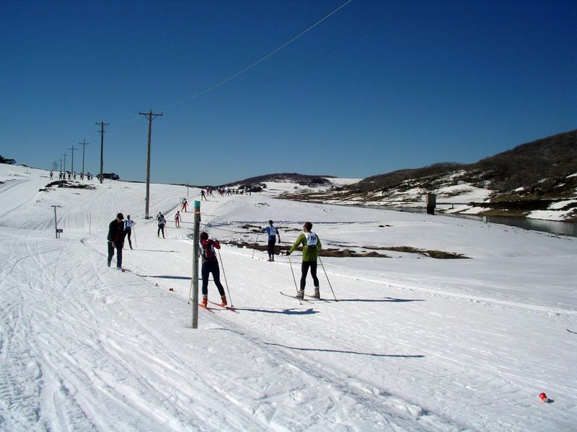
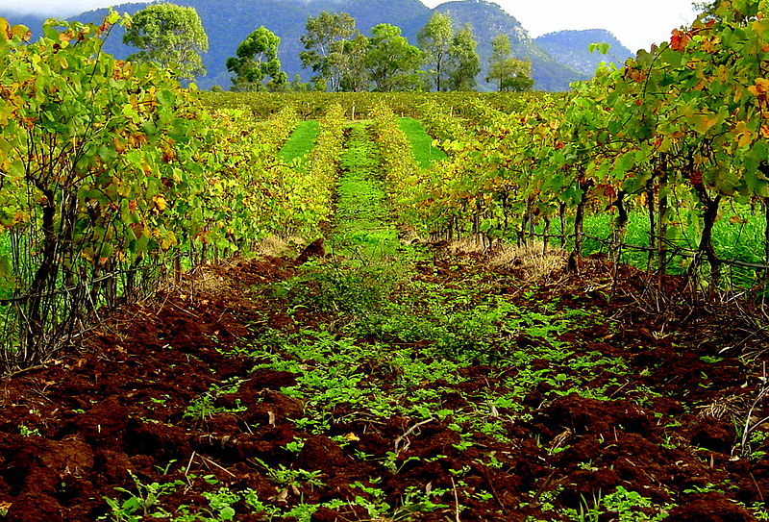
Basic Facts
called The First State
between Victoria and Queensland
2100 km of coastline
720 ocean beaches
ski resorts in the Snowy Mountains
the world´s richest deposits of silver,
lead, zinc
opal mines in the outback
The Snowy Mountains
Hunter Valley

Slide 5
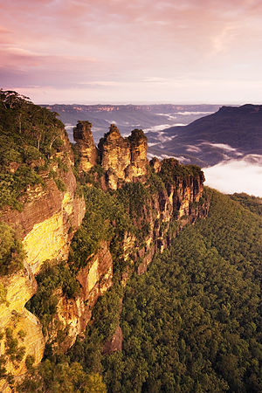
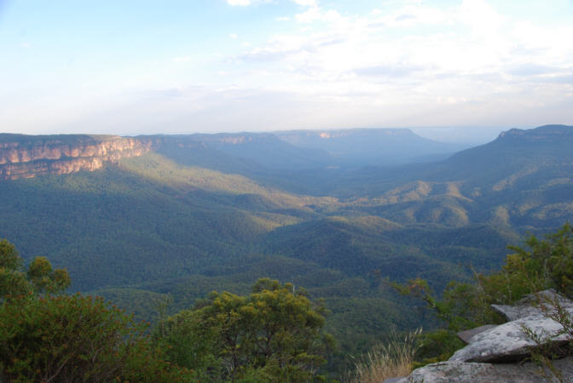
The Blue Mountains
Australia´s most accessible wilderness territory
2 – hour drive from Sydney
ideal for bushwalking and hiking
eucalyptus trees
Three Sisters

Slide 6
Why are the mountains called
The Blue Mountains ?

Slide 7
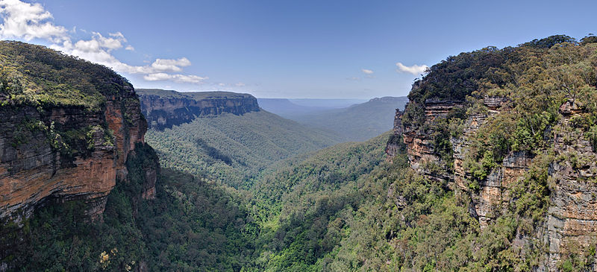
You can see the blue haze above the mountains when eucalyptus oil is vaporized in hot sunny days.

Slide 8
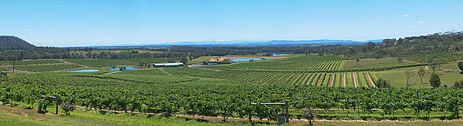
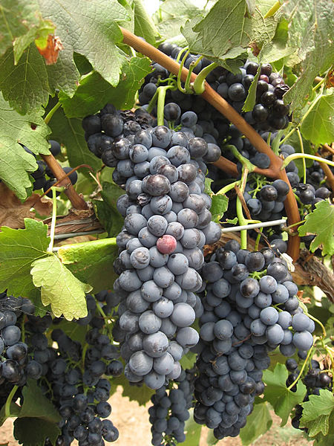
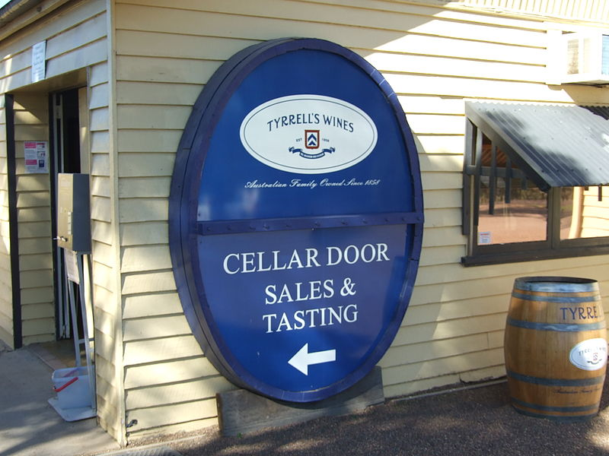
Hunter Valley
160 km north of Sydney
more than 120 vineyards + cellar doors
the oldest wine country in Australia
world – class wine / Chardonnay , Sauvignon /
Hunter Valley

Slide 9

Which Australian state is
the biggest producer of
wine ?

Slide 10
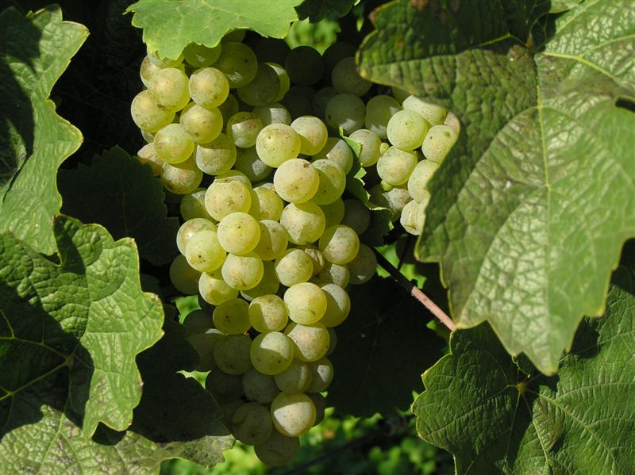
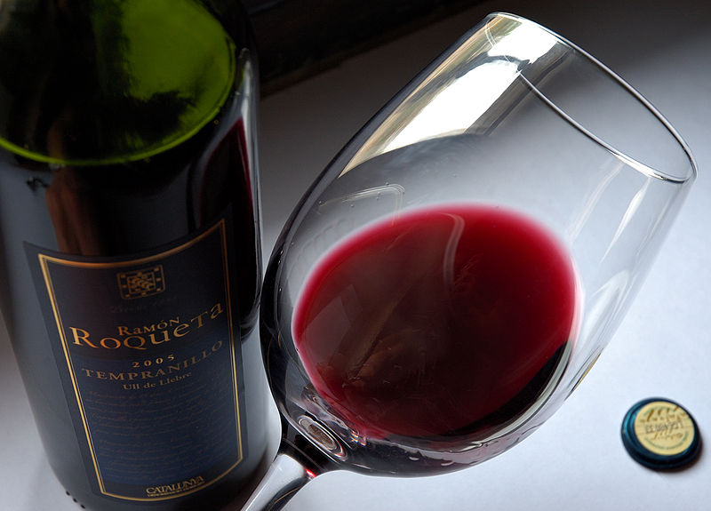
SOUTH AUSTRALIA

Slide 11
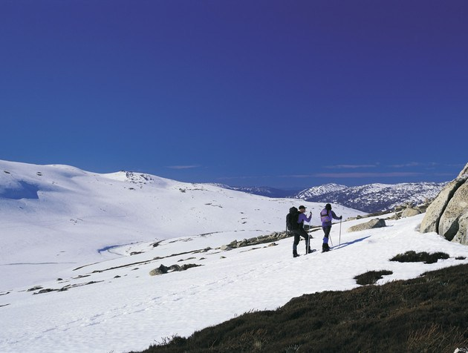
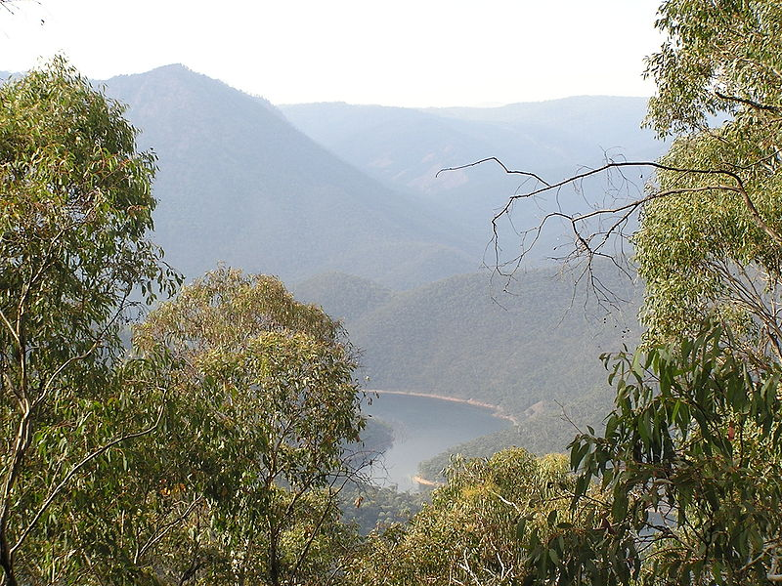
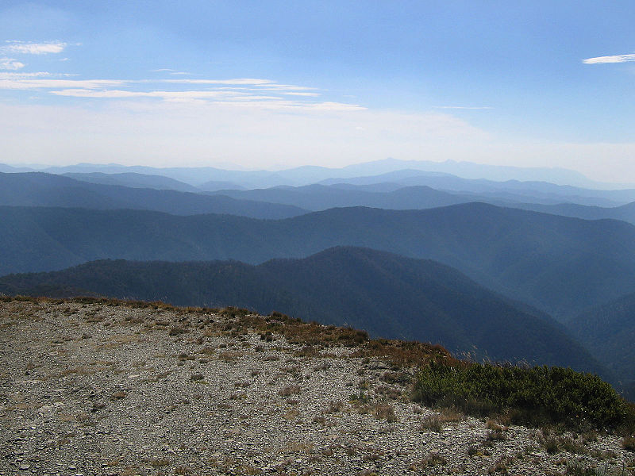
The Australian Alps
part of the Great Dividing Range
the highest mountain range in Australia
includes The Snowy Mountains and The Victorian
Alps
Kosciuszko National Park / the highest mtn. in
Australia is located here /
skiing, hiking, climbing

Slide 12

Resources:
www.en.wikipwdia.org/newsouthwales
www.en.wikipedia.org/bluemountains
www.en.wikipedia.org/huntervalley
www.en.wikipedia.org/australianalps
www.infinityholidays.com.au

