Slide 2
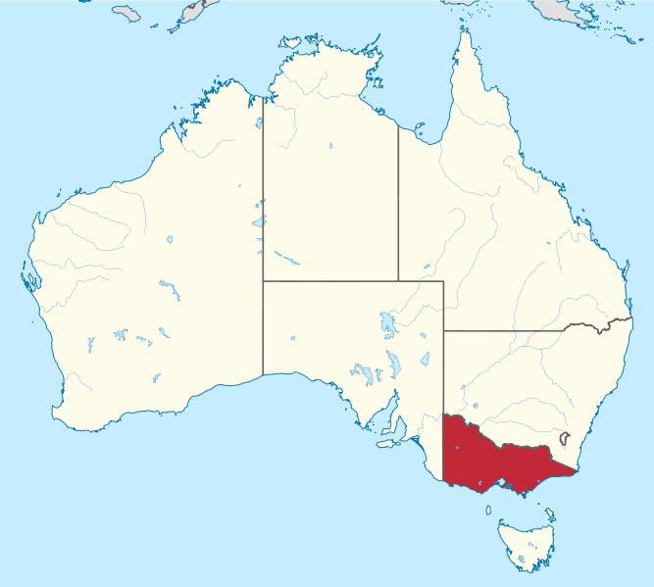

Slide 3
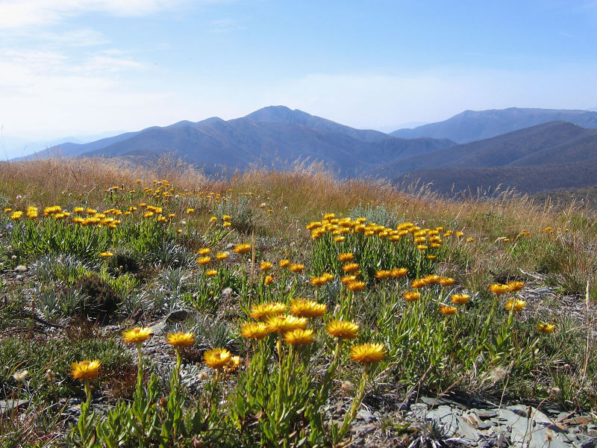
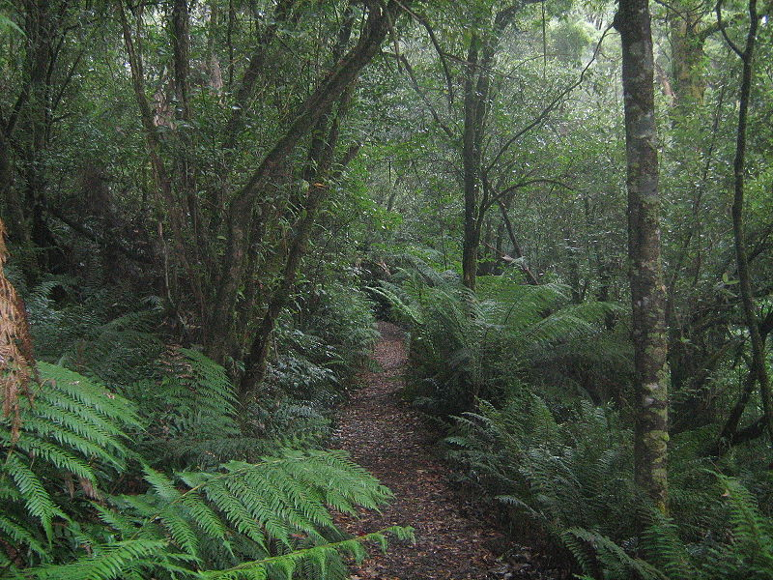
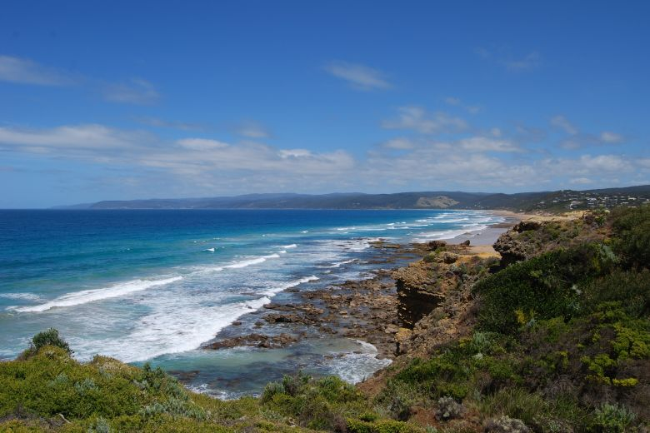
Victoria / VIC /
called The Garden State
the smallest and greenest state
the only state without the outback
beaches, ski resorts, rainforests

Slide 4
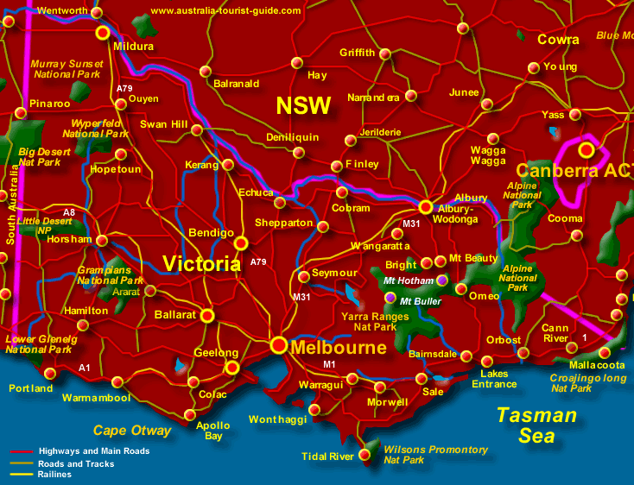

Slide 5
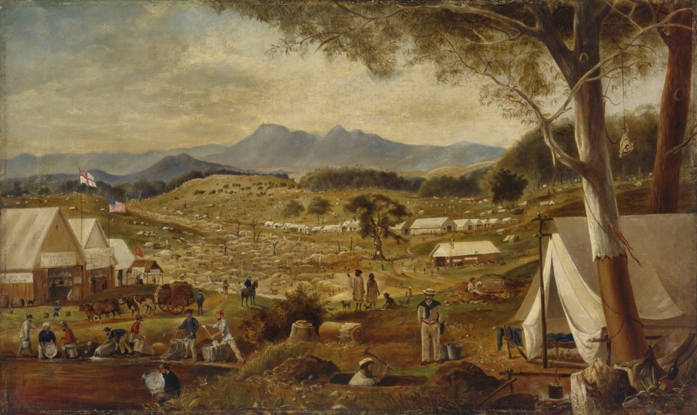
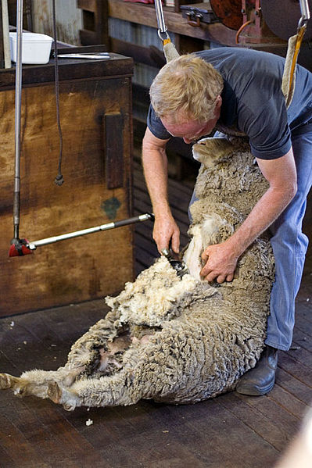
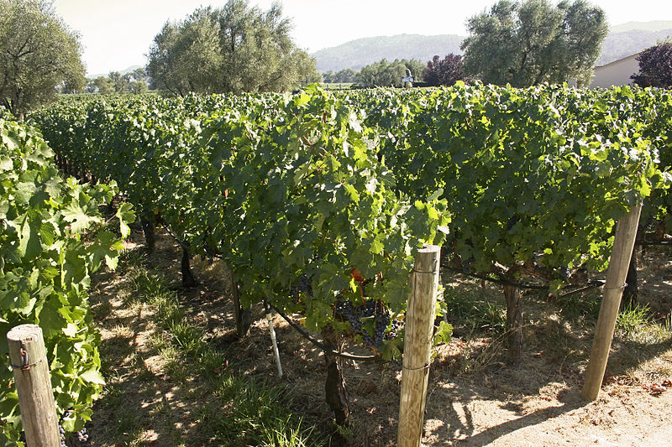
Victoria Economy
prosperous thanks to deposits of gold
gold fields from the gold rush
industrial heart
agriculture – wheat, fruit, dairy products
world – class wines in the Yarra Valley
Sheep shearing

Slide 6
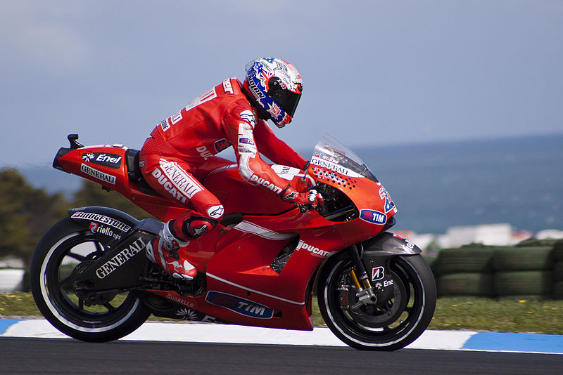
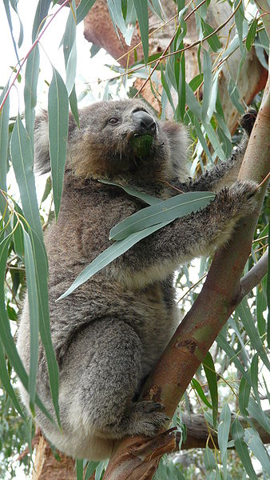
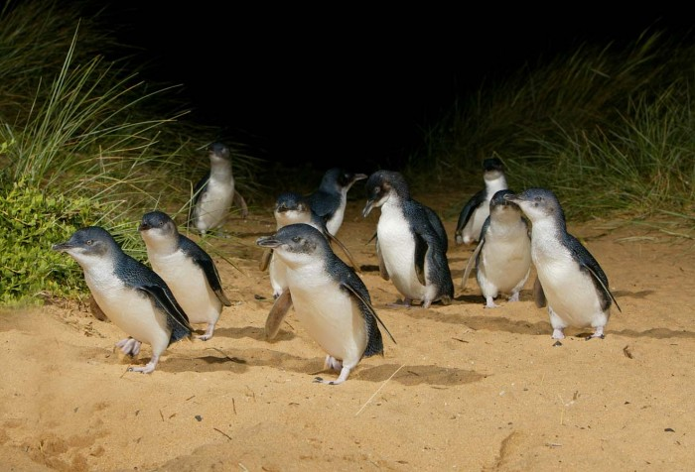
Phillip Island
90 – minute drive from Melbourne
famous for the daily penguin parade
at dusk – march to their nesting places
colonies of koalas and seals
The World Superbike Championship

Slide 7
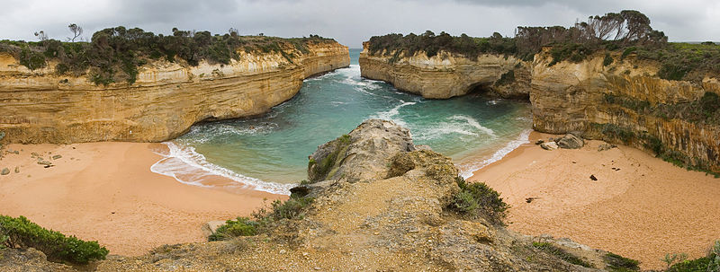
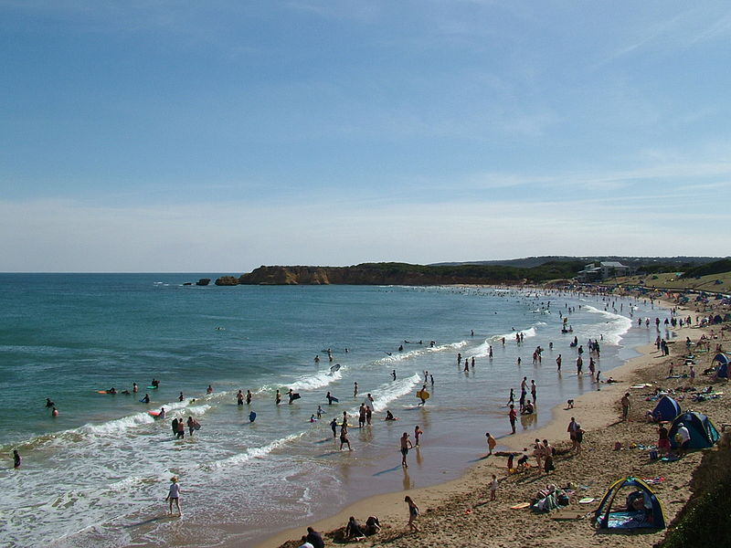
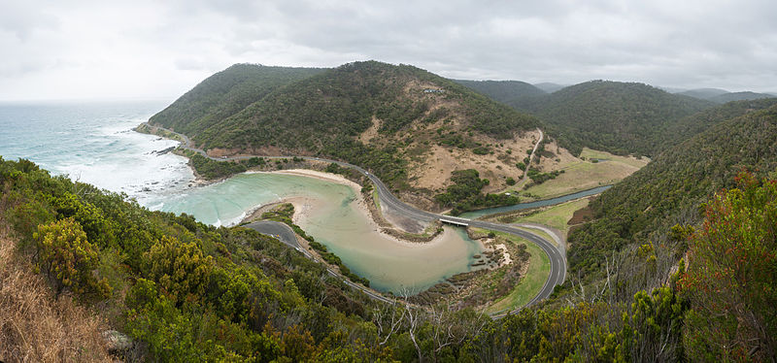
Great Ocean Road
400 km of rugged coastline
Shipwreck Coast with Loch Ard Gorge
Torquay – The World Surfing Championship
The Great Otway NP – the ancient rainforest
The 12 Apostles
Loch Ard Gorge
Torquay

Slide 8
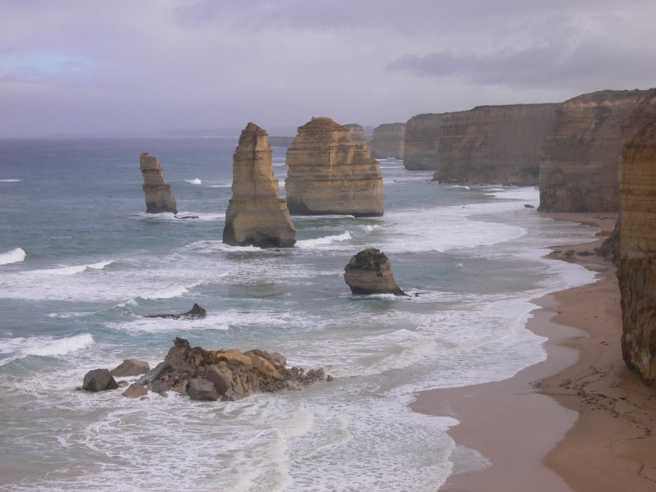
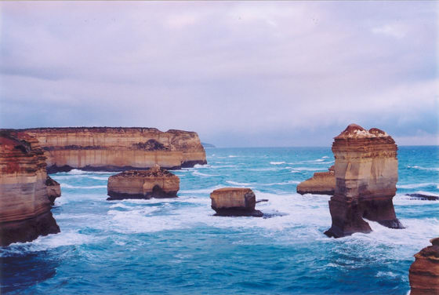
The 12 Apostles
weather – sculptured limestone pillars
only 8 nowadays / 4 have collapsed /

Slide 9
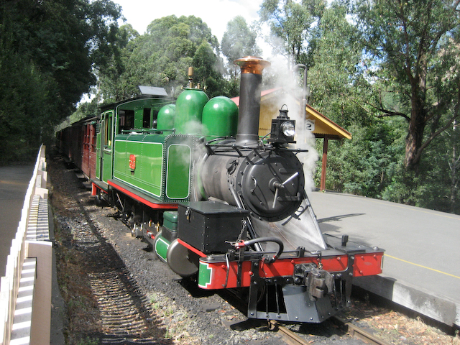
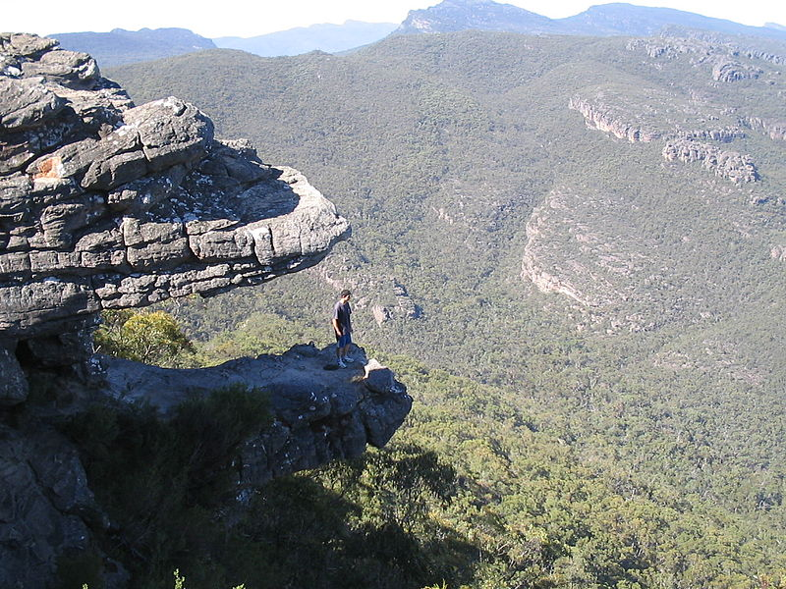
Dandenongs Ranges
Grampians NP
like The Blue Mountains for Sydney
/ blue colour – eucalyptus oil /
more than 100 species of birds
Puffing Billy – the oldest operating
steam train in Australia
Aboriginal rock paintings
Jaws of Death

Slide 10
Match the tourist attractions
to their locations
The 12 Apostles Grampians NP
Puffing Billy Shipwreck Coast
The World Surfing Championship Phillip Island
Aboriginal rock galleries Dandenongs Ranges
Penguin Parade Torquay
Loch Ard Gorge The Southern Ocean

Slide 11
Solution
The 12 Apostles The Southern Ocean
Puffing Billy Dandenongs Ranges
The World Surfing Championship Torquay
Aboriginal rock galleries Grampians NP
Penguin Parade Phillip Island
Loch Ard Gorge Shipwreck Coast

Slide 12
Resources:
www.en.wikipedia.org/victoria
www.en.wikipedia.org/victoria/economy
www.en.wikipedia.org/phillipisland
www.en.wikipedia.org/gratoceanroad
www.en.wikipedia.org/puffingbillyrailway
www.infinityholidays.com.au

