Slide 2
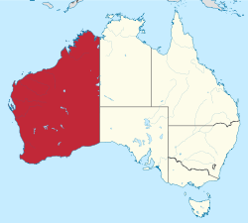

Slide 3
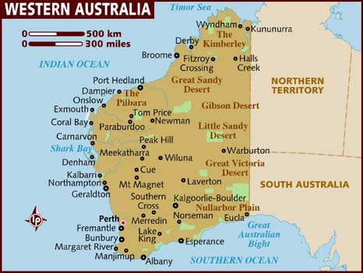

Slide 4
Basic facts
called The Wildflower State
covers 1/3 of the continent
desert areas – Gibson, Great Sandy , Great Victoria
the least populated Australia´s state / 2.3 million /
majority of the population - Perth + its surroundings
the richest state
the world´s largest deposits of minerals
gold, diamonds, oil, iron ore, nickel
agriculture – wheat, barley, wine
The South – a bio – diverse floral region / eucalyptus , Jarrah trees /

Slide 5
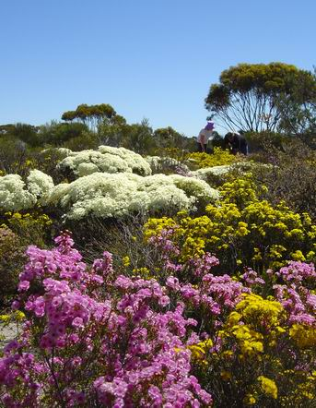
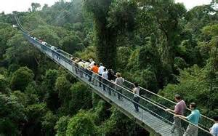
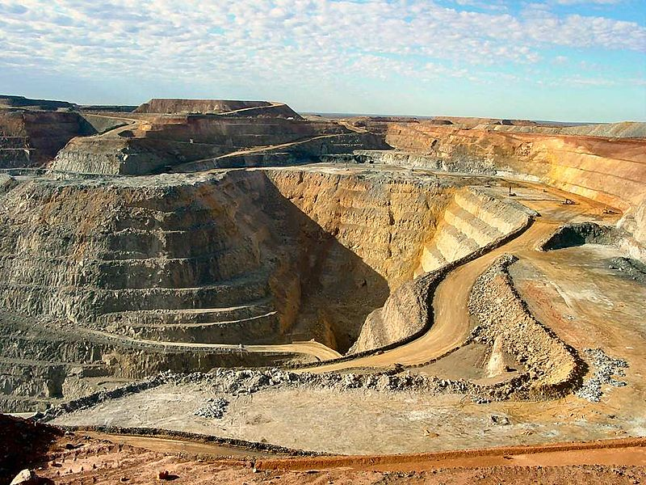
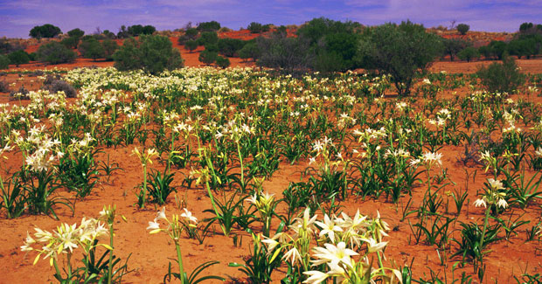
W
E
S
T
E
R
N
A
U
S
T
R
A
L
I
A

Slide 6
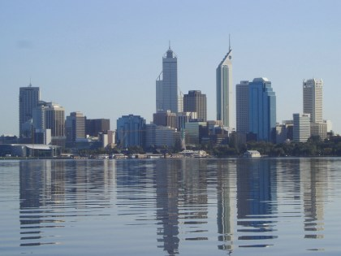
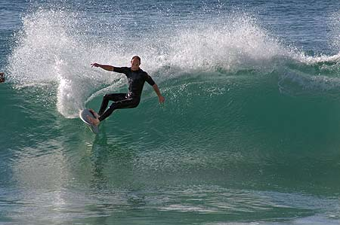
PERTH - the capital city
the most isolated capital city in the world
on the Swan River
80 km of white beaches
the city skyline – skyscrapers in the centre
parks around the centre and residential areas

Slide 7
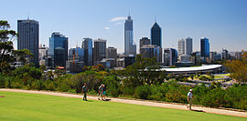
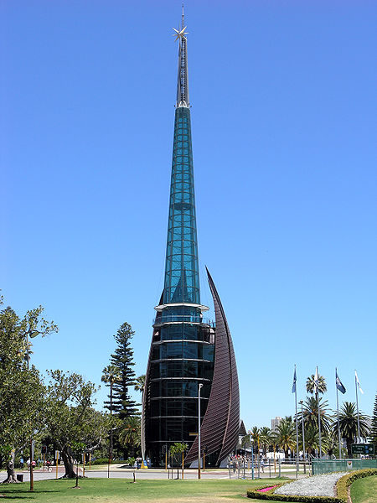
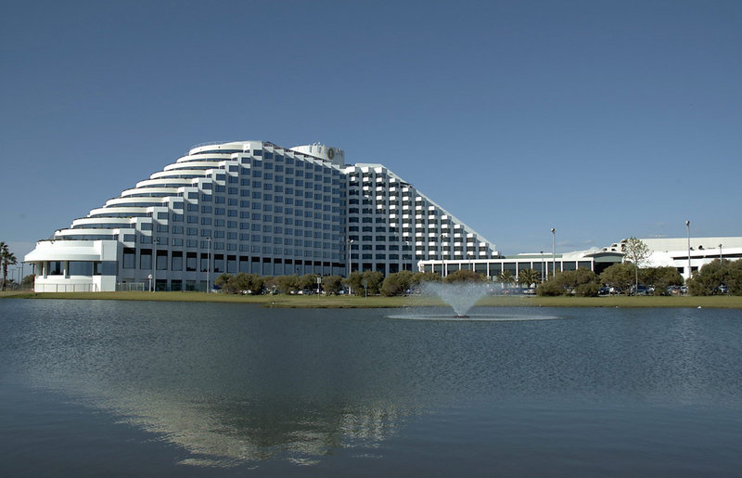
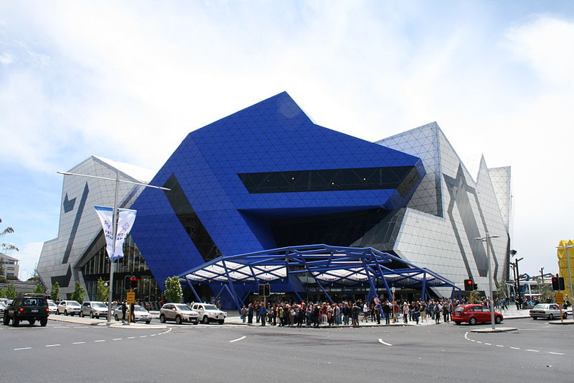
SWAN BELLS
PERTH
CASINO
ARENA

Slide 8
Perth Surroundings
Rottnest Island – home to quokka / a marsupial /
The Pinnacles – limestone pillars formed by seashells
5 m – the highest
Wave Rock –an impressive rock formation
110 m long

Slide 9
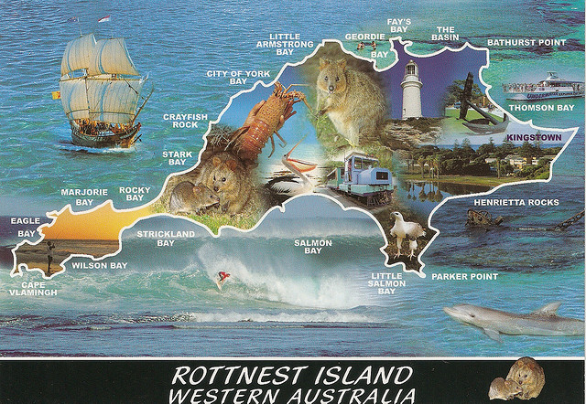
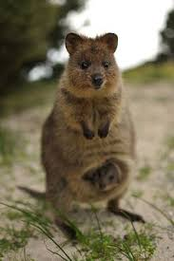
QUOKKA
WAVE ROCK
THE PINNACLES

Slide 10
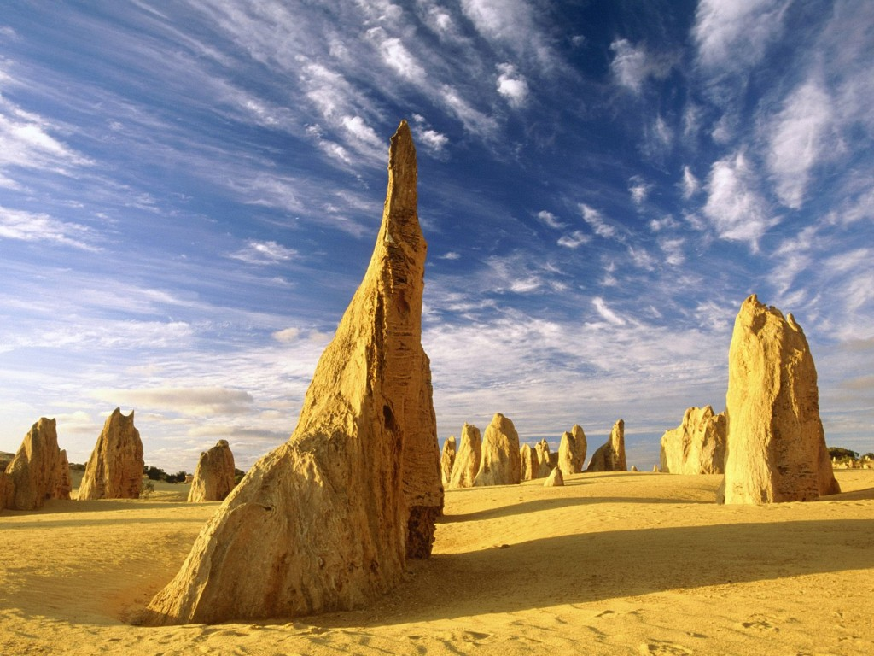
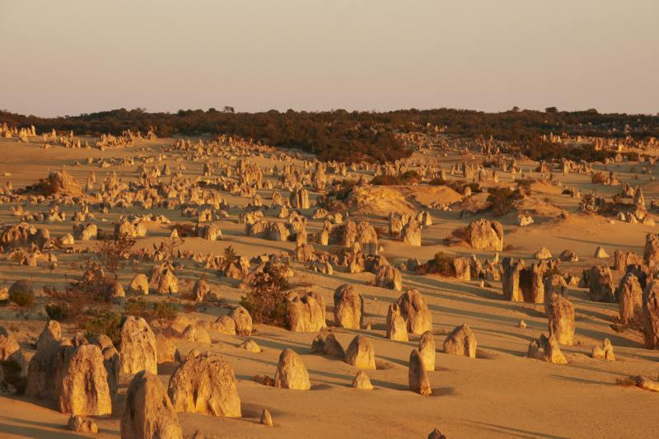
The Pinnacles
the moon– like landscape

Slide 11
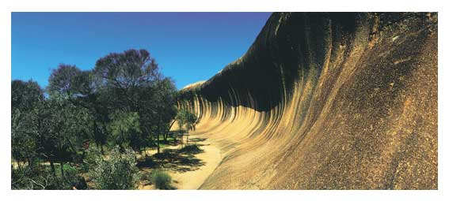
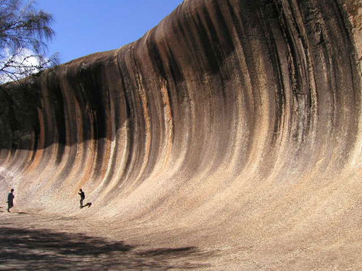
WAVE ROCK

Slide 12
Why is the island called Rottnest ?
How many pillars are there in The Pinnacles ?
5 OOO
50 000
150 000
How high is Wave Rock ?
10 m
15 m
20 m

Slide 13
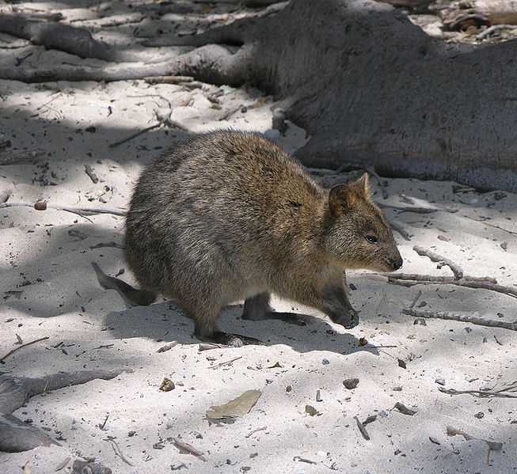
SOLUTION
Rottnest = the rat nest / Dutch word/
quokka - looks like a big rat
150 000
15 m

Slide 14
The Coral Coast
Shark Bay – The World Heritage Site
12 species of shark
dolphins at Monkey Mia
The Ningaloo Marine Park
- 260 km
- wonderful sealife
- excellent for diving
- swimming with the Whale Shark
the world´s largest fish
up 18m , 13 tonnes /
attractions

Slide 15
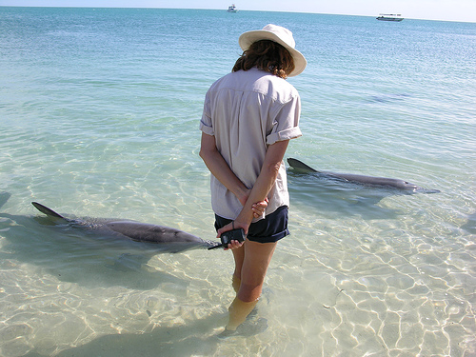
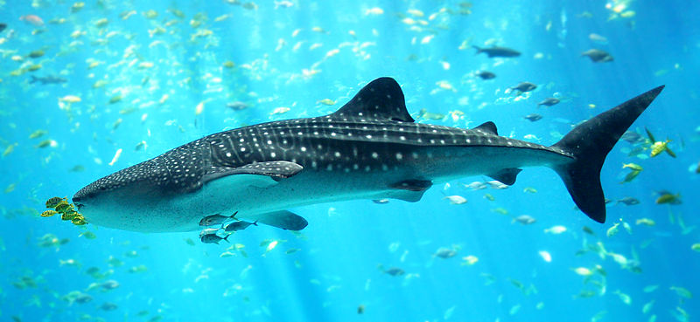
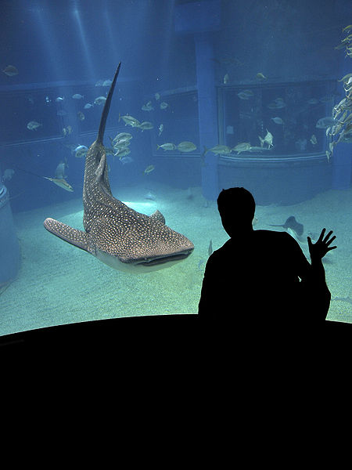
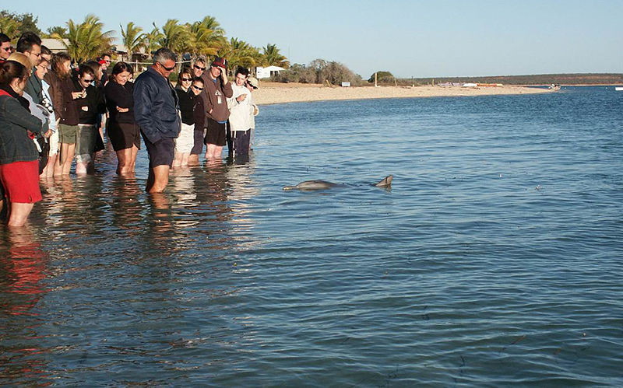
Whale Shark
Dolphins hand – fed by tourists

Slide 16
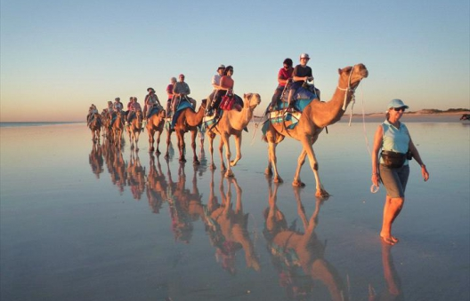
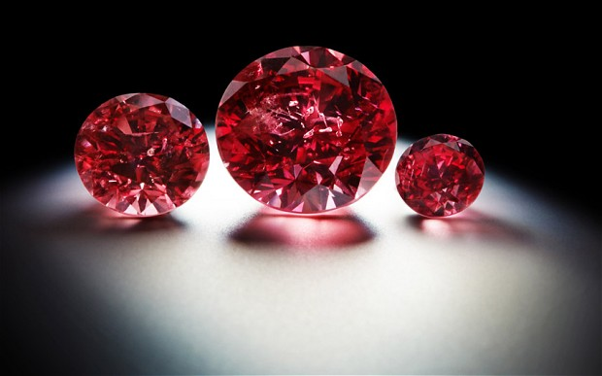
Broome
the gateway to NW
the old pearl town
Cable Beach – sunset camel rides
The Bungle Bungle Range
beehive – like sandstone domes
100 m high
KIMBERLY
true wilderness
ancient rock formations, gorges
Aboriginal art
diamond and gold mines
crocodiles

Slide 17
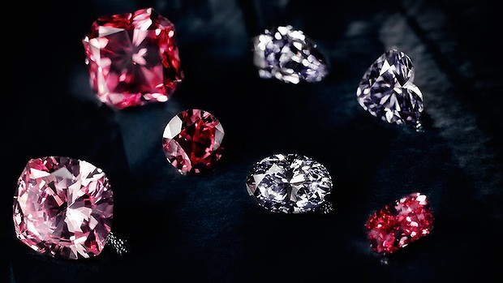
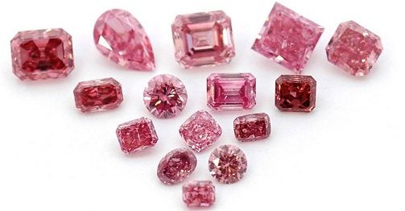
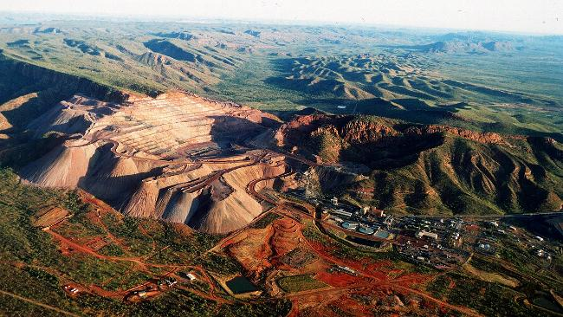
Argyle Diamond Mine
The world´s largest mine
1/3 of the world´s production

Slide 18
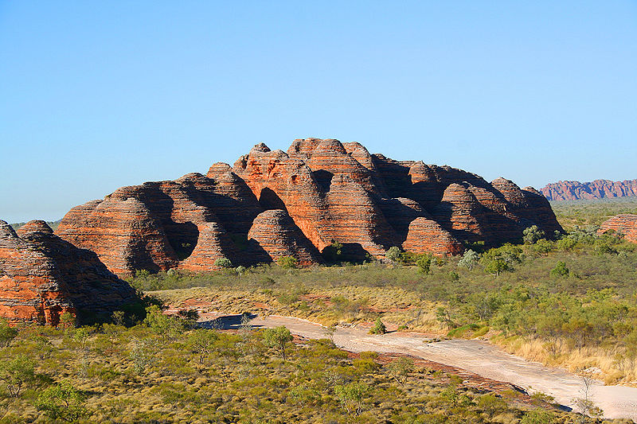
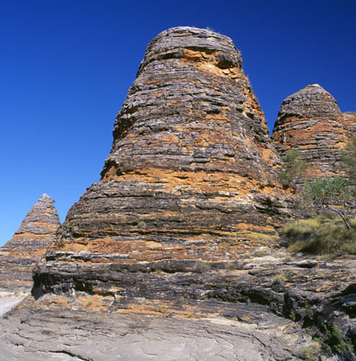
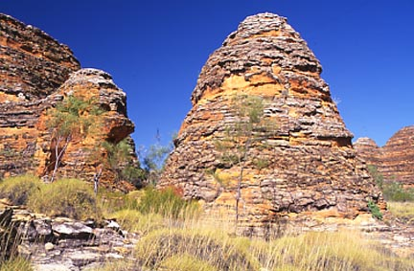
THE BUNGLE
BUNGLE

Slide 19
Which film was made
in
KIMBERLY ?

Slide 20
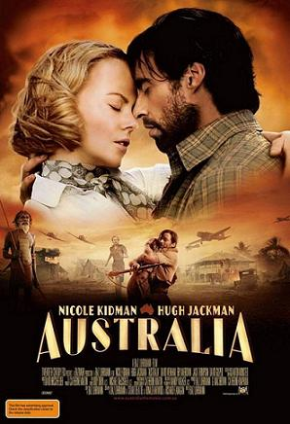

Slide 21
Resources:
www.en.wikipedia.org/westernaustralia
www.en.wikipedia.org/perth
www.en.wikipedia.org/pinnacles
www.en.wikipedia.org/waverock
www.en.wikipedia.org/rottnestisland
www.en.wikipedia.org/coralcoast
www.en.wikipedia.org/kimberly
www.en.wikipedia.org/bunglebungle
www.infinityholidays.com.au

