Slide 2
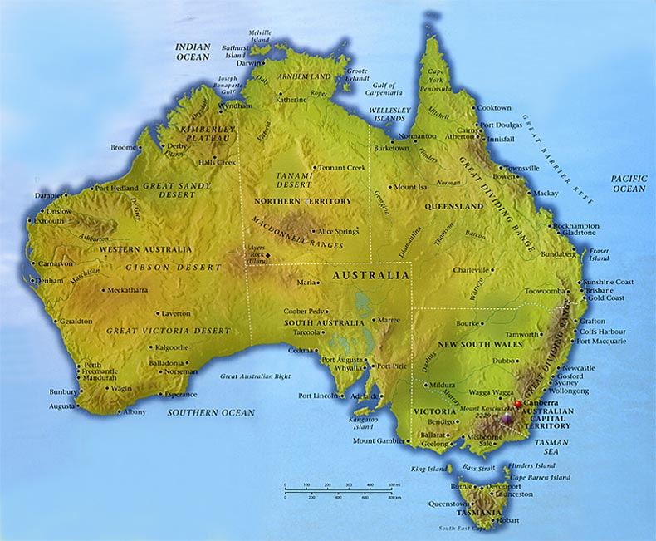
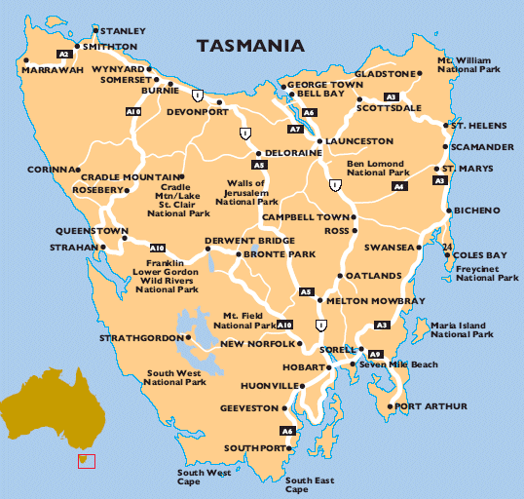
TASMANIA

Slide 3
Basic facts
named after Abel Tasman – a Dutch explorer/ 1642 /
colloquially known as Tassie
an island state
separated from mainland Australia by Bass Strait / 240 km/
Bass Strait – similar to Bermuda Triangle
/ships and planes disappeared without a trace/
45 % - national parks, reserves and the World Heritage Sites
Aborigines - extinct

Slide 4
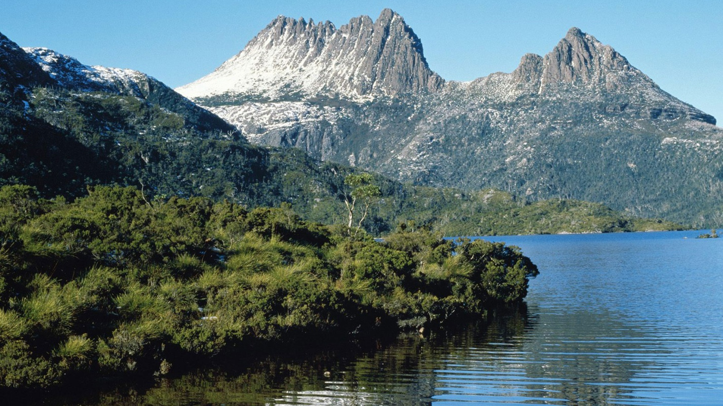
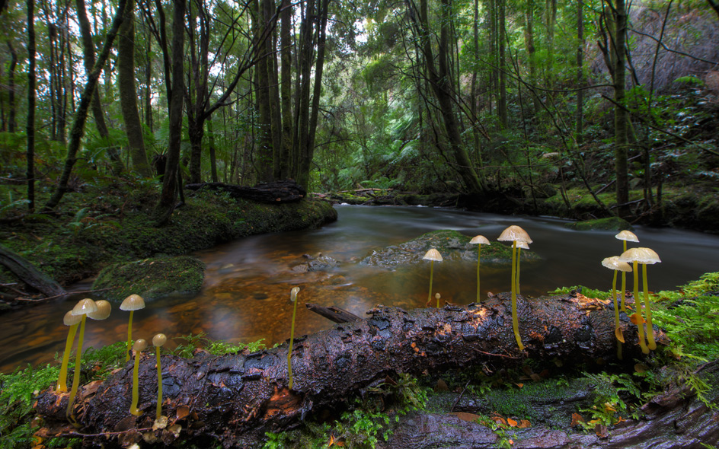
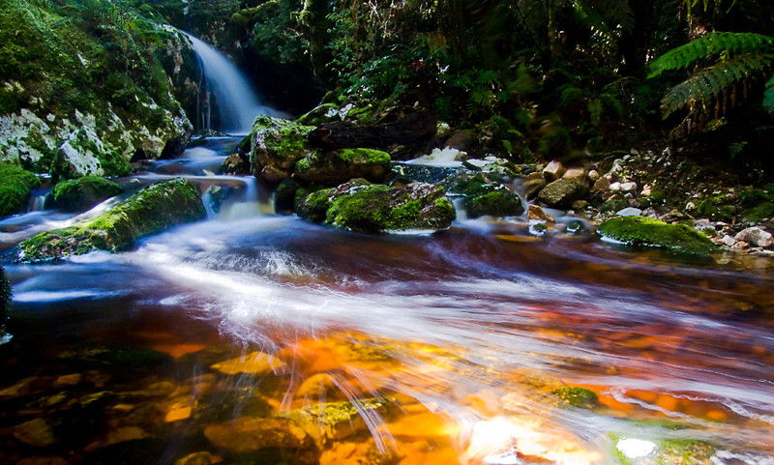
Breathtaking
wilderness

Slide 5

What ´s the name of the black furry dog – sized animal with sharp teeth
found only in Tasmania ?

Slide 6
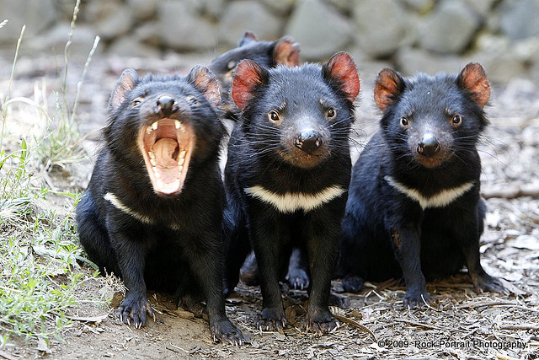
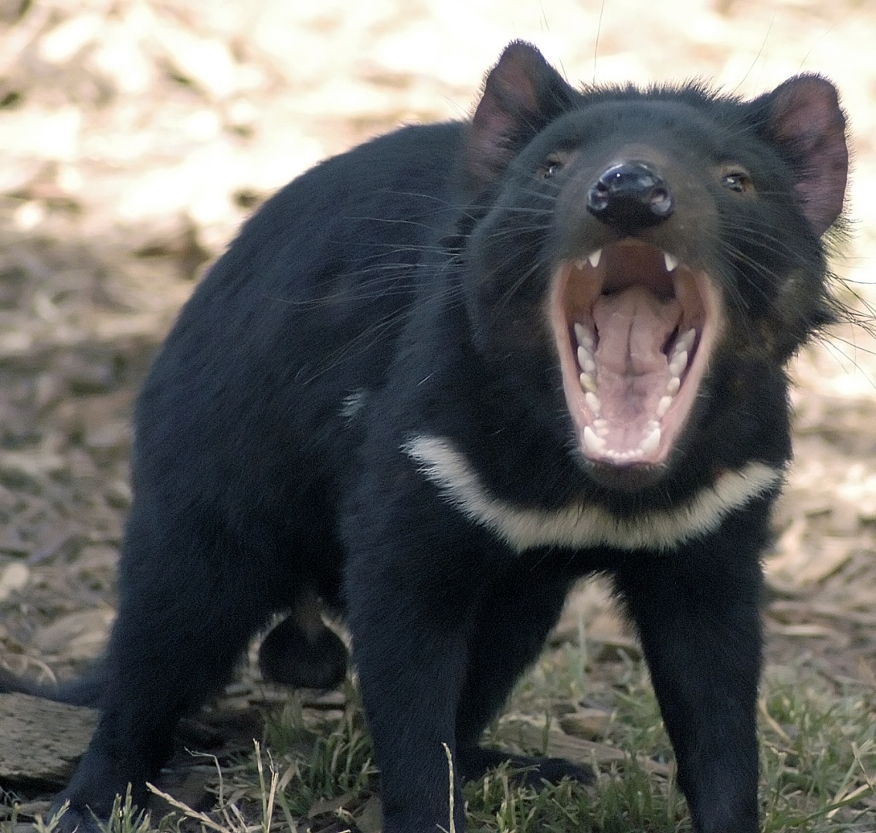
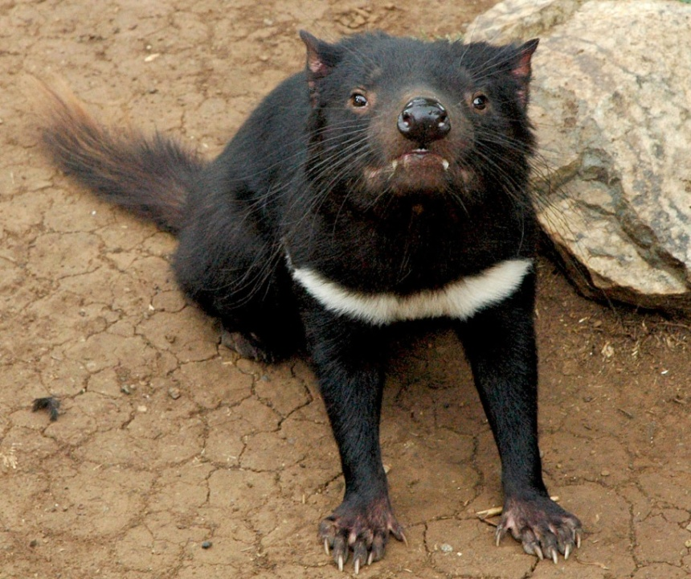
TASMANIAN
DEVIL

Slide 7
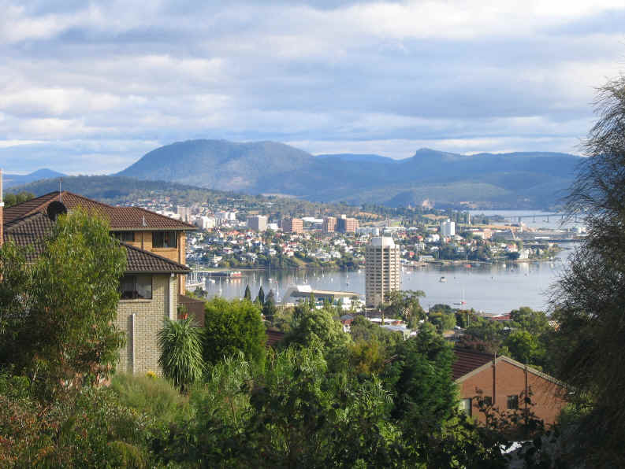
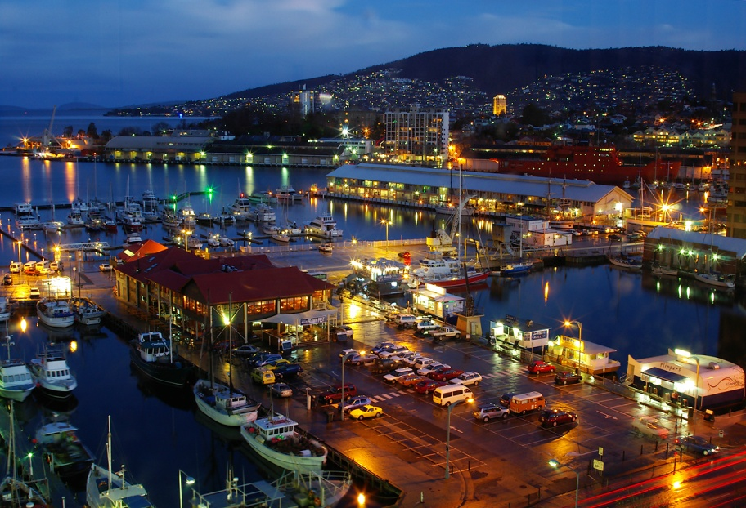
HOBART
the capital of Tasmania
at the foot of Mt. Wellington
2nd oldest Australian city
mostly wooden houses
an important whale port in the 19th century

Slide 8
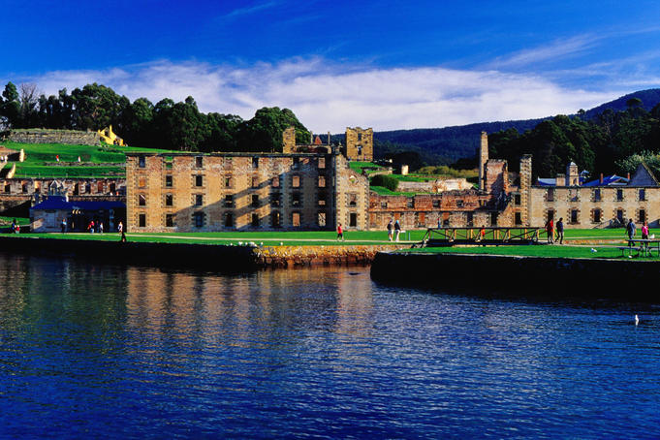
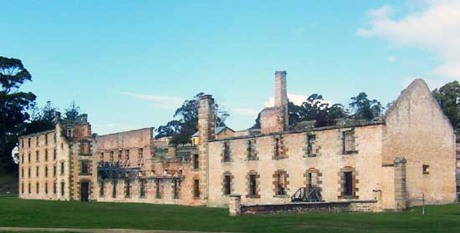
PORT ARTHUR
60 km from Hobart
a former convict settlement
the hardest criminals
impossible to escape / shark infested waters
+ guards with wild dogs /
the biggest tourist attraction nowadays

Slide 9
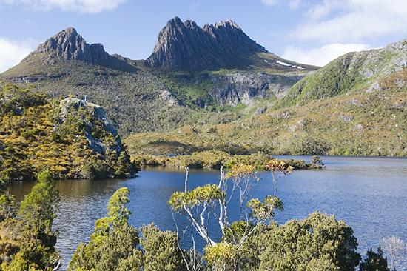
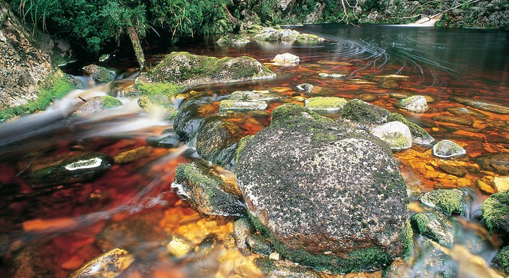
THE CRADLE MOUNTAINS
the World Heritage-listed area
lakes, waterfalls, rainforests
the most popular NP in Tasmania
Lake St. Clair
The deepest fresh water lake in Australia
183 m /

Slide 10
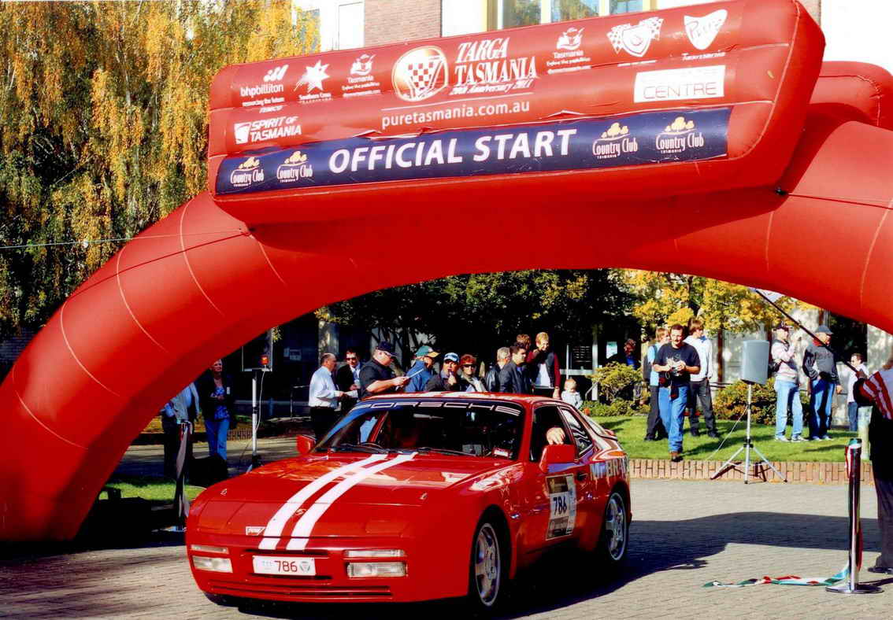
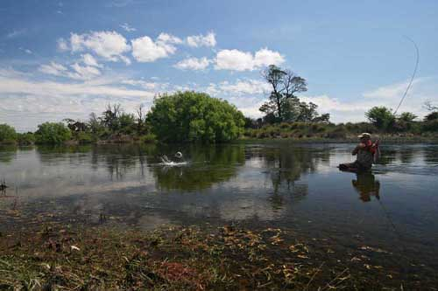
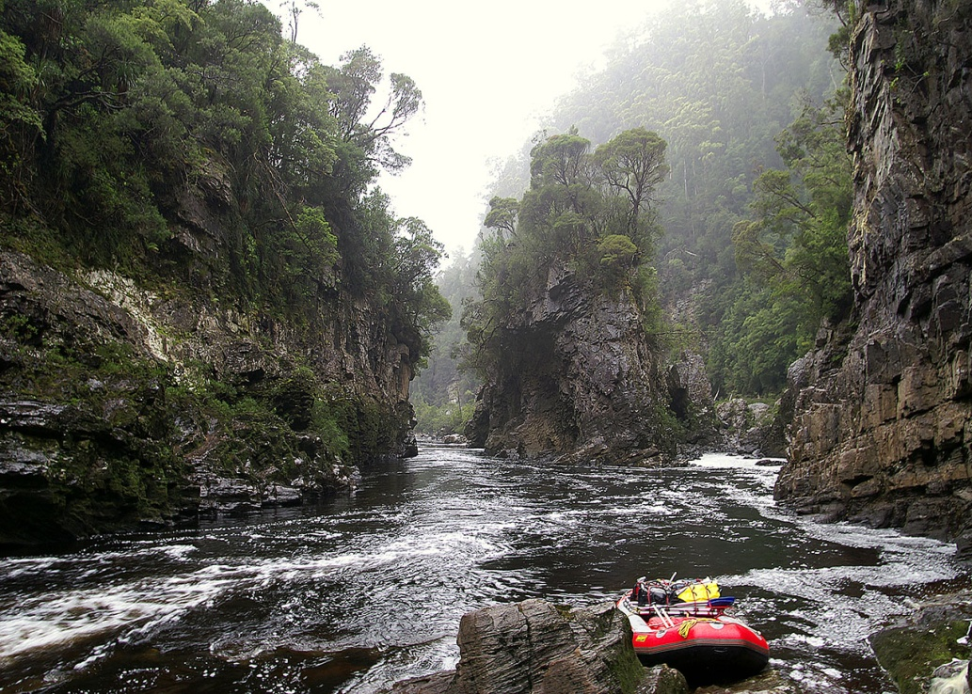
Targa Tasmania
Rafting – The Franklin-Gordon River
Trout fishing

Slide 11

Resources :
www.en.wikipedia.org/tasmania
www.en.wikipedia.org/hobart
www.en.wikipedia.org/portarthur
www.en.wikipedia.org/cradlemountains
www.infinityholidays.com.au

