Slide 2
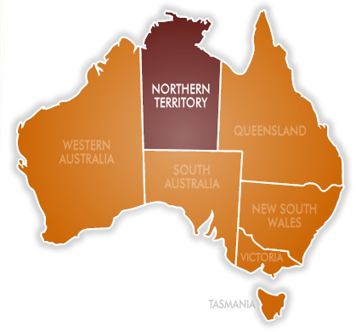

Slide 3
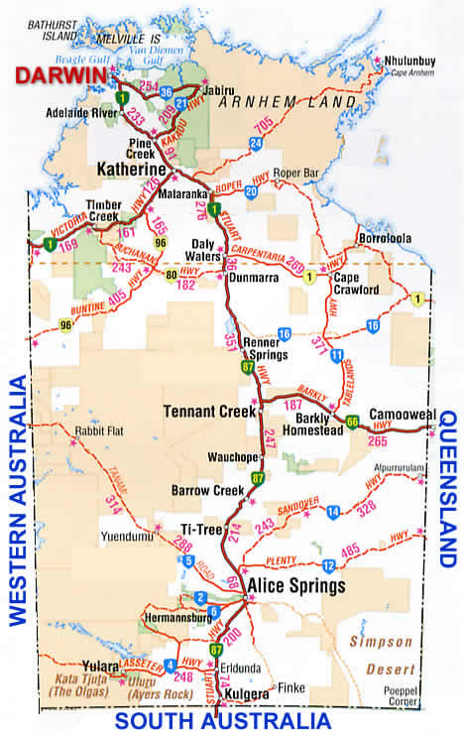

Slide 4
OUTBACK AUSTRALIA
as big as Alaska
one of the least settled regions on Earth
the population of 250,OOO
30 % are Aborigines
50 % of the land – to Aborigines / entry by permit /
iconic natural wonders – Uluru , Kakadu NP, Kata-Tjuta, …

Slide 5
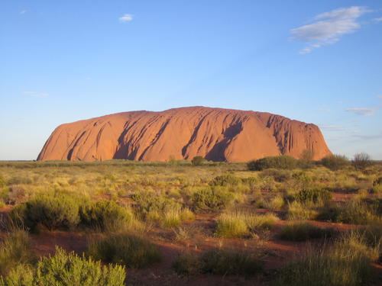
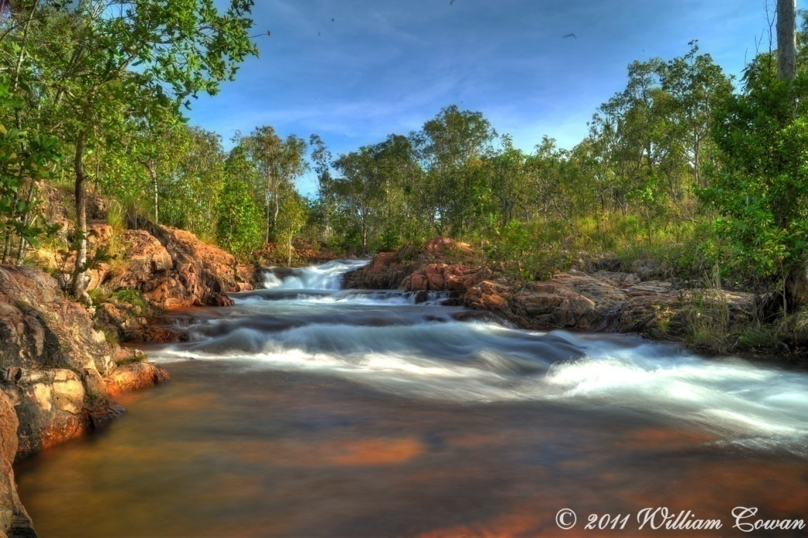
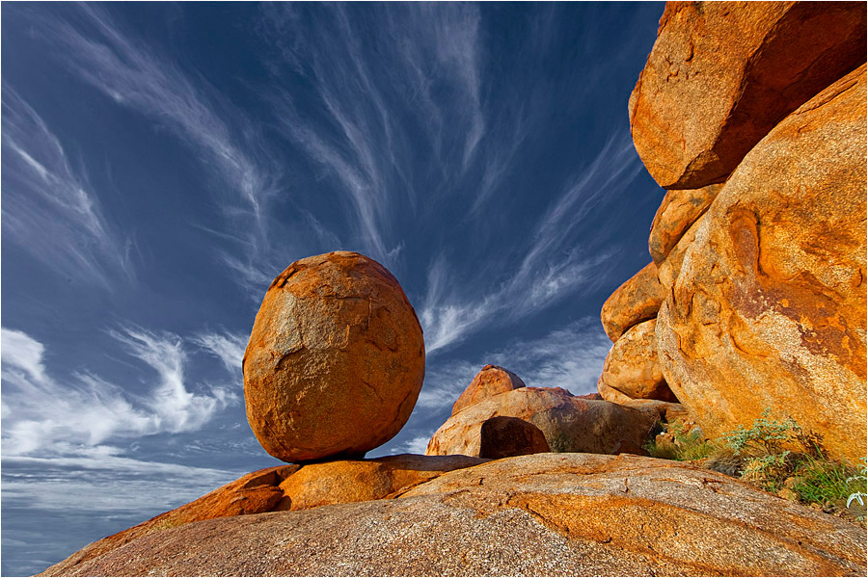
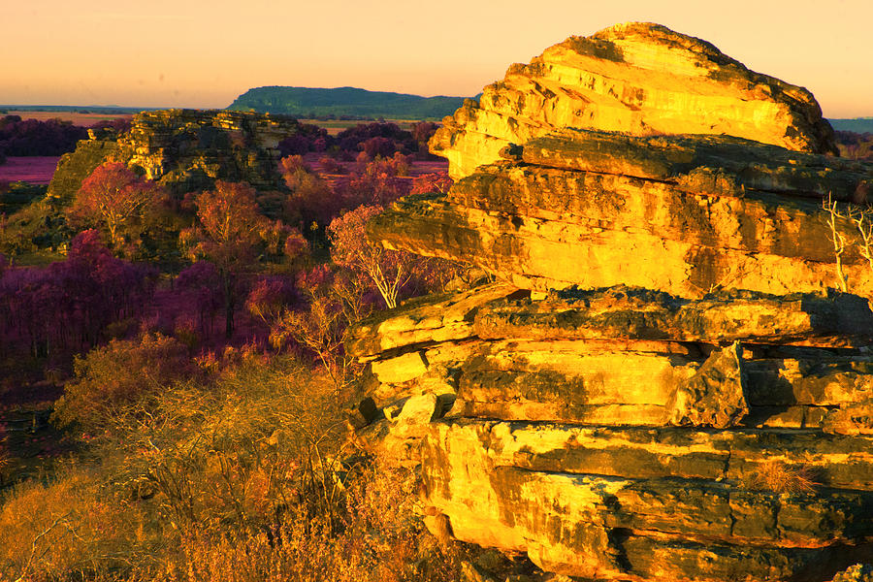
ULURU
KAKADU NATIONAL PARK
DEVIL´S MARBLES

Slide 6
DARWIN
named after Ch. Darwin
the capital of the Northern Territory
the population of 125, 000
10 % are Aborigines – the biggest of all capitals
badly damaged by the Japanese / WW2/
Cyclone Tracy /1974/ - 75 % of the houses destroyed
modern Darwin – low brick buildings, modern residential areas
NT Museum of Arts and Sciences / Aboriginal arts /
Crocosaurus Cove- saltwater crocodiles
the Cage of Death – face-to-face experience with crocodiles

Slide 7
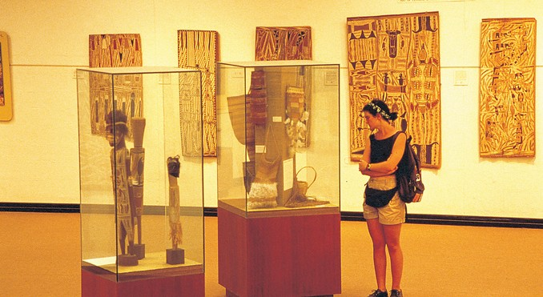
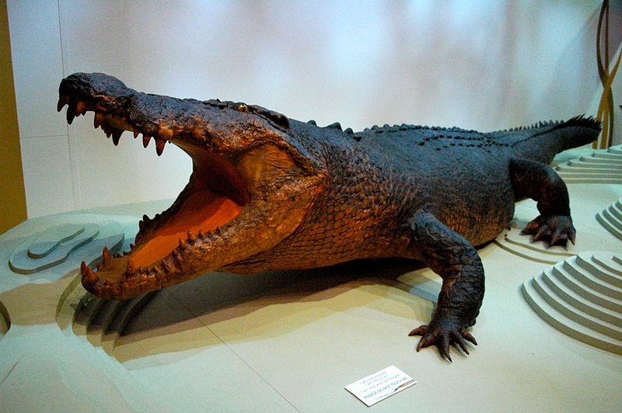
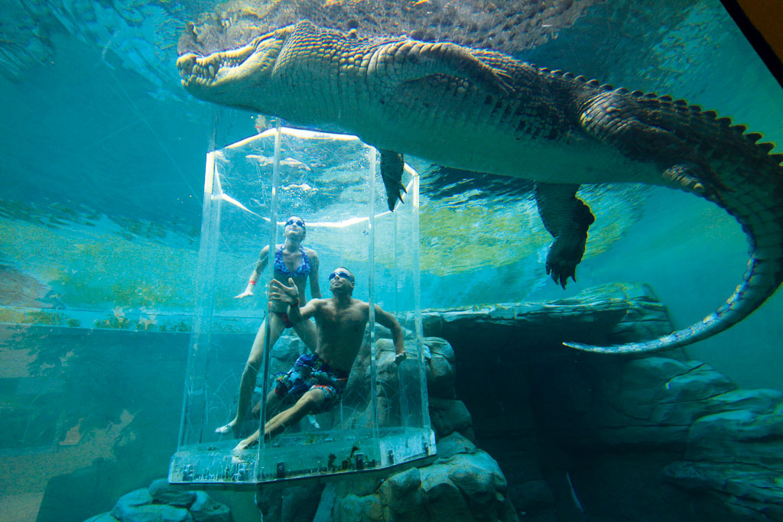
The Museum of Arts and Sciences
Sweatheart
a 5-m freshwater crocodile
The Cage of Death

Slide 8
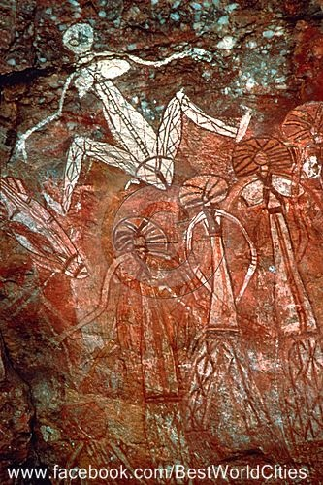

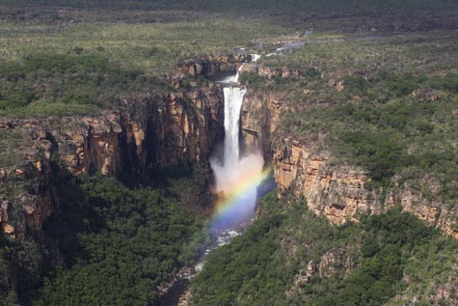
KAKADU NATIONAL PARK
the largest NP in Australia / 20, 000 sq km /
belongs to Aborigines
Aboriginal rock art / caves and gorges /
waterfalls, wetands, woodlands
a nature-lover´s paradise / birds, fish, crocodiles /

Slide 9
Do you know the film made in
Kakadu NP ?
Who is its film star ?

Slide 10
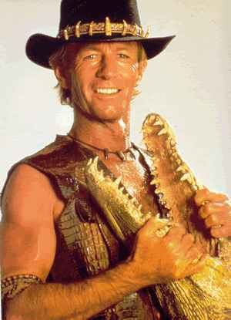
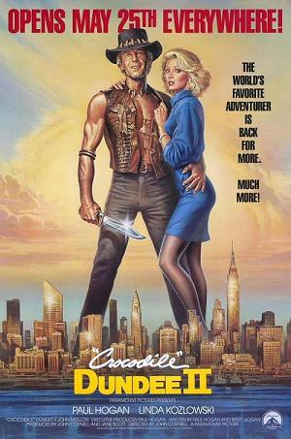
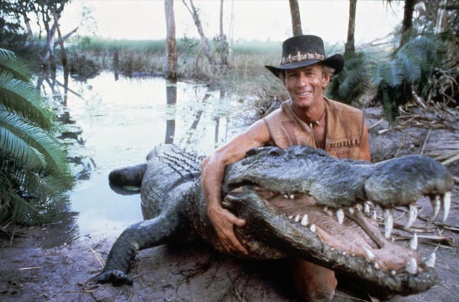
PAUL HOGAN

Slide 11
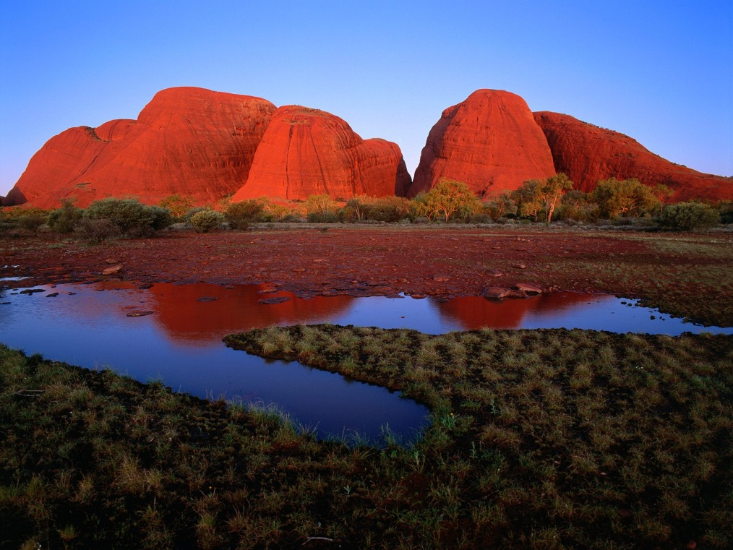
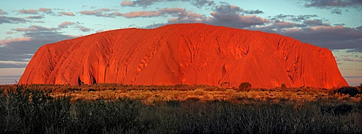
ULURU
Australia´s most recognisable icon
also called Ayers Rock
in Uluru – Kata Tjuta NP
the world´s largest monolith
the World Heritage Site
caves with Aboriginal rock paintings
350 m high, 3. 5 km long
2/3 under the surface
KATA TJUTA / OLGAS /
AYERS ROCK

Slide 12
What are salties and freshies ?

Slide 13
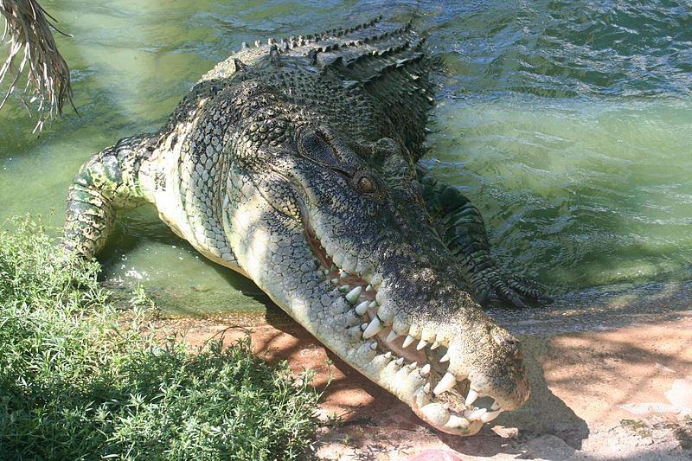
Saltwater crocodiles
the largest reptile
5-7 m , 500 kg
dangerous
coastal areas in QLD, NT, WA
Freshwater crocodiles
smaller
rarely attack and kill people

Slide 14
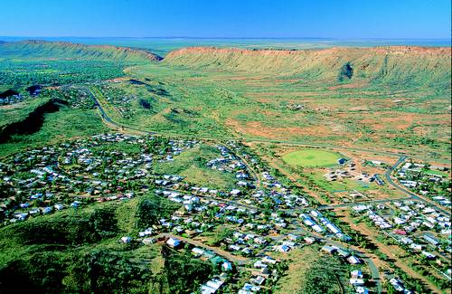
ALICE SPRINGS
the heart and capital of the outback
the populaton of 30,000
close to geographical heart of Australia
festivals throughout the year
Alice Desert Festival – rich cultural diversity
The Todd River Regatta
dry riverbed / if water – it´s cancelled/
special boats without bottoms
„sailors“ stand inside and carry the boats
races for small / 2 people/ and big boats/ 10 people/

Slide 15
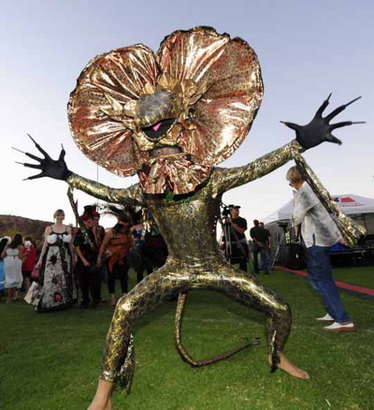
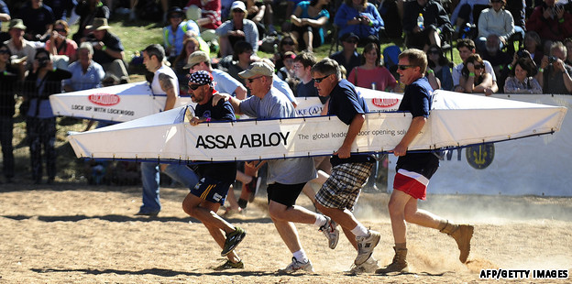
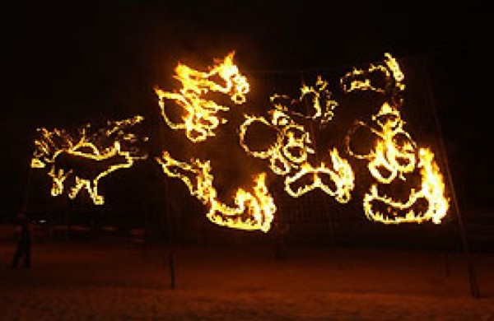
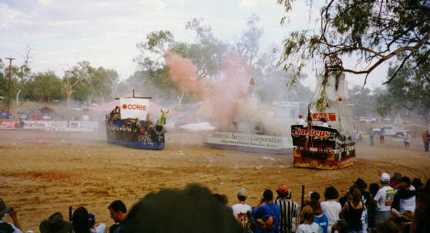
The Todd River Regatta
Alice Desert Festival
Final battle

Slide 16
Resources:
www.en.wikipedia.org/northernterritory
www.en.wikipedia.org/darwin
www.en.wikipedia.org/kakadunationalpark
www.en.wikipedia.org/uluru
www.en.wikipedia.org/alicesprings
www.infinityholidays.com.au

